Slide 1
Recent Developments in GST
02nd May, 2020
CA. Tony M P, Thrissur
Trichur Branch of SIRC of ICAI

Slide 2
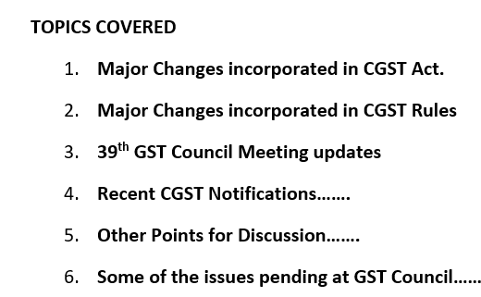

Slide 3
Major Changes incorporated in CGST Act

Slide 4
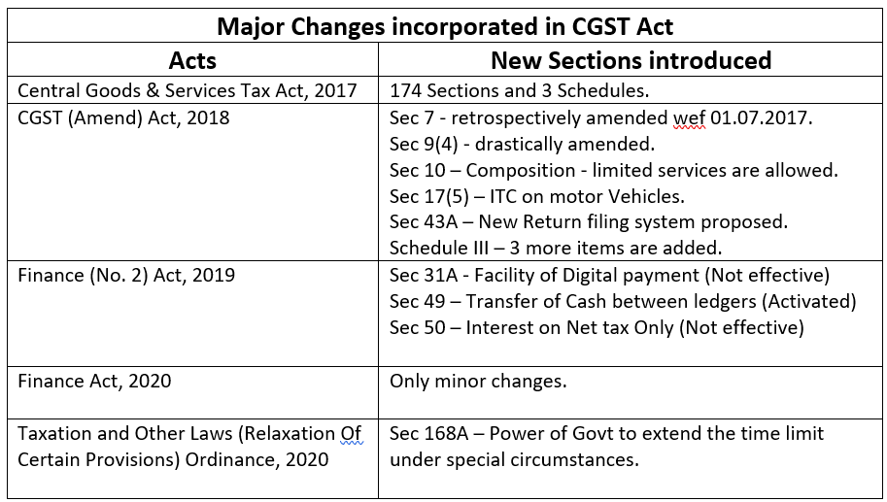

Slide 5
Major Changes incorporated in CGST Rules

Slide 6
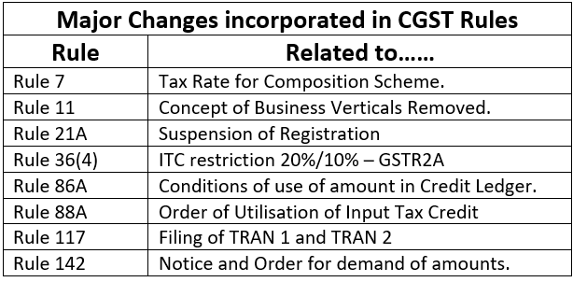

Slide 7
39th GST Council Meeting updates

Slide 8
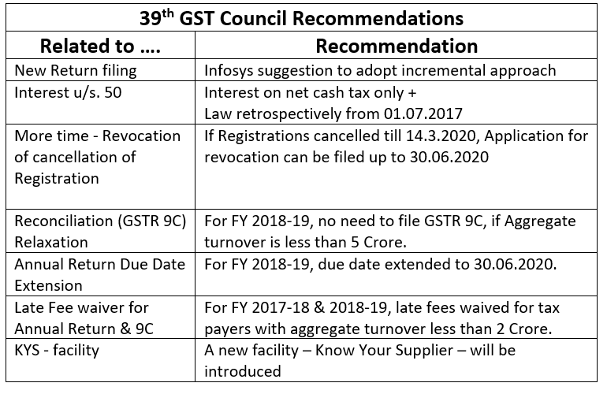

Slide 9
Recent CGST Notifications……..

Slide 10
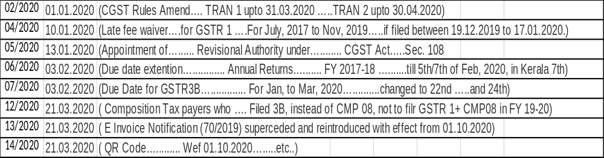

Slide 11
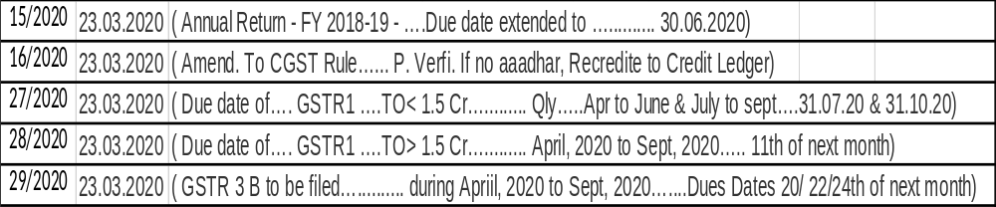

Slide 12
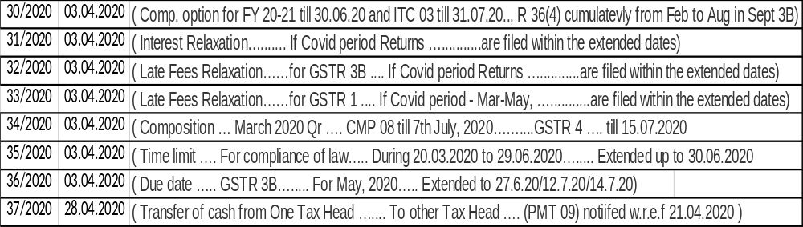

Slide 13
Other Points for Discussion……..

Slide 14
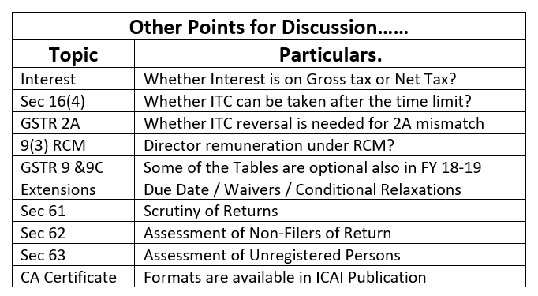

Slide 15
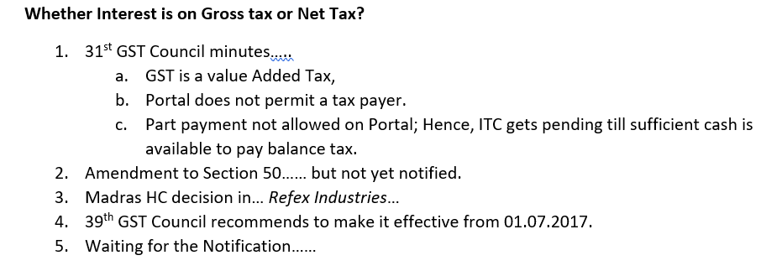

Slide 16
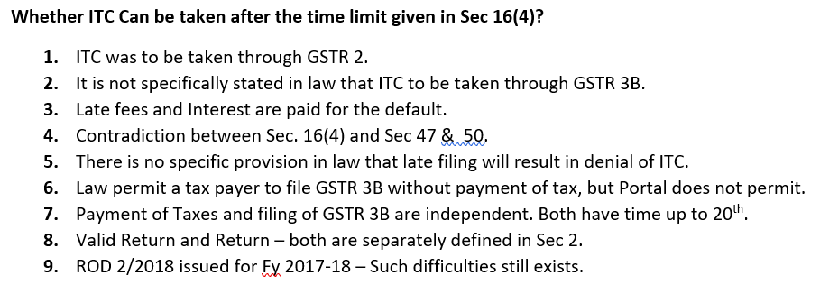

Slide 17
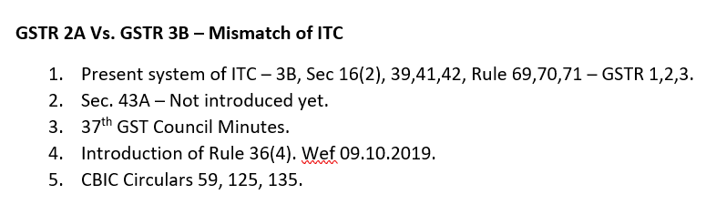

Slide 18
Some of the issues pending at GST Council……

Slide 19
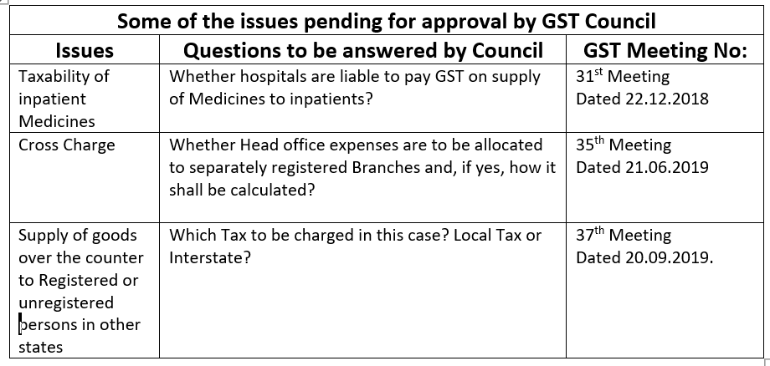

Slide 20
Thank You

