Slide 1




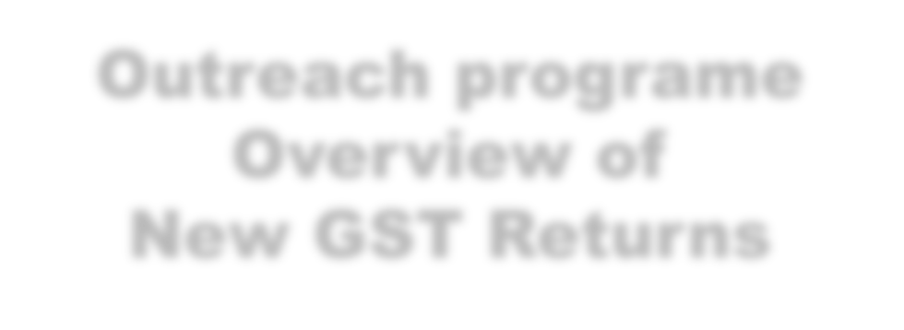
Office of The Principal Commissioner
Central GST & Central Excise Commissionerate Coimbatore
Outreach programe Overview of
New GST Returns
Presentation by B.Venkateswaran IRS.,
Asst.Commissioner CGST& Central Excise (Retired), Coimbatore,
5

Slide 2






Let us embrace changes happily
5

Slide 3
Legal provision for new return
Over view of new return, salient feature and details to be furnished
‾ GST-RET-1,
‾ SAHAJ (RET-2)
‾ SUGAM(RET-3)
‾ Form GST-PMT-08 ( Payment of self assessed Tax)
‾ ANX-1& ANX-2
‾ Matching Tool (Purchase Vs ANX-2)
Mode of filing of new return
‾ Online
‾ Offline
Q & A
Session schema
5

Slide 4

GST New Returns
Legal provisions and features
5

Slide 5
In the 31st GST Council Meet, it was decided that a New Return System under GST to introduce for taxpayers. This return system should contain simplified return forms, for ease of filing across taxpayers registered under GST. This return will need to filed on a monthly basis, except for small taxpayers who can opt to file the same quarterly. Small taxpayers are taxpayers with a turnover up to Rs 5 crore in the preceding financial year should be provided with different simplified return.
Accordingly new return system, was notified.
In the new GST Return System, there will be three main components to the new return – one main return (FORM GSTRET-1) and two annexures (FORM GST ANX-1 and GST-ANX-2)
Under this there is one main return GST RET-1 and Two Annexures GST ANX-1 and GST ANX-2 for
normal tax payer. Simplified return depending upon transaction type.
Small taxpayers opting to le the return on quarterly basis are required to pay tax, either by cash or credit or both, on monthly basis on the taxable supplies made during the month by filing FORM GST PMT – 08
Intro
5

Slide 6
CHAPTER VII-TAX INVOICE, CREDIT AND DEBIT NOTES
‾ 31. Tax invoice.
‾ 32. Prohibition of unauthorized collection of tax.
‾ 33. Amount of tax to be indicated in tax invoice and other documents.
‾ 34. Credit and debit notes.
CHAPTER IX-RETURNS
‾ 37. Furnishing details of outward supplies.
‾ 38. Furnishing details of inward supplies.
‾ 39. Furnishing of returns.
‾ 41. Claim of input tax credit and provisional acceptance thereof.
‾ 42. Matching, reversal and reclaim of input tax credit.
‾ 43. Matching, reversal and reclaim of reduction in output tax liability.
‾ 43A. Procedure for furnishing return and availing input tax credit.
Legal provision for filing of Returns
6

Slide 7

Section 43A(3)
‾ The procedure for furnishing the details of outward supplies by the supplier on the common portal, for the purposes of availing input tax credit by the recipient shall be such as may be prescribed.
Section 43A(5)
‾ The amount of tax specified in the outward supplies for which the details have been furnished by the supplier under sub-section (3) shall be deemed to be the tax payable by him under the provisions of the Act.
Section 43A(6)
‾ The supplier and the recipient of a supply shall be jointly and severally liable to pay tax or to pay the input tax credit availed, as the case may be, in relation to outward supplies for which the details have been furnished under sub-section (3) or sub-section (4) but return thereof has not been furnished.
Important provisions
7

Slide 8

Regular Tax payers
‾ GSTR-1 Monthly
‾ GSTR 3B
Regular Tax payers ( Up to Rs.1.5 Crores)
‾ GSTR-1-Quarterly
‾ GSTR 3B-Monthly
Others than regular
‾ GSTR-4-Compostion Scheme
‾ GSTR-5-Non-Resident Taxable person
‾ GSTR-6-Input Service Distributor
‾ GSTR-7-Person deducting TDS ( Specified Government Organisations)
‾ GSTR-8-Person Collecting Tax ( E-Commerce Operator)
‾ GSTR-11-Casual Taxable Person
The simplification is replacement for GSTR-1,GSTR-2A and GSTR-3B
Present returns

Slide 9
Over view:
Form GST-RET-1, Sahaj and Sugam

Slide 10
Simplified return is based on outward supply transaction type such as B2B, B2C, Export, SEZ
supply etc and turnover.
Option to file quarterly return is available for taxpayers whose aggregate annual turnover in the previous financial year was up to Rs. 5 Crore instead of present 1.5 Crores
The concept of B2C-L, HSN wise and Documents details reporting is removed in the proposed return,
Invoice details can be uploaded continuously by the supplier and the same can be viewed by the recipient on real time basis.
B2B supplies, liable to reverse charge mechanism, ITC on Import of goods , services needs to be shown by the supplier in the GST ANX-1,
Salient features of the New GST Return System
10

Slide 11
Various summery such as Invoice wise for supplier, various table are provided.
Taxpayer can report missing invoices at an invoice level (that is when a supplier has not uploaded an invoice in T+2 period) and avail ITC.
Matching tool is available which will help the taxpayer to match their Input Tax Credit based on their FORM GST ANX - 2 and purchase register.
Option to file NIL return through SMS.
Salient features of the New GST Return System
10

Slide 12
ANX-1, ANX-2
(Regular)
(RET-1) Monthly
FORM GST PMT – 08
Regular-(RET-1) Quarterly
ANX-1, ANX-2
New Return Schema
FORM GST PMT – 08
ANX-1, ANX-2
Sahaj ( RET-2)
FORM-GST PMT – 08
ANX-1, ANX-2
Sugam (RET-3)
Returns proposed
12

Slide 13
FORM GST RET-1 (Normal Monthly)
‾ Taxpayers whose aggregate turnover in the preceding financial year was above Rs.5 Crore have to file monthly return. This return needs to be filed monthly by 20th of the month succeeding the month to which the tax liability pertains.
‾ Monthly return in FORM GST RET-1 needs to be filed based on FORM GST ANX – 1 and
FORM GST ANX – 2 .
FORM GST RET-1 (Normal Quarterly)
‾ Taxpayers whose aggregate turnover in the preceding financial year was up to Rs.5 Crore can file this return.
‾ This return needs to be filed quarterly by 20th of the month succeeding the quarter to which the tax liability pertains.
‾ Tax has to be paid on monthly basis through FORM GST PMT-08.
FORM GST RET-1 (Regular / Quarterly (Normal))

Slide 14


ANX- 1
ANX- 1
ANX- 2
ANX- 2
PMT- 08
RET-1(Monthly)
RET-1 (Quarterly)

Slide 15
Taxpayers whose aggregate turnover in the preceding financial year was up to Rs.5 Crore and have supplies only to consumers and unregistered persons (B2C supplies) can file this return based on FORM GST ANX – 1 and FORM GST ANX – 2 on quarterly basis, but pay tax on monthly basis through FORM GST PMT-08.
Taxpayers opting to file Sahaj can declare outward supply under B2C category and inward supplies transacting reverse charge only.
Taxpayers making supplies through E-commerce operators are ineligible to file Sahaj.
FORM GST RET-2 (SAHAJ Quarterly)

Slide 16
Taxpayers whose aggregate turnover in the preceding financial year was up to Rs.5 Crore and have made supplies to consumers and un-registered persons (B2C) and to registered persons (B2B) can file this return based on FORM GST ANX – 1 and FORM GST ANX – 2 on quarterly basis, but pay tax on monthly basis through FORM GST PMT-08.
Taxpayers opting to file Sugam can declare outward supply under B2C and B2B category and inward supplies attracting reverse charge only.
Taxpayers making supplies through E-commerce operators are ineligible to file Sugam like Sahaj.
FORM GST RET-3 (SUGAM Quarterly)
16

Slide 17
















ANX- 1
ANX-2
ANX-1
PMT-08
ANX- 2
RET-2
RET-3
PMT- 08
16

Slide 18
Large Tax payer (Turn over above Rs. 5 Crores) |  | RET-1 |  | All the Information’s in ANX-1
 |  |  | Normal Quarterly-RET |  | All the Information’s in ANX1
Small Tax payers (Turn over up to Rs.5 Crores) |  |  | Sahaj-RET-2 |  | Only B2C & RCM -in ANX-1
 |  |  | Sugam-RET-3 |  | B2B+B2C & RCM -in ANX-1
Details to be furnished in return
16

Slide 19
Periodicity of filing return will be deemed to be monthly for all taxpayers unless
quarterly filing of the return is opted for.
For newly registered taxpayers, turnover will be considered as zero and hence they will have the option to file monthly, Sahaj, Sugam or Quarterly (Normal) return.
Change in periodicity of the return filing (from quarterly to monthly and vice versa) would
be allowed only once at the time of filing the first return by a taxpayer.
The periodicity of the return filing will remain unchanged during the next financial year unless changed before filing the first return of that year.
The taxpayers opting to file quarterly return can choose to file any of the quarterly return namely – Sahaj, Sugam or Quarterly (Normal).
Periodicity of filing returns
19

Slide 20
The taxpayers can switch their returns in the following manner: -
‾ From Quarterly (Normal) to Sugam or Sahaj only once in a financial year at the beginning of any quarter
‾ From Sugam to Sahaj only once in a financial year at the beginning of any quarter
‾ From Sahaj to Quarterly (Normal) or Sugam more than once in a financial year at the beginning of any quarter
‾ From Sugam to Quarterly (Normal) more than once in a financial year at the beginning of any quarter
Switch over to returns
20

Slide 21
Form GST ANX-1 -Layout
Details of outward supplies, inward supplies attracting reverse charge and import of goods and services
21

Slide 22
Three important details need to be declared in FORM GST ANX – 1.
‾ Outward Supplies
‾ Inward Supplies attracting Reverse Charge
‾ Details of import of Goods & Services
Supplier can upload invoice details continuously and the recipient can view them and take action on real time basis.
Inward supplies attracting reverse charge will be reported only by the recipient.
Option is available to include details omitted in the previous tax periods.
FORM GST ANX-1

Slide 23
Details of outward supplies, inward supplies attracting reverse charge and import of goods
and services
‾ 3A. Supplies made to consumers and un-registered persons (Net of debit / credit notes)
‾ 3B. Supplies made to registered persons (other than those attracting reverse charge)(including
edit/amendment
‾ 3C. Exports with payment of tax
‾ 3D. Exports without payment of tax
‾ 3E. Supplies to SEZ units/developers with payment of tax (including edit/amendment)
‾ 3F. Supplies to SEZ units/developers without payment of tax (including edit/amendment)
‾ 3G. Deemed exports (including edit/amendment)
Details to be furnished in ANX-1 - Outward Supply

Slide 24
3H. Inward supplies attracting reverse charge (to be reported by the recipient, GSTIN wise
for every supplier, net of debit/credit notes and advances paid, if any)
3I. Import of services (net of debit/ credit notes and advances paid, if any)
3J. Import of goods
3K. Import of goods from SEZ units / developers on a Bill of Entry
3L. Missing documents on which credit has been claimed in T-2 /T-1 (for quarter) tax period and supplier has not reported the same till the filing of return for the current tax period
4. Details of the supplies made through e-commerce operators liable to collect tax under section 52 (out of any outward supplies declared in table 3)
Details to be furnished in ANX-1 - Inward supply
24

Slide 25
The amendment of details of earlier tax period can be made in FORM GST ANX-1A before the due date of September return following the end of the financial year or the actual date of furnishing relevant annual return, whichever is earlier.
Editing of documents can be done only by supplier.
Editing by supplier is allowed only if recipient has not accepted such supply. If already accepted, unless reset/unlock by recipient details cannot be edited by supplier.
Recipient filing monthly returns can accept details uploaded by supplier till 10th of following month.
Edit/Amendment of uploaded documents FORM GST- ANX-1A

Slide 26
Recipient filing Quarterly returns can accept details uploaded by supplier till 10th of the
month succeeding the quarter for which the return is being filed.
Documents rejected by the recipient shall be conveyed to the supplier only after filing of the return by the recipient.
Supplier may edit the rejected documents before filing any subsequent return. However, credit will be made available to recipient through the next FORM GST ANX-2 for the recipient. The tax liability for such edited documents will be accounted for in the same tax period.
Edit/Amendment of uploaded documents FORM GST- ANX-1A

Slide 27
Form GST ANX-2
Details of auto- drafted inward supplies
(FORM GST ANX-1, FORM GSTR-5 & FORM GSTR-6)

Slide 28
Details of documents uploaded by the corresponding supplier(s) will be auto populated in FORM GST ANX-2 and recipient can take action on the auto populated documents to – accept, reject or to keep pending on continuous basis After 10th of the following month on which it was uploaded by supplier.
Certain other detsils to be entered by the recipient to calm ITC, etc
Accepted documents would not be available for amendment at the corresponding supplier’s end.
Supplier may edit rejected documents before ling subsequent return. However, credit will be available to recipient through next FORM GST ANX-2. The tax liability will be accounted for in the same tax period.
Form GST ANX-2
28

Slide 29
Availing of ITC will depend on uploading of invoices or debit notes by the supplier, within the
stipulated time frame.
An invoice uploaded by the supplier within the 10th of the following month will be visible continuously for the recipient.
The taxes payable thereafter which can be claimed as ITC will be posted in the ITC table of the recipient’s return before the 11th of the following month. These invoices will be available for availing ITC in the return which is filed by the recipient.
Invoices that are uploaded by the supplier after the 10th of the following month will get posted in
the concerned field of the recipient’s return of the subsequent month, however, the viewing facility will be on a continuous basis.
Input Tax Credit (ITC) under the New GST Return System
29

Slide 30
Returns not filed for consecutive two months by the supplier:
‾ Indication in FORM GST ANX – 2 to the recipient that credit shall not be available. However uploaded invoices will be visible but recipient cannot avail ITC on such invoices.
‾ Recipient to reject or keep such invoices pending till the supplier files return
Return not filed by the Supplier

Slide 31
3A. Supplies received from registered persons including services received from SEZ units (other than those attracting reverse charge) –Auto populated-Action to be taken by the recipient
3B. Import of goods from SEZ units / developers on Bill of Entry
3C. Import of goods from overseas on Bill of Entry
4. Summary of the input tax credit
5. ISD credits received (eligible credit only)
‾ Note –
Table 3B and 3C shall be used after the data from the ICEGATE and SEZ (through ICEGATE) starts flowing to the GST system online. Thereafter, table 3J & 3K of FORM GST ANX-1 shall be discontinued. Data will be shown to the taxpayer as received from the ICEGATE
Nil return can be filed if you have not uploaded FORM GST ANX-1 and no inward supplies (purchases) have been auto-populated in FORM GST ANX-2 and no other information is required to be reported in the main return i.e. FORM GST RET-1.
ANX-2 Details to be furnished
31

Slide 32
FORM GST RET-1, Sahaj and Sugam
Monthly / Quarterly (Normal) Return-Layouts
33

Slide 33
1. Profile Option Intimation of option for return periodicity and type of quarterly
return
2. FORM GST ANX-1 Annexure of outward supplies and inward
supplies attracting
reverse charge
3. FORM GST ANX-
2-Annexure of inward supplies
6. FORM GST RET- 1A.Amendment to FORM GST RET-1
5. FORM GST ANX- 1A Amendment to FORM GST ANX-1
4. FORM GST RET-1-
Monthly/Quarterly
return
FORM GST RET-1-Schema
33

Slide 34
1.GSTIN -Auto
2. Legal name of the registered person-Auto
3. Summary of outward supplies, inward supplies attracting reverse charge, debit / credit notes, etc. and tax liability (AUTO POPULATED-ANX-1)
4. Summary of inward supplies for claiming input tax credit (ITC) & Details of reversals of credit (AUTO POPULATED-ANX-1 and reversal details has to be provided)
5. Amount of TDS and TCS credit received in electronic cash ledger.
6. Interest and late fee liability details (User input)
7. Payment of tax
8. Refund claimed from electronic cash ledger
Form RET-1-Layout
34

Slide 35
FORM GST RET-2- Sahaj
Return-Layouts and schema for filing
36

Slide 36
















7. FORM GST PMT-08- Payment of self-assessed tax
6. FORM GST RET- 2A.Amendment to FORM GST RET-2
5. FORM GST ANX- 1A Amendment to FORM GST ANX-1
4. FORM GST RET-2-Quarterly return
3. FORM GST ANX-2-Annexure of inward supplies
2. FORM GST ANX-1 Annexure of outward supplies and inward supplies attracting reverse
1. Profile Option Intimation of option for return periodicity and type of quarterly return
charge
Sahaj Return – (FORM GST RET-2)-Schema
36

Slide 37
FORM GST ANX-1:Details of outward supplies and inward supplies attracting reverse
charge
‾ 1. GSTIN
‾ 2. Legal name of the registered person
‾ 3. Details of outward supplies and inward supplies attracting reverse charge
  3A. Supplies made to consumers and un-registered persons (Net of debit / credit notes )
  3H. Inward supplies attracting reverse charge (to be reported by the recipient, GSTIN wise for every supplier, net of debit / credit notes and advances paid, if any)
ANX-1 for Sahaj-Details to be provided
37

Slide 38
FORM GST ANX-2: Details of auto- drafted inward supplies (FORM GST ANX-1 &
FORM GSTR-5)
‾ 1. GSTIN
‾ 2. Legal name of the registered person
‾ 3. Inward supplies received from a registered person (other than the supplies attracting reverse
charge)
  3A. Supplies received from registered persons (other than those attracting reverse charge)
‾ 4. Summary of the input tax credit
ANX-2 (SAHAJ)
38

Slide 39
FORM GST PMT – 08-Payment of self-assessed tax
‾ 1.GSTIN
‾ 2. Legal name
‾ 3. Summary of self-assessed liability and input tax credit (ITC) availed
‾ 4. Payment of tax
‾ 5. Verification
FORM GST PMT – 08-Payment of self-assessed tax
39

Slide 40
1. GSTIN
2. Legal name of the registered person
3. Summary of outward supplies, inward supplies attracting reverse charge and tax liability
4. Summary of inward supplies for claiming input tax credit (ITC)
5. Interest and late fee liability details
6. Payment of tax
7. Refund claimed from electronic cash ledger
FORM GST RET-2 Quarterly Return (Sahaj)
40

Slide 41
Sugam Return – FORM GST RET-3) (Quarterly)
40

Slide 42
type of quarterly return
1. Profile Option Intimation of option for return periodicity and
FORM GST ANX-1 Annexure of outward supplies and inward supplies attracting reverse charge
FORM GST ANX-2-Annexure of inward supplies
FORM GST PMT-08- Payment of self-assessed tax 5 FORM GST RET-2-Quarterly return
Sugam (Form GST-3) Schema
40

Slide 43
1. GSTIN
2. (a) Legal name of the registered person
3. Details of outward supplies and inward supplies attracting reverse charge
‾ 3A. Supplies made to consumers and un-registered persons (Net of debit / credit notes)
‾ 3B. Supplies made to registered persons (other than those attracting reverse charge)(including edit/amendment)
‾ 3H. Inward supplies attracting reverse charge(to be reported by the recipient, GSTIN wise for every supplier, net of debit/credit notes and advances paid, if any)
ANX-1 –For Sugam

Slide 44
1. GSTIN
2. (a) Legal name of the registered person
3. Inward supplies received from a registered person (other than the
supplies attracting reverse charge)
3A. Supplies received from registered persons (other than those attracting reverse charge
4. Summary of the input tax credit
ANX-2 for Sugam
44

Slide 45
FORM GST PMT – 08-Payment of self-assessed tax
‾ 1.GSTIN
‾ 2. Legal name
‾ 3. Summary of self-assessed liability and input tax credit (ITC) availed
‾ 4. Payment of tax
‾ 5. Verification
FORM GST PMT – 08-Payment of self-assessed tax
45

Slide 46
1. GSTIN
2. Legal name of the registered person
3. Summary of outward supplies, inward supplies attracting reverse charge and tax liability
4. Summary of inward supplies for claiming input tax credit (ITC)
5. Interest and late fee liability details
6. Payment of tax
7. Refund claimed from electronic cash ledger
FORM GST RET-3 Quarterly Return (Sugam)
46

Slide 47
De | tails to be furnished | NORMAL MONTLY | NORMAL-QTRLY | SAHAJ | SUGAM
Outward Supply
B2B |  | Yes | Yes | No | Yes
B2C |  | Yes | Yes | Yes | Yes
EXPORT |  | Yes | Yes | No | No
SEZ SUPPLY |  | Yes | Yes | No | No
DEEMED EXPORT |  | Yes | Yes | No | No
SUPPLY THROUTH E COM |  | Yes | Yes | No | No
Exempted and Nil |  | Yes | Yes | Yes | Yes
Inward supply
RCM |  | Yes | Yes | Yes | Yes
Import of Goods |  | Yes | Yes | No | No
Import of Servcies |  | Yes | Yes | No | No
Other details
Supply through E-Com |  | Mandatory | Optional | Optional | Optional
ITC on missing invocie |  | Yes | No | No | No
ISD Credit |  | Yes | Yes | No | No
NIL return by SMS |  | Yes | Yes | Yes | Yes
Comparison of details to be furnished
47

Slide 48
Sl. No | Details to be furnished | Normal Monthly | Normal Qtrly | SAHAJ | SUGAM
1 | ANX1 | Continuous upload | Continuous upload | Continuous upload | Continuous upload
2 | ANX-2 | Auto-Real time basis | Auto-Real time basis | Auto-Real time basis | Auto-Real time basis
3 | RETURN | RET-1 Monthly | RET-1 Qtrly | RET-2-Qtrly | RET-3 Qtrly
4 | PMT-O8 | No | Monthly | Monthly | Monthly
Periodicity of filing return
48

Slide 49
Sl No Rerurn Type |  | ANX-1 | ANX-2 | RETURN | PMT-08
1 | NORMAL MONTLY | 01 To10 th | 11 th to | 20 th | 20 th
2 | NORMAL-QTRLY | 01 To10 th | 11 th to | 25 th on Next Quarter | 20 th
3 | SAHAJ | 01 To10 th | 11 th to | 25 th on Next Quarter | 20 th
4 | SUGAM | 01 To10 th | 11 th to | 25 th on Next Quarter | 20 th
Amenmdnet for Any time up to Sep or Filing of Annual Return. Not possisble between 23 to 25 ANX1-ANX1A
Amenmdnet for RET- Any time up to Sep or Filing of Annual Return. Not possible between 18 to 20 1-RET-1A
Time line for filing and Amendment
49

Slide 50
Filing of New GST Returns
Online Mode
Offline Mode
50

Slide 51
GSTN has provided Protype in the GSTN portal
Navigate to URL - https://demoofflinetool.gst.gov.in/. Read the instructions and click Proceed to Prototype button given at the bottom of the page. You will navigate to Profile page
Begin by adding profile of the taxpayer. Click Manage Profile > Add Profile.
‾ Note:
‾ Adding profiles in Master List helps in saving the most frequently used GSTIN and their details, which will be available as a quick link for future use. In this prototype the Profile data cannot be edited or saved.
Online Mode
51

Slide 52
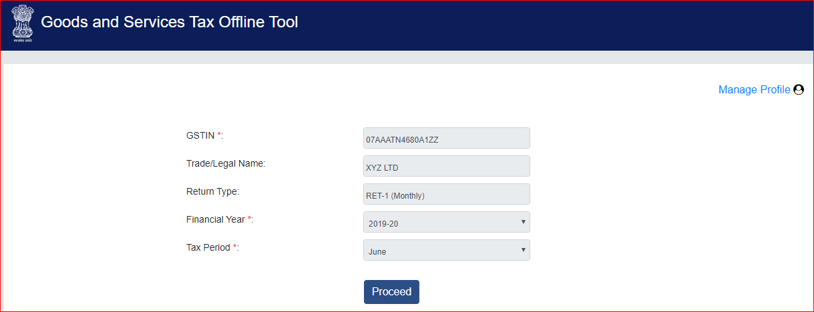
Profile page
52

Slide 53
Prototype-ANX-1 & ANX-2
Some Screen shots
53

Slide 54
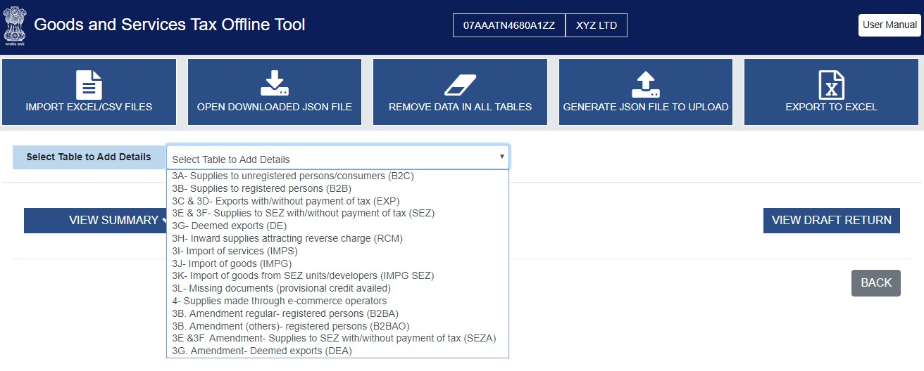
Select Table to add details
53

Slide 55
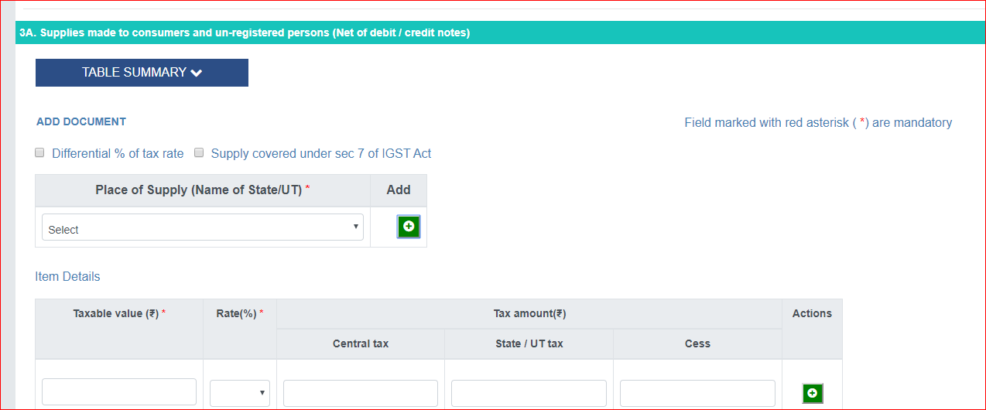
3A. Supplies made to consumers and un-registered persons (Net of debit / credit notes)
55

Slide 56
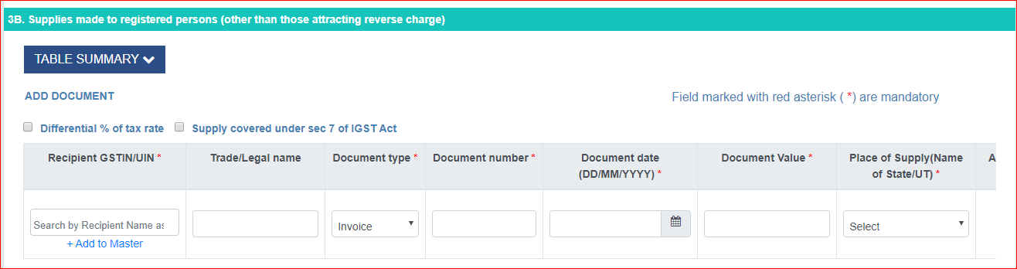
3B. Supplies made to registered persons (other than those attracting reverse charge)
56

Slide 57
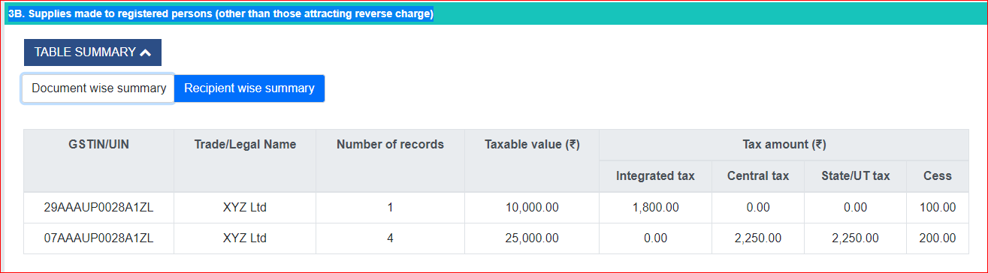
Table Summary
57

Slide 58
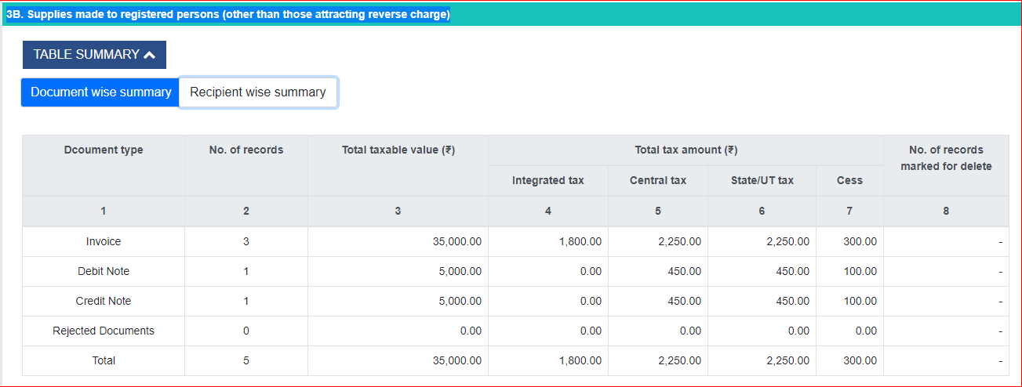
Recipient wise Summary
58

Slide 59
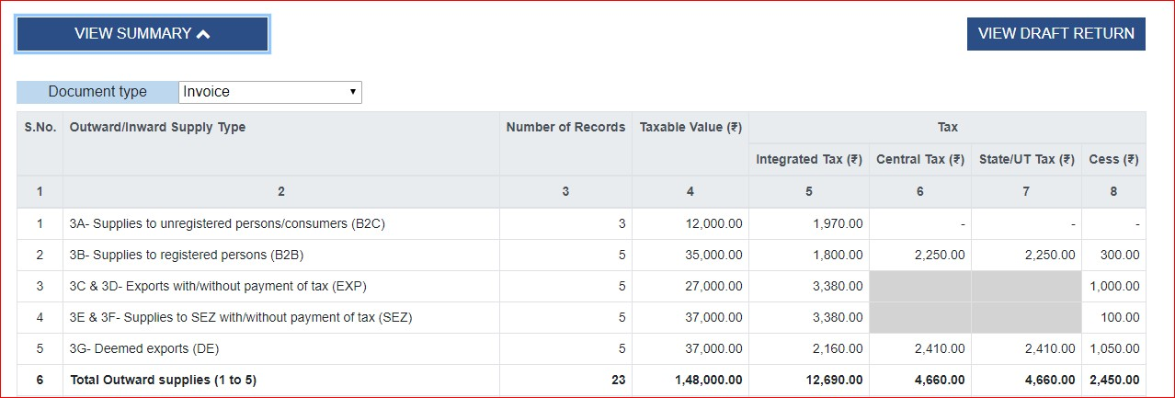
Consolidated Table summary
59

Slide 60
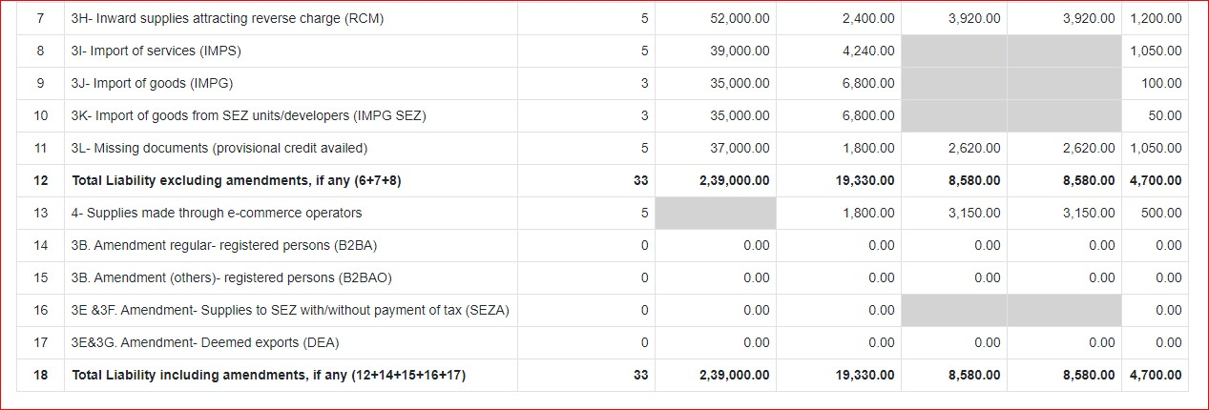
Consolidated Table summary
59

Slide 61
ANX-2 Prototype
63

Slide 62
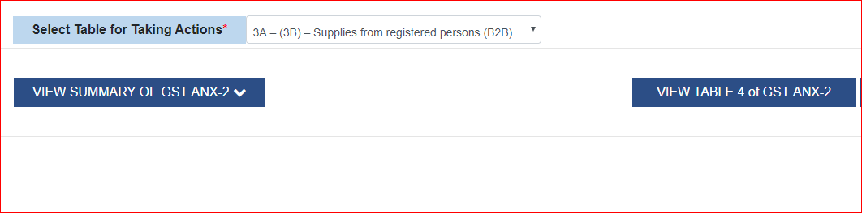
63

Slide 63
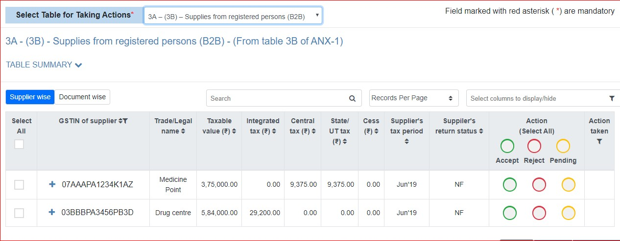
Screen to take action
63

Slide 64
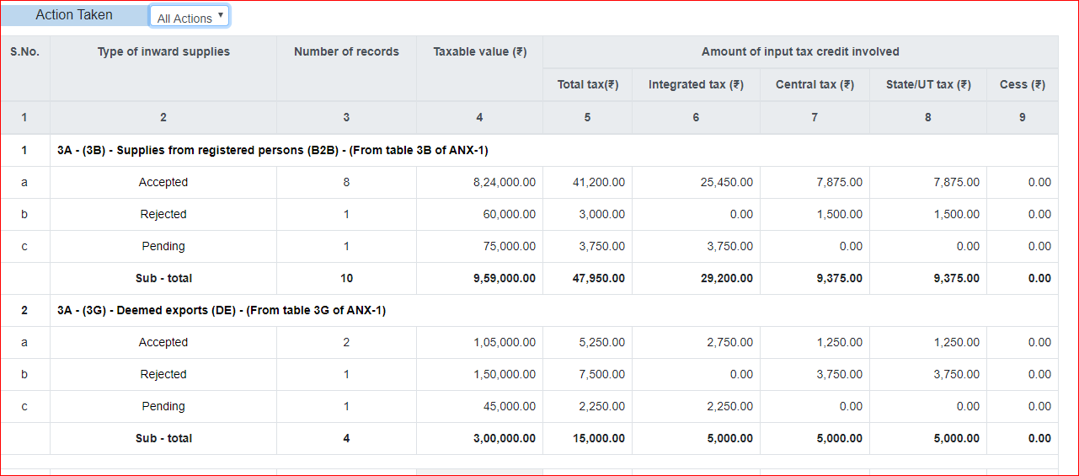
Table 3 Action Taken summary
64

Slide 65
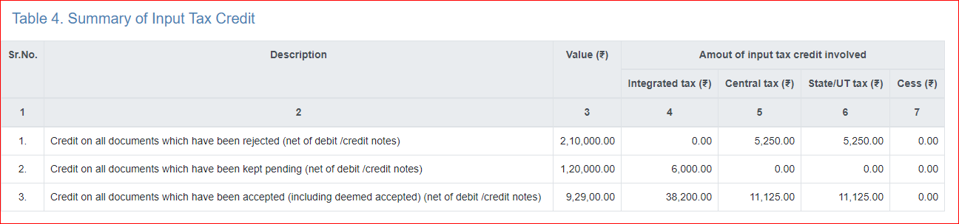
Table 4: Summary of Input Tax credit
65

Slide 66
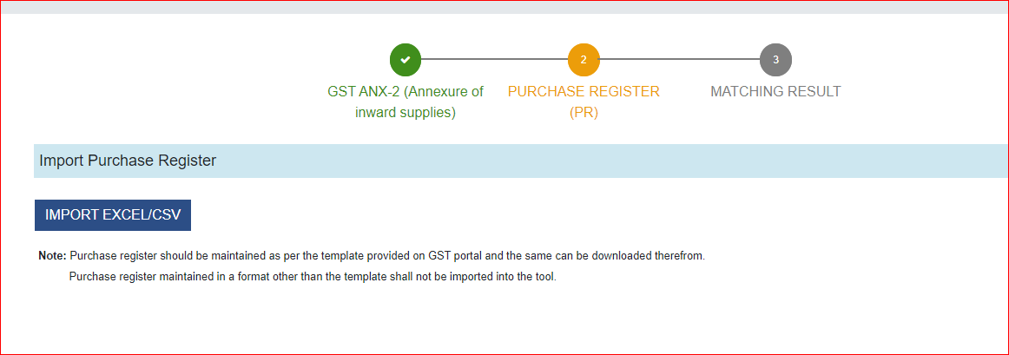
Matching Tool

Slide 67
Results after matching of Purchase and ANX-2
In GST ANX-2
Not in Purchase Register
In Purchase Register Not in GST ANX-2
Exact Match
Partial Match
Probable match
Unmatched
Matching of Purchase and ANX-2
67

Slide 68
Exact Match
‾ Matching of all seven parameters Viz, GSTN, Document Type, Document No, Document Date, Total taxable value, Tax amount head wise and Total tax amount
Partial Match
‾ Matching of GSTN and Document Type, and mismatch in as any one of the parameters Viz., Document No, Document Date, total taxable value, Tax amount head wise and Total tax amount
Probable match
‾ Matching of parameters Viz., Document No, Document Date, total taxable value, Tax amount head wise and Total tax amount and mismatch in any one Viz., GSTN and Document Type.
Unmatched
‾ Matching of all four parameters Viz, GSTN, Document Type, Document No, Document Date but does not no match Total taxable value, Tax amount head wise and Total tax amount
In GST ANX-2 but not in Purchase Register
‾ All documents exist in GST ANX-2 but not available in purchase Register
In Purchase Register Not in GST ANX-2
‾ All documents exist in purchase Register but not available in GST ANX-2
Matching concepts used by GSTN
68

Slide 69
GSTN is expected to provide Click the REFINE MATCHING RESULT button, to further refine
matching results for tax amount and/ or document number.
Tax payer can set a tolerance limit in monetary value (from INR 1 to INR 10), for matching the tax amount.
‾ For example, if invoice value in your Purchase Register is INR 101 and the document uploaded by supplier is showing INR 100 and if tolerance limit is defined as > 1, the documents will match 100%.
Similarly, Tax payer can select Yes to apply approximation logic on document number.
‾ In case, approximation logic is selected YES, the following will be ignored for match document numbers:
‾ Special characters are not present (‘/’ or ‘-‘); or Prefix or suffix as ‘zero’
Click APPLY & REMATCH and results will be matched again based on the refined matching parameters. APPLY & REMATCH will show results of match with tolerance limits selected.
Refine Matching Result
69

Slide 70
Offline Tool for new returns
ANX-1,ANX-2
72

Slide 71
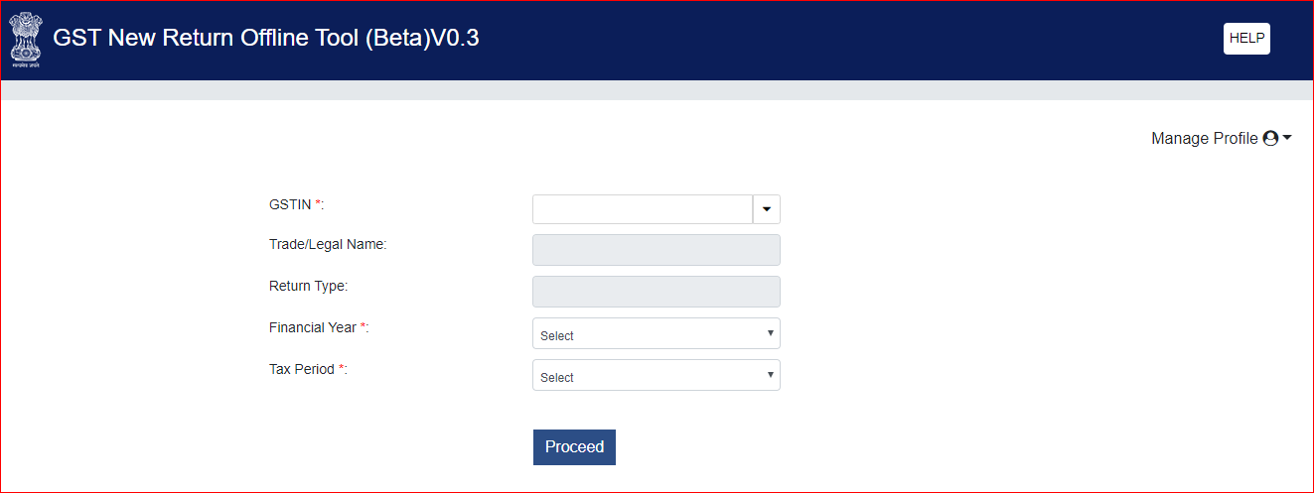
Creating profile
72

Slide 72
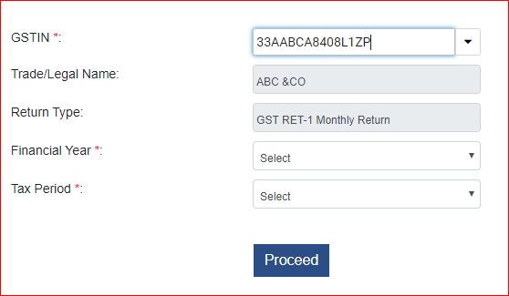
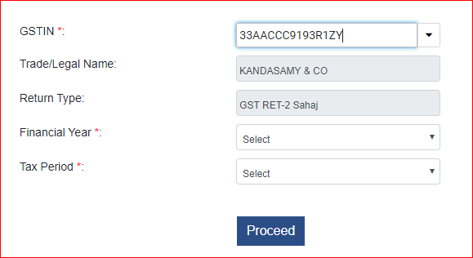
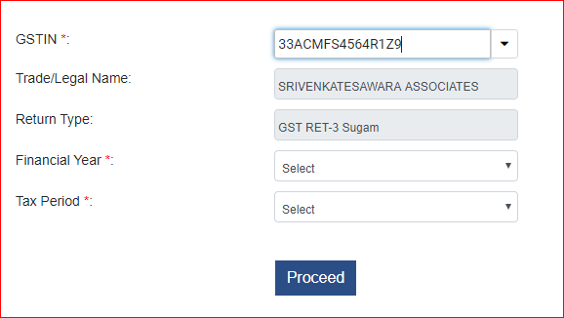
72

Slide 73
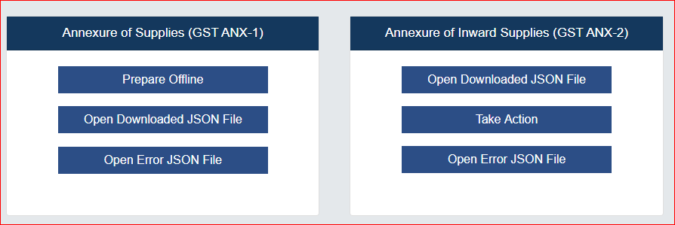
ANX-1 & ANX-2 OFFLINE TOOL
72

Slide 74
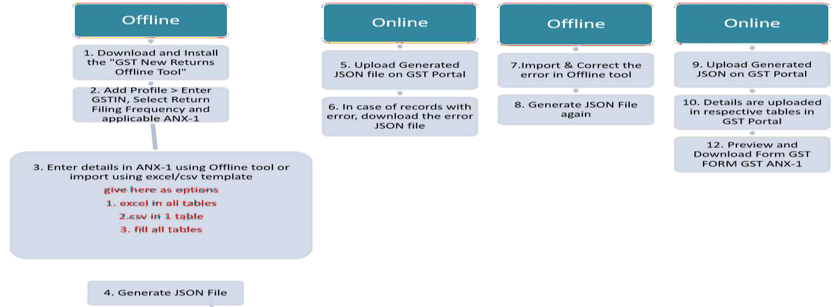
ANX-1 Offline Flow chart
74

Slide 75
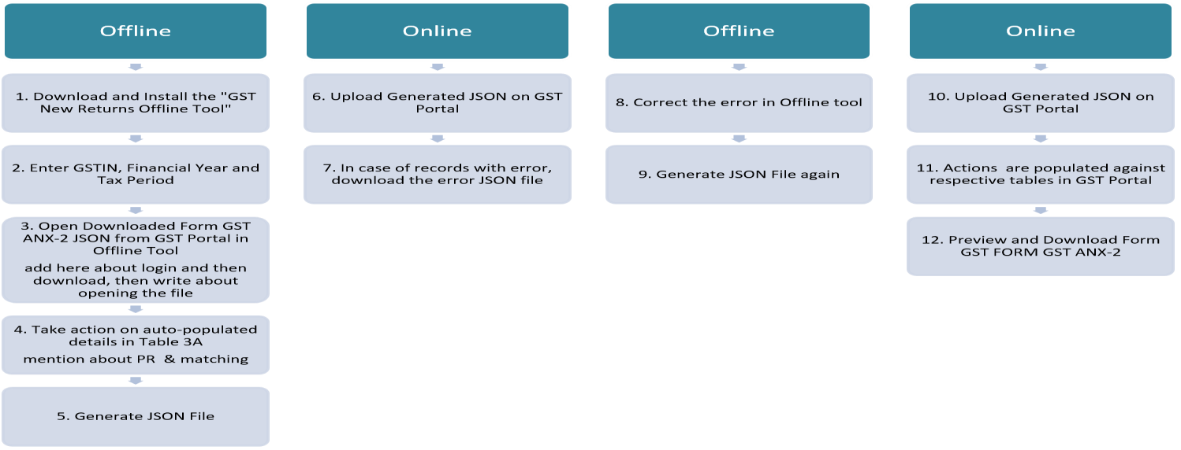
ANX-2 Offline Flow Chart
75

Slide 76
CBIC Website www.cbic.gov.in
‾ Format and Instructions on various returns
GSTN Portal
‾ User manuals
Social media pages of GSTN
‾ https://www.facebook.com/gstsystemsindia/
‾ https://twitter.com/askGSTech
‾ https://www.youtube.com/channel/UCFYpOk92qurlO5t-Z_y-bOQ/about
www.cleartax.com
‾ Articles on new returns
Reference for further reading

Slide 77

Heard melodies are sweet, those unheard are sweeter
-John Keats (Ode on Grecian Urn)
Presentation by B.Venkateswaran IRS.,
Asst.Commissioner CGST& Central Excise (Retired)
Coimbatore Email:beevenkateswaran@gmail.com
9442012335/8500885294
77

