Slide 1

AUDTING
STANDARDS
Are we doing it right ?
Peer review/bank audit
CA. Jomon K George

Slide 2
APPLICABILITY of SAs
Wherever there is
‘Expression of Opinion”
Non-Corporate Tax Audits ( Form 3CB)
Bank Audits ( Branch/CSA)

Slide 3
Peer review schedule
Category | Deadline
Statutory Audits’s of Unlisted Public companies having paid-up capital of not less than 500 crore or Turnover of not less than 1000 crore or Deposits of not less than Rs. 500 Crore as on 31st March of the Previous Year & Firms with five partners or more | 30/06/2024
Statutory Audits’s of Entities who raised Equity from Public or taken loans from Banks or Financial Institutions during the year under review and there of public interest entities including Trusts & Firms with 4 partners or more | 31/12/2024
Firms conducting Branch audit of Public Sector Banks and Firms having 3 or more partners rendering Assurance services | 01/04/2025

Slide 4

HISTORY
&
EVOLUTION
APC set up in 1982 - SAPs
Renamed as AASB in 2002 – AASs
New Preface in 2008

Slide 5
NEW CLASSIFICATION
SQCs
Engagement
Standards
STANDARDS ON AUDITING-AN UPDATE
JOMON K GEORGE
SAs
SAs
SREs
SREs
SAEs
SRSs

Slide 6

WHY
COMPLY WITH STANDARDS
to expedite audits effectively in accordance with GAAPs
to utilize resources effectively
to guide, direct and supervise assistants properly
to ensure quality control
to disprove charges of negligence
to face & pass PEER REVIEW
JOMON K GEORGE

Slide 7
WHY
COMPLY WITH STANDARDS
The Companies Act 2013
Section 143(9)
Every Auditor shall comply with AUDITING STANDARDS
JOMON K GEORGE

Slide 8
A SHAMEFUL REMARK
We do not expect the auditors to find a needle
in a haystack but they must see the elephant
in the room.
Former MCA Secretary

Slide 9
AUDIT PROCESS
01
02
OPENING BALANCE CHECKING
IC EVALUATION & COMMUNICATING FINDINGS TO TCWG
04
05
LEDGER ANALYSIS
VERIFICATION
03
VOUCHING

Slide 10
AUDIT PROCESS
06
07
AS COMPLIANCE
COMPARING FS WITH BOOKS – SIGNED TB
09
10
ANALYTICAL REVIEW
CARO POINTS –INFORMED REPORTING
08
SCHEDULE III COMPLIANCE - INFO FOR NOTES

Slide 11

Overall Objectives of the Independent Auditor and the conduct of an audit in accordance with SAs.
SA 200
Professional Skepticism - An attitude that includes a questioning mind, being alert to conditions which may indicate possible misstatement due to error or fraud, and a critical assessment of audit evidence.
Auditor – Can’t just be a watchdog anymore

Slide 12
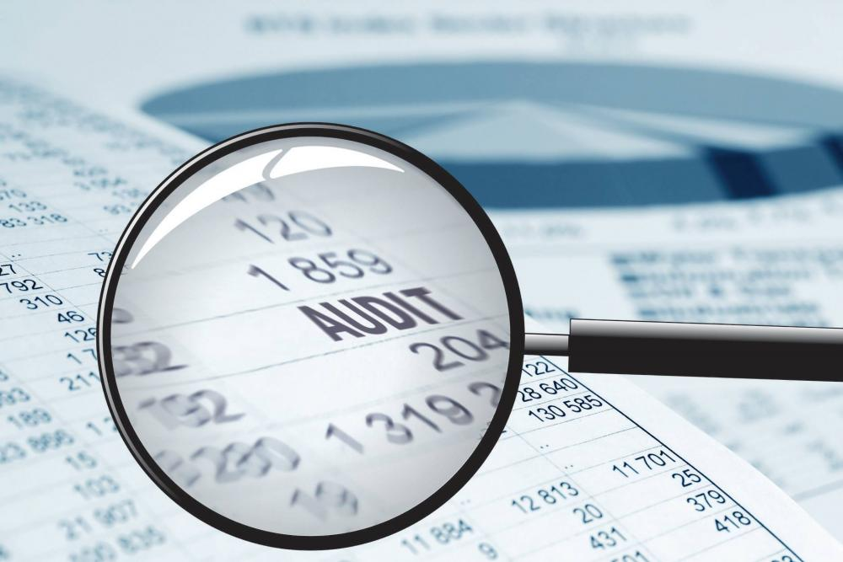
Professional skepticism includes being alert to :
Audit evidence that contradicts other audit evidence obtained.
Information that brings into question the reliability of documents and responses to inquiries to be used as audit evidence.
Conditions that may indicate possible fraud.
Circumstances that suggest the need for audit procedures in addition to those required by the SAs.
SA 200
SOME PRACTICE BASED STANDARDS
Are we skeptical enough, Asking Questions, Being a little doubting,
Doing Deep drills where required. If NOT, Let us

Slide 13
Agreeing on Terms of Audit Engagement
Obtain an Audit Engagement Letter covering :
the objective and scope of the audit of FS.
the responsibilities of the auditor
the responsibilities of management
identification of the applicable financial reporting framework .
reference to the expected form and content of any reports to be issued by the auditor
SA 210
Are we obtaining Letter of Engagement without fail …. Format in Appendix.
If NOT, Let us

Slide 14

Quality Control for Audit Work
SA 220
This SA deals with the specific responsibilities of the auditor regarding quality control procedures for an audit of financial statements.
This SA is to be read in conjunction with relevant ethical requirements.

Slide 15
SA 220
Under SQC 1, the firm has an obligation to establish and maintain a system of quality control to provide it with reasonable assurance that :
the firm and its personnel comply with professional standards and regulatory and legal requirements
and
the reports issued by the firm are appropriate in the given circumstance.
Do we have a Quality Perception.. A policy.. Is it being monitored, Are they being reviewed and applied in Execution. How good is our Team

Slide 16
SA 230
Audit Documentation
The auditor shall prepare audit documentation that is sufficient to enable an experienced auditor to understand :
The nature, timing, and extent of the audit procedures performed to comply with the SAs and applicable legal and regulatory requirements
The results of the audit procedures performed, and the audit evidence obtained;
Significant matters arising during the audit, the conclusions reached thereon, and significant professional judgments made in reaching those conclusions.
How good is our documentation. Physical/Digital. Will it stand a test ?
Permanent documents and Working Papers … AWP Template of AASB

Slide 17
SA 240
The Auditor’s Responsibilities relating to Fraud in an Audit of Financial Statements
Do we evaluate the possibility of fraud ?. If we smell the rat …. Do we reframe the plan ?.. Until we either confirm or dispel the doubt.

Slide 18
SA 250
The auditor’s responsibilities relating to Laws and Regulations in an Audit of Financial Statements
Are the Non Compliances impacting warranting an accounting hit/disclosure ?
NOCLAR – Whistle Blowing

Slide 19
SA 260
Communication with those charged with governance
Do we communicate with TCWG. In writing. Observations ?
The spirit of KAM

Slide 20
Planning an Audit of FS
SA 300
This SA deals with the auditor’s responsibility to plan an audit of financial statements in recurring audits and initial audit engagements.
Overall Audit Strategy
Detailed Audit Plan
Do we plan an audit ? Is there an APM and an Audit Programme
Is there review during the audit..

Slide 21
Identifying and Assessing the Risks of Material Misstatement Through Understanding the Entity and its Environment
SA 315
Deals with the auditor’s responsibility to identify and assess the risks of material misstatement in the financial statements, through understanding the entity and its
environment, including internal controls
Do we have good understanding of the business, revenue model etc.
Entity specific, Indusstry and the Macro-economy.. Risk assessment in that light ?

Slide 22

SA 500
Audit Evidence
Deals with the auditor’s responsibility to design and perform audit procedures to obtain sufficient appropriate audit evidence to draw reasonable conclusions on which to base his opinion.
Do we collect sufficient appropriate audit evidence (written, Visual, Oral) and evaluate it for drawing conclusions

Slide 23
SA 501 - Audit Evidence
Specific Considerations for Selected Items
This SA deals with specific considerations by the auditor in obtaining sufficient appropriate audit evidence with respect to :
Certain aspects of inventory
Litigation and claims involving the entity
Segment Information.
Do we attend/supervise/oversee stock verification
Enquire about suits ?. Analyse Segment Information

Slide 24

External Confirmations
SA 505
SA 500 indicates that the reliability of audit evidence is influenced by its source and by its nature and states :
Audit evidence obtained from independent sources outside the entity, directly by the auditor is much more reliable than audit evidence obtained indirectly or by inference.
Audit evidence is more reliable when it exists in documentary form, whether paper/electronic.

Slide 25
When using external confirmation procedures, the auditor shall maintain control over external confirmation requests, including :
Selecting the appropriate confirming party and determining the information to be confirmed or requested;
Designing the confirmation requests, including determining that requests are properly addressed and contain return information for responses to be sent directly to the auditor
Do we obtain Confirmations for balances/documents/goods ?
How do we pick the lot ?... Let us change …. Notes/Qualify/EoM

Slide 26
SA 510
Initial Audit Engagements – Opening Balances
In an initial audit engagement, the auditor should make sure that :
Opening Balances do not contain misstatements that materially affect the current period’s financial statements
Appropriate Accounting Policies reflected in the opening balances have been consistently applied in the current period’s financial statements or changes if any thereto are properly accounted for and adequately presented and disclosed.
Is it only a clerical exercise. Not enough. Are the balances maintainable
The spirit of KAM

Slide 27
Analytical Procedures
Analytical Procedures means evaluations of financial information through analysis of plausible relationships among both financial and non-financial data.
Analytical procedures also encompass such investigation as is necessary of identified fluctuations or relationships that are inconsistent with other relevant information or that differ from expected values by a significant amounts
Do we do ratio analysis/trend analysis and analyse adverse trends ? We must

Slide 28
Audit Sampling
Audit Sampling is the application of audit procedures to less than 100% of items within a population of audit relevance such that all sampling units have a chance of selection in order to provide the auditor with a reasonable basis on which to draw conclusions about the entire population.

Slide 29

When designing an audit sample, the auditor shall determine a sample size sufficient to reduce sampling risk to an acceptably low level.
The auditor shall select items for the sample in such a way that each sampling unit in the population has a chance of selection.
How do we pick the sample. How do we ensure Randomness of the Sample.
Use rational methods/technology

Slide 30
SA 570
Going Concern
The auditor should obtain sufficient appropriate audit evidence regarding the appropriateness of management’s use of Going Concern basis of accounting in the preparation of the financial Statements.
Also assess, whether a material uncertainty exists related to conditions that may cast significant doubt on the entity’s ability to continue as a Going Concern.
Do we think about this and analyse the situation ? Indicators ??

Slide 31
SA 580
Written Representations
The auditor should obtain Written Representations from the management that they believe that they have fulfilled their responsibility for the preparation of the financial statements and that information provided is complete.

Slide 32
WR is to support other audit evidence relevant to the financial statements or specific assertions in the financial statements by means of written representations, if determined necessary by
the auditor or required by other SAs.
Do we obtain MRL.. Has that been upated 21-22 particularly…. We must

Slide 33

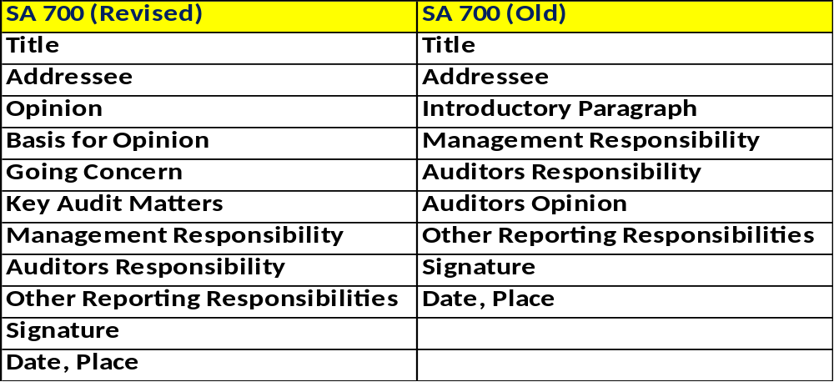
Forming an opinion and reporting on Financial Statements
Cant be a COPY PASTE …. Do give keen attention

Slide 34
SA 701
Communicating Key Audit Matters in AR (Listed Co.s)
Key Audit Matters - Those matters that, in the auditor’s professional judgment, were of most significance in the audit of the financial statements of the current period.
Key Audit Matters are selected from matters communicated with those charged with governance.
Are here KAMs. Discuss Sort Out.. Report …. TCWG Communications ??

Slide 35
SA 705
Modifications to the Opinion in the Independent AR
Clean Report
Qualified Opinion
Disclaimer
Adverse
Are we so used to Clean Reports. Is there a Scare ….
Issue the most approparaite Opinion

Slide 36
Emphasis of Matter Paragraphs and Other Matter Paragraphs in the Independent Auditor’s Report.
SA 706
EoM Paragraph
A paragraph included in the auditor’s report that refers to a matter appropriately presented or disclosed in the financial statements that, in the auditor’s judgment, is of such importance that it is fundamental to users’ understanding of the financial statements.
EoM is a safe soft option than a qualification… use it appropriately ***

Slide 37

Thank You
.98470 31343 cajomonkgeorge@gmail.com

