Slide 1


Issues with respect to Input Tax Credit
CA Roopa Nayak
September 2024
16/07/20199

Slide 2
Issue- Credit on motor vehicles
  ITC eligible on the motor cars purchased for demonstration purposes by a car dealer?
  Repair and Maintenance of M.V. for transport of persons- No ITC if approved seating capacity is less than 12+1 it is used by director of co. in course of business
  Rent paid on cars used for employee transportation- same as above
  Aircraft for company internal transport purchase, supplied after few years. ITC available?
  Motor Car taken on lease further leased.
  Cabs provided to female employees during night shift- ITC can be availed if obligatory for an employer to provide such services to its employees under any other law time being in force

Slide 3
ITC- Credit on motor vehicles
  Lease Rent/operational charges paid on buses taken for employee transportation- ITC can be availed when lease rent/operational charges paid on buses for employee transport.
  Goods transport vehicle-credit available?
  Can the GTA avail credit on the goods transport vehicle?

Slide 4
Issue- Food/ Drinks
Credit on food/beverages-water can avail?
Food, beverages, outdoor catering used in event management supply– composite (principal) or mixed (1 price)
Food supplied by third party in factory/office canteen- No ITC to canteen contractor?
Food taxed at 5%-can avail ITC- can restriction of notification 11/2017-CT(R) bar credit.
GST – Most restrictions in Act itself- Amendments to enable restriction

Slide 5
ITC- Food/ Drinks
Credit on Outdoor catering- Company covered under Factories Act
Canteen facility to employees-credit can avail?
Recovery made for canteen facility-tax paid at 5% and ITC?
In such case-whether dept can demand reversal of ITC?

Slide 6
Issue-Insurance
Insurance
Building
Marine
Burglary
Goods transit insurance
Fire
Keyman-avail or not- Service Tax Law in the case of Anjani Port Land Vs CST 2017 (47) STR 326 (Tri-Hyd) it was held that Credit is eligible on service tax charged on Keyman Insurance policies

Slide 7
Issue-Insurance
Accident Insurance= Life/ Health Insurance?
Accident insurance is necessary for the Company to provide as employees travel to / from work + travel on account of the company. 100% in furtherance of business
There may be a statutory requirement to cover the employees as per law
Accident insurance be covered within health

Slide 8
Issue-Insurance
Insurance expenses of fire, machinery, cash handling insurance: ITC is eligible. In C.C.Ex.Raipur vs. Beekay Engg. & Castings Ltd (2009 (16) S.T.R. 709 (Tri. - Del.) held Cenvat credit of Service tax on Input service of insurance premium of general insurance for fire, machinery breakdown, cash handling is eligible for credit under Rule 2(l) of Cenvat Credit Rules, 2004.
ITC on marine insurance: In Alstom T & D Ltd. Vs Commissioner, LTU, Chennai (2016 (41) S.T.R. 646 (Tri. – Chennai) held Marine Insurance Policy undisputedly, said insurance policy taken to protect property being an integral part of export, credit available.
Credit on burglary insurance: Held in JSW Steel (Salav) Ltd. Vs Commissioner Of Central Excise, Raigad (2016 (46) S.T.R. 863 (Tri. – Mumbai).

Slide 9
Issue-Insurance
Plant and machinery/Laptop insurance: Held in Hindustan Zinc Ltd. Vs C.C.Ex., Jaipur (2015 (37) S.T.R. 608 (Tri. – Del).
Credit on cash in transit, goods in transit insurance: In DSCL Sugar vs C.C.Ex., Lucknow (2014 (34) S.T.R. 58 (Tri. – Del) held that Cenvat credit eligible on Insurance of sugar in transit, insurance of cash/money in transit.
Product liability and product recall insurance: CCL Products vs Commr of C.Tax. Guntur 2019 (369) E.L.T. 780 (Tri. – Hyd) held such credit eligible.

Slide 10
Issue- input tax credit on membership fee
Membership of an industrial association
Subscription paid to be member of trade/commerce associations -ITC
Import of services-RCM paid towards membership of international trade bodies-ITC

Slide 11
Issue- Employee related credits
Credit pertaining to employee – air travel/hotel accommodation - personal comfort-Posco AAR?
CCE vs Fine Care Biosystems (2009 (244) ELT 372 (CESTAT) and Goodluck Steel Tubes Ltd. Vs C. C. Ex., Noida 2013 (32) S.T.R. 123 (Tri. - Del.) ITC on air ticket service charges is eligible when air travel performed for purpose of company business.
Hotel accommodation eligible- One Advertising & Communication Services Ltd. vs C.S.T., Ahmedabad (2012 (27) S.T.R. 344 (Tri. - Ahmd.).

Slide 12
Issue- Employee related credits
Telephone/mobile- In Indian Rayon & Industries Ltd.vs. Commr of C. Ex., Bhavnagar (2006 (4) S.T.R. 79 (Tri. - Mumbai) held that the tax paid on mobile phone is available as credit to eligible service providers of output service and manufacturers in absence of any express prohibition under CCR
Shoes/uniforms/protective helmet/ID card- In Steel Authority Of India Ltd vs. CCE (2014 (301) ELT 592 (CESTAT Delhi) credit on shoes used by workers in the Steel plant held eligible
Laptop used in work from home
Personal use or used in course of business
Not blocked for goods/services used by employees/others in course of discharge of business functions.

Slide 13
Issue- ITC on Immoveable property
Supply and installation of fitouts?
Credit of transformer/ lift? – Whether immovable?
Foundations and support to Plant and machinery?
Test of moveable vs immoveable property
Commissioner of Central Excise vs. Solid and Correct Egg. Works 2010 (252) ELT 481 (SC) Attachment of the plant with nuts and bolts intended to provide stability and prevent vibration is not covered as attached to earth. The attachment can be easily detachable from the foundation and is not permanent

Slide 14
Issue- ITC on Immoveable property
Moveable/goods such as:
Electrical fittings [to extent it is not capitalized to buildings block?],
Equipment such as computer/UPS/ printer/PABX
Furniture such as tables/chairs
Moveable storage cabinets/shelves, racks
Fans,
AC
Fire fighting equipment

Slide 15
Issue- ITC on Immoveable property
Surveillance System
Public address system/fire alarm/lightning protection
P/M: Heating Ventiliation Air Conditioning system
STP Used in course of business vs course of making taxable supplies
Goods-Credit on moveable’s
Removable and functional-Workstations-easily disassembled/dismantled and could be used in other premises without causing any damage.
  Credit on renovation/repairs when capitalized includes building/sanitary fittings

Slide 16
Issue- Goods lost, stolen, destroyed
  Inputs evaporated during transit due to natural causes.
  Goods lost-natural causes– Credit reversal?
  Production/batch failure -in-process
  Inputs damaged during flood/fire.
  Insurance claim vis-à-vis ITC reversal

Slide 17
Issue- Gift/ Business Promotion
Gift vs Sales promotion-given diaries /others
“Gifts” to customers – credit reversal required?
TV/Fridge given to dealers on reaching targets
Gold coin given to dealers
Gold coin to employees
Gifts given on sales of certain monetary limits (e.g. earphones on purchase of Rs.10000)
Maruthi Suzuki India Ltd [2017 (49) STR 261 (P&H)], it was discussed that expenditure incurred to promote sales and for efficient running of business was said to be related to business
ITC can be availed on Free Samples distributed for Promotional Activity?

Slide 18
Issue-Samples/Warranty replacement
  Paid or free samples of FG
  Free sample export– credit reversal?
Whether free warranty replacement - credit needs to be reversed?
FOC goods-imported used for repairs-Avail ITC?
Circular No. 195/07/2023-GST can refer
Replacement out of warranty

Slide 19
Issue-Credit on pre-paid expenses
System of paying advances for goods / services – Impact on timing of credit
Prepaid Insurance premium-paid in advance-towards service agreed to be provided?
Prepaid AMC charges-can avail credit at time of advance?

Slide 20
Issue-CSR Expense
Mandatory requirement under section 135 of the Companies Act.
Whether eligible to credit?
CSR activities are mandated by law and are required for carrying out business legally.
Being a statutory requirement, it can be said that CSR activities are incidental to business.
Whether it is in the course or furtherance of business?
FA 2023 effect from October 2023– restricted under section 17(5)

Slide 21
Possible Action Points based on Safari
Possible Action Points based on Safari HC decision[Appealed to SC]
Taxpayers can avail ITC on the procurement made for the construction of commercial properties such as Mall, shops, plug & play commercial properties or plain commercial properties. etc., meant for letting out
Applying of same logic: The factory/office buildings used for providing taxable services or production of goods should also be able to make their claim
Availment of ITC: The procurements made during FY 2023-24 can be availed on or before 30th November 2024.

Slide 22
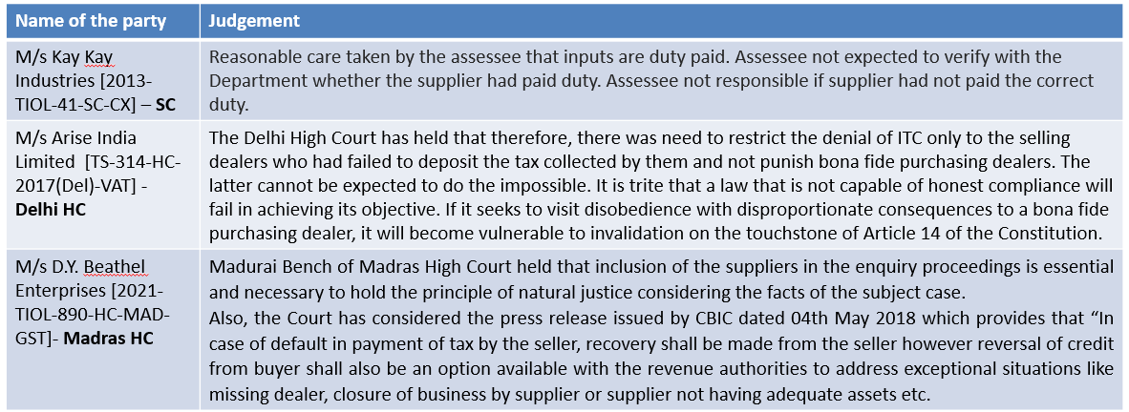
Issue-Condition – Tax payment by supplier
Impact:
Recipient should not be punished for the fault of the supplier.
Impossible to check whether GST paid by the supplier. No mechanism for the supplier
Judgements:
Madras HC: Jai Balaji Paper Cones [(2023) 8 Centax 298 (Mad.)] The registered person is not entitled to ITC if the tax has not been paid to the Govt. However, he is entitled to recover the amount from the suppliers in the manner known to the law.

Slide 23
Issue-Invoices not appearing in GSTR-2B
Reasons:
B2B supplies are treated as B2C while reporting in GSTR-1.
Wrong GSTIN is reported in GSTR-1.
The invoice details are not considered while filing the GSTR-1.
Impact:
No condition for reflecting in GSTR-2B. Condition only that tax should be paid in GST returns.
Condition applicable w.e.f. 01.01.2022 and not applicable for prior period
Circular 183/15/2022-GST dated 27.12.2022 [FY 2017-18 and 2018-19]
Karnataka HC- M/s. Wipro Ltd [(2023) 4 Centax 179 (Kar.)]
Circular 193/05/2023-GST dated 17.07.2023- Clarification to deal with difference in Input Tax Credit (ITC) availed in FORM GSTR-3B as compared to that detailed in FORM GSTR-2A for the period 09.10.2019 to 31.12.2021

Slide 24
Issue-Mismatch with GSTR 2A / 2B
Can ITC be recovered on mismatch with GSTR-2A / 2B ?
  Sec. 16 (2) – no condition in respect of furnishing of invoice details
  Sec. 16 (2) (aa) –notified wef 1.1.2022
  Sec. 16 (2) (c) – presumption of non-payment is not valid
    Sec. 37 and sec. 39 – no statutory interlinking between GSTR-1 & 3B except that the tax declared in GSTR 1 shall be considered to be self assessed.
    CBIC press release dated 18.10.2018 –
    “4….the facility to view the same in FORM GSTR-2A by the recipient is in the nature of taxpayer facilitation and does not impact the ability of the taxpayer to avail ITC on self-assessment basis in consonance with the provisions of section 16 of the Act. The apprehension that ITC can be availed only on the basis of reconciliation between FORM GSTR-2A and FORM GSTR-3B conducted before the due date for filing of return in FORM GSTR-3B for the month of September 2018 is unfounded as the same exercise can be done thereafter also.”

Slide 25
Credit eligibility should be proved by recipient?
M/s Ecom Gill Coffee Trading Private Limited (CIVIL APPEAL NO. 230 OF 2023)
SC allows Revenue's appeal, sets-aside Karnataka HC judgment allowing purchasing dealers to claim ITC while elucidating that “The dealer claiming ITC has to prove beyond doubt the actual transaction” and the “actual physical movement of the goods” which cannot be proved by producing tax invoices and payment by cheque;
SC categorically mentions that aforesaid information regarding actual physical movement of the goods would be in addition to tax invoices, particulars of payment etc. : SC
M/s. Gargo Traders - High Court Calcutta – (WPA 1009 of 2022 pronounced on 12.06.2023)
Credit cannot be denied where supplier registration cancelled with retrospective effect as long as transaction was valid.
Where at the time of transaction, the name of the supplier as registered taxable person was already available on the Government record and the petitioner has paid the amount of purchased articles as well as tax on the same through bank and not in cash, credit cannot be denied just because registration of the supplier was cancelled with retrospective effect without considering the documents relied on by the petitioner.

Slide 26
Credit eligibility when not reflected in GSTR 2A/2B
Calcutta HC: Suncraft Energy Pvt Ltd [WPA 12153 of 2023]issuance of demand notice on recipient of service on account of mismatch in GSTR 2A and GSTR 3B ITC cannot be sustained without any investigation being done at the end of the supplier whose invoices are not reflecting in GSTR 2A and that allegation of non payment of tax by supplier and denial of ITC u/s 16(2)(c) of the Act cannot be made without any investigation of the supplier in question.
In a recent writ petition in the case of Goparaj Gopalakrishnan Pillai v. State Tax Officer-1 [WP(C) NO. 29855 OF 2023], the Hon’ble Kerala High Court ruled in favour of the petitioner, by stating that the excess Input Tax Credit (ITC) claimed in Form GST-3B, which was not reflected in GSTR-2A, should not be a reason for denying the right to claim Input Tax Credit (ITC).

Slide 27
Credit eligibility when not reflected in GSTR 2A/2B
In Henna Medicals Vs. State Tax Officer (W.P. (C) No. 30660 of 2023, decided on 19-9-2023) [(2023) 11 Centax 32 (Ker.)] the High Court of Kerala relies on The State of Karnataka v. M/s Ecom Gill Coffee Trading Private Limited 2023 (3) TMI 533 SC as well as Suncraft Energy Private Limited v. The Assistant Commissioner, State Tax, Ballygunge Charge [Judgment dated 2-8-2023 in MAT No. 1218/2023] has held that the input tax credit of the assessee under the GST regime cannot be denied merely on the difference of GSTR 2A and 3B (Para 2).
Diya Agencies Vs. State Tax Officer (Kerala High Court) - WP(C) No. 29769 of 2023, the Hon’ble Kerala High Court highlights that, denying input tax credit based solely on discrepancies in GSTR-2A is unjust. Taxpayers should not be penalized for issues beyond their control, such as the non-deposit of taxes by the seller dealer. The court has directed assessing authorities to allow taxpayers the opportunity to provide evidence supporting their input tax credit claims. This ruling emphasizes the importance of a fair and evidence-based approach when evaluating input tax credit claims.

Slide 28
Relaxation for availment of ITC under Sec 16(4) of CGST Act availment of ITC under section 16(4) of CGST Act
Relaxation in condition for availment of ITC under Section 16(4) of the CGST Act, 2017:
The time limit to avail input tax credit in respect of any invoice or debit note under Section 16(4) of CGST Act, through any return in FORM GSTR 3B filed upto 30.11.2021 for the financial years 2017-18, 2018-19, 2019- 20 and 2020-21, may be deemed to be 30.11.2021.
  HNA comments:
  Big relief for many taxpayers who could not file GSTR-3B within statutory due date in the initial period of GST implementation.
  All pending matters to be closed once the amendment is made in the Act.
  In case of taxpayers who had already paid/reversed the credit in the department proceedings, should be given the opportunity for refund
Retrospective amendment to Section 16(4) of CGST Act from July 1, 2017. Conditionally relaxes provision if returns for period from registration cancellation to revocation are filed within thirty days of revocation order.
  HNA comments:
  Businesses should not be penalized for not being able to file return during the cancellation period.
  Welcome move to provide that restriction of Section 16(4) would not be applicable where returns could not be filed due to registration of cancellation.

Slide 29
Circular-Time limit starts from the date of issuance of invoice
The Council clarified that for supplies from unregistered suppliers under reverse charge, the financial year for claiming input tax credit under section 16(4) of CGST Act is the year of recipient-issued invoice.
  HNA Comments:
  Suppose a supply liable to RCM is received in 2019-20 but the taxpayer pays the tax under RCM thereon in 2023-24 along with interest during department audit.
  There was confusion whether time limit of 16 (4) would be applicable in such case and taxpayer would be entitled to claim ITC thereof.
  Council has clarified that time limit in such case would be applicable from the date of raising of self-invoice ie the date of payment of tax liability. Hence, all past disputes would get resolved.
  The Council should have extended similar benefit to supplies received from registered suppliers also where recipient is liable to pay RCM.
  [Circular No.211/5/2024-GST- 26th June 2024]

Slide 30





GST – Issues in Real Estate
CA Roopa Nayak
September 2024
16/07/20199

Slide 31
Levy
Section 7(1): Supply includes
  All forms of supply made for consideration.
Activities to be treated as supply of goods or services as per Schedule-II.
Schedule – II:
  5(b): Construction of a complex, building, civil structure or a part thereof
  5(b) : Construction of complex or building intended for sale to a buyer, wholly or partly.
  Exceptions,
    Entire consideration has been received after issuance of completion certificate, or
    After its first occupation, whichever is earlier.
Schedule – II:
  6(a) : Composite supply of works contract
“Works Contract” means a contract for building, construction, fabrication, completion, erection, installation, fitting out, improvement, modification, repair, maintenance, renovation, alteration or commissioning of any immovable property wherein transfer of property in goods (whether as goods or in some other form) is involved in the execution of such contract
Schedule-III-neither supply of goods nor services
  Excludes sale of land+ completed building

Slide 32
JDA – LL’s share

Slide 33
JDA -GST
JDA: Irrevocable right to enter the land and do construction
Intention is to hand over the constructed IP- can it be excluded from GST levy at Schedule III Entry 5?
L&T 2013 SC decision(2013-TIOL-46-SC-CT-LB) sets out that construction done under agreement is works contract
Construction services agreed to be provided to LL
Against non-monetary consideration
Residential/commercial project
What about plotted development?

Slide 34
JDA – Entered in GST regime
JDA entered in GST regime and project completed in GST regime before 01.04.2019
Levy:
  GST: It is a supply and GST is payable by the developer
Valuation:
  Rule 27
    Open market value
    Like kind and quality
    Cost of construction + 10%
Time of discharge tax
  Date of handover – notification 4/2018-CT(R)

Slide 35
JDA – Entered in GST regime
JDA entered in GST regime and project completed in GST regime after 01.04.2019
Levy:
  GST: It is a supply and GST is payable by the developer on construction services
Valuation:
  First sale value less 1/3rd deduction – para 2A of 11/17-CT(R)
  Rule 27 if first sale value not available
    Open market value
    Like kind and quality
    Cost of construction + 10%
Time of supply
  Date of OC/CC – notification 6/2019-CT(R)

Slide 36
JDA – Entered in ST regime
JDA entered in ST regime and project completed in GST regime before 01.04.2019
Levy:
  ST: Part construction done under ST regime however no mechanism to compute ST and hence no levy under ST
  VAT: VAT is not payable
  Can it be contended that the taxing event takes place prior to 1.7.2017?
  Value recovered from Customers of Developer share include value of LL units?
  GST: It is a supply and GST is payable by the developer on construction services
Valuation:
  Rule 27
    Open market value
    Like kind and quality
    Cost of construction + 10%
Time of discharge tax-Date of handover – notification 4/2018-CT(R)

Slide 37
JDA – Entered in ST regime
JDA entered in ST regime and project completed in GST regime after 01.04.2019
Levy:
  ST: ST not payable as handover has not taken place before 01.07.2017
  VAT: VAT is not payable
  GST: GST leviable on the developer on construction services
Valuation:
  First sale value less 1/3rd deduction
  Rule 27 if first sale value not available
    Open market value
    Like kind and quality
    Cost of construction + 10%
Time of discharge tax
  Date of OC/CC?? / notification 4/2018-CT(R)

Slide 38
Valuation
Landowner share:
  Para 2A of Notification 11/2017-CT(R) - the value of construction service shall be deemed to be equal to the Total Amount charged for similar apartments in the project from the independent buyers nearest to the date of JDA, less 1/3rd towards the value of transfer of land.
  If similar apartment do not exist? Rule 27 of the CGST Act could be relevant – open market value / value of like kind and quality / cost of construction + 10%.

Slide 39
GST on Commercial Projects
No 5% option
GST @ 18% with ITC
Actual Deduction for land instead of 1/3rd ?
ITC on all goods and service – Section 17(5)?
RCM on Development Rights - Credit eligibility ?
Reversal for unsold as on date of CC
Retention for leasing
ITC for leasing? – Safari decision Odisha High Court [2019-TIOL-1088-HC-ORISSA-GST]
Pending before SC in 2020 (32) G.S.T.L. J120 (S.C.)

Slide 40
Plot development - JDA
Sale of land after leveling, laying down of drainage lines etc. is sale of land and does not attract GST-Circular 177/2022.
Under JDA-intention to give immovable property hence no GST.
Both views being taken!!
GST could be paid by the developer on infrastructural development services
Valuation
  OMV
  Like kind and quality
  Cost of development + 10% (applicable in most cases)
Time of supply
  JDA before 01.04.2019 – date of handover of plots
  JDA on or after 01.04.2019 – date of completion
Rabia Khanum AAR [Appeal Number: Advance Ruling No. KAR ADRG 31/2022 and affirmed by the Appellate AAR [(2023) 5 Centax 120 (App. A.A.R. - GST - Kar.)] /Godrej Properties AAR (AAR KAR ADRG 19/2023 dated 26.04.2023)

Slide 41
GST implication- Revenue sharing JDA
Whether Revenue share arrangement between Developer and Land owner will be taxable?
If GST fully paid on all the flats sold to end customers by developer, then mere apportion of profit may not be again taxable to GST in the hands of land owner. Share of revenue - not liable to service tax [Decision of Mumbai Tribunal in case of Mormugao Port Trust 2016 – TIOL – 2843 – CESTAT – MUM]
Amount paid to LL is towards sale of land – not leviable to ST and GST
Clear agreement

Slide 42
Other related aspects
Developer can collect GST from LL? Yes, if specific clause in JDA
N Bala Baskar Vs CST(2016­-TIOL­-824-­HC-­MAD­ST)-it is open to developer to pass on burden to recipient
Whether LL could avail credit of GST paid to developer?
Whether developer could issue invoice to LL in advance?
Whether developer can avail ITC related to LL’s share (Residential)
  JDA before 01.04.2019 – Yes as tax payable at 12%
  JDA on or after 01.04.2019 – No, as developer cannot take any credit??

Slide 43
GST implication for LL
GST to be paid to developer if provided in JDA
GST payable on units sold before OC/CC
No GST on sale of units after OC/CC
GST of 5% charged by developer could be availed by LL [if LL sells unit before OC/CC].
When to pay tax to developer?

Slide 44
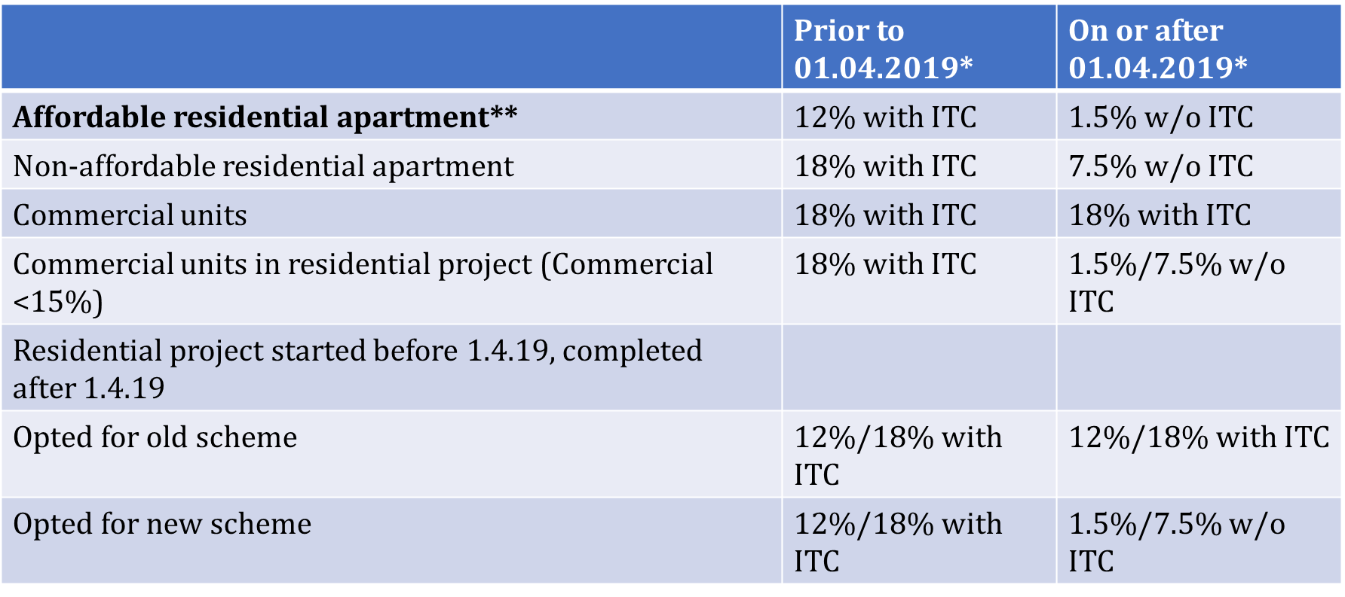
Rate of tax
*1/3rd deduction towards land value is available

Slide 45
Valuation of developer share
Sales to end customer:
  Total consideration less 1/3rd deduction for land value.
  Value of land to be at market value
  Other charges such as documentation charges, club house charges, maintenance charges – ancillary to construction services. To be considered along with construction services as composite supply.
If land value separately available, value = amount charged for construction services – similarly held in the case of Munjaal Manishbhai Bhatt [R/SPECIAL CIVIL APPLICATION NO. 1350 of 2021]
Should certify by approved valuer+take on periodic basis- dept can dispute

Slide 46
Deemed deduction towards land
As per Notification 11/2017-CT(R) - 1/3rd deduction towards land should be taken
The Hon’ble High Court of Gujarat has examined the issue in the case of Munjaal Manishbhai Bhatt Vs UOI [R/SPECIAL CIVIL APPLICATION NO. 1350 of 2021] and held that where actual land value is ascertainable, then the deeming fiction of 1/3rd of total agreement value towards land is clearly contrary to the provisions and scheme of the CGST Act and therefore ultra-vires the statutory provisions.
It further held that:
  Paragraph 2 of Notification No. 11/2017- Central Tax (Rate) dated 28th June 2017 and the parallel State tax Notification is read down to the effect that the deeming fiction of 1/3rd will not be mandatory in nature.
  The specific price agreed for land sale in the agreements between the parties is sufficient to avail the deduction of actual land value in place of deemed 1/3rd.

Slide 47


Slide 48
Transfer of DR – ST JDA
The term “service” as defined in the Chapter V of the Finance Act, 1994 is as follows:
“Service” means any activity carried out by a person for another for consideration, and includes a declared service, but shall not include­­-
(i) a transfer of title in goods or immovable property, by way of sale, gift or in any other manner; or
Sec. 3(a) of Land Acquisition Act the expression ‘land’ includes benefits to arise out of land
Hon. Gauhati High Court in the case of Nagen Hazarika v. Manorama Sharma AIR 2007 Gau 62 held that the expression ‘title’ is a broad expression in law which cannot always be understood as akin to ownership.
Immovable property in the General Clauses Act, 1987 would include land, benefits to arise out of land
The right to develop a land could be a benefit arising out of land
The ‘transfer (irrevocably and permanently) of title in land including transfer of rights in the form of benefits arising from it’
Hence DR transferred in ST regime is not leviable to tax.

Slide 49
Transfer of DR – ST JDA
GST implication on ST JDA
Transitional provisions: In section 142 sets out:
(10) Save as otherwise provided in this Chapter, the goods or services or both supplied on or after the appointed day in pursuance of a contract entered into prior to the appointed day shall be liable to tax under the provisions of this Act.
(11)(b) notwithstanding anything contained in section 13, no tax shall be payable on services under this Act to the extent the tax was leviable on the said services under Chapter V of the Finance Act, 1994”.
The levy has failed in ST when the DR was actually transferred
Rulings - CCE vs Vazir Sulthan Tobacco Co Ltd (1996 (83) ELT3 (SC); Association of Leasing & Financial Service Companies Vs Union ofIndia (2010 (20) STR 417 (SC); Delhi Chartered Accountants Society (Regd.) Vs UOI 2013 (31) S.T.R. 429 (Del.)
Therefore, no GST implication on DR

Slide 50
Transfer of DR – GST JDA
DR transferred in GST regime before 01.04.2019
  Schedule III exclude sale of land
  Land includes benefits associated with it
  Transfer of DR – irrevocable. Whether covered under sale?
  DR leviable to Stamp duty. Hence excluded from GST?
  Can contend not leviable to GST however need to be judicially tested.

Slide 51
Transfer of DR – GST JDA
DR transferred in GST regime on or after 01.04.2019
  Covered in Third Schedule
  Whether taxable due to RCM entry?
  Intention of the department – to collect tax?
  If paid, whether credit available?
  Prahitha Contruction Private Limited vs UOI, WP 5493/2020 Telengana HC on taxability of DR-pending at SC.

Slide 52


Slide 53
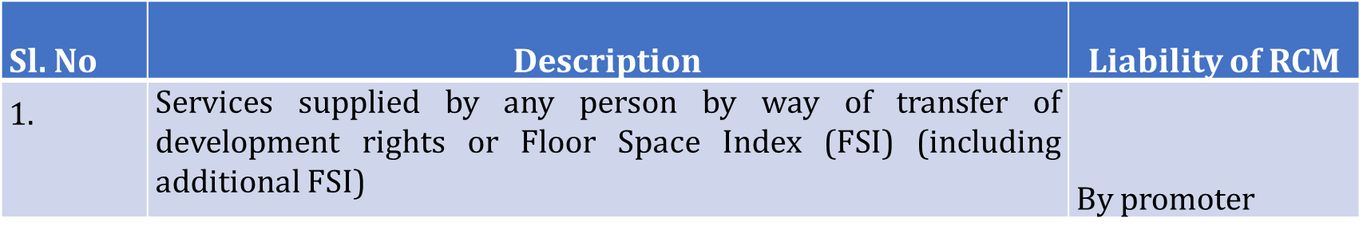
RCM - JDA
Liability to pay tax shall arise on CC/ First Occupancy
Residential apartments remain un-booked – GST under RCM
Liability under RCM
= GST payable on TDR or FSI or upfront premium (*) carpet area of un-booked/total carpet area of residential apartments.
Rate of GST = 1%/5% for affordable & non-affordable projects respectively
Tax payable not exceed 2.5% of the value in case of residential apartments
Remaining un- booked on the date of issuance of completion certificate or first occupation

Slide 54
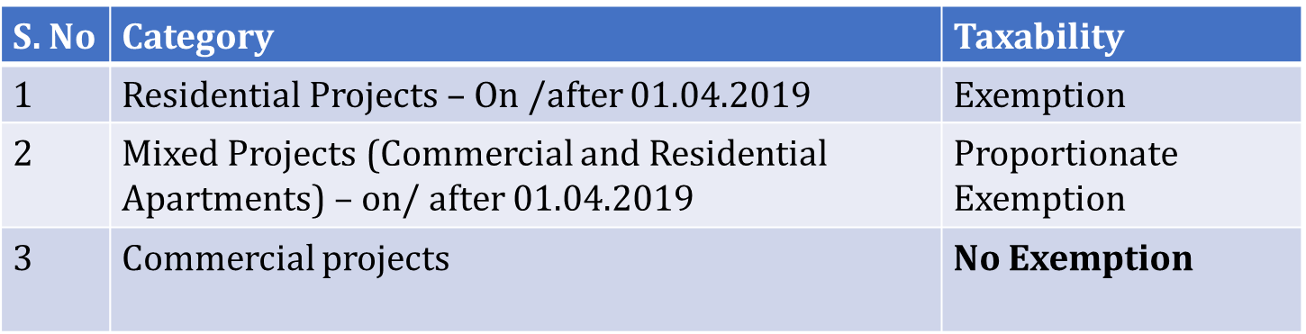
Transfer of DR – Exemption
Exemption is given for services by way of
  Transfer of development rights (TDR), or
  Floor Space Index (FSI), or
  Upfront premium on long term lease (>30 years)
  For construction of residential apartments by a promoter in a project, intended for sale to a buyer, wholly or partly
Value of exemption = GST payable on TDR or FSI or upfront premium (*) carpet area of residential apartments (/) (total carpet area of residential and commercial apartments)

Slide 55
Other aspects-real estate
Confirming party arrangement
For sale of land
ATS and sale deed with the Land owner
Do assignment to the ultimate purchaser
Is there GST on confirming party?
Elegant Developers Vs CST, New Delhi (2019 (29) G.S.T.L. 477 (Tri. - Del.)
Premium Real Estate Developers vs CST, Delhi (2019 (22) G.S.T.L. 373 (Tri. - Del.

Slide 56
Issues
Whether the landowner is eligible to avail full credit of tax charged at 5% by developer even some part of their share was retained by such landowner?
LL would be eligible for credit only if they sell flats which are liable to GST. In case if sales are made after CC/OC, or LL hold certain portion towards self-consumption, credit may not be eligible towards such portion as no taxes has been collected on it.
Whether GST is payable on cancellation charges?
Whether there is a supply at all. In the absence of supply, levy fails. Schedule II no longer deemed supply and hence levy exclusion could be claimed.
Circular 178/10/2022-GST
Dhiren Chemicals Industries Case. [2002 (143) ELT 19 (SC)].

Slide 57
Issues
Whether new scheme under real estate is mandatory?
Notification does not provide an option. View possible that conditions cannot be attached against any entry in rate notification (Case of Mohit Minerals Civil Appeal No. 1390 of 2022). Further, conditional entry cannot be made mandatory. However, no judicial clarity presently.
Whether 1/3rd deduction towards land mandatory?
This mechanism may lead to taxing certain portion of land value where land value is available and is more than 1/3rd value. This seems to be arbitrary and irrational. Similarly held by the High Court in the case of Munjaal Manishbhai Bhatt [R/SPECIAL CIVIL APPLICATION NO. 1350 of 2021] .

Slide 58
Issues
Whether after 1.4.19, GST on LL’s share could be paid at 18% and ITC could be availed?
It could be said that 1%/5% is applicable only where units are sold to a buyers. Land value is not included for LL[land belongs to LL] and hence 1%/5% are not applicable to him. Hence, GST to be paid at 18% and proportionate credit could be availed. Judicial clarity awaited.
Whether electricity charges collected can be kept out of tax net by developers supplying facility services?
As per circular 206/18/2023 yes when pure agent conditions fulfilled

Slide 59

THANK YOU
- For any queries
roopa@hnaindia.com
16/07/20199

