Slide 1
ITR FILING ON INCOME FROM HOUSE PROPERTY & SALARY
CA HARI GOPINATH
MAHADEVAN & HARI, CHARTERED ACCOUNTANTS
THRISSUR

Slide 2
BEFORE BEGINNING!
THE TIMES WE LIVE IN
MY COUSIN’S QUEST
WHERE WE ARE HEADED

Slide 3

ITR FILING ON INCOME FROM HOUSE PROPERTY

Slide 4
THROUGH SECTIONS
22
Income from House property
The charging section
Annual value how determined
23
How annual value for the purpose of taxation is computed under different scenarios.
Deductions from income from house property.
24
Deductions to be taken under consideration while calculating the income from house property.
25
Amounts not deductible from income from house property
Interest on loan, which cannot be availed as deduction is explained here

Slide 5
THROUGH SECTIONS
25A
Special provision for arrears of rent and unrealised rent received subsequently
Property owned by co-owners.
26
How the income should be assessed in case of co-owners of property
"Owner of house property", "annual charge", etc., defined.
27
Different scenarios worked out.

Slide 6
CHARGEABILITY
TEXT FROM ACT : The annual value of property consisting of any buildings or lands appurtenant thereto of which the assessee is the owner, other than such portions of such property as he may occupy for the purposes of any business or profession carried on by him the profits of which are chargeable to income-tax, shall be chargeable to income-tax under the head "Income from house property".
So we can safely say - Annual value of the following properties are chargeable under the head
“Profits and gains of business or profession”-
(i) Portions of property occupied by the assessee for the purpose of any business or profession
carried on by him
(ii) Properties of an assessee engaged in the business of letting out of properties

Slide 7
INCOME CHARGEABLE
Rental income from a property owned (includes co-owner and deemed owner) by the taxpayer. The property may be residential, commercial (shop, office) or land appurtenant to building
Lease amount received from leasing the property.
Income received from a leased property (as a lessee) for 12 years or more.

Slide 8
INCOME NOT CHARGEABLE
Rental Income earned by anyone other than the owner, co-owner or deemed owner (section 27), would be either charged as income from other sources or PGBP.
Rental income from sub-letting is taxable under "Income from other sources" or business/profession income
If other assets are rented out along with the property (example: furniture, Generator) that are inseparable, the income is charged under head “Profit under Head Business and Profession (PGBP) “or Income from other sources.
Rental income of a vacant plot (not appurtenant to building) is not chargeable to tax under the head “Income from house property”, but is taxable either under the head “Profits and gains of business or profession” or under the head “Income from other sources”, as the case may be.

Slide 9
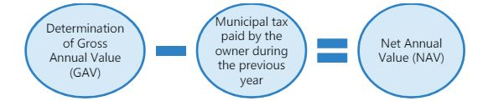
AV
ANNUAL VALUE

Slide 10
GROSS ANNUAL VALUE
(a) the sum for which the property might reasonably be
expected to let from year to year; or
(b) where the property or any part of the property is let and
the actual rent received or receivable by the owner in
respect thereof is in excess of the sum referred to in
clause (a), the amount so received or receivable
(c) where the property or any part of the property is let and was
vacant during the whole or any part of the previous year and
owing to such vacancy the actual rent received or receivable by
the owner in respect thereof is less than the sum referred to in
clause (a), the amount so received or receivable :

Slide 11
GROSS ANNUAL VALUE
EXPECTED RENTAL VALUE– In order to determine the
expected rent for a property, one must take the higher
value between municipal value and fair rent subject to
a maximum of standard rent.
STEP 1 : COMPARE FAIR RENT WITH MUNCIPAL VALUE
STEP 2 : TAKE THE HIGHER FIGURE
STEP 3 : COMPARE STEP 2 FIGURE WITH STANDARD RENT
STEP 4 : WHICHEVER IS LOWER IS THE EXPECTED RENT

Slide 12
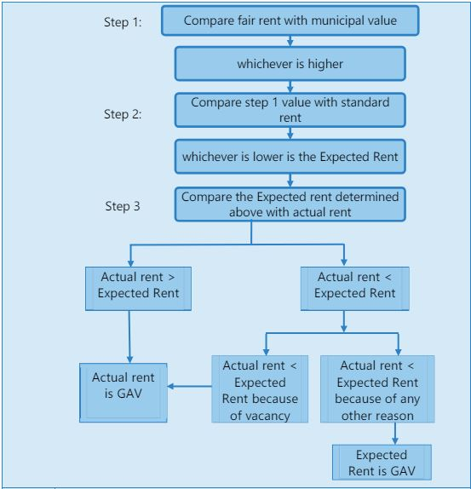
GROSS ANNUAL VALUE

Slide 13
GROSS ANNUAL VALUE
Points to be noted :
Amount of actual rent received or receivable shall not
include the amount of rent which cannot be realised. (Rule 4)
In some cases, property consisting of any buildings or lands appurtenant thereto may be held as stock-in-trade, and the whole or any part of the property may not be let out during
the whole or any part of the previous year. In such cases, the
annual value of such property or part of the property shall be Nil. This benefit would be available for the period upto two years from the end of the financial year in which certificate of completion of
construction of the property is obtained from the competent
authority.

Slide 14
SELF OCCUPIED VS LET OUT
Self Occupied Property :
Where the property consists of a house or part of a house which—
(a) is in the occupation of the owner for the purposes of his own residence; or
(b) cannot actually be occupied by the owner by reason of the fact that owing to his employment,
business or profession carried on at any other place, he has to reside at that other place in a
building not belonging to him
Annual Value of Such Self occupied property shall be NIL
The Property is not a Self occupied property if, -
The house or part of the house is actually let during the whole or any part of the previous year.
If he have more than 2 self occupied property – Meaning, only two of the house properties can be claimed as self occupied.

Slide 15
HP
DEDUCTIONS
Muncipal Taxes
Its should be borne by the owner
It should be actually paid during the year
Not allowed to Self occupied
Standard Deduction
Deduction u/s 24
30% of NAV is allowed as deduction
Not allowed to Self occupied
Interest on borrowed Capital
Interest payable on loans borrowed for the purpose of acquisition, construction, repairs, renewal or reconstruction of house property can be claimed as deduction.
Interest payable on a fresh loan taken to repay the original loan

Slide 16
DEDUCTION OF INTEREST – S/O PROPERTY
S No | Conditions | Amount of Deduction
(A) | Loan borrowed before 1.4.99: Where the property has been acquired, constructed, repaired, renewed or reconstructed with borrowed capital before 1.4.99. | Actual interest payable subject to maximum of ₹ 30,000.
(B) | Loan borrowed on or after 1.4.99: (i) Where the property is acquired or constructed with capital borrowed on or after 1.4.99 and such acquisition or construction is completed within 5 years from the end of the financial year in which the capital was borrowed. | Actual interest payable subject to maximum of ₹ 2,00,000
 | (ii) Where the property is acquired or constructed with capital borrowed on or after 1.4.99 and such acquisition or construction is not completed within 5 years from the end of the financial year in which the capital was borrowed. | Actual interest payable subject to a maximum of ₹ 30,000.
 | (iii) Where the property is repaired, renewed or reconstructed with capital borrowed on or after 1.4.99. | Actual interest payable subject to a maximum of ₹ 30,000.

Slide 17
DEDUCTION OF INTEREST – POINTS TO BE NOTED
a) The ceiling limit would not apply to let-out/deemed let-out property: The ceiling prescribed for one self-occupied property as above in respect of interest on loan borrowed does not apply to a deemed let-out property.
(b) Interest allowable on accrual basis: Deduction under section 24(b) for interest is available on
accrual basis. Therefore interest accrued but not paid during the year can also be claimed as
deduction.
(c) Unpaid purchase price would be considered as capital borrowed: Where a buyer enters into an arrangement with a seller to pay the sale price in installments along with interest due thereon,
the seller becomes the lender in relation to the unpaid purchase price and the buyer becomes
the borrower. In such a case, unpaid purchase price can be treated as capital borrowed for
acquiring property and interest paid thereon can be allowed as deduction under section 24.
(d) Interest on unpaid interest is not deductible.
(e) Interest payable on a fresh loan taken to repay the original loan raised earlier for the aforesaid
purposes is also admissible as a deduction.

Slide 18
PRE CONSTRUCTION PERIOD INTEREST
Topic | Details
Definition | Interest paid on a loan for the purchase, construction, or repair of a property before the construction is completed.
Pre-Construction Period | Period from the loan start date to the end of the financial year before construction completion/acquisition.
Interest Deduction | Total pre-construction interest divided into 5 equal installments, starting from the year of completion or acquisition.
Conditions for Deduction | Property should be completed or acquired within 5 years from the end of the financial year in which the loan was borrowed. Loan must be for purchase, construction, repair, renewal, or reconstruction of the property.
Example | Loan taken on April 1, 2020, construction completed on May 31, 2023. Pre-construction period: April 1, 2020, to March 31, 2023. Total interest: ₹1,00,000. Deduction: ₹20,000/year for five years starting from 2023-24. (FY 23-24)
Steps to Claim Deduction | Maintain detailed records of the loan and interest payments. Obtain a completion certificate. Claim the deduction in the Income Tax Return (ITR).

Slide 19
ARREARS & UNREALISED RENT
HP
Taxable in the year of receipt/realisation
Deduction of 30% of rent received/realised is available
Taxable even if assessee is not the owner of the property in the financial year of receipt/realisation.

Slide 20
CO-OWNED PROPERTY
Where property is owned by two or more persons, whose shares are definite and ascertainable, then the income from such property cannot be taxed as income of an AOP.
The share income of each co-owner should be determined in accordance with sections 22 to 25 and included in his individual assessment.
Where the house property owned by co-owners is self-occupied by each of the co-owners, the annual value of the property of each co-owner will be Nil and each co-owner shall be entitled to a deduction of 30,000 / `2,00,000, as the case may be, under section 24(b) on account of interest on borrowed capital.
Where the house property owned by co-owners is let out, the income from such property shall be computed as if the property is owned by one owner and thereafter the income so computed shall be apportioned amongst each co-owner as per their specific share.

Slide 21
ANALYSIS OF SCENARIOS - INTEREST
Scenario | Owner of House Property | Loan in the name of | Self Occupied/ Letout | Interest Amount | Deduction Available to X | Deduction Available to Y
1 | Both X an Y | Both X and Y | Self Occupied | 5,00,000 | 2,00,000 | 2,00,000
2 | Both X an Y | Both X and Y | Self Occupied | 3,00,000 | 1,50,000 | 1,50,000
3 | Both X an Y | Both X and Y | Letout | 5,00,000 | 2,50,000 | 2,50,000
4 | Both X an Y | Only X | Self Occupied | 3,00,000 | 2,00,000 | -
5 | Both X an Y | Only X | Letout | 3,00,000 | 3,00,000 | -

Slide 22
ANALYSIS OF SCENARIOS - INTEREST
Scenario | Owner of House Property | Loan in the name of | Self Occupied/ Letout | Interest Amount | Deduction Available to X | Deduction Available to Y
6 | Both X and Y | Loan in the name of X and Y is the guarantor to the loan | Self Occupied | 5,00,000 | 2,00,000 | -
7 | Only X | Both X and Y | Self Occupied | 5,00,000 | 2,00,000 | -
8 | Only X | Both X and Y | Self Occupied | 1,50,000 | 75,000 | -
9 | Only X | Both X and Y | Letout | 3,00,000 | 1,50,000 | -
10 | Only X | Only X | Letout | 4,00,000 | 4,00,000
11 | Only X | Only Y | Letout | 4,00,000 | - | -

Slide 23
DEEMED OWNERSHIP
Transfer to Spouse/ Minor Child : an individual who transfers otherwise than for adequate consideration any house property to his or her spouse, not being a transfer in connection with an agreement to live apart, or to a minor child not being a married daughter, shall be deemed to be the owner of the house property so transferred.
Holder of an impartible estate : The impartible estate is a property which is not legally divisible. The holder of an impartible estate shall be deemed to be the individual owner of all properties comprised in the estate.
Member of a co-operative society etc : A member of a co-operative society, company or other association of persons to whom a building or part thereof is allotted or leased under a House Building Scheme shall be deemed to be owner of that building

Slide 24
DEEMED OWNERSHIP
Person in possession of a property: a person who is allowed to take or retain possession of any building or part thereof in part performance of a contract of the nature referred to in section 53A of the Transfer of Property Act, 1882 (4 of 1882), shall be deemed to be the owner of that building or part thereof
Person having right in a property for a period not less than 12 years : A person who acquires any rights in or with respect to any building or part thereof, by virtue of any transaction as is referred to in section 269UA(f) i.e. transfer by way of lease for not less than 12 years, shall be deemed to be the owner of that building or part thereof.

Slide 25
CASES WHERE HOUSE PROPERTY INCOME IS EXEMPT FROM TAX
Section 10(1) - Income from any farm house forming part of agricultural income.
Section 10(19A) - Annual value of any palace in the occupation of an ex-ruler.
Section 10(20) - Income from house property of a local authority.
Section 10(21) - Income from house property of an approved scientific research association.
Section 10(23C) - Property income of universities, educational institutions, etc.
Section 10(24) - Property income of a registered trade union.
Section 11 - Income from house property held for charitable or religious purpose.
Section 13A - Property income of any political party.

Slide 26
SCENARIOS
The benefit of exemption of self-occupied property is available only to individuals and HUF. The benefit of self-occupied property is not available to a company, partnership firm, trust or other classes of assesses.
A house property may consist of two or more independent units, one of which is self-occupied and the remaining are used for any other purpose. Part/unit which is occupied by the taxpayer for his residence throughout the year will be treated as an independent property and income from such a part/unit will be computed in the manner as discussed in case of a self-occupied property.
Part/unit which is let out will be treated as an independent property and income from such a part/unit will be computed in the manner as discussed in case of let out property.
Property tax paid and interest on loan shall be bifurcated proportionally between the self-occupied unit and let out unit, and income will be computed after giving effect to this.
If the tenant incurs and bears some repair expenses, the same shall not be allowed as a deduction to the owner, and neither shall it be added to actual rent. That amount shall not be taxable.

Slide 27
SCENARIOS
Interest paid on loans taken from friends and relatives be claimed as deduction while calculating house property income, if the loan is taken for purchase, construction, repair, renewal or reconstruction of the house.
Interest u/s 24b is allowed on accrual basis. Interest is allowable on accrual basis u/s 24(b). Interest will be allowable as a deduction irrespective of whether interest has been paid or not in the current financial year. Interest accrued, but not due shall still be allowed as a deduction
If as per the terms of moratorium agreed upon by the parties, if interest continues to accrue during moratorium period, such accrued interest is allowable u/s 24(b).
When the assessee pays the consideration for house property in installments, the unpaid purchase price shall be treated as amount borrowed for acquiring/purchasing the property, and any interest paid or payable on the same would be allowable as a deduction u/s 24(b)
Income from house property is taxable in the hands of the owner of the property, irrespective of whether he owns the land on which it is situated.

Slide 28
SCENARIOS
If 2 or more people own a property and share of each co-owner is not definite, the income from house property shall be determined and charged to tax in the capacity of an AOP.
If partnership firm operates in property owned by partner, and If the partner has not derived any benefit from the property, it would be deemed to be used for the partner’s own business, hence would not be taxable under ‘Income from House Property’
In a case where composite rent includes rent of building and charges for different services (like lift, watchman, water supply, etc.): In this situation, the composite rent is to be bifurcated and the sum attributable to the use of property will be charged to tax under the head “Income from house property” and charges for various services will be charged to tax under the head “Profits and gains of business and profession” or “Income from other sources”
A house property is owned (ownership) by parents. However, elder son has taken housing loan and paying interest and principal of same. The elder son cannot claim the deduction of the interest paid on housing loan u/s 24 since the ownership of the house property is not with the elder son.

Slide 29
SCENARIOS
Rental income where the purchase consideration for the property is paid by husband and the property is registered in both the husband and wife’s name : As per section 64(1)(iv) If any individual transfers any asset to his or her spouse without consideration or for inadequate consideration then income from such assets which is received by the spouse is assessable to tax in the hands of the transferor.
Advance municipal taxes are allowed as a deduction in the year it becomes due and not in the year of payment, as it would not qualify as a tax levied, and liability incurred in the year of payment.
Refund of municipal taxes by the local authority shall not be chargeable to tax even if it was allowed as a deduction in computation of income from house property.
If the ownership of the property is under dispute, it shall be taxed in the hands of the assessee as decided by the Income Tax authorities until a final judgement is delivered.
Any non-refundable deposit received from a tenant, in whatever name it may be called, shall be included in the rent received on pro rata basis.

Slide 30
SCENARIOS
If an assessee who owns terrace floor of a building gives the same on a license to a telecom company for installing tower/antenna, the license fee is taxable as Income from house property.
If an assessee carries on business of purchasing and selling buildings, income received from the buildings so long as they are owned by the assessee will be shown under the head 'Income from house property’ and not under the head 'Profits and gains of business‘
Where owner of the property running the paying guest establishment, than Income form Property is assessable under the head of business.
Where any property occupied by employees or its director etc. who are concerned with the promotion of the business of the assessee company to enable them to discharge their functions efficiently, with or without payment of rent and the letting out of the property is subservient and incidental to the main business of the assessee, such an occupation amounts to an occupation and user of the property by the assessee itself for the purposes of its business, even though no business is actually carried on in such premises. Income from such property is not assessable as income from house property.

Slide 31
SET OFF AND CARRY FORWARD
HP
Aggregating Income/ loss from all properties: The income from house property is not calculated on an individual basis but aggregate of all houses.
Setting of Loss from house property with other income : if you have incurred loss from house property, you can set it off against other head of income subject to condition.
The maximum loss that could be set off against other House Property is 2 Lakhs in a year
If the loss exceeds 2 lakhs in a year, it could be carried forwarded for 8 years. However, in the subsequent years it could be only set off under the same head “Income Under Head House property.”

Slide 32
NEW VS OLD REGIME
HP
Interest Deduction on Home Loans : Under the new tax structure, the only time one may claim a deduction for home loan interest under section 24 is when the residence is rented out.
Losses from Residential Property : Under the new tax regime, losses from residential property cannot be offset against other sources of income.
Set-off for Residential Property Losses : If a person rents out many homes, the loss from one home might be offset by the income from a different home.
Carry Forward Losses for House Properties: The new tax system does not allow for the carrying forward of losses. Losses on residential property could be carried forward for up to eight fiscal years under the previous tax system

Slide 33
ITR FILING ON INCOME FROM SALARY

Slide 34
THROUGH SECTIONS
15
Salaries
The charging section
Deductions from salaries
16
Amounts which can be claimed as deduction from Salary
17
"Salary", "perquisite" and "profits in lieu of salary" defined.
Detailed analysis of various concepts under Salary

Slide 35
CHARGEABILITY
The following income shall be chargeable to income-tax under the head "Salaries"—
Any salary due from an employer or a former employer to an assessee in the previous year, whether paid or not;
Any salary paid or allowed to him in the previous year by or on behalf of an employer or a former employer though not due or before it became due to him;
Any arrears of salary paid or allowed to him in the previous year by or on behalf of an employer or a former employer, if not charged to income-tax for any earlier previous year.
Where any salary paid in advance is included in the total income of any person for any previous year it shall not be included again in the total income of the person when the salary becomes due.

Slide 36
CHARGEABILITY
Where any salary paid in advance is included in the total income of any person for any previous year it shall not be included again in the total income of the person when the salary becomes due.
Any salary, bonus, commission or remuneration, by whatever name called, due to, or received by, a partner of a firm from the firm shall not be regarded as "salary" for the purposes of this section.

Slide 37
POINTS TO CONSIDER
Income from salary taxable during the year shall consists of following:
Salary due from employer (including former employer) to taxpayer during the previous year, whether paid or not;
Salary paid by employer (including former employer) to taxpayer during the previous year before it became due;
Arrear of salary paid by the employer (including former employer) to taxpayer during the previous year, if not charged to tax in any earlier year
Existence of relationship of employer and employee is must between the payer and payee to tax the income under this head.
Section 17(1) defined the term “Salary”. It is an inclusive definition and includes monetary as well as non-monetary items.

Slide 38
SALARY – SECTION 17(1)
wages
any annuity or pension
any gratuity
any fees, commission, perquisite or profits in lieu of or in addition to any salary or wages
any advance of salary
leave salary or leave encashment
Provident Fund
The contribution made by the Central Government or any other employer in the previous year to the account of an employee under a pension scheme referred to in section 80CCD

Slide 39
POINTS TO CONSIDER
Full-time or part-time employment:
Once the relationship of employer and employee exists, the income is to be charged under the head “salaries”. It does not matter whether the employee is a full-time employee or a part-time one.
Forgoing of salary :
Once salary accrues, the subsequent waiver by the employee does not absolve him from liability to income-tax. Such waiver is only an application and hence, chargeable to tax.
Surrender of salary:
However, if an employee surrenders his salary, in the public interest, to the Central Government under section 2 of the Voluntary Surrender of Salaries (Exemption from Taxation) Act, 1961, the salary so surrendered would be exempt while computing his taxable income.

Slide 40
POINTS TO CONSIDER
Salary Paid Tax-free:
The income from salaries in the hands of the employee will consist of his salary income and also the tax on this salary paid by the employer. However, As per section 10(10CC), the income-tax paid by the employer on non-monetary perquisites on behalf of the employee would be exempt in the hands of the employee.
Place of accrual of salary:
Under section 9(1)(ii), salary earned in India is deemed to accrue or arise in India even if it is paid outside India or it is paid or payable after the contract of employment in India comes to an end.
If an employee is paid pension abroad in respect of services rendered in India, the same will be deemed to accrue in India. Similarly, leave salary paid abroad in respect of leave earned in India is deemed to accrue or arise in India.

Slide 41
ALLOWANCES
Allowances which are Fully Taxable under both regimes
Allowances which are Fully Taxable under default tax regime (New)/ Partly Exempt under the optional tax regime
Allowances which are partly exempt under both regimes
Allowances which are Fully Exempt only
under the optional tax regime

Slide 42
FULLY TAXABLE
Entertainment Allowance
Dearness Allowance
Overtime Allowance
Fixed Medical Allowance
City Compensatory Allowance (to meet increased cost of living in cities)
Interim Allowance
Servant Allowance
Project Allowance
Tiffin/Lunch/Dinner Allowance
Any other cash allowance
Warden Allowance
Non-practicing Allowance
Transport allowance to employee other than blind/ deaf and dumb/ orthopedically handicapped employee

Slide 43
FULLY TAXABLE UNDER NEW & PARTLY EXEMPT UNDER OLD
House Rent Allowance [u/s 10(13A)]
Special Allowances[u/s 10(14)]
Except -
Travelling allowance
Daily allowance
Conveyance allowance
Transport allowance to blind/ deaf and dumb/ orthopedically handicapped employee.

Slide 44
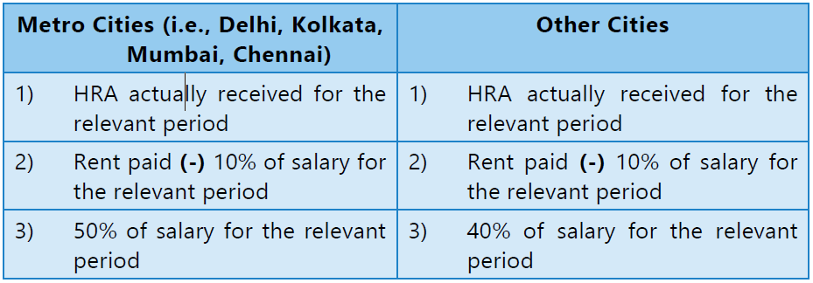
House Rent Allowance [Section 10(13A)]
HRA granted to an employee is exempt to the extent of least of the following, in case such assessee exercises the option of shifting out of the default tax regime provided under section 115BAC(1A):
Note
1. Salary = Basic Salary + DA (if) + commission (as a fixed percentage of turnover) 2. Exemption is not available to an assessee who lives in his own house, or in a house for which he has not incurred the expenditure of rent.

Slide 45
Special Allowances[u/s 10(14)]
Special allowances or benefit, not being in the nature of a perquisite,
specifically granted to meet expenses incurred wholly, necessarily and
exclusively in the performance of the duties of an office
Example - Helper Allowance, Research Allowance, Uniform Allowance
Exemption : Actual allowance received or actual amount spent for the performance of the duties of an office or employment of profit, whichever is less would be exempt.

Slide 46
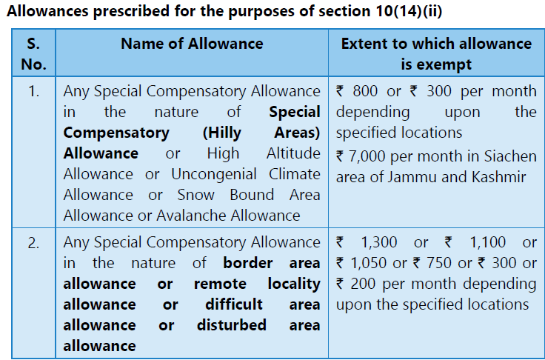

Slide 47
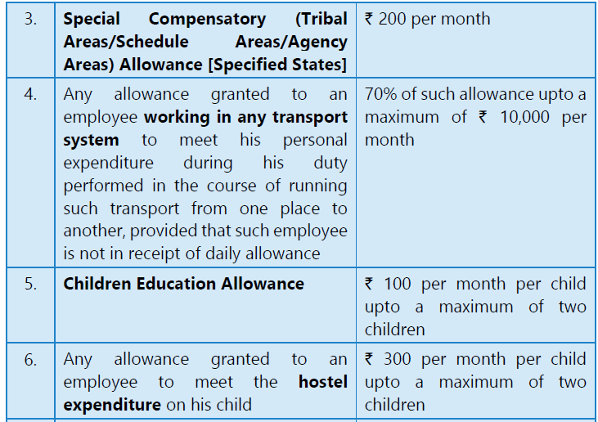

Slide 48
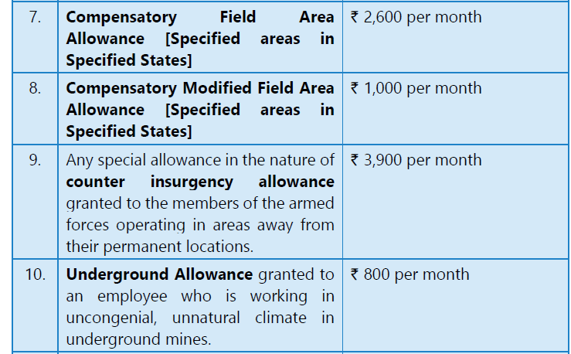
Note - Any assessee claiming exemption in respect of allowances mentioned at serial numbers 7 & 8 and 9 shall not be entitled to exemption in respect of the allowance and disturbed area allowance referred at serial number 2, respectively.

Slide 49
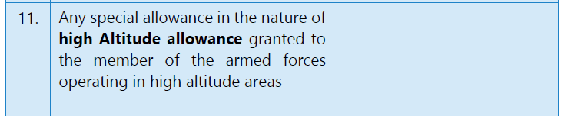
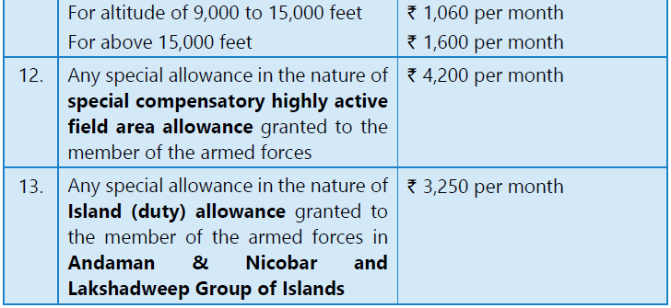

Slide 50
PARTLY EXEMPT UNDER BOTH
Section 10(14)(i) - Travelling Allowance(Rs.1,600 pm), Daily allowance, Conveyance Allowance.
Section 10(14)(ii) - Any transport allowance granted to an employee who is blind or deaf and dumb or orthopedically handicapped with disability of the lower extremities of the body, to meet his expenditure for commuting between his residence and place of duty would be exempt upto Rs. 3,200 per month.

Slide 51
FULLY EXEMPT UNDER OLD
Allowances to High Court Judges
Salary and Allowances paid by the United Nations Organization
Sumptuary allowance granted to High Court or Supreme Court Judges
Allowances payable outside India [Section 10(7)]: Allowances or perquisites paid or allowed as such outside India by the Government to a citizen of India for services rendered outside India are exempt from tax.

Slide 52
ANNUITY
Annuity is a sum payable in respect of a particular year. It is a yearly grant.
Annuity received by a present employer is to be taxed as salary
Annuity received from a past employer is taxable as profit in lieu of salary.
Annuity received from person other than an employer is taxable as “income from other sources”.

Slide 53
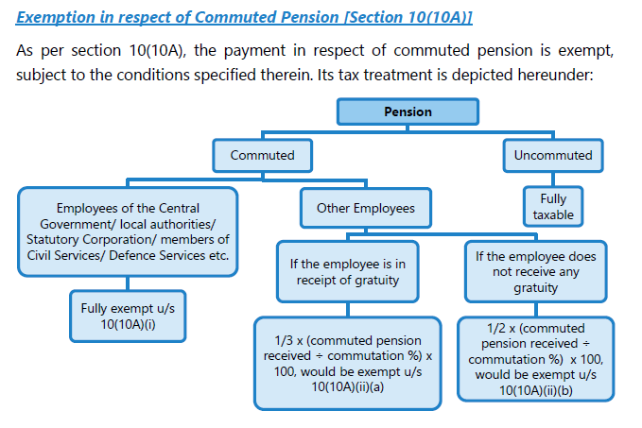
PENSION
Note
- Exemption u/s 10(10A) in respect of commuted pension is available to an assessee irrespective of the regime under which he pays tax.

Slide 54
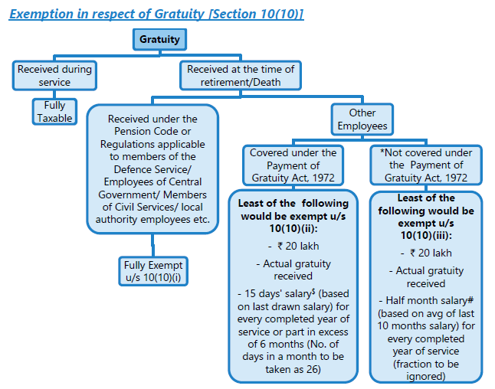
GRATUITY
Note
- Exemption u/s 10(10) is available to an assessee irrespective of the regime under which he pays tax.

Slide 55
GRATUITY
Note
Exemption u/s 10(10) is available to an assessee irrespective of the regime under which he pays tax.
Where gratuity is received from 2 or more employers in the same previous year, then, aggregate amount of gratuity exempt from tax cannot exceed
Rs.20,00,000.
Where gratuity is received in any earlier previous year from former
employer and again received from another employer in a later previous year, the limit of Rs.20,00,000 will be reduced by the amount of gratuity exempt earlier.

Slide 56
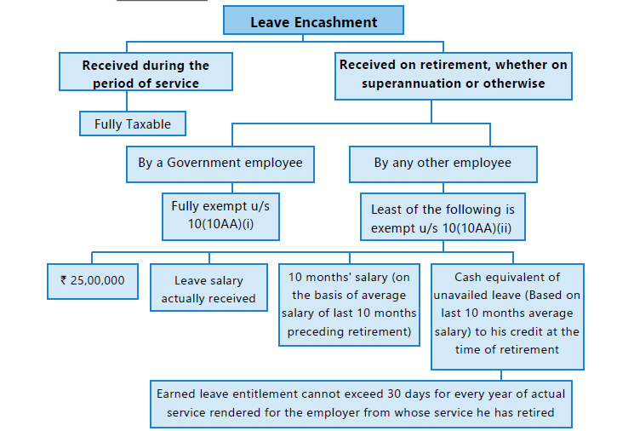
LEAVE SALARY OR LEAVE ENCASHMENT
Note
- Exemption u/s 10(10AA) is available to an assessee irrespective of the regime under which he pays tax.

Slide 57
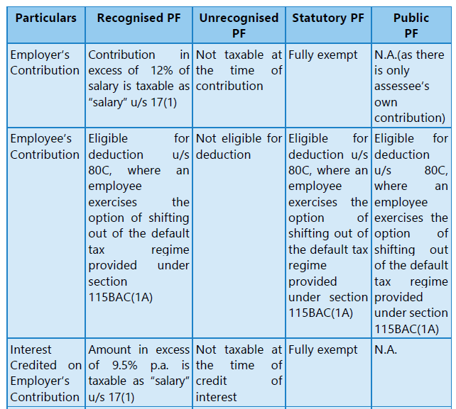
TAX TREATMENT OF PROVIDENT FUND

Slide 58
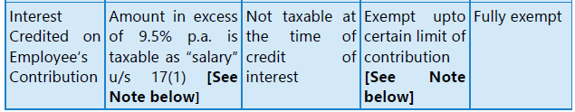
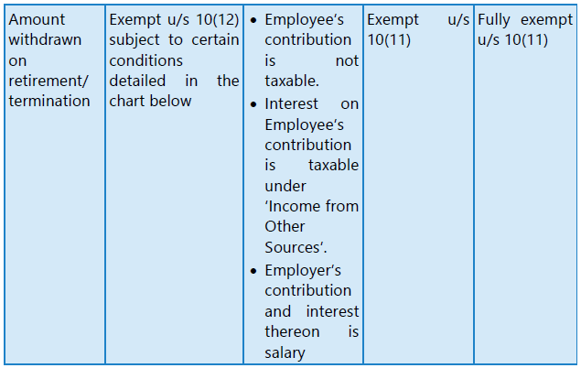
Note
Salary = Basic Salary + DA(if)+ Commission as a fixed % of turnover

Slide 59
Note:
As per section 10(11), any payment from a Provident Fund (PF) to which Provident
Fund Act, 1925, applies or from Public Provident Fund would be exempt.
Accumulated balance due and becoming payable to an employee participating in a
Recognized Provident Fund (RPF) would be exempt under section 10(12).
However, the exemption under section 10(11) or 10(12) would not be available in
respect of income by way of interest accrued during the previous year to the extent it relates to the amount or the aggregate of amounts of contribution made by that
person/employee exceeding Rs. 2,50,000 in any previous year in that fund, on or
after 1st April, 2021.
If the contribution by such person/employee is in a fund in which there is no
employer’s contribution, then, a higher limit of Rs. 5,00,000 would be applicable for such contribution, and interest accrued in any previous year in that fund, on or after 1st April, 2021 would be exempt upto that limit.
It may be noted that interest accrued on contribution to such funds upto 31st March, 2021 would be exempt without any limit, even if the accrual of income is after that date.

Slide 60
For this purpose, separate accounts within the provident fund account shall be maintained during the previous year 2021-22 and all subsequent previous years for taxable contribution and non-taxable contribution made by a person.
Non-taxable contribution account – Aggregate of
(i) closing balance in the account as on 31.03.2021;
(ii) any contribution made by the person in the account during the previous year 2021-22 and subsequent previous years, which is not included in the taxable contribution account; and
(iii) interest accrued on (i) and (ii),
as reduced by the withdrawal, if any, from such account.
(b) Taxable contribution account – Aggregate of
(i) contribution made by the person in the account during the previous year 2021-22 and subsequent previous years, which is in excess of the yearly threshold limit; and
(ii) interest accrued on (i)
as reduced by the withdrawal, if any, from such account.

Slide 61
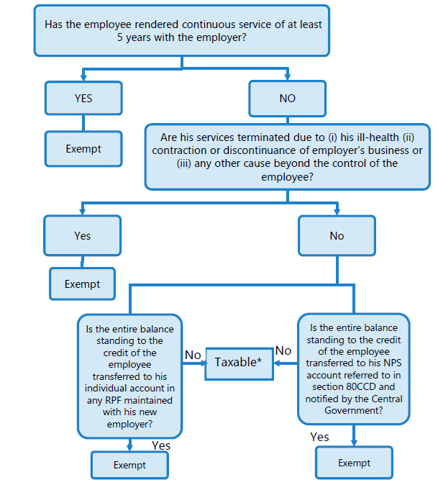
Exemption of Accumulated balance of RPF, payable to an employee

Slide 62
VOLUNTARY RETIREMENT RECEIPTS [SECTION 10(10C)]
The employees of notified Eligible undertakings are eligible for exemption under this clause
Limit: The amount of Exemption should be the least of the following:
Compensation actually received
Statutory limit of Rs.5,00,000
3 months’ salary × completed years of service
Last drawn salary × remaining months of service left
Conditions: Employee who has completed 10 years of service or completed 40 years of age.
Note:
1. Salary = Basic Salary + DA(if)+ Commission as a fixed % of turnover
2. Exemption under section 10(10C) would be available to an assessee irrespective of the
regime under which he pays tax.

Slide 63
RETRENCHMENT COMPENSATION
(a) 15 days average pay x completed years of service and part thereof in
excess of 6 months
(or)
(b) An amount, not less than Rs. 5,00,000 as may be notified by the Central
Government in this behalf,
whichever is lower is Exempt
Note:
(1) Average pay means average of the wages payable to a workman
- in the case of monthly paid workman, in the three complete calendar months,
- in the case of weekly paid workman, in the four calendar weeks,
- in the case of daily paid workman, in the twelve full working weeks,
(2) Exemption under section 10(10B) would be available to an assessee irrespective of the regime under which he pays tax.

Slide 64
PERQUISITES
Types of Perquisites
Perquisites taxable in the
case of all employees
Tax free perquisites in
case of all employees
Perquisites taxable only in
the hands of specified
employees

Slide 65
TAXABLE PERQUISITES
Rent Free Accommodation
Exception: Rent-free official residence provided to a Judge of a High Court or to a Judge of the Supreme Court is not taxable if they exercise the option of shifting out of the
default tax regime provided under section 115BAC(1A).
Concession in rent
Payment by the employer in respect of an obligation of employee
Amount payable by an employer directly or indirectly to effect an assurance on the life of the assessee
Specified security or sweat equity shares allotted or transferred, by the employer
The amount or aggregate of amounts of any contribution made
- in a recognised provident fund
- in NPS referred to in section 80CCD(1)
- in an approved superannuation fund
by the employer to the account of the assessee, to the extent it exceeds
Rs. 7,50,000
Any other fringe benefit or amenity - Interest free or concessional loan, Travelling,
touring and accommodation, Free or concessional food and non-alcoholic beverages, Gift, voucher or token in lieu of such gift, Credit card expense, Club expenditure,
Use of movable assets, Transfer of movable assets

Slide 66
TAX FREE PERQUISITES
Telephone
Transport Facility provided by an employer engaged in the business of carrying of
passengers or goods to his employees either free of charge or at concessional rate
Privilege passes and privilege ticket
Perquisites allowed outside India by the Government
Employer’s contribution to staff group insurance scheme
Annual premium by employer on personal accident policy
Refreshment
Subsidized lunch provided to an employee during working hours at office or business premises provided the value of such meal is upto Rs.50 (Only available if shifting out
of default tax regime provided under section 115BAC(1A)
Recreational facilities, including club facilities, extended to employees in general i.e.,
not restricted to a few select employees

Slide 67
TAX FREE PERQUISITES
Amount spent on training of employees
Leave travel concession if the assessee exercises the option of shifting out of the
default tax regime provided under section 115BAC(1A)
Note: Value of Leave travel concession provided to the High Court judge or the Supreme
Court Judge and members of his family are completely exempt without any conditions if
they exercise the option of shifting out of the default tax regime provided under section
115BAC(1A).
Medical facilities
Rent-free official residence provided to a Judge of a High Court or the Supreme Court
if they exercise the option of shifting out of the default tax regime provided under
section 115BAC(1A)
Conveyance facility provided to High Court & Supreme Court Judges if they exercise
the option of shifting out of the default tax regime provided under section 115BAC(1A).

Slide 68
TAXABLE PERQUISITES FOR SPECIFIED PERSONS
The value of any benefit or amenity granted or provided free of cost or at concessional rate
which have not been included in (A) & (B) above will be taxable in the hands of specified
employees. Followings are the example of such services:
(i) Provision of sweeper, gardener, watchman or personal attendant
(ii) Facility of use of gas, electricity or water supplied by employer
(iii) Free or concessional tickets
(iv) Use of motor car
(v) Free or concessional educational facilities
Meaning of specified employees:
Director employee
An employee who has substantial interest in the company : A person has a substantial
interest in a company if he is a beneficial owner of equity shares carrying 20% or more of the voting power in the company.
Employee drawing in excess of Rs.50,000 : The above salary is to be considered exclusive
of the value of all benefits or amenities not provided by way of monetary payments.

Slide 69
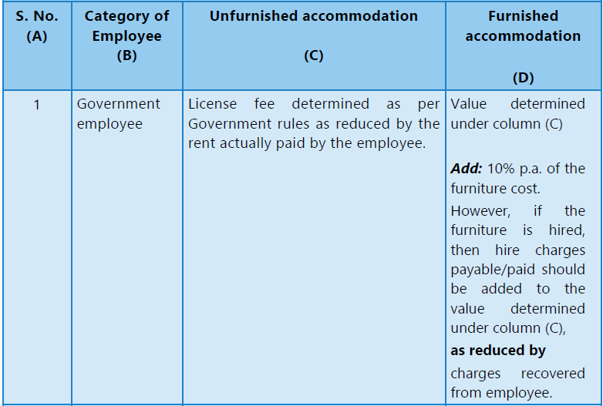
RENT-FREE RESIDENTIAL ACCOMMODATION/ ACCOMMODATION
PROVIDED TO AN EMPLOYEE AT CONCESSIONAL RATE

Slide 70
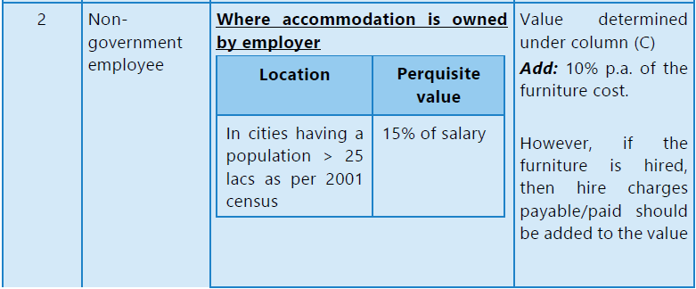
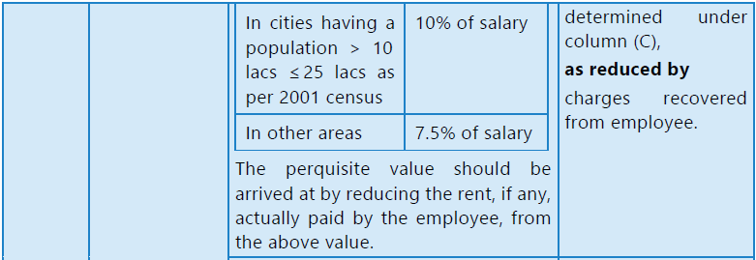

Slide 71
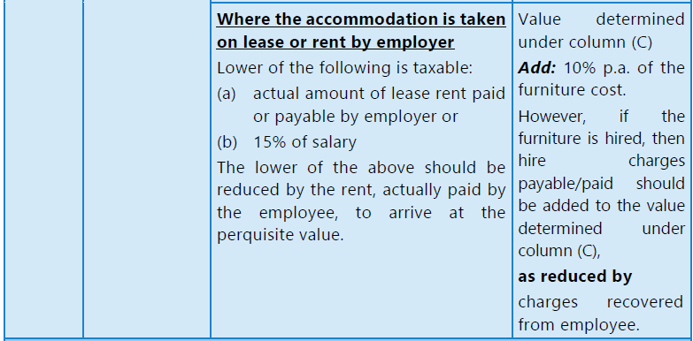
Exception: Rent-free official residence provided to a Judge of a High Court or to a Judge of the Supreme Court is not taxable if they exercise the option of shifting out of the default tax regime provided under section 115BAC(1A).

Slide 72
Note: Salary means All pay, allowance, bonus or commission or any monetary payment by
whatever name called but excludes:
Dearness allowance not forming part of computation of superannuation or retirement
benefit
employer’s contribution to the provident fund account of the employee;
allowances which are exempted from the payment of tax;
value of the perquisites specified in section 17(2);
any payment or expenditure specifically excluded under the proviso to section 17(2)
i.e., payment of medical insurance premium specified therein.
lump-sum payments received at the time of termination of service or superannuation or voluntary retirement, like gratuity, leave encashment, voluntary retirement benefits,
commutation of pension and similar payments.

Slide 73
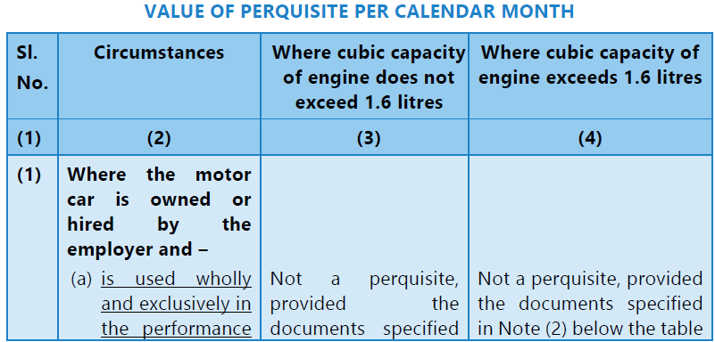

PERQUISITE ON MOTOR CAR

Slide 74
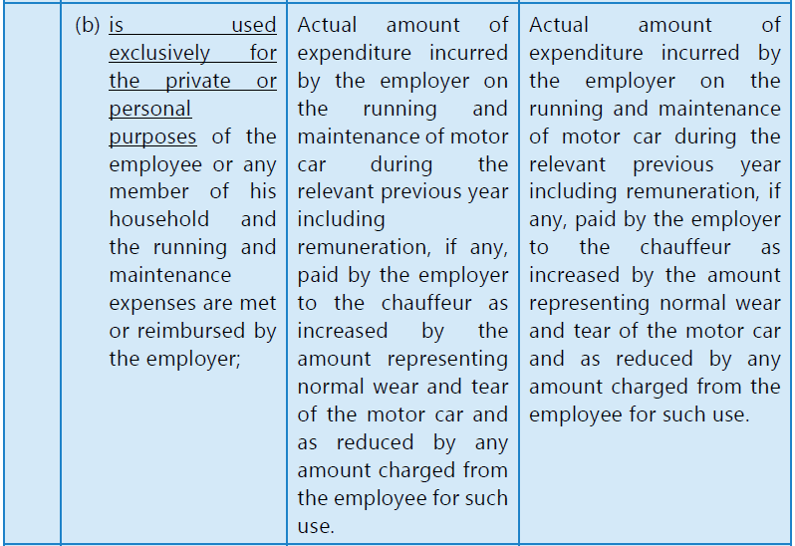

Slide 75
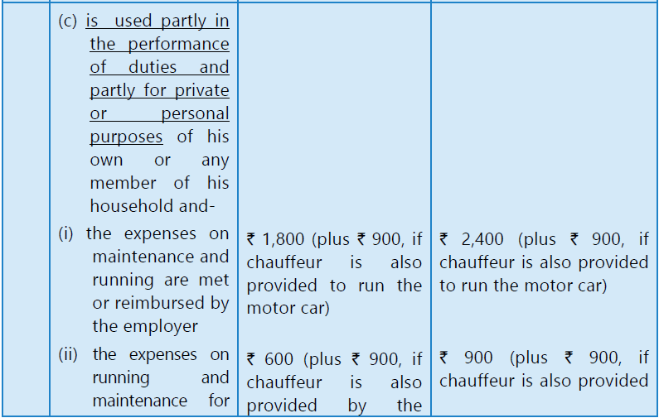


Slide 76
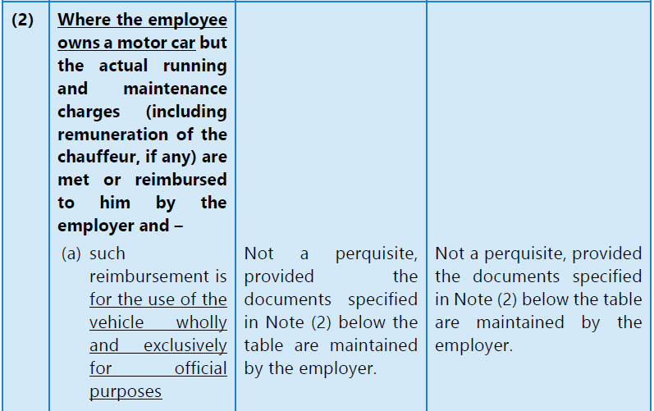

Slide 77
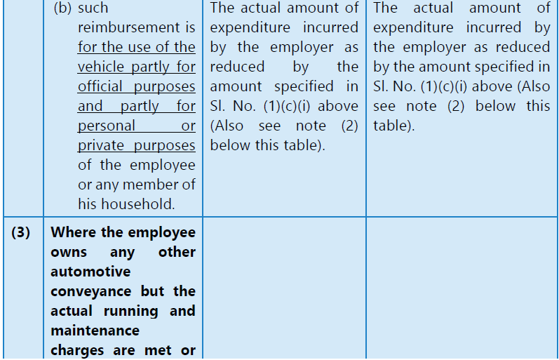

Slide 78
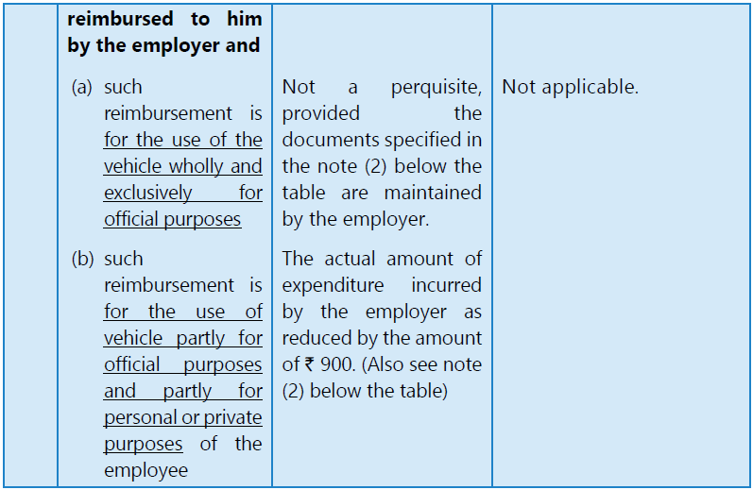
Notes:
Where more than one motor car is provided – The value of perquisite shall be
the amount calculated in respect of one car as if the it is partly for official and
partly for personal use & in respect of the other car or cars as if it is exclusively
for his private or personal purposes.

Slide 79
Valuation of specified security or sweat equity share for the
purpose of
section 17(2)(vi) [Sub-rule (8)]
FMV of the Sweat Equity Shares shall be determined in following manner:
If shares are listed on recognized stock exchange - average of the opening price and
closing price of the share on that date on the said stock exchange.
(2) If shares are not listed on recognized stock exchange - the fair market value shall be
such value of the share in the company as determined by a merchant banker on the
specified date.
“specified date” means,—
the date of exercising of the option; or
any date earlier than the date of the exercising of the option, not being a date which
is more than 180 days earlier than the date of the exercising.
Note: Where any amount has been recovered from the employee, the same shall be
deducted to arrive at the value of perquisites.

Slide 80
Interest-free or concessional loan [Sub-rule 7(i) of Rule 3]
The value of the benefit to the assessee resulting from the provision of interest-free or concessional loan for any purpose made available to
• the employee or
• any member of his household
during the relevant previous year by the employer or any person on his behalf shall be
determined as the sum equal to the interest computed at the rate charged per annum by
the State Bank of India, as on the 1st day of the relevant previous year in respect of loans for the same purpose advanced by it on the maximum outstanding monthly balance as reduced by the interest, if any, actually paid by him or any such member of his household.
(b) However, no value would be charged if such loans are made available for medical treatment in respect of prescribed diseases (like cancer, tuberculosis, etc.) or where the
amount of loans are not exceeding in the aggregate Rs.20,000. (exemption would not apply if the loan as has been reimbursed to the employee under any medical insurance scheme).

Slide 81
DEDUCTION FROM SALARY
Standard Deduction : A deduction of fifty thousand rupees or the amount of the salary, whichever is less
Entertainment Allowance : Deduction in respect of Entertainment Allowance specifically granted by an employer to the assessee who is in receipt of a salary from the Government. Deduction is sum equal to one-fifth of his salary or Rs.5,000 whichever is less
Professional Tax : Deduction for Professional Tax based on payment. Any state government is not eligible to levy more than Rs. 2,500 annually as professional tax. If an employer pays the professional tax on behalf of an employee, then it is included in the employee's salary under 'perquisite, and after that, deducted from Salary

Slide 82
ARREARS OF SALARY
Higher taxable income due to salary in arrears, advance salary, or salary for more than twelve months in one financial year.
Relief under Section 89 of the Income Tax Act, 1961.
Computation as per Rule 21A by comparing tax payable with and without the arrears/advance salary.
Form 10E must be filed to claim relief.
Ensures fair taxation and prevents undue hardship from lump-sum salary payments.

Slide 83
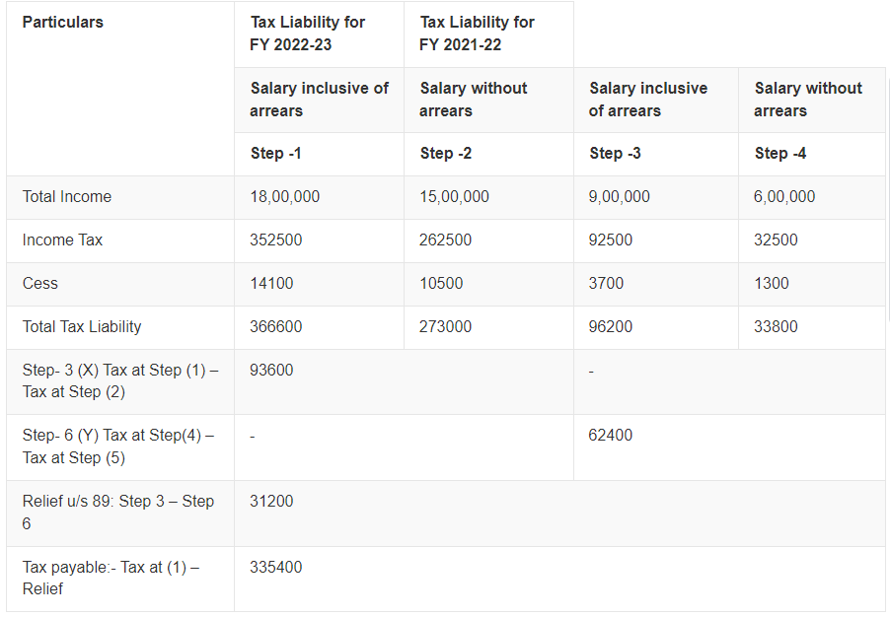
FY 2023-24
FY 2023-24
FY 2022-23
FY 2022-23
5
3
4
5

Slide 84
AMENDMENTS – FY 2023-24
LTA encashment limit raised from Rs. 3 lakhs to Rs. 25 lakhs: The leave encashment for non-government employees is exempt up to a certain limit. This LTA encashment limit was Rs. 3 lakh for two decades (since 2002). It has now increased to Rs. 25 lakhs w.e.f. FY 2023-24.
New Tax Regime to be the default regime: Starting 1st April 2023, the new income tax regime will become the default tax regime. However, taxpayers will still have the option to go for the old regime, but to do so, you will have to file your ITR on or before the due date.
Reduced Surcharge for HNIs under New Tax Regime: Under the New Tax Regime, the highest surcharge of 37% will be lowered to 25% for those earning more than Rs. 5 crores. This also brings down the highest effective tax rate from 42.74% to 39%.
Standard deduction benefit extended to the New Tax Regime: The standard deduction of Rs. 50,000 on salary income was earlier not allowed in the New Tax Regime until FY 2022-23 (AY 2023-24). However, from FY 2023-24 (AY 2024-25) this benefit of a standard deduction will now be allowed for salaried employees and pensioners opting under the New Tax Regime as well.
The government has increased the tax rebate limit u/s 87A from Rs. 5 lakhs to Rs. 7 lakhs under the New Tax Regime.
Marginal tax relief introduced for small taxpayers under New Tax regime. Hence, individual taxpayers with income of Rs. 7,27,777 would be benefited by this relief

Slide 85
THANK YOU

Slide 86


Profits and Gains of Business or Profession
- REFRESHER SESSION -
CA Hari K Narayanan (B.Com, ACA)
Mahadevan & Hari Chartered Accountants
Thrissur

Slide 87
Key Highlights
1
Simplified Tax Slabs
2
Enhanced Reporting system
3
Digital Transformation
The income tax slabs have been revised, making the process more straightforward for taxpayers.
With improvement in IT infrastructure, reporting system has improved
The tax filing process has been further digitized, offering more convenience and efficiency.

Slide 88
Important Dates
Return Filing Deadline (Non- Audit cases)
Belated Return Filing
July 31st, 2024
December 31st, 2024
1
2
3
Audit cases
31st October 2024

Slide 89

How many Tax Returns are filed as on date ?
Any Guess ?

Slide 90
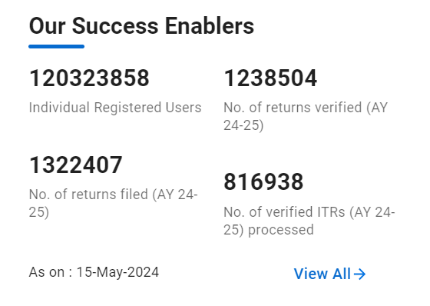

Slide 91
Who should file Income Tax Return ?
Lets start with the Basic Question

Slide 92
Who should file Income Tax Return ?
All Companies
All firms
A person other than a company or a firm, if his total income exceeded Basic Exemption limit

Slide 93
Basic Exemption Limit (Individual / HUF /AOP/BOI/ AJP)
Opted for New Default Scheme
Opted out of New Default Scheme
Rs. 3,00,000
Rs. 2,50,000

Slide 94
Lets demystify some facts
Total Income should be Total Income without giving effect to the provisions of 10(38), 10A, 10B, 10BA, 54, 54B, 54D, 54EC, 54F, 54G, 54GA, 54GB or Chapter VI-A

Slide 95

Example
Gross Total Income : Rs. 3,10,000
Less:- Chapter VI-A Deductions : (Rs. 75,000)
Total Income : Rs. 2,35,000
Whether Income Tax Return to be filed ?

Slide 96



Situations : IT filing Mandatory
Deposited an amount exceeding Rs. 1 Crores in one or more current accounts maintained with a Banking Company or a Co-operative Bank
Incurred an amount exceeding Rs. 1 Lakhs towards consumption of electricity
Incurred expenditure exceeding Rs. 2 Lakhs for travel to a foreign country for himself or any other persons

Slide 97


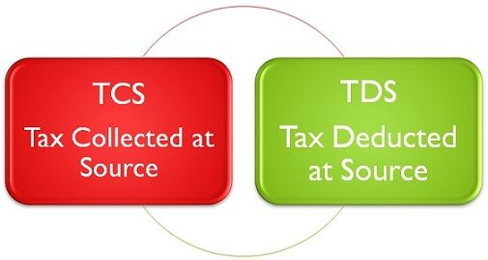

Situations : IT filing Mandatory
Total Sales, Turnover or Gross Receipts in Business exceed Rs. 60 Lakhs
Gross Receipts from Profession exceed Rs. 10 Lakhs
Aggregate of TDS & TCS during FY exceed Rs. 25,000 or more. In case of Senior Citizens, the limit will be Rs. 50,000
Deposit in one more Savings Bank Account, in aggregate, is Rs. 50 Lakhs or more

Slide 98
Lets refresh Basics of PGBP

Slide 99
COMPUTATION OF PGBP INCOME
PGBP
Chargeability (28 &41 )
Deductions (30 to 37)
Inadmissible Deductions (40)
Exp. Deductible in certain circumstances (40A)
Other provisions

Slide 100
Business
Section 2(13)
Include any trade, commerce or manufacture or any adventure or concern in the nature of trade, commerce or manufacture
Profession
Word “Profession” not defined in the Act
Section 2(36)
Profession includes vocation

Slide 101
Business - Defined
  The word `business' is one of wide import and it means activity carried on continuously and systematically by a person by the application of his labour or skill with a view to earning an income. The expression "business" does not necessarily mean trade or manufacture only – Barendra Prasad Ray v ITO [1981] 129 ITR 295 (SC).

Slide 102
Incomes chargeable under Section 28
  Profits and Gains from Business or profession
  Income derived from carrying on any trade, commerce, manufacturing activity, or profession. This includes the main source of earnings for businesses and professionals
  Compensation for Loss of Profit:
  Amount received as compensation for the loss of profit due to the termination or modification of a business contract. This includes compensation for breach of contract or damages received.
  Export Incentives
  Benefits received from the government to encourage exports, such as Duty Drawback, Duty Entitlement Passbook (DEPB), and other similar schemes. These incentives are considered as business income

Slide 103
Incomes chargeable under Section 28
  Income from Speculative Business
  Profits from transactions considered speculative in nature, such as trading in stocks or commodities where the contracts are settled otherwise than by actual delivery
  Profit on Sale of a License
  Income derived from selling a license granted under the Import (Control) Order, 1955 made under the Imports and Exports (Control) Act, 1947.
  Cash Assistance (Subsidy) Received or Receivable
  Cash assistance received or receivable against any scheme of the Government of India to support business operations, including subsidies

Slide 104
Incomes chargeable under Section 28
  Duty of Customs or Excise Repayable as Drawback
  Duty of customs or excise repaid to the taxpayer as a drawback when goods are exported or deemed to be exported
  Income Derived by a Trade, Professional, or Similar Association
  Income received by associations from specific services rendered to its members. This is considered as business income
  Profit on Sale of Goodwill
  Income earned from selling the goodwill of a business. Goodwill refers to the reputation and customer loyalty of a business, which has a monetary value

Slide 105
Incomes chargeable under Section 28
  Value of Any Benefit or Perquisite Arising from Business or Profession
  The value of any benefit or perquisite arising from business or the exercise of any profession, whether -
  - convertible into money or not
  - in cash or in kind or partly in cash and partly in kind
  TDS u/s 194R – Cross check with AIS, TIS, and 26AS
  FMV of Inventory on its conversion as Capital Asset
  The fair market value of inventory as on the date on which it is converted into, or treated as, a capital asset determined in the prescribed manner

Slide 106
How to Compute PGBP Income (Sec 29)
PGBP Income to be computed in accordance with the provisions contained in Sec. 30 to 43D
Admissible Deductions
(Section 30 to 37)
Inadmissible Deductions
(Section 40)
Expenses or payments not deductible in certain circumstances (Section 40A)
Profits chargeable to Tax (Section 41)
Other Provisions

Slide 107
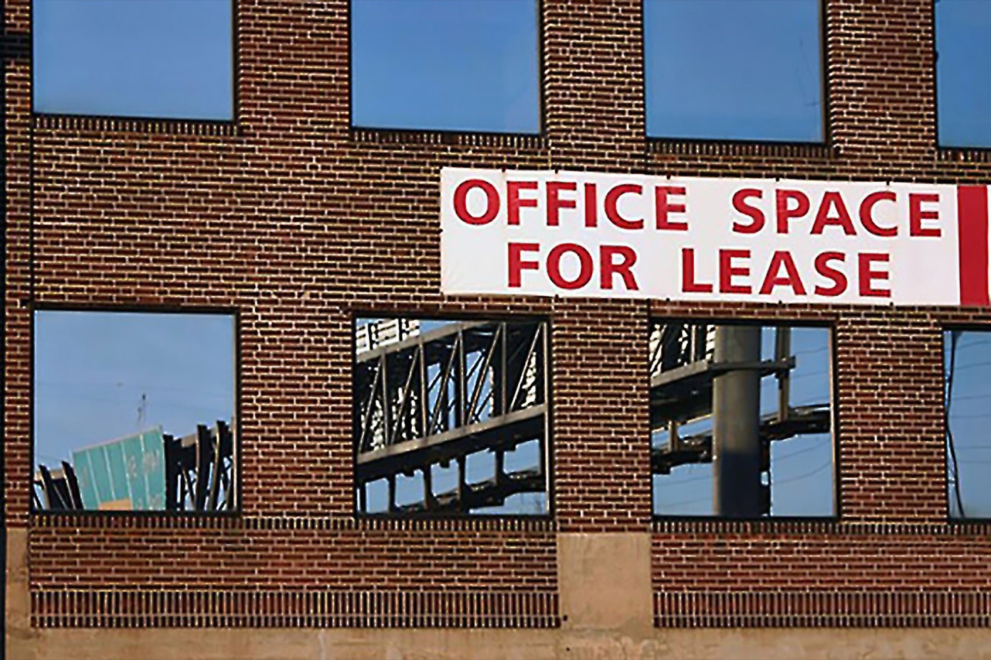

Section 30 & 31
Section 30
Section 31
Rent, Repair, Taxes and Insurance for Buildings
Repair and Insurance of Machinery, Plant & Furniture
Notional rent not allowed for owned property
Repair & Insurance of Machinery, Plant & Furniture used in the Business. Use includes Passive use also

Slide 108

Section 32 : Depreciation
Assets should be actually used by the assessee for the purpose of his Business or Profession during the Previous Year
Assessee must be the owner, wholly or partly

Slide 109
Section 33AB, Section 33ABA, Section 35
Section 33AB
Business : Growing & Manufacturing of Tea/Coffee/Rubber
Deduction for deposit made in Special Account with NABARD / Scheduled Bank (Deduction : Lower of Deposit amount and 40% of PGBP Income)
Section 35
Deduction for Scientific Exp.
Deduction can be claimed by a company engaged in bio technology business or specified articles / Incurred by assessee on scientific research related to business / Approved Institutions
Section 33ABA
Business : Prospecting for or extraction or production – Petroleum & Natural Gas (Entered Agreement with CG)
Deduction : Amount deposited with SBI or 20% of Profits which is lower
Section 35AD
Specified Business – Tax Incentive
100% of Capital Expenditure would be allowed as deduction

Slide 110
Section 35CCA, 35CCC, 35CCD
Section 35CCA
Contribution for Rural Development
Deduction for contribution to Notified Rural Development Fund/Notified Urban Poverty Eradication Fund
Section 35 CCC
Deduction for exp. on notified Agriculture Extension project
Deduction for sum equal to expenditure incurred by assessee on agriculture extension project in accordance with guidelines
Section 35CCD
Deduction for exp. On notified skill development projects by companies
Deduction : for expenditure on notified skill development projects

Slide 111
Section 35D, 35DD, 35DDA, 35E : Amortisation
Section 35D
Preliminary Expenses
Deduction for amortisation of preliminary expenses (To be amortised over a period of 5 years)
Section 35 DD
Amortisation of expenses – Amalgamation/Demerger
Deduction equal to 1/5th of such expenditure for 5 successive periods starting from the PY in which amalgamation or demerger took place
Section 35DDA
Exp. Incurred under VRS of employees
Deduction : 1/5th of amount paid and balance in 4 equal instalments
Section 35E
Amortisation of expenses for prospecting and development of certain minerals
1/10th of Qualifying Expenditure

Slide 112
Preliminary Expenses Deduction – Form 3AF
Section 35D(2)(a) r.w Rule 6ABBB
Form No. 3AF to be filed for claiming deduction for preliminary expenses
Preliminary expenses in connection with preparation of feasibility report, project report, conducting market survey or other survey necessary for business of taxpayer, engineering services relating to business of taxpayer. (Only applicable for expenses covered u/s 35D(2)(a)
Form 3AF to be filed one month prior to due date u/s 139(1)

Slide 113
Section 36 – Other Deductions
Section 36 provides deductions for various expenses like Insurance Premium, Bonus and Commission, Interest on Borrowed Capital, Discount on Zero Coupon Bonds, Bad debts etc.
As per Section 2(24)(x), Income includes “any sum received by the assessee from his employees as contributions to any provident fund or superannuation fund or any fund set up under the provisions of the Employees' State Insurance Act, 1948 (34 of 1948), or any other fund for the welfare of such employees”
As per Section 36(1)(va), amount received by assessee employer as contribution from his employees towards their welfare fund to be allowed only if such amount is credited on before the due date of the relevant Act

Slide 114
Section 37 – Residuary Expenses
Section 37 provides deductions for residuary expenses
  Expenditure not of the nature described in Section 30 to 36
  Incurred by assessee in the accounting year
  Incurred wholly and exclusively for the purpose of Business
  In respect of business carried on by assessee – profits of which are being computed
  Incurred after business set up
  Not personal expenses
  It should not be capital nature
  Not prohibited by law

Slide 115
Section 40 – Inadmissible Deductions
Sec 40(a)(i)- Payments/ Credits made to Non- Resident, not being a Company or to a foreign Company
If there is default in the TDS deduction or payment by the payer in respect of the payment/ credit of interest, Royalty, Fee for technical Services or any other sum chargeable under this Act (Other than Salary) to non-Resident, not being a Company or to a foreign Company, then 100% of such expenditure is disallowed in the hands of the payer.

Slide 116
Section 40 – Inadmissible Deductions
Sec 40(a)(ia)- Payments/Credits made to Resident
If there is default in the TDS deduction or payment by the payer in respect of the payment/ credit on which tax is deductible at source under Chapter XVII-B to Resident, then 30% of such expenditure is disallowed in the hands of the payer.
Is Sec 40(a)(ia) attracted when the amount is not payable but has been actually paid..??
Yes – Disallowance u/s 40(a) (ia) is attracted also in respect of amount paid (Palam Gas Services vs CIT (SC) )

Slide 117
Section 40 – Inadmissible Deductions
Whether disallowance U/s 40(a)(i) and (ia) can be avoided ??
Yes, disallowance U/s 40(a)(i) and (ia) can be avoided if all the below mentioned conditions are satisfied cumulatively:
The Payee has
• Furnished his Return of Income U/s 139(1)
• Taken such amount in his total income
• Paid tax on such amount
• Payer furnishes a certificate of a Chartered Accountant in Form 26A stating that the payee has fulfilled the above mentioned conditions.

Slide 118
Section 40 – Inadmissible Deductions
Sec 40(a)(ib)- Equalisation Levy
  Any amount paid or payable to Non- Resident on which Equalisation Levy is deductible is not deducted or has been deducted but not remitted to on or before filing Return of Income U/s 139(1)
  100% of such expense shall be disallowed

Slide 119
Section 40 – Inadmissible Deductions
Sec 40(a)(ii)/(iia)- Disallowance of Income Tax, Wealth Tax, etc
  Payment of Income tax like TDS, Self Assessment Tax and Wealth tax is not allowed as deduction while computing Profits and Gains from Business or Profession.
  Income tax also includes interest on delayed payment of Income Tax, interest paid on delayed filing of Income Tax and TDS Returns, tax paid in any other country for which relief is available U/s 90, 90A and 91.

Slide 120
Section 40 – Inadmissible Deductions
Sec 40(a)(iib)- Payment made to State Government by State Govt. Undertaking
Payer
State Govt. Undertaking
Payee
State Government
Nature of payment
Royalty, License fee, Service fee, Privilege Fee, Service Charge or any other fee or charge
% of Disallowance
100%

Slide 121
Section 40 – Inadmissible Deductions
Sec 40(a)(iii)- Payment of Salaries
Any Salary payable
  Outside India or
  To a Non- Resident in India shall be disallowed, if tax has not been deducted or paid on or before the due date prescribed for such deductions
Period | Timeline
For the period from April to Feb | On or before 7th of subsequent month. For Ex: TDS for the month of April 2024 should be remitted on or before 7th of May 2024
March | On or before 30th April

Slide 122
Section 40 – Inadmissible Deductions
Sec 40(a)(iii)- Payment of Salaries
Whether TDS on Salary to Non-Resident should be deducted as per Sec 195 or Sec 192..??
  Sec 195 specifically excludes Salary. Therefore, TDS on payment of Salary to Non- Resident should be deducted as per Sec 192
Mr A (Non-Resident) was employed by XYZ Ltd. XYZ Ltd was liable to deduct TDS on Salary paid of Rs.2,00,000-00 to Mr A for the month of June 2022. XYZ Ltd remitted TDS to government on 8th July 2022. Whether such expense is disallowed to XYZ Ltd..??

Slide 123
Section 40 – Inadmissible Deductions
Practical Issues
Transaction in which TDS deductible u/s 194Q – not deducted : Disallowance u/s 40(a)(ia)
Reporting in 3CD of TDS Compliances and TDS Notices

Slide 124
Section 40A – Expenses or payments not deductible in certain circumstances (Section 40A)
40A(2)
Excessive payment to Specified person
40A(3)
Payment in excess of Rs. 10,000 made otherwise than through prescribed modes
40A(7)
Disallowance for
Provision for Gratuity
40A(9)
Contribution by Employer to funds, Trusts etc.
40A(13)
Marked to market losses except allowable u/s 36

Slide 125
Section 43B – Certain deduction on payments
Section 43B mandates that certain expenses can only be claimed as a deduction in the year they are actually paid, regardless of the accounting method followed.
Specified expenses include
  Taxes, duties, cess, fees,
  Employer contributions to provident fund or superannuation fund gratuity fund
  Bonus or commission to employees,
  Interest on loans from banks and financial institutions,
  Leave salary,
  Amount payable for use of Railway assets
  Amount payable to Micro and Small enterprises beyond the specified period under Section 15 of MSME Act, 2006

Slide 126
Section 43B – Certain deduction on payments
To claim these deductions, payments must be made by the due date for filing the income tax return for the relevant assessment year.
An important proviso to Section 43B allows deductions if the specified payments are made by the due date for filing the return of income.
Judicial decisions, such as CIT vs. Vinay Cement Ltd. and Allied Motors (P) Ltd. vs. CIT, have reinforced that timely payments before the return filing due date qualify for deductions

Slide 127
Lets dive into Income Tax Returns

Slide 128
INCOME TAX RETURNS - INTRO
ITR 2
ITR 4
ITR 6
1
2
3
4
5
6
7
ITR 1
ITR 3
ITR 5
ITR 7

Slide 129
ITR 4 - APPLICABILITY
Resident Individual /HUF/Partnership Firm whose Total Income for AY 2024-25 includes
1
Business Income u/s 44AD/44AE/ Income from Profession u/s 44ADA
2
Salary / Pension income
3
Income from One House Property (excluding the brought forward losses or losses to be carried forward cases under this head)
4
Income from other sources (excluding winning from lottery and income from horse races)

Slide 130
Who can not file ITR 4 ?
ITR 4 can not be filed by the following Individuals / Partnership firms
Having total income from Salary, House Property, Other Sources above Rs. 50 Lakhs
Having Income from Capital Gain
An Individual who is either Director in a Company or has invested in Unlisted Equity Shares
Whose books of accounts are required to be audited under the Income Tax Act
Non- Residents

Slide 131
PRESUMPTIVE TAXATION
Section 44AD
1
Notwithstanding anything to the contrary contained in Section 28 to 43C
2
Eligible Assessee & Eligible Business
3
Sum equal to 8% of Total Turnover or Gross Receipts or such higher amount shall be deemed to be Income from PGBP
4
6% applicable in case of Banking channel transactions ( if received by due date specified u/s 139(1) )

Slide 132
Notwithstanding anything to contrary contained in Sec 28 to 43C
1
Over riding effect over Section 28 to 43C
2
Any deduction allowable u/s 30 to 38 shall be deemed to be allowed
3
WDV of any asset of shall be deemed to have been calculated as if depreciation is actually allowed
4
Not Applicable for Professions mentioned in Sec. 44AA(1), Commission or Brokerage, Agency Business

Slide 133
Eligible Assessee
1
Individual/ HUF/ Partnership Firm (not LLP)
2
Resident
3
Deduction not claimed under 10A/10AA/10B/10BA or under Chapter VI A under the heading C
4
LLP not Eligible Assessee

Slide 134
Eligible Business
1
Business except the business of plying, hiring or leasing goods carriages
2
Turnover or Gross Receipts doesn’t exceed Rs. 2 Crores
3
If aggregate amount received in Cash during the year doesn’t exceed 5% of Total Turnover or Gross Receipts, then Rs. 3 Crores will be the limit
4
Receipts in Bank by a Cheque/Draft which is not A/c payee, shall be treated as Cash Receipt

Slide 135
PRESUMPTIVE TAXATION
Section 44ADA
1
Notwithstanding anything to the contrary contained in Section 28 to 43C
2
Resident Individual/Firm (excluding LLP)
3
Profession notified u/s 44AA(1)
4
Gross Receipts doesn’t exceed Rs. 50 Lakhs (in case aggregate cash receipts during the FY doesn’t exceed 5% of Gross Receipts, then Rs. 75 Lakhs)

Slide 136
PRESUMPTIVE TAXATION
Section 44ADA
5
50% of Gross Receipts shall be deemed to income under the head PGBP
6
WDV of any asset of shall be deemed to have been calculated as if depreciation is actually allowed
7
If declaring profit below 50%, Tax Audit u/s 44AB applicable
8
Any deduction allowable u/s 30 to 38 shall be deemed to be allowed

Slide 137
Professions notified u/s 44AA (1)
Legal
Medical
Engineering
Architecture
Accountancy
Technical Consultancy
Interior Decoration
Authorised Representative
Company Secretary
IT Professionals
Film Artist
  Actor
  Cameraman
  Director
  Music Director
  Art Director
  Dance Director
  Editor
  Singer
  Lyricist
  Story Writer
  Screenplay writer

Slide 138
PRESUMPTIVE TAXATION
Section 44AE
1
Notwithstanding anything to the contrary contained in Section 28 to 43C
2
Assessee who owns not more than 10 goods carriage at any time during PY and engaged in business of plying, hiring, or leasing goods carriages
3
In case of heavy goods vehicle – Rs. 1000 per ton of gross vehicle weight per month or part of month or amount actually claimed to have been earned (whichever is higher) - Heavy Goods Carriage : More than 12,000 kg
4
Other than heavy goods vehicle : Rs. 7500 per month or part of month or amount actually claimed to have been earned (whichever is higher)

Slide 139
PRESUMPTIVE TAXATION
Section 44AE
5
Any deduction allowable u/s 30 to 38 shall be deemed to be allowed
6
In case of firm, salary & interest paid to partners shall be deducted (subject to 40(b)
7
WDV of any asset of shall be deemed to have been calculated as if depreciation is actually allowed
8
If declaring profit below 44AE, maintenance of books u/s 44AA and audit under u/s 44AB applicable

Slide 140
ITR – 4 STRUCTURE
PART-B
PART-D
Gross Total Income
Tax Computation & Tax status
1
2
3
4
PART-A
PART-C
General Information
Deductions &
Taxable Total Income

Slide 141
ITR – 4 STRUCTURE
Schedule IT
Details of Adv Tax &
Self Assessment Tax
Schedule TDS-1
Details of TDS from Salaries
1
2
3
4
5
Schedule BP
Schedule TCS
Schedule TDS-2
Details of Income
From PGBP
Details of TCS
Details of TDS (other than Salaries)

Slide 142
Changes in ITR 4 – New Fields added
Have you exercised the option u/s 115BAC(6) of Opting out of new tax regime? (default is “No”). Options available are No / Yes, within the due date/ Yes, but beyond the due date ( If option other than ‘No’ is selected, please furnish date of filing and Acknowledgement number of Form 10-IEA)
Note -For Opting out, option should be exercised on or before the due date for filing return u/s 139(1)
Clause No. A(23) of PART A

Slide 143
Changes in ITR 4 – New Fields added
Receipts in Cash Column added to claim enhanced Turnover limit.
FA 2023, enhanced turnover threshold limit from Rs. 2 Crores to Rs. 3 Crores for Presumptive Taxation if receipts in Cash limited to 5% of Gross Receipts (Sec. 44AD)
FA 2023, enhanced threshold limit of gross receipts from Rs. 50 Lakhs to Rs. 75 Lakhs if receipts in Cash limited to 5% of Gross Receipts (Sec. 44ADA)
Clause No. E1(b) of
Schedule BP
Clause No. E3(b) of
Schedule BP

Slide 144
Changes in ITR 4 – New Fields added
In ITR 4 Form, a new column is added “Type of Bank Account” & type of account should be selected from Drop-down
Also, selection of Bank Account for credit of Refund has been removed from the Utility from this AY
In case taxpayer is having multiple accounts, then refund will be credited to one of the pre-validated accounts available after processing the return
Type of Bank Account

Slide 145
Changes in ITR 4
Standard Deduction
Family Pension
Standard deduction for Salaries (Sec. 16(ia)) of Rs. 50,000 will be available in New Tax regime also
Deduction u/s 57(iia)against family pension will be given in New Tax regime also
.
Chapter VI A Deduction
Schedule 80GGC, 80U, 80DD : New schedules added to provide additional details

Slide 146
Filing of Form 10-IA
Applicability
When to file
Consequences
In case the taxpayer is claiming any deduction u/s 80DD or 80U
Before filing the IT Return
Non-availability of deduction
Section 80DD
Deduction in respect of maintenance including medical treatment of a dependant who is a person with disability . Normal deduction : Rs. 75,000 ; Severe Disability : Rs. 1,25,000. Dependent person can be spouse, children, parents, brothers and sisters of Resident Individual.
Section 80U
Deduction in case of a Resident Individual with disability. Normal deduction : Rs. 75,000 ; Severe Disability : Rs. 1,25,000 . (Disability : Autism, Cerebral palsy etc.)

Slide 147
STRUCTURE OF ITR 3
1
PART
2
SCHEDULE
Two Parts to ITR 3
PART A
PART B
Schedules are given to provide further details

Slide 148
ITR – 3 STRUCTURE – PART A
Nature of
Business & Profession
PART A -
Manufacturing Account
1
2
3
4
5
PART -A
PART A - BS
PART A
General
Balance Sheet
Particulars
Trading Account

Slide 149
ITR – 3 STRUCTURE – PART A
PART A - OI
Other Information
6
7
8
PART -A
PART A - QD
P&L
Quantitative Details

Slide 150
ITR – 3 STRUCTURE – PART B
PART B - TTI
Computation of Tax Liability on
Total Income
1
2
PART B - TI
Computation of
Total Income

Slide 151
PART A – GENERAL INFORMATION
Personal Information
1
.Personal Information like Name, Address, DOB, Aadhaar No., E-mail, Due date etc.
2
Filing Status
Return filing section, Residential Status, Shareholding in Unlisted equity shares etc.
Auditor Information
3
Details of Auditor, Date of Audit Report, Membership No. of Auditor etc.

Slide 152
Changes in ITR 3 – New Fields added
Clause No. A(19)(ai) of PART A
A new column has been inserted in ITR Forms seeking information on the deadline for submitting the income tax return. The taxpayer is required to select the applicable due date for filing the return from the provided dropdown options, namely, July 31st, October 31st or November 30th
Have you exercised the option u/s 115BAC(6) of Opting out of new tax regime? (default is “No”). Options available are No / Yes, within the due date/ Yes, but beyond the due date ( If option other than ‘No’ is selected, please furnish date of filing and Acknowledgement number of Form 10-IEA)
Note -For Opting out, option should be exercised on or before the due date for filing return u/s 139(1)
Clause No. A(19)(b) of PART A

Slide 153
Changes in ITR 3 – New Fields added
Clause No. A(19)(q) of PART A
Details of Legal Entity Identifier (LEI)
The Legal Entity Identifier (LEI) is a 20-character alpha-numeric code used to uniquely identify parties in financial transactions worldwide. It has been implemented to improve the quality and accuracy of financial data reporting systems for better risk management.
As per the RBI Regulations, all single payment transactions of INR 50 crores and above undertaken by entities (non-individuals) should include remitter and beneficiary LEI information.
In order to be in line with the RBI regulations, the new ITR Forms have incorporated a column for furnishing details of the LEI number. Such taxpayer is required to furnish the LEI details if he is seeking a refund of INR 50 crores or more

Slide 154
Changes in ITR 3 – New Fields added
Clause No. 8 & 9 in Audit Information under PART A
Furnishing Acknowledgement No. of Audit Report and UDIN
Information about audits conducted under Section 44AB, including audit under Section 92E, assessee are required to furnish the acknowledgment number of the audit report and the UDIN
Additional information pertains to the circumstances under which an assessee is obligated to undergo an audit, such as:
  Sales, turnover or gross receipts exceed the limits specified under Section 44AB;
  Assessee falling under Section 44AD/44ADA/44AE/44BB but not offering income on presumptive basis;
  Others
Clause No. (bi) , (bii) & (biii) Audit Information under PART A

Slide 155
Changes in ITR 3 – PART A – OI
New Fields added
Clause No. 11(h) of PART A of Other Information
Amount payable to Micro or Small enterprises beyond specified date
Finance Act 2023 has inserted a new clause (h) in Section 43B to provide that any sum payable to a micro or small enterprise beyond the time limit specified in Section 15 of the Micro, Small and Medium Enterprises Development Act 2006 (MSME Act) shall not be allowed as a deduction.
Accordingly, a new column is inserted under Part A-OI (Other Information) to disclose the sum payable to Micro or small enterprises beyond the specified time limit per the MSMED Act

Slide 156
Changes in ITR 3 – PART A – OI
New Fields added
Clause No. 11(h) of PART A of Other Information
Amount payable to Micro or Small enterprises beyond specified date
Time limit u/s 15 of Section 15 of the Micro, Small and Medium Enterprises Development Act 2006 (MSME Act)
  Note:- In case of reporting u/s 43B(h), cross check with Balance Sheet particulars about Micro or Small enterprises dues
In case of written agreement between buyer and seller of goods or provider of service | Payment should be made within maximum of 45 days or date as per agreement whichever is earlier
In case of no agreement | 15 days

Slide 157
SCHEDULES IN ITR - 3
Schedule | Name
Schedule S | Salaries | Details income received as salary, including allowances, perquisites, and other benefits.
Schedule HP | Income from House Property | Reports income from house property, calculating net income after deducting permissible expenses like property taxes and interest on home loans.
Schedule BP | Profit and Gains of Business or Profession | For reporting income from any business or profession, including presumptive income under sections 44AD, 44ADA, and 44AE.
Schedule DPM | Depreciation on Plant and Machinery | Calculates depreciation on plant and machinery under the Income-tax Act.
Schedule DOA | Depreciation on Other Assets | Depreciation calculation for assets other than plant and machinery, such as buildings, furniture, etc.
Schedule DEP | Summary of Depreciation on assets | Summary of Schedule DPM + DOA
Schedule DCG | Deemed Capital Gains on Sale of Depreciable Assets | Calculates capital gains arising from the sale of depreciable assets, where gains are deemed as short-term.
Schedule ESR | Deduction under Section 35 (Expenditure on Scientific Research) | Details deductions claimed for expenditure on scientific research related to the business.

Slide 158
SCHEDULES IN ITR - 3
Schedule | Name
Schedule CG | Capital Gains | Details capital gains (or losses) arising from the transfer of capital assets, categorized into short-term and long-term.
Schedule 112A | Sale of Equity share in a company or unit of equity oriented fund | Details of sale of equity share in a company or unit of equity oriented fund or unit of business trust on which STT is paid
Schedule 115AD(1)(b)(iii) Proviso | Sale of Equity share in a company or unit of equity oriented fund | Details of sale of Equity share in a company or unit of equity oriented fund
Schedule VDA | Income from transfer of Virtual Digital Assets | Schedule for income from Virtual Digital Assets
Schedule OS | Income from Other Sources | Reports income from other sources not covered under any other heads like dividends, interest, winnings from lotteries, etc.
Schedule CYLA | Set off of Current Year Losses | Provides details on how current year losses are set off against income from other heads.
Schedule BFLA | Details of Income after Set off of Brought Forward Losses from earlier years | Details how losses from previous years are adjusted against the current year's income.
Schedule CFL | Carry Forward of Losses | Lists losses to be carried forward to future years for set-off.
Schedule UD | Unabsorbed Depreciation | Details any depreciation not yet absorbed or utilized that can be carried forward.
Schedule ICDS | Effect of Income Computation Disclosure Standards on Profit | Shows the impact of mandated ICDS on the profits of the business.

Slide 159
SCHEDULES IN ITR - 3
Schedule | Name
Schedule 10AA | Deductions under Section 10AA | Details deductions claimed under Section 10AA for units in Special Economic Zones (SEZs).
Schedule 80G | Deductions under Section 80G | Details of donations eligible for deduction under this section, specifying various eligible entities.
Schedule 80GGA | Deductions under Section 80GGA for Donations | Details deductions for donations towards scientific research or rural development.
Schedule 80GGC | Deductions under Section 80GGC for Donations to Political Parties | Details deductions for donations made to political parties.
Schedule 80DD | Deduction for Medical Treatment | Offers deductions for medical treatment of specified diseases, for self or dependents.
Schedule 80U | Deduction in respect of Disability | Provides deductions for disabled individuals, based on the severity of the disability.
Schedule RA | Deduction under Section 35AD | Details deductions under Section 35AD for specified businesses like cold chain facilities, affordable housing projects, etc.
Schedule 80IA | Deductions under Section 80IA | Details deductions available for profits and gains from industrial infrastructure undertakings.

Slide 160
SCHEDULES IN ITR - 3
Schedule | Name
Schedule 80IB | Deductions under Section 80IB | Lists deductions for certain businesses such as industrial units in North-Eastern States, etc.
Schedule 80IC/80-IE | Deductions under Section 80IC/80-IE | Provides deductions for businesses in special category states under Sections 80IC and deductions for certain undertakings in North-Eastern states under 80-IE.
Schedule VIA | Chapter VI-A Deductions | Consolidates all deductions under Chapter VI-A, covering various sections from 80C to 80U.
Schedule AMT | Computation of Alternate Minimum Tax | Form 29C to be filed
Schedule AMTC | Computation tax credit u/s 115JD
Schedule SPI | Income of Specified Persons (minor, spouse, etc.) | Includes income of specified persons like a minor child, which is clubbable in the hands of the assessee.
Schedule SI | Income Chargeable to Tax at Special Rates | Details incomes that are taxable at special rates
Schedule IF | Information regarding partnership firms in which you are partner | Details to be provided

Slide 161
SCHEDULES IN ITR - 3
Schedule | Name
Schedule EI | Exempt Income | Reports income that is exempt from tax, such as agricultural income, interest from PPF, etc.
Schedule PTI | Pass Through Income | Reports income from business trusts or investment funds that are to be passed through to the investor.
Schedule TPSA | Details of tax on secondary adjustments | Details of tax on secondary adjustments
Schedule FSI | Income from Outside India | Details foreign income and the taxes paid on such income, which may qualify for relief or deduction in India.
Schedule TR | Tax Relief | Provides details of taxes paid in foreign countries, used to claim relief under section 90/90A/91.
Schedule FA | Details of Foreign Assets and Income from any source outside India | Details foreign assets held and income from any source outside India.
Schedule 5A | Information regarding apportionment of income between spouses | Information regarding apportionment of income between spouses as per Portuguese Civil Code
Schedule SH | Details of Shareholding in Unlisted Companies | Reports details of shares held in unlisted companies at any time during the previous year.

Slide 162
SCHEDULES IN ITR - 3
Schedule | Name
Schedule AL | Asset and Liability at the year-end if total income exceeds Rs. 50 Lakhs | Details assets and liabilities of the taxpayer
Schedule GST | Information regarding Turnover or Gross Receipt reported for GST | Turnover information to be filled GSTIN wise separately
Schedule T | Tax deferred on ESOP | Details tax deferred on ESOPs as per the special provisions related to certain employees.

Slide 163
Changes in ITR 3 – New Fields added
Information about deduction claimed against CG
(Schedule CG)
Schedule-CG has been modified to gather more information pertaining to sums deposited in the Capital Gains Accounts scheme (CGAS). The revised schedule now requires the inclusion of the following additional details towards CGAS:
  Date of deposit
  Account number
  IFS code

Slide 164
Changes in ITR 3 – New Fields added
Clause 10(2) in Schedule OS
  Disclosure of Winnings from online games chargeable u/s 115BBJ
  The Finance Act 2023 has inserted a new Section 115BBJ to tax winnings from online games, w.e.f. Assessment year 2024-25. A corresponding Section 194BA has also been inserted with effect from 01-04-2023 for the deduction of tax from the net winnings from online games. Thus, all winnings from online games on or after 1-4-2023 shall be taxable under Section 115BBJ and subject to TDS under Section 194BA
  To report such income in ITR form, Schedule OS has been amended to disclose income by way of winning from online games chargeable under Section 115BBJ.

Slide 165
Changes in ITR 3 – New Fields added
Clause 2d(ia) in Schedule OS
  Dividend from a unit in IFSC
Finance Act, 2023 has amended the provisions of Section 115A by inserting a proviso to Section 115A(1)(a)(A) to provide that the dividend income received from a unit in an IFSC, as referred to in Section 80LA(1A) shall be taxed at a reduced tax rate of 10% instead of 20%.
‘Schedule OS’ has been amended in new ITR forms to incorporate such change

Slide 166
Changes in ITR 3 – New Fields added
Schedule 80GGC
Schedule 80GGC seeks details of contributions made to political parties
Section 80GGC allows for a deduction for contributions to a political party or electoral trust. The new ITR forms include a new Schedule 80GGC, which requires the furnishing of the following details:
  Date of Contribution
  Contribution Amount (with a breakdown of contributions made in cash and other modes)
  Eligible Contribution Amount
  Transaction Reference Number for UPI transfer or Cheque Number/IMPS/NEFT/RTGS
  IFS Code of the Bank

Slide 167
Changes in ITR 3 – New Fields added
Schedule 80 U
Schedule 80U seeks details of deduction for person with disability
In the new ITR-3, a new ‘Schedule 80U’ has been added, seeking details of deduction in case of a person with a disability.
The ‘Schedule 80U’ seeks the following details:
Nature of disability
Date of filing Form 10-IA
Acknowledgment number of the Form 10-IA
UDID number (If available)

Slide 168
Changes in ITR 3 – New Fields added
Bank Account
Reporting of all banks held at any time
The ITR forms require information about the taxpayer’s bank accounts, including the selection of the specific account for receiving income tax refunds.
In the new ITR forms, it is obligatory for the taxpayer to disclose all the bank accounts they have ever held, with the exception of dormant accounts.

Slide 169
Changes in ITR 3 – New Fields added
Unabsorbed Depreciation
Adjustment of unabsorbed depreciation (pertaining to additional depreciation) from WDV of the block of assets as on 01-04-2023
Section 115BAC introduced by Finance Act 2020 offers lower tax rates for individuals and HUFs from AY 2021-22.
Finance Act 2023 extends this regime to AOP, BOI, and AJP, making it the default tax regime but requires forfeiting exemptions and deductions.
Assessees opting for Section 115BAC can't set off unabsorbed depreciation attributable to additional depreciation.
Rule amendments require adjustment of unabsorbed depreciation to the written down value of assets as of 01-04-2023, affecting Schedule DPM in new ITR Forms

Slide 170
Changes in ITR 3 – Technical
Rule 12 Amendment
Individuals/HUFs liable for audit can verify ITR using EVC
Rule 12 has been amended to allow individuals and HUF who are liable to tax audits under Section 44AB to verify the return of income through an electronic verification code. Earlier, they could verify the returns only through digital signature

Slide 171
ITR 5 - APPLICABILITY
What Rule 12 Says : “in the case of a person not being an individual or a Hindu undivided family or a company or a person to which clause (g) applies, be in Form No. ITR-5 and be verified in the manner indicated therein”
Clause (g) of Rule 12 talks about entities who are required to file ITR 7

Slide 172
ITR 5 – APPLICABILITY
Partnership Firm
Limited Liability Partnership
Local Authority
Cooperative Bank
Society
Rural Development Bank
Estate of deceased (AJP)

Slide 173
Changes in ITR 5
Due date
A new column has been inserted in ITR Forms seeking information on the deadline for submitting the income tax return. The taxpayer is required to select the applicable due date for filing the return from the provided dropdown options, namely, July 31st, October 31st or November 30th
Do you wish to exercise the option u/s 115BAC(6) of Opting out of new tax regime? (default is “No”)
New ITR Forms have incorporated a column for furnishing details of the LEI number. Such taxpayer is required to furnish the LEI details if he is seeking a refund of INR 50 crores or more.
New Scheme
Introduction of LEI Code

Slide 174
Changes in ITR 5
New ITR-3 seeks additional details from the assessee subject to audit under Section 44AB. The additional information pertains to the circumstances under which the company is obligated to undergo an audit, such as gross receipts exceed the limits specified under Section 44AB, Assessee falling under Section 44AD/44ADA/44AE/44BB but not offering income on presumptive basis
When providing information about audits conducted under Section 44AB, including audit under Section 92E, companies are required to furnish the acknowledgment number of the audit report and the UDIN.
CBDT has amended ITR forms to include a new column of “receipts in cash” for disclosing cash turnover or cash gross receipts under the Schedule BP.
Reason for Tax Audit
Audit
Receipt in Cash

Slide 175
Changes in ITR 5
New ITR-5 has a new Schedule seeking details with respect to the deductions claimed by organisations under Section 80-IAC. This includes the following: 1. Date of incorporation of the startup, 2. Nature of business, 3. Certificate number as obtained from Inter-Ministerial Board of Certification, 4. First AY in which deduction was claimed, 5. Amount of deduction claimed for current AY. In the previous ITR Forms, only the information about the amount eligible for deduction under Section 80-IAC was sought.
If an institution approved under Section 10(23C) or registered under Section 12AB, gets converted into a form that is not eligible for registration under Section 12AB or approval under Section 10(23C), it will be ineligible to file its income tax return in ITR-7. Therefore, a new Schedule 115TD has been inserted in the ITR form for the reporting of tax payable on accreted income. This schedule requires various details such as the computation of accreted income (FMV of total assets as reduced by the total liability), tax payable on accreted income and details of challans for deposit of tax on accreted income.
New Details of Startup
Schedule 115 TD

Slide 176
Changes in ITR 5
The new ITR forms include a new Schedule 80GGC, which requires the furnishing of the following details: 1. Date of Contribution, 2. Contribution Amount (with a breakdown of contributions made in cash and other modes), 3. Eligible Contribution Amount, 4. Transaction Reference Number for UPI transfer or Cheque Number/IMPS/NEFT/RTGS & 5. IFS Code of the Bank
In the new ITR Forms, Schedule DPM, which deals with depreciation on Plant and Machinery, has been amended. It provides that the WDV of the block as on 01-4-2023 shall be increased by the amount of unabsorbed depreciation (pertaining to additional depreciation), which was not allowed to be adjusted on account of opting for Section 115BAC.
Political Party Contribution
Unabsorbed Depreciation

Slide 177
Changes in ITR 5
The new ITR-5 mandates that an assessee should furnish information regarding its recognition status as a Micro, Small, and Medium Enterprise (MSME). It is also required to provide the registration number allotted as per the Micro, Small and Medium Enterprises Development Act, 2006.
A new tax scheme has been introduced by the Finance Act 2023 for the resident co-operative societies engaged in the manufacturing or production of an article or thing. If a co-operative society opts for this scheme, then income will be taxable at a concessional rate if certain conditions are fulfilled. In order to avail the benefit of Section 115BAE, the co-operative society is required to furnish Form No. 10-IFA on or before the due date specified under Section 139(1) in the first return of income for any previous year relevant to the assessment year commencing on or after 1st day of April 2024.To align the changes brought by the Finance Act of 2023, a new field has been inserted seeking details on whether the assessee is a manufacturing co-operative society opting for taxation under Section 115BAE. Further, date of filing Form 10-IFA and its acknowledgement number is required to be furnished.
MSME Details
Section 115BAE

Slide 178
ITR 6 - APPLICABILITY
For Companies other than claiming exemption u/s 11
1
Applicability
2
Filing Requirement
ITR-6 is exclusively for companies that do not claim exemption under Section 11.
Comprehensive disclosure of earnings, taxes, and liabilities, detailing the company's financial particulars
3
Digital Compliance
4
Annual updates
Electronic filing of return by authorised person
Form subject to frequent updates to comply with regulatory requirements

Slide 179
ITR 6 – DEEP DIVE
PARTS
1
PART A – 12 Sections
PART B – 2 Sections
2
SCHEDULES
46 SCHEDULES
VERIFICATION
3
.

Slide 180
PART A – DEEP DIVE
PART A
1
PART A
4
General
Info.
Manufacturing
Account
5
PART A
PART A
2
BS
Particulars
Trading
Account
PART A
3
PART A
6
BS
Ind AS
.
P&L Account

Slide 181
PART A – DEEP DIVE
PART A
7
PART A - OI
10
Manufacturing A/c
Ind AS
Other Info.
PART A
11
8
PART A - QD
Trading A/c
Ind AS
Quantitative
Details
PART A
9
PART A - OL
12
P&L Account
.
R&P A/c of Company
Under liquidation

Slide 182
PART A – General
Personal
Info.
1
Holding
Status
4
Filing
Status
Business
organisation
2
5
Key persons
Auditor
Info.
6
3
.

Slide 183
Shareholder
Info.
7
8
Ownership
Info.
Nature of Company
& Business
9
.

Slide 184
Changes in ITR 6 – PART A – Filing Status
Clause No. A(19)(ai) of PART A
A new column has been inserted in ITR Forms seeking information on the deadline for submitting the income tax return. The taxpayer is required to select the applicable due date for filing the return from the provided dropdown options, namely, October 31st or November 30th

Slide 185
Changes in ITR 6 – Part A – Filing Status New Fields added
Clause No. A(19)(r) of PART A
Details of Legal Entity Identifier (LEI)
The Legal Entity Identifier (LEI) is a 20-character alpha-numeric code used to uniquely identify parties in financial transactions worldwide. It has been implemented to improve the quality and accuracy of financial data reporting systems for better risk management.
As per the RBI Regulations, all single payment transactions of INR 50 crores and above undertaken by entities (non-individuals) should include remitter and beneficiary LEI information.
In order to be in line with the RBI regulations, the new ITR Forms have incorporated a column for furnishing details of the LEI number. Such taxpayer is required to furnish the LEI details if he is seeking a refund of INR 50 crores or more

Slide 186
Changes in ITR 6 – Part A – Filing Status New Fields added
Clause No. A(19)(s) of PART A
Assessee recognized as MSME
The assessee should furnish information regarding its recognition status as a Micro, Small, and Medium Enterprise (MSME). It is also required to provide the registration number allotted as per the Micro, Small and Medium Enterprises Development Act, 2006

Slide 187
Changes in ITR 6 – PART A - Audit Info. - New Fields added
Clause No. C(8) & C(9) in Audit Information under PART A
Furnishing Acknowledgement No. of Audit Report and UDIN
Information about audits conducted under Section 44AB, including audit under Section 92E, assessee are required to furnish the acknowledgment number of the audit report and the UDIN
Additional information pertains to the circumstances under which an assessee is obligated to undergo an audit, such as:
  Sales, turnover or gross receipts exceed the limits specified under Section 44AB;
  Assessee falling under Section 44AD/44ADA/44AE/44BB but not offering income on presumptive basis;
  Others
Clause No. (bi) , (bii) & (biii) Audit Information under PART A

Slide 188
Changes in ITR 6 – PART A – OI
New Fields added
Clause No. 11(h) of PART A of Other Information
Amount payable to Micro or Small enterprises beyond specified date
Finance Act 2023 has inserted a new clause (h) in Section 43B to provide that any sum payable to a micro or small enterprise beyond the time limit specified in Section 15 of the Micro, Small and Medium Enterprises Development Act 2006 (MSME Act) shall not be allowed as a deduction.
Accordingly, a new column is inserted under Part A-OI (Other Information) to disclose the sum payable to Micro or small enterprises beyond the specified time limit per the MSMED Act

Slide 189
Changes in ITR 6 – PART A – OI
New Fields added
Clause No. 11(h) of PART A of Other Information
Amount payable to Micro or Small enterprises beyond specified date
Time limit u/s 15 of Section 15 of the Micro, Small and Medium Enterprises Development Act 2006 (MSME Act)
  Note:- In case of reporting u/s 43B(h), cross check with Balance Sheet particulars about Micro or Small enterprises dues
In case of written agreement between buyer and seller of goods or provider of service | Payment should be made within maximum of 45 days or date as per agreement whichever is earlier
In case of no agreement | 15 days

Slide 190
ITR 6 – PART A GEN : Important field
Opting for concessional tax u/s 115 BA / 115BAA/115BAB
Concessional scheme of taxation for companies
Form 10-IB /10-IC/ 10-ID has to be filed. Provide the date of filing of relevant form (10-IB/10-IC/10-ID) & acknowledgment number
Additional information to be provided w.r.t Startup companies
  DPIIT Recognition No.
  Form 2 filing date, if filed
  Certificate No. from Inter Ministerial Board for Certification
Start up Company

Slide 191
SCHEDULES IN ITR - 6
Schedule | Name
Schedule HP | Details of Income from House Property | Reports income from house property, calculating net income after deducting permissible expenses like property taxes and interest on home loans.
Schedule BP | Profit and Gains of Business or Profession | Computation of income from PGBP
Schedule DPM | Depreciation on Plant and Machinery | Calculates depreciation on plant and machinery under the Income-tax Act.
Schedule DOA | Depreciation on Other Assets | Depreciation calculation for assets other than plant and machinery, such as buildings, furniture, etc.
Schedule DEP | Summary of Depreciation on assets | Total of DPM + DOA
Schedule DCG | Deemed Capital Gains on Sale of Depreciable Assets | Calculates capital gains arising from the sale of depreciable assets, where gains are deemed as short-term.
Schedule ESR | Deduction under Section 35 (Expenditure on Scientific Research) | Details deductions claimed for expenditure on scientific research related to the business.

Slide 192
SCHEDULES IN ITR - 6
Schedule | Name
Schedule CG | Capital Gains | Details capital gains (or losses) arising from the transfer of capital assets, categorized into short-term and long-term.
Schedule 112A | Sale of Equity share in a company or unit of equity oriented fund | Details of sale of equity share in a company or unit of equity oriented fund or unit of business trust on which STT is paid
Schedule 115AD(1)(b)(iii) - Proviso | Sale of Equity share in a company or unit of equity oriented fund | Provides details on how current year losses are set off against income from other heads.
Schedule VDA | Income from transfer of Virtual Digital Assets | Details of all transactions to be filled in
Schedule OS | Income from Other Sources | Reports income from other sources not covered under any other heads like dividends, interest, winnings from lotteries, etc.
Schedule CYLA | Details of Income after set off of CY losses | Details of CY set off to be provided
Schedule BFLA | Details of Income after Set off of Brought Forward Losses from earlier years | Details how losses from previous years are adjusted against the current year's income.
Schedule CFL | Carry Forward of Losses | Lists losses to be carried forward to future years for set-off.

Slide 193
SCHEDULES IN ITR - 6
Schedule | Name
Schedule UD | Unabsorbed depreciation and allowance under section 35(4) | Details of unabsorbed depreciation and allowance under section 35(4)
Schedule ICDS | Effect of Income computation Disclosure standards on profit | Details of ICDS application and effect on profit (Increase/Decrease)
Schedule 10AA | Deduction u/s 10AA | Deduction details u/s 10AA ( Should match with Item 17 of Form 56F)
Schedule 80G | Details of donations entitled for deduction u/s 80G | Schedule of Donation to be filled
Schedule 80GGA | Details of donations for scientific research or rural development | Details of donations for scientific research or rural development
Schedule 80GGC | Details of contributions made to political parties | Details of contributions made to political parties
Schedule 80IAC | Deduction in respect of eligible startup | To be filled in only if answer to A19(q) is Yes
Schedule 80LA | Deduction in respect of offshore banking unit or IFSC | Schedule of deduction in respect of offshore banking unit or IFSC
Schedule RA | Details of donations to research associations | Deduction under sections 35(1)(ii) or 35(1)(iia) or 35(1)(iii) or 35(2AA)

Slide 194
SCHEDULES IN ITR - 6
Schedule | Name
Schedule 80-IA | Deduction u/s 80-IA | To match with Sl. No 30 of Form 10CCB of the undertaking
Schedule 80-IB | Deduction u/s 80-IB | To match with Sl. No 30 of Form 10CCB of the undertaking
Schedule 80-IC | Deduction u/s 80-IC | To match with Sl. No 30 of Form 10CCB of the undertaking
Schedule VI-A | Deduction under Chapter VI-A | Summary schedule
Schedule SI | Income chargeable to tax at special rates | Details of Income chargeable at special rates
Schedule IF | Information regarding investment in unincorporated entities | Details of investment to be provided
Schedule EI | Details of Exempt Income (Income not to be included in Total Income) | Exempt Income schedule
Schedule PTI | Pass Through Income details from business trust or investment fund as per section 115UA, 115UB | Schedule for Pass through income details
Schedule MAT | Computation of MAT u/s 115JB | Form 29B to be filed

Slide 195
SCHEDULES IN ITR - 6
Schedule | Name
Schedule MATC | Computation of tax credit u/s 115JAA | Schedule to compute MAT credit u/s 115JAA
Schedule – BBS | Details of tax on distributed income of a domestic company on buy back of shares | Schedule of tax on distributed income of a domestic company on buy back of shares
Schedule – TPSA | Details of Tax on secondary adjustments | Details of Tax on secondary adjustments as per section 92CE(2A) as per the schedule provided in e-filing utility
Schedule 115TD | Accreted income under section 115TD | Details of accreted income u/s 115TD
Schedule FSI | Details of Income from outside India and tax relief | Available in case of Resident
Schedule TR | Summary of tax relief claimed for taxes paid outside India | Available in case of Resident
Schedule FA | Details of Foreign Assets and Income from any source outside India | Details of Foreign Assets and Income from any source outside India
Schedule SH-1 | Shareholding of unlisted company | Not Applicable for Startups
Schedule SH-2 | Shareholding of startups | Schedule of startup company to be filled

Slide 196
SCHEDULES IN ITR - 6
Schedule | Name
Schedule AL-1 | Assets & Liabilities as at the end of the year | Not applicable for startups
Schedule AL-2 | Assets & Liabilities as at the end of the year | Applicable for startups
Schedule GST | Information regarding Turnover or Gross Receipt reported for GST | Turnover information to be filled GSTIN wise separately
Schedule FD | Breakup of payments or receipts in Foreign currency | To be filled by assessee not liable for audit u/s 44AB

Slide 197
Changes in ITR 6 – New Fields added
Information about deduction claimed against CG
(Schedule CG)
Schedule-CG has been modified to gather more information pertaining to sums deposited in the Capital Gains Accounts scheme (CGAS). The revised schedule now requires the inclusion of the following additional details towards CGAS:
  Date of deposit
  Account number
  IFS code

Slide 198
Changes in ITR 6 – New Fields added
Clause 2c(ia) in Schedule OS
  Dividend from a unit in IFSC
Finance Act, 2023 has amended the provisions of Section 115A by inserting a proviso to Section 115A(1)(a)(A) to provide that the dividend income received from a unit in an IFSC, as referred to in Section 80LA(1A) shall be taxed at a reduced tax rate of 10% instead of 20%.
‘Schedule OS’ has been amended in new ITR forms to incorporate such change

Slide 199
Changes in ITR 6 – New Fields added
Schedule 80 IAC
New Schedule 80-IAC added in respect of Eligible startup
Deduction under Section 80-IAC is available to an eligible startup for 3 consecutive assessment years out of 10 years at the option of such a startup
A new Schedule seeking details with respect to the deductions claimed by companies under Section 80-IAC. This includes the following:
  Date of incorporation of the startup
  Nature of business
  Certificate number as obtained from Inter-Ministerial Board of Certification
  First AY in which deduction was claimed
  Amount of deduction claimed for current AY.
  In the previous ITR Forms, only the information about the amount eligible for deduction under Section 80-IAC was sought.

Slide 200
Changes in ITR 6 – New Fields added
Schedule 80 LA
80LA Schedule seeking details towards offshore banking unit or IFSC
Section 80LA provides deductions in respect of certain incomes of Offshore Banking Units and the International Financial Services Centre (IFSC). A Schedule Bank, a foreign Bank, or a unit of IFSC is eligible to claim a deduction under this provision. In the case of a bank, 100% of the income is deductible for 10 consecutive assessment years. In the case of a unit of an IFSC, 100% of income is deductible for 10 consecutive assessment years out of 15 years
80 LA schedule added and following information to be provided
  Type of entity
  Type of income of the unit
  Authority granting registration
  Date of registration
  Registration number
  First AY during which deduction is claimed
  Amount of deduction claimed for current AY

Slide 201
ITR – 6 STRUCTURE – PART B
PART B - TTI
Computation of Tax Liability on
Total Income
1
2
PART B - TI
Computation of
Total Income

Slide 202
Reference
1
ITR Forms released by Income Tax
2
Taxman website
3
Various other websites
4
ICAI Materials

Slide 203

CA Hari K Narayanan
Mahadevan & Hari
Chartered Accountants
Mob: 9633902769
E-mail: hnambudiri@gmail.com
E-mail: harimundayur1996@gmail.com

