Slide 1

AUDIT quality
Key ingredients
ICAI TRICHUR
JOMON K GEORGE

Slide 2

Key Ingredients
Attitude & Approach
Processes
Compliance with Standards
Presentation
Informed Reporting
JOMON K GEORGE

Slide 3

STANDARDS
ON
AUDITING
AN UPDATE

Slide 4
AUDIT PROCESS
01
02
OPENING BALANCE CHECKING
IC EVALUATION & COMMUNICATING FINDINGS TO TCWG
04
05
LEDGER ANALYSIS
VERIFICATION
03
VOUCHING

Slide 5
AUDIT PROCESS
06
07
AS COMPLIANCE
COMPARING FS WITH BOOKS – SIGNED TB
09
10
ANALYTICAL REVIEW
CARO POINTS –INFORMED REPORTING
08
SCHEDULE III COMPLIANCE - INFO FOR NOTES

Slide 6

AUDITING STANDARDS
HISTORY
&
EVOLUTION
APC set up in 1982 - SAPs
Renamed as AASB in 2002 – AASs
New Preface in 2008

Slide 7
NEW CLASSIFICATION
SQCs
Engagement
Standards
STANDARDS ON AUDITING-AN UPDATE
JOMON K GEORGE
SAs
SAs
SREs
SREs
SAEs
SRSs

Slide 8

WHY
COMPLY WITH STANDARDS
to expedite audits effectively in accordance with GAAPs
to utilize resources effectively
to guide, direct and supervise assistants properly
to ensure quality control
to disprove charges of negligence
to face & pass PEER REVIEW
JOMON K GEORGE

Slide 9
WHY
COMPLY WITH STANDARDS
The Companies Act 2013
Section 143(9)
Every Auditor shall comply with AUDITING STANDARDS
JOMON K GEORGE

Slide 10
A SHAMEFUL REMARK
We do not expect the auditors to find a needle
in a haystack but they must see the elephant
in the room.
Former MCA Secretary

Slide 11

Overall Objectives of the Independent Auditor and the conduct of an audit in accordance with SAs.
SA 200
Professional Skepticism - An attitude that includes a questioning mind, being alert to conditions which may indicate possible misstatement due to error or fraud, and a critical assessment of audit evidence.
SOME PRACTICE BASED STANDARDS
Auditor – Can’t just be a watchdog anymore

Slide 12

Professional skepticism includes being alert to :
SA 200
Audit evidence that contradicts other audit evidence obtained.
Information that brings into question the reliability of documents and responses to inquiries to be used as audit evidence.
Conditions that may indicate possible fraud.
Circumstances that suggest the need for audit procedures in addition to those required by the SAs.
SOME PRACTICE BASED STANDARDS

Slide 13
Agreeing on Terms of Audit Engagement
SA 210
Obtain an Audit Engagement Letter covering :
the objective and scope of the audit of FS.
the responsibilities of the auditor
the responsibilities of management
identification of the applicable financial reporting framework .
reference to the expected form and content of any reports to be issued by the auditor
SOME PRACTICE BASED STANDARDS

Slide 14

Quality Control for Audit Work
SA 220
This SA deals with the specific responsibilities of the auditor regarding quality control procedures for an audit of financial statements.
This SA is to be read in conjunction with relevant ethical requirements.
SOME PRACTICE BASED STANDARDS

Slide 15

Under SQC 1, the firm has an obligation to establish and maintain a system of quality control to provide it with reasonable assurance that :
the firm and its personnel comply with professional standards and regulatory and legal requirements
and
the reports issued by the firm are appropriate in the given circumstance.
SA 220
SOME PRACTICE BASED STANDARDS

Slide 16

Audit Documentation
SA 230
The auditor shall prepare audit documentation that is sufficient to enable an experienced auditor to understand :
The nature, timing, and extent of the audit procedures performed to comply with the SAs and applicable legal and regulatory requirements
The results of the audit procedures performed, and the audit evidence obtained;
Significant matters arising during the audit, the conclusions reached thereon, and significant professional judgments made in reaching those conclusions.
SOME PRACTICE BASED STANDARDS

Slide 17
The Auditor’s Responsibilities relating to Fraud in an Audit of Financial Statements
SA 240
SA 250
SA 260
The auditor’s responsibilities relating to Laws and Regulations in an Audit of Financial Statements
SOME PRACTICE BASED STANDARDS
Communication with those charged with governance

Slide 18
Planning an Audit of FS
SA 300
This SA deals with the auditor’s responsibility to plan an audit of financial statements in recurring audits and initial audit engagements.
Overall Audit Strategy
Detailed Audit Plan
SOME PRACTICE BASED STANDARDS

Slide 19
Identifying and Assessing the Risks of Material Misstatement Through Understanding the Entity and its Environment
SA 315
Deals with the auditor’s responsibility to identify and assess the risks of material misstatement in the financial statements, through understanding the entity and its
environment, including internal controls
SOME PRACTICE BASED STANDARDS

Slide 20

Audit Evidence
SA 500
Deals with the auditor’s responsibility to design and perform audit procedures to obtain sufficient appropriate audit evidence to draw reasonable conclusions on which to base his opinion.
SOME PRACTICE BASED STANDARDS

Slide 21
Audit Evidence – Specific Considerations for Selected Items
SA 501
This SA deals with specific considerations by the auditor in obtaining sufficient appropriate audit evidence with respect to :
Certain aspects of inventory
Litigation and claims involving the entity
Segment Information.
SOME PRACTICE BASED STANDARDS

Slide 22

External Confirmations
SA 505
SA 500 indicates that the reliability of audit evidence is influenced by its source and by its nature and states :
Audit evidence obtained from independent sources outside the entity, directly by the auditor is much more reliable than audit evidence obtained indirectly or by inference.
Audit evidence is more reliable when it exists in documentary form, whether paper/electronic.
SOME PRACTICE BASED STANDARDS

Slide 23
When using external confirmation procedures, the auditor shall maintain control over external confirmation requests, including :
Selecting the appropriate confirming party and determining the information to be confirmed or requested;
Designing the confirmation requests, including determining that requests are properly addressed and contain return information for responses to be sent directly to the auditor
SA 505
SOME PRACTICE BASED STANDARDS

Slide 24
Initial Audit Engagements – Opening Balances
SA 510
In an initial audit engagement, the auditor should make sure that :
Opening Balances do not contain misstatements that materially affect the current period’s financial statements
Appropriate Accounting Policies reflected in the opening balances have been consistently applied in the current period’s financial statements or changes if any thereto are properly accounted for and adequately presented and disclosed.
SOME PRACTICE BASED STANDARDS

Slide 25
Analytical Procedures
SA 520
Analytical Procedures means evaluations of financial information through analysis of plausible relationships among both financial and non-financial data.
Analytical procedures also encompass such investigation as is necessary of identified fluctuations or relationships that are inconsistent with other relevant information or that differ from expected values by a significant amounts
SOME PRACTICE BASED STANDARDS

Slide 26
Audit Sampling
SA 530
Audit Sampling is the application of audit procedures to less than 100% of items within a population of audit relevance such that all sampling units have a chance of selection in order to provide the auditor with a reasonable basis on which to draw conclusions about the entire population.
SOME PRACTICE BASED STANDARDS

Slide 27

When designing an audit sample, the auditor shall determine a sample size sufficient to reduce sampling risk to an acceptably low level.
The auditor shall select items for the sample in such a way that each sampling unit in the population has a chance of selection.
SA 530
SOME PRACTICE BASED STANDARDS

Slide 28
Going Concern
SA 570
The auditor should obtain sufficient appropriate audit evidence regarding the appropriateness of management’s use of Going Concern basis of accounting in the preparation of the financial
Statements.
Also assess, whether a material uncertainty exists related to conditions that may cast significant doubt on the entity’s ability to continue as a Going Concern.
SOME PRACTICE BASED STANDARDS

Slide 29
Written Representations
SA 580
The auditor should obtain Written Representations from the management that they believe that they have fulfilled their
responsibility for the preparation of the financial statements and that information provided is complete.
SOME PRACTICE BASED STANDARDS

Slide 30
SA 580
WR is to support other audit evidence relevant to the financial statements or specific assertions in the financial statements by means of written representations, if determined necessary by
the auditor or required by other SAs.
SOME PRACTICE BASED STANDARDS

Slide 31
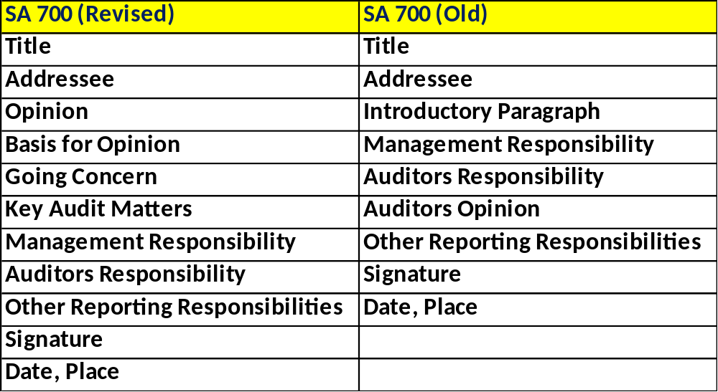

Forming an opinion and reporting on Financial Statements
SA 700
SOME PRACTICE BASED STANDARDS

Slide 32
Communicating Key Audit Matters in AR
SA 701
Key Audit Matters - Those matters that, in the auditor’s professional judgment, were of most significance in the audit of the financial statements of the current period.
Key Audit Matters are selected from matters communicated with those charged with governance.
SOME PRACTICE BASED STANDARDS

Slide 33
Modifications to the Opinion in the Independent AR
SA 705
Clean Report
Qualified Opinion
Disclaimer
Adverse
SOME PRACTICE BASED STANDARDS

Slide 34
Emphasis of Matter Paragraphs and Other Matter Paragraphs in the Independent Auditor’s Report.
SA 706
EoM Paragraph – A paragraph included in the auditor’s report that refers to a matter appropriately presented or disclosed in the financial statements that, in the auditor’s judgment, is of such importance that it is fundamental to users’ understanding of the financial statements.
SOME PRACTICE BASED STANDARDS

Slide 35

ACCOUTING STANDARDS

Slide 36



ASB and its
Evolution
Total of
29-2 Standards
Legal Position
The CA 2013

Slide 37
SECTION 133 (CHAPTER IX)
The Central Government may prescribe the standards of accounting, or any addendum thereto, as recommended by the ICAI in consultation with and after examination of the recommendations made by the NFRA.
ACCOUTING STANDARDS-AN UPDATE
JOMON K GEORGE

Slide 38
Section 143 (Chapter X)
The auditor shall report whether, in his opinion, the financial statements comply with the accounting standards
ACCOUTING STANDARDS-AN UPDATE
JOMON K GEORGE
For all unlisted companies (except NBFCs) with net worth of less than 250 Crs, ASs are applicable.

Slide 39
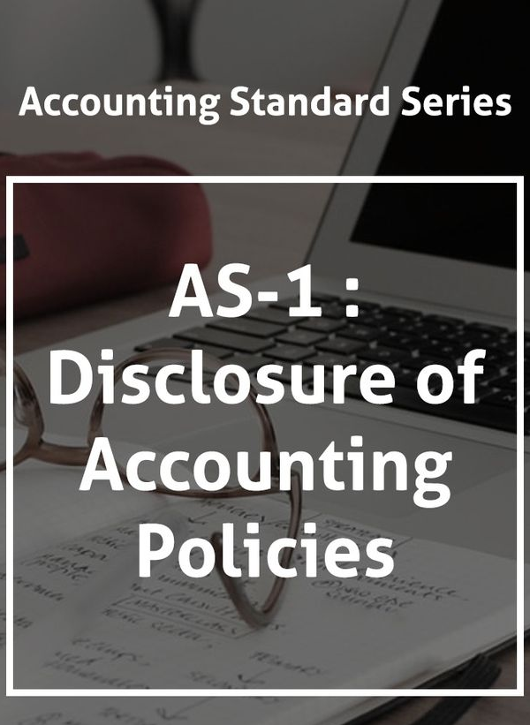
JOMON K GEORGE
All significant policies to be disclosed
Any change in the policy should also be closed.
Accounting Assumptions need not be mentioned.
DISCLOSURE OF ACCOUNTING POLICIES
-DISCLOSURE OF ACCPOUNTING POLICIES

Slide 40
JOMON K GEORGE
Poor disclosures . Very generic
Poor disclosures . Very generic
SMC aspect missing
Sketchy One Pager
SMC aspect missing
DISCLOSURE OF ACCOUNTING POLICIES
-DISCLOSURE OF ACCPOUNTING POLICIES
Sketchy One Pager

Slide 41
JOMON K GEORGE
No mention about :
  Employee Benefits
  Borrowing Costs
  Earnings per Share
  Deferred Taxation
  Impairment
  Provisions & Contingent Liabilities
DISCLOSURE OF ACCOUNTING POLICIES
-DISCLOSURE OF ACCPOUNTING POLICIES

Slide 42
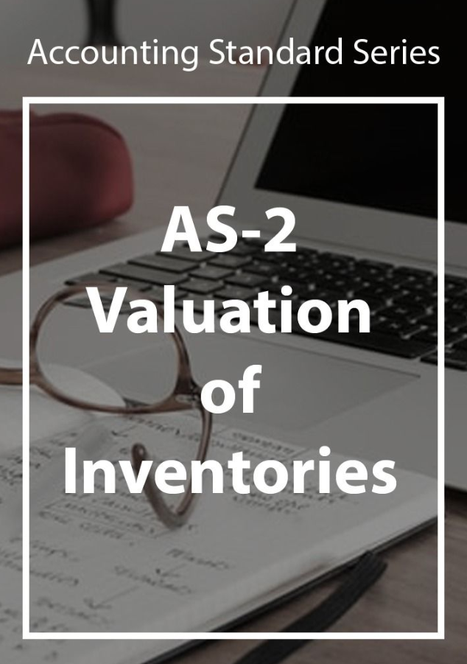
Financial Charges are not normally included in cost.
JOMON K GEORGE
Inventories should be valued and stated at lower of Cost or NRV.
-VALUATION OF INVENTORIES-
-VALUATION OF INVENTORIES-

Slide 43
Recognises Absorption Costing only
Cost Formula - Only FIFO, WAC allowed
Allows exclusive method of GST only
-VALUATION OF INVENTORIES-

Slide 44
Changes in Classification :
  Raw materials and components
  Work-in-progress
  Finished goods
  Stock-in-trade (in respect of goods acquired for trading)
  Stores and spares
  Loose tools
  Others (specify nature).
-VALUATION OF INVENTORIES-
-VALUATION OF INVENTORIES-

Slide 45
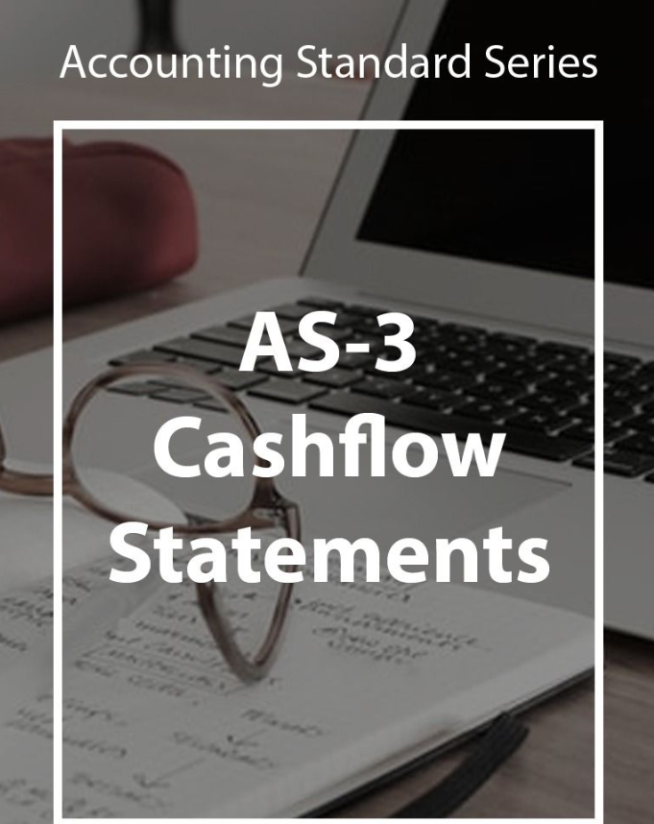
All companies except Small, Dormant & OPCs have to prepare Cash Flow Statements - Section 2(40)
Not prepared in many applicable cases
Wrong classifications
CASH FLOW STATEMENTS
-CASH FLOW STATEMENTS

Slide 46

All paragraphs dealing with Contingencies withdrawn
Adjusting Events Occurring after the BS date to be recognized
JOMON K GEORGE
-CONTINGENCIES AND EVENTS OCCURING AFTER BALANCE SHEET-
-CONTINGENCIES AND EVENTS OCCURING AFTER BALANCE SHEET-

Slide 47
Change in treatment of dividend declared after balance sheet date but before the date financial statements are approved
  Not to be treated as a liability.
  However, disclosure in the notes is to be made.
-CONTINGENCIES AND EVENTS OCCURING AFTER BALANCE SHEET-
-CONTINGENCIES AND EVENTS OCCURING AFTER BALANCE SHEET-

Slide 48

AS-5
Net Profit or Loss for the Period, Prior Period Items and Changes in Accounting Policies
Extraordinary Items
Prior Period Items
Changes in Accounting Estimates
Changes in Accounting Policies
Net Profit or Loss for the Period, Prior Period Items and Changes in Accounting Policies

Slide 49
Withdrawn Fully.
AS-6
Depreciation
AS-8
Accounting for Research and Development
-AS 6 & AS 8-
-AS 6 & AS 8-

Slide 50
AS-7
Construction Contracts
Recognises “Percentage of Completion” method only.
CONSTRUCTION CONTRACTS
CONSTRUCTION CONTRACTS
JOMON K GEORGE

Slide 51
Revenue From:
Sales
Services
Interest
Royalty
Dividend
AS-9
Revenue Recognition
-REVENUE RECOGNITION
REVENUE RECOGNITION-
AS 7 & AS 9 are mutually exclusive

Slide 52
AS-10
Property, Plant and Equipment
Name of Accounting Standard changed from Fixed Assets to Property, Plant and Equipment
Accounting Standard 6 : Depreciation Accounting merged with Accounting Standard 10 : Property, Plant and Equipment.
PROPERTY, PLANT AND EQUIPMENT
PROPERTY, PLANT AND EQUIPMENT
JOMON K GEORGE

Slide 53
AS-10
Property, Plant and Equipment
Para 32 and 34 : Model for Subsequent Revaluation
Revaluations should be made with sufficient regularity
Entire class to be revalued and revaluation not on ad hoc basis (earlier permitted by AS 10)
PROPERTY, PLANT AND EQUIPMENT
PROPERTY, PLANT AND EQUIPMENT
JOMON K GEORGE

Slide 54
Only cost model to be applied for Investment Property
(land and building other than related to operations)
(Para 20)
AS-13
Accounting for Investments
ACCOUNTING FOR INVESTMENTS
ACCOUNTING FOR INVESTMENTS-

Slide 55
Para 9: Change in the scope of the consolidated financial statements to make consolidation mandatory in the absence of subsidiary company
Amendment in accordance with Companies Act, 2013 which require the consolidation of Associate/ JV even if subsidiary is not there.
Consolidation to be done in accordance with AS 23 : Accounting for Associates in Consolidated Financial Statements & Accounting Standard (AS) 27:Financial Reporting of Interests in Joint Ventures.
AS-21
Consolidated Financial Statements
CONSOLIDATED FINANCIAL STATEMENTS
CONSOLIDATED FINANCIAL STATEMENTS
JOMON K GEORGE

Slide 56
The concept of virtual certainty
Full provisioning
AS-22
Taxes on Income
JOMON K GEORGE

Slide 57
Recognition Principle
Prel. Expenses
DRE
AS-26
Intangible Assets
JOMON K GEORGE

Slide 58
Discounting of Provisions permitted in case of decommissioning, restoration etc.
Earlier discounting of provisioning was not permitted.
The discount rate (or rates) should be a pre-tax rate (or rates) that reflect(s) current market assessments of the time value of money and the risks specific to the liability. The discount rate(s) should not reflect risks for which future cash flow estimates have been adjusted.
AS-29
Provisions, Contingent Liabilities/ Assets
PROVISIONS, CONTINGENT LIABILITIES/ ASSETS
-
PROVISIONS, CONTINGENT LIABILITIES/ ASSETS

Slide 59
APPLICABILITY
-APPLICABILITY OF ACCOUNTING STANDARDS-
ACCOUTING STANDARDS-AN UPDATE
-APPLICABILITY OF ACCOUTING STANDARDS-

Slide 60
Small & Medium Company
An SMC is a company which meets all the
following conditions :
Its equity/debt securities are not listed/ proposed
to be listed in India/
abroad.
It is not a Bank, FI or
Insurance Company.
Its turnover does not exceed Rs.250 crores in the PY
JOMON K GEORGE
Its borrowings does not
exceed Rs.50 crores
during the PY.
It is not a holding/subsidiary of a non-SMC.

Slide 61
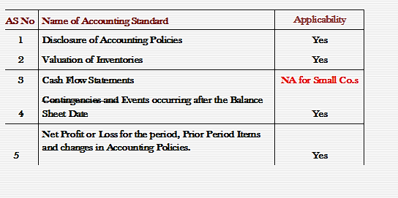
APPLICABILITY OF ACCOUNTING STANDARDS
JOMON K GEORGE
ACCOUTING STANDARDS-AN UPDATE

Slide 62
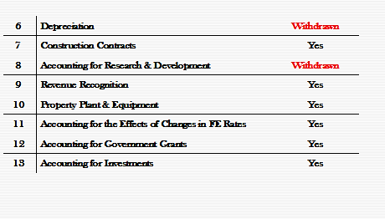
APPLICABILITY OF ACCOUNTING STANDARDS
JOMON K GEORGE
ACCOUTING STANDARDS-AN UPDATE

Slide 63
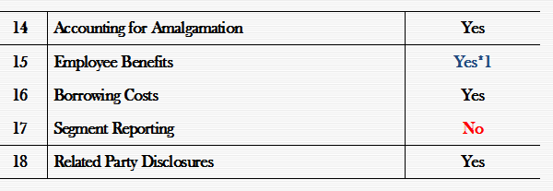
APPLICABILITY OF ACCOUNTING STANDARDS
JOMON K GEORGE
ACCOUTING STANDARDS-AN UPDATE
*1 Termination benefits falling due after 12 months need not be accounted on discounted basis.

Slide 64
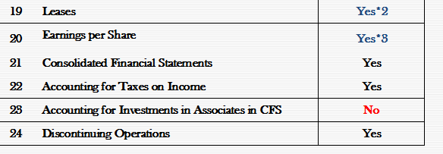
APPLICABILITY OF ACCOUNTING STANDARDS
JOMON K GEORGE
ACCOUTING STANDARDS-AN UPDATE
*2 AS 19 – Paragraph 22(c), (e) & (f), 25(a), (b) & (e), 37(a) & (f) and 46 (b) & (d) dealing with additional disclosures about operating and financing leases are not applicable.
*3. AS 20 – Need not calculate/disclose Diluted earnings per share.

Slide 65
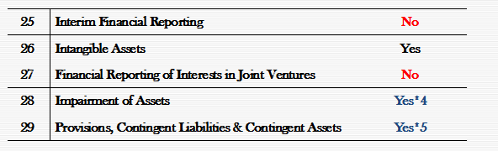
APPLICABILITY OF ACCOUNTING STANDARDS
JOMON K GEORGE
ACCOUTING STANDARDS-AN UPDATE
*4.AS 28 – Have an option to measure (value in use) on a reasonable estimate basis (without discounting).
*5.AS 29 – Paragraphs 66 & 67 dealing with disclosures of opening balance, additions/deletions and closing balance of provisions are not applicable.

Slide 66


... Let us change …
Infrastructure & Technology
People & Processes
Billing & Collection
Financial Planning
Student friendly… Academic Culture
A Happy Organisation

Slide 67

ICAI TRICHUR
Thank You…
JOMON K GEORGE

