Slide 1
MIGRATION TO INCOME TAX ACT 2025
P.M.VEERAMANI FCA, COCHIN

Slide 2
CHANGE OF LAWS
OLD
NEW
FERA 1973
Companies Act 1956
Sales tax and VAT – Central and State
Sick Industrial Companies Act
Income Tax Act 1961
FEMA 1999
Companies Act 2013
GST 2017
IBC 2016
Income Tax Act , 2025

Slide 3
THE TRANSITION
Income Tax Act , 1961 – as amended by Finance Act , 2026
Income Tax Act, 2025 – as amended by Finance Act, 2026

Slide 4
THE NEW LAW
The Income Tax 2025 is a restructured and simplified version of existing Income Tax 1961 with the intention to make the law easier to read, understand and use without substantially changing the basic principles in many areas

Slide 5
THE NEW LAW
While many concepts continue from the earlier law, tax payers and professionals will need to familiarise themselves with the new structure, terminology and section references
It is like renovating a large building without changing its core foundation

Slide 6
CONCISED
Section | Topic | Summary
1 | Short title, Extent and effective date | Income Tax 2025 Extends to Whole of India (including J &K) Effective from 1.4.2026
535 | ROD – Removal of Difficulties | Central Government by General /Special order for a period of 3 years from 1.4.2026
536 | Repeal and Savings | IT Act 1961 repealed subject to various aspects of compliance for respective years mentioned to safeguard all rights & liabilities accrued under IT Act 1961

Slide 7
TRANSITION
Structural Re-organization
Simplification of Language
Re-numbering of sections
Continuity vs change
Impact on professionals
Judicial Precedence
Compliance and Documentation
Transitional Issues

Slide 8
STRUCTURAL REORGANISATION
Re-arrangement of chapters and provisions
Logical grouping of related sections
Reduction of scattered cross references
Easier navigation of the statute

Slide 9
RE-ARRANGING/GROUPING
Salaries
Section 16 –standard deduction and all other exemptions covered by sections 10(10), (10A), (10AA), (10B) and (10C) now merged and brought in as a deduction from salary under section 19 [ Exemption vs Deduction - Exempt income is totally excluded from the computation of total income. Deductions are specific amounts subtracted from the gross total income.]
Profits and Gains of Business or Profession
Sections 30,31 & 38 – Rent , rates, taxes repairs and maintenance merged to Sec.28
Section 36(1)(iv),(iva), (v), (va), with explanation , 40A(7)(b) & 40A(9) – relating to employee welfare merged to Section 29

Slide 10
RE-ARRANGING/GROUPING
Sections 36(1)(i), (ia), (iv) – deductions on insurance premia – merged into section 30
Sections 36(1)(via), 36(1)(vii), & 36(2) – deductions for bad and doubtful debts and its provision – merged to section 31
All other deductions under sections 36(1)(ii), (iii), (iiia), (viii) and explanation , 36(1)(xii),(xvii),(xviii), 36(1)(ix), 36(1)(vi), 36(1)(xvi) and 40A merged into Section 32
Section 32 & 38 on depreciation merged into Section 33

Slide 11
RE-ARRANGING/GROUPING
Sections 44AD, 44ADA & 44AE – presumptive taxation for Residents merged into Section 58
Sections 44B, 44BB, 44BBA, 44BBB, 44BBC & 44BBD – presumptive taxation for Non-residents merged into section 61
No merging for income from capital gains and income from other sources

Slide 12
EASIER NAVIGATION
Chapter XIII – Determination of tax in special cases- Sections 190 - 235
Part A – Determination of tax in certain special cases – Sec.190-195 [ ss- 110,111,113,115ACA, 115BBE]
Part B – Capital Gains special provisions – Sec.196-198 [ss- 111A, 112, 112A]
Part C – New tax regime – Sec.199-205 [ss- 115BA, BAA,BAB, BAC, BAD, BAE]
All conditions for tax on income which were under sections 115BA, BAA,BAB, BAC, BAD, BAE for certain companies and co-operative societies brought under Sec.205
Part D - All provisions relating to MAT and AMT covered by section 115 JA – 115JF brought under single section 206

Slide 13
EASIER NAVIGATION
Chapter XIII – Determination of tax in special cases- Sections 190 - 235
Part E – Special Provisions relating to non-residents and foreign companies – sections 207- 220 [old 115A – 115 JH]
Part F – Special Provisions relating to pass through entities – Sec.221-224 [old 115 TC – 115 UB] –venture capital, business trust, investment fund etc
Part G – Special Provisions relating to shipping companies – Sec.225 – 235 [ old tonnage tax chapter]

Slide 14
SCATTERED CROSS REFERENCES
Taxation of AOP / BOI governed by section 67A, 86 and 167B now brought together under sections 309-311
Taxation of Non-Profit organizations scattered through section 11-13 with various sub-sections, explanations, proviso now brought under 7 sub headings in one chapter
Chapter XVII B - Registration, Determination of income, Commercial activities, compliance, violations, special approval and interpretation(new) – Section 332-355

Slide 15
SHIFT FROM ACT TO RULES
Section 13(2) – Manner of computation of portion of income applied by charitable institution for the benefit of related person
Section 139(1) – 7th proviso & explanation 3 – Requirement to file ROI when certain conditions are fulfilled – deposits > 1 cr; Travel to Foreign country where expenditure is >2 lakh; Consumption of electricity > 1 lakh; such other conditions to be prescribed
Section 139(9) – explanation & its proviso – Conditions for treating a return as defective return
Rule 183 - Manner of computation of portion of income applied by non-profit organization , directly or indirectly, for the benefit of related person
Rule 163 – Conditions for furnishing return of income by persons other than company –
In addition to existing conditions, 4 conditions under Rule 12AB are also included
Rule 166 - Conditions for treating a return as defective return

Slide 16
SHIFT FROM ACT TO RULES
Section 144B – Faceless assessment – Procedure for faceless assessment as contained in section 144B along with explanations and proviso
The Second Schedule – Procedure for Recovery of tax (sec.222 and 276)
The Third Schedule – Procedure for distraint and sale by Tax Recovery Officer
Rule 176 – Procedure for faceless assessment, re-assessment and re-computation
Rule 225 - Procedure for Recovery of Tax for the purposes of section 413 and 475
Rule 153 – Distraint and Sale

Slide 17
MAPPING – MOST COMMONLY USED
OLD | NEW | TOPIC
2(22)(e ) | 2(40)(e) | Deemed Dividend
36(1)(va) | 29(1)(e) | Deduction of employee contribution to PF /ESI etc
40(a)(ia) | 35(b)(i) | Disallowance of expenditure for non-deduction of TDS
40(b) | 35(e ) | Limits of remuneration and interest to partners of Firm
40(A)(2b) | 36(2) | Payment to relatives
40A(3) | 36(4) | Cash payments in a day exceeding limits
43B | 37 | Deduction of certain statutory / other payments
44AB | 63 | Tax audit
56(2)(x) | 92(2)(m) | Gift from Non-relative
139 | 263 | Return of Income
Chap VIA | Chap VIII | Deductions from Income

Slide 18
COMPARISON – deemed dividend
2(22)(e ) - any payment by a company, not being a company in which the public are substantially interested, of any sum (whether as representing a part of the assets of the company or otherwise) made after the 31st day of May, 1987, by way of advance or loan to a shareholder, being a person who is the beneficial owner of shares (not being shares entitled to a fixed rate of dividend whether with or without a right to participate in profits) holding not less than ten per cent of the voting power, or to any concern in which such shareholder is a member or a partner and in which he has a substantial interest (hereafter in this clause referred to as the said concern) or any payment by any such company on behalf, or for the individual benefit, of any such shareholder, to the extent to which the company in either case possesses accumulated profits;
Dividend means – (i), ia, ii, iii, iv & v
Explanations – 1,2, 2A, 3
2(40)(e ) - any payment by a company, not being a company in which the public are substantially interested, of any sum (whether as representing a part of the assets of the company or otherwise),––
(i)as an advance or loan to a shareholder, being a person who is the beneficial owner of shares (not being shares entitled to a fixed rate of dividend, with or without a right to participate in profits) holding not less than 10% of the voting power; or
(ii)as an advance or loan to any concern in which such shareholder is a member or a partner and in which he has a substantial interest (herein referred to as the said concern); or
(iii)made on behalf, or for the individual benefit, of any such shareholder, to the extent to which the company in either case possesses accumulated profits;

Slide 19
COMPARISON – Employee Contribution to PF/ESI
36(1)(va) - any sum received by the assessee from any of his employees to which the provisions of sub-clause (x) of clause (24) of section 2 apply, if such sum is credited by the assessee to the employee's account in the relevant fund or funds on or before the due date.
Explanation—For the purposes of this clause, “due date” means the date by which the assessee is required as an employer to credit an employee’s contribution to the employee’s account in the relevant fund under any Act, rule, order or notification issued thereunder or under any standing order, award, contract of service or otherwise;
29(1)((e ) - (i)the amount of contribution received from an employee to which the provisions of section 2(49)(o) apply, if it is credited by the assessee to the account of the employee in the relevant fund or funds by the due date;
(ii)for the purposes of sub-clause (i), "due date" means the date by which the assessee is required as an employer to credit employee contribution to the account of an employee in the relevant fund under any Act, rule, order or notification issued under it or under any standing order, award, contract of service or otherwise and the provisions of section 37 shall not apply for determining the "due date" under this clause.

Slide 20
MAPPING – sections into schedules
Sch | Old Sec | TOPIC
I | 9 | Business Connection in India - Conditions
II | 10 | Income not to be included in TI [ TI – Total Income] -50 sections into 6 schedules – agricultural income and specified exemptions like NPS, superannuation funds, scholarship
III | 10 | Income not to be included in TI of eligible persons Institutional and Public Charitable trust exemptions
IV | 10 | Income not to be included in TI of eligible non-residents, foreign cos. & other such persons units of SEZ, export exemptions
V | 10 | Income not to be included in TI of certain eligible persons including investment funds, business trusts & their unit holders , income received by scientific research associations, universities, colleges, and other approved non-profit associations
VI | 10 | Income not to be included in TI of certain eligible persons in IFSC or having income therefrom; exemptions and tax holiday provisions relating to specified infrastructure facilities, cooperative societies,
VII | 10 | Persons exempt from tax - specific entities, local authorities, and institutions whose total income is unconditionally or conditionally exempt from chargeability
XV | 80C | Deduction in respect of life insurance premia, contri. to PF…… upto Rs. 1.50 Lacs
XVI | 11(5) | Permitted modes of investment or deposits by a charitable or religious T/I

Slide 21
MAPPING ….contd..
1961 Act | Nature of Income | 2025 Act
Sec.10(`1) | Agricultural Income | Schedule II – Table – Sl No.1
Sec.10(2A) | Share income of a partner | Schedule III – Table – Sl No.2
Sec.10(4)(ii) | Interest on NRE Account | Schedule IV – Table – Sl No.1
Sec.10(10), (10A), (10AA), (10B) and (10C) | Exemptions from Salary income – Gratuity, leave encashment etc | Section 19 – Deduction from salary
Sec.10(10D) | Maturity value of insurance policy including bonus | Schedule II – Table – Sl No.2
Sec.10(16) | Scholarship | Schedule II – Table – Sl No.9
Sec.10(23C)(iiia, b,c,d) | Income of university, educational institution, hospital ..etc | Schedule VII – Table Sl No.17-19
Sec.10(32) | Exemption for Income of Minor when clubbing applies | Schedule III – Table Sl.No.17
Sec.10(37) | Capital gains on sale of agricultural land | Schedule III – Table Sl.No.18

Slide 22
OLD vs NEW – TDS
Provisions contained in sections 190 to 196 D of IT Act 1961 summarized in a table form under section 393
Tables are divided into SIX categories :
Payment to Residents
Payment to Non-residents
Payment to Any person
No TDS cases
Declaration for no TDS
TCS

Slide 23
OLD vs NEW – TDS
Payment to Residents further divided under Eight sub heads
1. Commission or Brokerage
2. Rent
3. Payment on transfer of immovable property other than agricultural land
4. Income from Capital Market
5. Interest Income
6. Payment to contractors, for professional or technical services
7. Dividends
8. Other cases

Slide 24
OLD vs NEW – TDS
Each table divided into four columns
Notes at the end of each table
Understanding the table and implementing could be the challenge
Sl No | Nature of Income or Sum | Payer | Rate/Threshold limits
A | B | C | D

Slide 25
OLD vs NEW
Income of the previous year relevant to the assessment year…….. Becomes
Income of the tax year
Omitted styles
Provided further that notwithstanding anything contained……
Subject to clause (iv) of proviso to sub-section (2) of section….
Notwithstanding anything contained…..
New Style : This section does not apply where……..

Slide 26
SIMPLICATION – HOW ACHIEVED
a. Notwithstanding anything
b. Provisos (1200) & explanations
(900) Removed
c. Complex & lengthy provisions
d. Provisions related to common
topic scattered across.
E.g., Salary related deductions & exemptions in separate Chapters. i.e.. allowances u/s 10
a. Irrespective of anything
b.Sub-section & clauses aggregating all provisos & explanations at one place.
c. Formulas introduced in Rules
d. Provisions related to common topic are consolidated into 1 section as a table.
Ex. Salary related deductions & exemptions tabulated into one Section. TDS thresholds into tables

Slide 27
SIMPLICATION – HOW ACHIEVED
Definitions consolidated under different chapters as
Interpretation
Banking Cos, Co-op. banks, Primary Agri. credit society, Specified Sums, Specified Advance, defined repeatedly in S. 269SS, 269T & 269 ST….. NOW under sec.189
Definitions relating to Income from Business or Profession u/s 43 now under sec.66
Special provisions relating to shipping companies u/s 115 V/VC/VC now under sec.235
Block period, requisition, search, ‘last of the authorizations’, undisclosed income u/s 158B now under 301
Special provisions relating to NPO earlier under section 13 now under 355
Definitions relating to TDS provisions contained under 192 – 206 CB now under 402
Now you need to read from right to left …. Definition [ Interpretation] being the last section in the chapter

Slide 28
ASSESSEE FRIENDLY CHANGES
Definition of Relative | No clarity on inclusion of maternal lineal ascendants | Relative includes lineal ascendants (Maternal & Paternal) & descendents.
DRP directions | No mandate to include reasoning & points considered to reach decision in the directions. S. 144C | DRP to give directions in writing, stating points of determination, decision thereon & reasons for such decision. S. 275(6) (DRP orders will now be well-reasoned & adequately explained, ensuring transparency & reducing reliance on past rulings)
Tolerance Range (TR) for deviation B/w transaction price & ALP | Not clear when only single comparable is determined as ALP. S. 92C | Clarified that TR (+/-3%) available even when only single comparable is determined as ALP. S. 165.
Exemption of medical expense Reimbursement | Certificate from an approved hospital is mandatory to claim medical expense reimbursement for prescribed diseases as a deduction from salary for employee. S. 17(2) | Requirement of such medical certificate from an approved hospital to claim medical expense reimbursement for prescribed diseases as deduction from salary for employee omitted

Slide 29
REVENUE BENEFIT CHANGES
Section 132 – Power of Officer in charge of Search and Siezure
“Break open lock of any door, box, locker, safe, almirah or other receptacle for exercising powers conferred by clause (i) where keys thereof are not available;”
Section 92 – Scope of AE for TP -
S. 92A meaning of AE told in 2 parts:
1. General definition of direct/Indirect control OR common control.
2. Specific scenarios covered to call entities as AEs.
In many scenarios under 2nd part (e.g., >90% of RM procured from other party – becomes AE), no control existed as required under part 1.
Litigations arose as to whether both conditions as laid out in part 1 & 2 has to be satisfied to be called as AEs.
Section 247 - “break open lock of any door, box, locker, safe, almirah, or other receptacle or override access code to any computer system for exercising powers conferred by clause (i) where keys thereof are, or access to such building, place, etc., or access code to such computer system, as the case may be, is not available;”
S. 162 – Meaning of AE - Combined definition
i.e, Not in 2 parts.
This ensures that even if 2 entities do not meet the control/common control criteria, they will be considered as AEs if any conditions as per the definition is satisfied.
“Associated enterprise shall also include other units, undertakings, enterprises or business of such assessee or such person referred to in Section 140(13) in respect of transactions referred in Chapter VIII are applicable”

Slide 30
REVENUE BENEFIT CHANGES
S. 148 - For purposes of this section & S. 148A, information with AO which suggests that income chargeable to tax has escaped assessment means,—
i. any info. in case of assessee for relevant AY in accordance with risk management strategy formulated by CBDT from time to time;
ii. any audit objection to the effect that assessment in case of assessee for relevant AY has not been made in accordance with provisions of this Act;
iii. any info. received under an agreement referred to in S. 90 or S. 90A of the Act;
iv. any information made available to AO under scheme notified U/s 135A;
v. any information which requires action in consequence of the order of a Tribunal or a Court;
vi. any information in the case of the assessee emanating from survey conducted U/s 133A, other than under sub-section (2A) of the said section, on or after the 1st day of Sep, 2024.
Issue of SCN u/s 148A not applicable for item (iv)
S. 280 - For purposes of this section S. 281, information with AO which suggests that income chargeable to tax has escaped assessment means,—
i. any info. in case of assessee for relevant TY as per risk management strategy formulated by CBDT from time to time;
ii. any audit objection to the effect that assessment in case of assessee for relevant TY has not been made as per this Act;
iii. any info. received under an agreement referred to in S. 159 of this Act;
iv. any information made available to AO under scheme notified U/s 260;
v. any information which requires action in consequence of the order of a Tribunal or a Court;
vi. any information in the case of the assessee emanating from the survey conducted U/s 253, other than under sub-section (4) of the said section;
vii. any directions in case of assessee given by Approving Panel U/s 274(6);(GAAR)
viii. any finding or direction contained in an order passed by any authority, Tribunal or court in any proceeding under this Act by way of appeal, reference or revision, or by a Court in any proceeding under any other law.
Clause vii & viii added.
Issue of SCN u/s 281 (before issue of notice u/s 280) not applicable for clauses iv, vii & viii above.

Slide 31
Finance Act 2026
Finance Act 2026 amends both Income Tax Act 1961 as well as Income Tax Act 2025.
The new Act which was brought in as a simplification exercise has :
▪ 87 amendments
▪ Omission of provisions even before coming into force
▪ After claim of deleting all sections with alphabets in the 1961 Act through the simplified IT Act, 2025, this bill adds a new Section 354A , 269(13A), Clauses 38A, 38B, 38C , 38 D to Schedule III [more to come ..]

Slide 32
Penalty merged with assessment
Section 471(4) inserted , to provide that, penalty for underreporting/ misreporting of income under levied under section 439 to be imposed within the assessment Order
where any draft of the proposed order of assessment under section 275 or assessment under section 270 or reassessment under section 279 is made on or after 1st of April, 2027 in respect of the assessment year 2026-2027
Consequential amendments are made in Section 411 of the Income Tax Act, 2025.
Additional tax liability AS PENALTY is automatic
[ 220, 270A and 274 of IT Act 1961]

Slide 33
Immunity for Mis-reporting
Sec.439(11) amended – Mis-reporting of income shall include income referred to in section 195(1)(b) [ 270A(9) & 115BBE]
Section 440 [270AA] of the Act, provides, inter-alia, procedure of granting immunity by the Assessing Officer from imposition of penalty or prosecution if –
the tax and interest payable as per Assessment order, has been paid within the period specified in notice of demand; no appeal against the such assessment order has been filed.
Amendment to scope the power to grant immunity in cases of misreporting except those under 195(1)(b) – subject to payment of an additional income-tax to the extent of 100% of the amount of tax payable on such income in lieu of the penalty. 120% for cases u/s 195(1)(b)
Immunity cannot be granted if the prosecution has already been initiated

Slide 34
Penalty becomes fee…..
Sec.446 of IT Act 2025 [271B of IT Act 1961] providing for penalty for failure to get accounts audited and obtain audit report u/s 63 is deleted AND
Sub Clause (c) is added to Sec.428 of IT Act 2025 [234 F of IT Act 1961] to provide for a fee of
(i) a sum of ₹ 75000 for a delay up to one month for which such failure continues; and
(ii) a sum of ₹ 150000 thereafter;
Sec.447 of IT Act 2025 [271BA of IT Act 1961] providing for penalty for failure to get TP report u/s 172 is omitted AND
Sub Clause (d) is added to Sec.428 of IT Act 2025 to provide for a fee of
(i) a sum of ₹ 75000 for a delay up to one month for which such failure continues; and
(ii) a sum of ₹ 150000 thereafter;
Sec.266 of IT Act 2025 [140A of IT Act 1961]…..the return of income shall be accompanied by proof of payment of tax, interest and fee

Slide 35
14A through back door…..Taxing of Gross Income
Section 93(2) of the IT Act, 2025 [Section 57(iii) of the IT Act, 1961] provided for deduction of any expenditure for earning income from other sources.
Section 93(2) to provide that no deduction shall be allowed in respect of any interest expenditure incurred for earning dividend income or income from units of mutual funds.
Amendment is being made to remove the deduction w.e.f. 01.04.2026

Slide 36
Updated return after Re-opening notice
Amendment in Section 263(6) of the IT Act, 2025 allowing filing of updated return in cases where:
• Notice u/s 280 [erstwhile 148] is issued ; Updated return can be in lieu of
return in response to
Section 267 amended to provide that where updated return is filed pursuant to a notice under Section 280 within the period specified in the Notice, the additional tax payable shall be increased by a further sum of 10% of the aggregate of tax and interest payable on account of furnishing of the updated return.
Where tax if so paid, the income on which such additional income tax is paid shall not be the basis for penalty under Section 439, by inserting section (13A)
Amendment to allow updated return in cases where tax payer reduces the amount of loss

Slide 37
Gold does not glitter
Section 70(1)(x) of the IT Act, 2025 provided for capital gains exemption in respect of income arising from Sovereign Gold Bonds issued by RBI under the Sovereign Gold Bonds Scheme, 2015 or subsequent ones
Amended provisions from 1.4.2026 for individual bond holders
Holding Period | Exemption
From date of issue to date of maturity | YES
From date of purchase in secondary market to date of maturity | NO
Purchase and Sale in secondary market | NO

Slide 38
Accident Relief
Insertion of clause 38A to Schedule III of the Income Tax Act 2025 [Exempt Income]
Disability pension received (including service element and disability element) | An individual who has been a member of the armed forces (including paramilitary forces) of the Union | The individual has been invalidated out of service in the armed forces on account of bodily disability attributable to or aggravated by such service ; AND (b) The individual has not retired on superannuation or otherwise

Slide 39
Accident Relief
Insertion of clause 38B Schedule III of the Income Tax Act 2025 [Exempt Income]
Consequential amendment made under Section 393(4) to provide that no TDS shall be applicable on such interest individuals and up to 50,000 for non-individuals
Any interest on compensation amount awarded by Motor Accident Claims Tribunal. | An individual or his legal heir | Such interest is received under the Motor Vehicles Act, 1988 (59 of 1988).

Slide 40
Acquisition Compensation
Insertion of clause 38 C to Schedule III of the Income Tax Act 2025 [Exempt Income]
Any income in respect of any award or agreement made on account of compulsory acquisition of any land. | An individual or HUF (companies ????) | Such award or agreement is made under the provisions of the Right to Fair Compensation and Transparency in Land Acquisition, Rehabilitation and Resettlement Act, 2013 96. Exemption from income-tax, stamp duty and fees.–No income tax or stamp duty shall be levied on any award or agreement made under this Act,

Slide 41
Form 121 [15 G/ 15 H] through depository
Insertion of Section 393(6) (b)
Filing of Form 121 (erstwhile 15G or Form 15H) to be routed through depositories for investors holding securities or units in the depository and securities are listed on a registered stock exchange in India. ▪
The entities holding such investments to file the declarations with the IT authorities on a quarterly basis instead of monthly basis.
Further, the time limit for filing the declaration by the person responsible for paying such income has been changed from monthly to quarterly

Slide 42
TAN replaced by PAN
Buyer to obtain a TAN when the seller of immovable property is a non-resident.
Practical problems since the purchase could be a one-off transaction and buyer would not need TAN.
Section 397(1)(c) of the Income Tax Act, 2025 is be amended to exempt resident individual / HUF from obtaining TAN to deduct tax at source when immovable property is sold by NRI
Amendment effective from 01.10.2026.

Slide 43
Income Tax Rules 2026

Slide 44
Dependence on Rules for compliance
Many substantive tax compliances depend heavily on Rules , such as –
Valuation
TDS Procedure
Transfer Pricing documentation
Depreciation
Reporting Formats
Exemptions and deductions
Even if Act becomes simpler, complexity may continue through detailed rules

Slide 45
Frequency of Amendments
One of the long standing practical problems faced is –
Rules can change frequently through notification and amendments when
technology systems evolve
reporting requirements expand
Government introduces compliance refinements

Slide 46
Form driven interpretation
We have been experiencing in practice that Forms, Utilities , schema validations often influence compliance interpretation more than statutory wording.
This creates situations where :
Portal logic may not fully align with legal interpretation
Procedural compliances becomes highly technical

Slide 47
Lower or No TDS certificate through electronic mode
Section 395 of IT Act 2025 [ erstwhile 197 of IT Act 1961] providing for certificate of TDS and TCS at lower rate or nil rate amended to facilitate application electronically before the Income Tax Authority which may
Issue the certificate subject to conditions as may be prescribed
Reject the application if the prescribed conditions are not fulfilled or the application is incomplete.

Slide 48
Lower or No TDS certificate through electronic mode
Form 128 - Common form - Registered NPO; Specified Entity u/s 263(9) ; Persons carrying on Business or Profession ; Persons other than above
Declaration that ROI for last 4 years is filed along with details
Details of existing liabilities as on date of application
Can the requirements of the form limit the use !!!!

Slide 49
Burden for small time professionals
Smaller CA firms may struggle with
Revised Forms
Digital compliance systems
New terminology
Procedural timelines
FAQ, CBDT clarifications , utility instructions and judicial guidance can create
Inconsistent professional practices ; varying departmental interpretations, uncertainty in compliance decisions

Slide 50
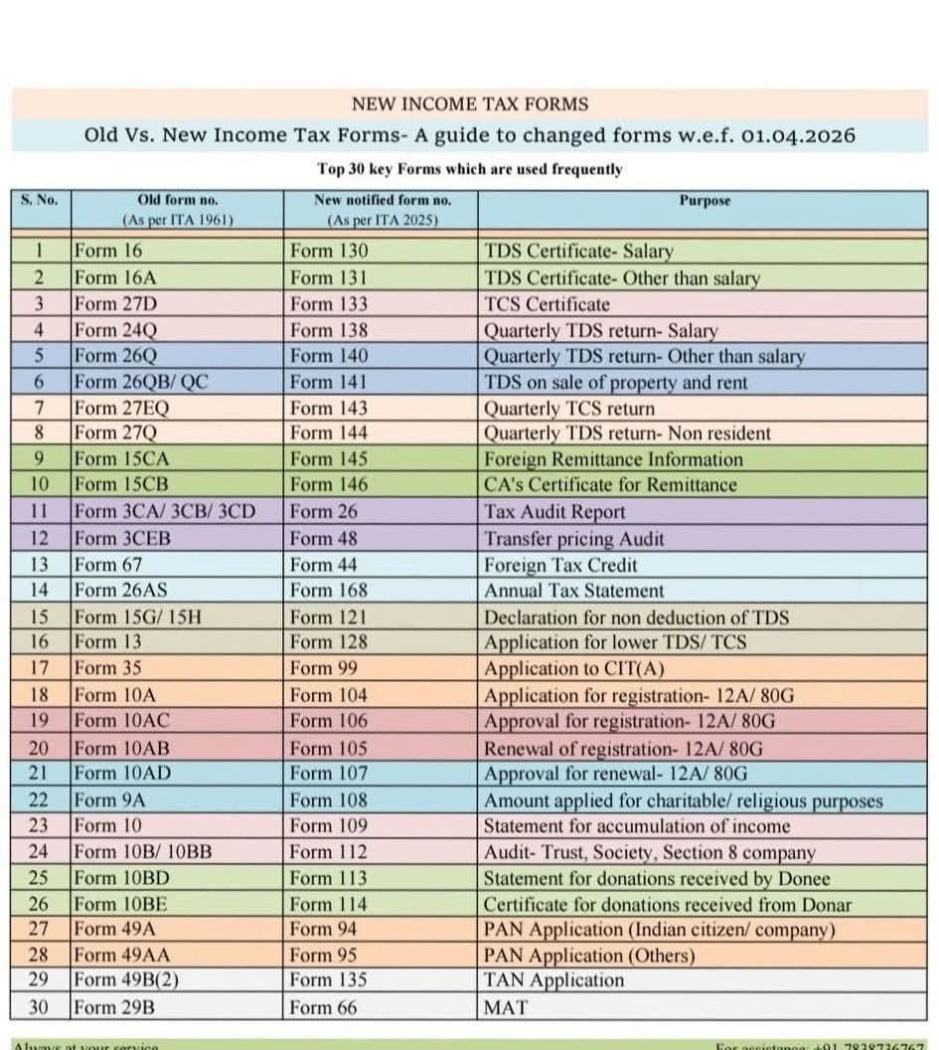

Slide 51
Audit Reports – Income Tax Rules 2026

Slide 52
Tax Audit Report
Form 3 CA / Form 3CB and Form 3 CD merged to Form 26
Form 26 divided into Part A, B, C
Form 26 has 55 clauses (sub clauses also) as against 44 in Form 3 CD
Clauses under Form 3 CD – grouped under sub-clauses A to K
Part C represents the audit report which is common for both those covered under audit any other law and IT Act

Slide 53
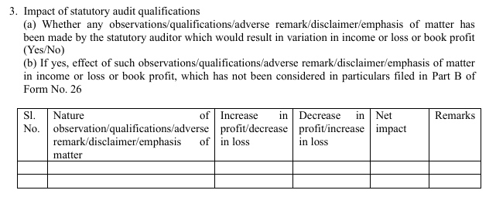
Tax Audit Report

Slide 54
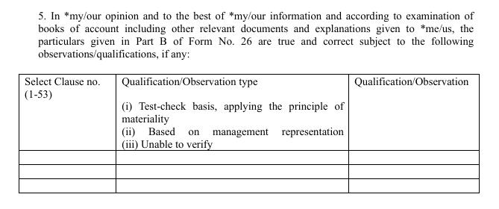
Tax Audit Report

Slide 55
Tax Audit Report on International Transactions
Form 3CEB becomes Form 48
1. Clear segregation of transactions as received and paid.
2. Mandatory disclosure of details under Advance Pricing Agreements (APAs).
3. Explicit listing of transaction categories in drop down menus for clarity.
4. Additional disclosures for royalty, corporate guarantees, and inter company financing.
5. Capturing of costs relating to free of cost assets and expenses
6. Disclosure of the economic adjustments made to the comparables
7. Emphasis on maintaining updated intercompany agreements and robust documentation.
8. Cautious application of the aggregation concept, with method wise ALP determination.

Slide 56
Reports / Certificates
Form | Nature | Notes
Form 24 | Audit Report u/s 59 – Royalty/ Fee for Tech services of PE | This report is to be given by an accountant as referred to in section 515(3)(b)
Form 26 | Tax Audit Report u/s 63 | This report has to be signed by an accountant as per section 515(3)(b)
Form 28 | Report u/s 77(4) – slump sale | “Accountant” means an accountant as defined in section 515(3)(b) of the Act.
Form 32 | Audit report under section 46, 138, 139, 140(8), 141, 142, 143, 144 of the Act- Various deductions | (i)"Accountant” shall have the meaning assigned to it in section 515(3)(b) of the Act and should provide the "CA Membership ID" as issued by the Institute of Chartered Accountants of India (ICAI) when signing the certificate
Form 48 | Report u/s 172 for determination of ALP | None

Slide 57
Reports / Certificates
Form | Nature | Notes
Form 66 | Report for Computation of Book Profit for the purposes of section 206(1) of the Act | This report is to be given by a chartered accountant, within the meaning of the Chartered Accountants Act, 1949 (38 of 1949), who holds a valid certificate of practice under section 6(1) of that Act and is not a person referred to in section 515(3)(b)(i) or (ii) of the Act.
Form 67 | Report for Computation of Adjusted Total Income and Alternate Minimum Tax for the purposes of section 206(2) of the Act | This certificate is to be given by: a chartered accountant within the meaning of the Chartered Accountants Act, 1949 (38 of1949); or any person, who in relation to any State, is, by virtue of the provisions in section 226(2) of the Companies Act, 1956 (1 of 1956), entitled to be appointed to act as an auditor of companies registered in that State.

Slide 58
RISK OF OVER SIMPLIFICATION
Simplified language may have resulted in –
Omitting Nuances
Reducing explanatory details
Creating ambiguity in edge cases
Professionals may initially find –
Interpretational gaps
Uncertainty in exceptional situations

Slide 59
OVER SIMPLIFICATION
Section 194A(3)(a) – TDS provisions shall not apply on interest not exceeding Rs.1,00,000 to senior citizens / 50,000 to persons other than senior citizens where the payer is a banking company to which the Banking Regulation Act applies (including any bank or banking institution ,referred to section 51 of that Act ) BR Act to apply to the State Bank of India (SBI), nationalized banks, and Regional Rural Banks (RRBs), alongside private banking companies
Section 393 – Table 5 (ii) – any income by way of interest other than interest on securities by a banking company- threshold - Rs.1,00,000 to senior citizens / 50,000 to persons other than senior citizens
Clarification in Twitter that section 402 defines banking company means a banking company to which Banking Regulation Act applies.

Slide 60
IMPACT ON PROFESSIONALS
Complete re-learning of section / rules references
Re-mapping of old sections to new sections and linking to the new rules – old references like 143(3), 147, 80C, 194 J will have to be re-mapped
Changes in chapter arrangements
Revised numbering of forms and procedures

Slide 61
IMPACT ON PROFESSIONALS
The changes can have effect on:
Opinions
Audit Reports
Tax Notes and Submissions
Legal Pleadings
ERP tax masters

Slide 62
IMPACT ON PROFESSIONALS
Interpretation of reworded provisions
Issues in applying old case laws to new wordings
tax audit templates, engagement letters, notices and replies
Training of staff through internal workshops
section mapping exercise
Client awareness
Atleast one-two years of steep learning curve

Slide 63
JUDICIAL PRECEDENTS
Earlier case laws may still remain relevant where provisions are substantially similar
However, interpretation issues can arise due to new wording or re-arrangement
Equivalent provisions will need careful comparative reading

Slide 64
COMPLIANCE /DOCUMENTATION
Migration Challenges will include --
Updating Forms
Revising Internal Manuals
Software Changes
Updating SOP and checklist
Revision of education materials

Slide 65
Change – does it matter ?
No deductions under new tax regime
Most items of receipt subject to TDS and major expenditure covered by TCS
Capital gains on security transactions provided by service provider
Annual Information Statement / Tax Information Statement captures all transactions
Form 168 [Form 26AS] virtually covers all tax related entries
Proposal to auto populate data for IT returns

Slide 66
Reliance on AI
The best approach to use AI for learning Income Tax Act 2025 would be to use it as –
a research assistant ; a language simplifier ; and a discussion partner
but not as the final authority on law as AI still makes mistakes such as:
Citing wrong sections
Confusing old and new provisions
inventing case laws
missing amendments
overlooking judicial nuances
giving over confident but incorrect conclusions

Slide 67
A practical case
The "Repatriation Block" (Liability to Seller)
Even though you are paying to an Indian NRO account, your liability to the seller doesn't end at the registration.
The Seller's Nightmare: When the seller tries to move this money from their NRO account to the US (Remittance), the bank will audit the source of funds.
The Result: The bank will demand the original Form 145/146 filed by the buyer (you) at the time of purchase. If you didn't file them, the seller’s funds will be frozen in India. The seller could then legally sue you for "Specific Performance" or damages because your failure to file mandatory tax forms is preventing them from accessing their money.

Slide 68
CONCLUSION
The migration is not merely a change in section numbers; it requires re-orientation in interpretation , compliance and professional practices and navigating through the risk of over simplification
Astrologer’s prediction ……..!!!!!

