Slide 1
VERIFICATION OF RECORDS AND REGISTERS IN BANKS
CA V RAVINDRAN SALEM
M.Com.,FCA.,DISA.,IP.,RV.,ID.,SA
rudiravi@gmail.com
99941 33388

Slide 2
CASH RECORDS AND REGISTERS
Cash Vault Register:
Kept Inside the Main Cash Vault
To Know the Stock of Cash in all denomination
Custodian of Cash – Key Holding persons
Verification of Periodical verification by Officers & Others
In and Out Cash Verification

Slide 3
CASH RECORDS AND REGISTERS
Counter Cash Verification:
Day to day operations
Under Cashier Control
Manual as well as in Systems
Surprise cash cheque – Erode Case

Slide 4
CASH RECORDS AND REGISTERS
3. ATM Cash /Ledger Verification
Address of ATM
Cash sent through Security team – Acknowledgment
Cash sent time and deposit at ATM
ATM Cash balance
ATM Compliant and redressal

Slide 5
CASH RECORDS AND REGISTERS
4. Cash In transit Register
Amount taken by whom
Cash sent out and reached time
Delay in remittance – reasons
Transferred by HO/RO permission
Same bank or other banks
HO Confirmation

Slide 6
CASH RECORDS AND REGISTERS
5. Cash Excess Short Register:
Date of occurrence
Cash Excess or Short
Cashier in charges
No of times happened
Reported to Controlling authorities and their directions and ratification
Release of Cash excess to customer account

Slide 7
CASH RECORDS AND REGISTERS
6. Soiled Note Register:
Stock of Soiled notes
Period of Holding
Return to Currency Chest once in ____ months
Acknowledgement of receipt of soiled notes

Slide 8
CASH RECORDS AND REGISTERS
7. Chest Branch Register
Money sent from Branch the currency Chest – records
HO/RO permission
Receipt at Currency Chest
Payment from Currency Chest
Van loading and off loading time

Slide 9
CASH RECORDS AND REGISTERS
Key Movement Register:
Person in charge of Keys
Signature must tally with cash vault register
All pages must be signed – in / out
Needed to fix the responsibility

Slide 10
CASH RECORDS AND REGISTERS
Cash Balance Certificate
Cash Retention Limit Certificate
Cash Insurance Letter

Slide 11
JEWEL LOAN RECORDS AND REGISTERS
Jewel Loan Application – Alive:
JL Application must be tallied with Stock at the Vault register
KYC of borrower
Weight to be checked
Gram value and loan as per HO norms
Appraiser recommendation and BM approval
Who is holding the Jewels after sanction
Sanction must tally with “in” in JL stock register
Borrower signature in the application

Slide 12
JEWEL LOAN RECORDS AND REGISTERS
2. Jewel Loan Duplicate Receipt:
Application to be duly signed by the borrower and not by representative.
Signature must be verified.
Branch Manager authorisation is required.
See that no “fraudulent intention”

Slide 13
JEWEL LOAN RECORDS AND REGISTERS
3. Jewel Loan Closed applications:
JL closed after paying full money including P+I+Penal interest+ other charges + Processing charges
JL closure must be approved by BM/Officer
Jewels to be handed over only to the borrower
Closure signature to be verified
Closed and not released – dispute/death/foreign settlement – analysed the reasons

Slide 14
JEWEL LOAN RECORDS AND REGISTERS
4. Jewel Loan stock register:
“In” and “Out” stock to be noted – compare the same with sanction and release
Add All Tray stocks and see that over all stock must be tallied
Verify the signature of Officers – compare the same with key movement register.
Periodical checking – Quantity and Quality

Slide 15
JEWEL LOAN RECORDS AND REGISTERS
5. Tray wise stock book:
It is a small book that is kept for each Tray
In and Out recorded
Person entering must put his signature
Tray wise stock must be consolidated and compared with JL Stock Register

Slide 16
JEWEL LOAN RECORDS AND REGISTERS
6. JL Auction Register:
Date of becoming NPA
Date of Information to Borrower with acknowledgment
RO permission to go for auction
Paper Advertisement details must tally with RO permission
Repayment done by borrower before Auction
Court stay if any
Full Quantity to be auctioned and not in Part
Auction Participation Formalities
Surplus – Credit to borrower account
Deficit – Recover from other source/Legal

Slide 17
JEWEL LOAN RECORDS AND REGISTERS
7. Jewel Loan Scale:
Comes under Labour Laws
Every year, sealing must be renewed
Kept inside the Airtight Glass Box
Glass Box should be Transparent
Electronic scale or manual scale

Slide 18
JEWEL LOAN RECORDS AND REGISTERS
8. Appraiser Record:
Appointment Letter – Period/Branch
KYC of Appraiser
Outsourcing or employed
Method of Commission Payment – as per Bank rules
Access to Bank records
Borrower Relationship Declaration
Application to be filled by Appraiser
Appraiser to appraise and not to sanction the JL

Slide 19
SECURITIES RECORDS AND VERIFICATION
Unissued FD/DD/TC receipts:
HO letter
Issue Register
Verification by Officer

Slide 20
SECURITIES RECORDS AND VERIFICATION
2. Duplicate keys of other Branches / Banks:
Key Numbers written in register
Period of exchange
Authorisation Letter to deposit keys.
Acknowledgment letter for receipt of keys.

Slide 21
BALANCE CONFIRMATION FROM BANKS
Get the Other Bank Statement.
Confirmation Letter
Branch to do the reconciliation
List of Outstanding un responded more than 6 months

Slide 22
INVESTMENT RECORDS
HO letter to invest in the types of investment
Investment made in India or Outside India
Investment to be done on whose behalf – Branch / HO
Interest on investment credited
Investment deposit receipt
Investment matured – renewed / not renewed - evidence

Slide 23
ADVANCE RECORDS AND REGISTERS
1. Proposal Received Register:
The following details must be properly mentioned
Date of application
Name of the Borrower and Address
Purpose of the Loan
Loan amount – Domestic/Forex
Pre Inspection date
Accept or Reject -

Slide 24
ADVANCE RECORDS AND REGISTERS
2. Process Note Preparation Sheet:
KYC details
Borrower full details
Purpose of the Loan
Inspection details
CIBIL and other reports
Legal opinion / Valuation Report
SWOT analysis
Demand, Supply Marketability, Viability study report
Defaulter List / Wilful Defaulters List
Additional conditions
Recommended to whom – sanction authority

Slide 25
ADVANCE RECORDS AND REGISTERS
3. Loan Sanction Letter
Sanction details
Terms and conditions
Adhering to sanction terms and conditions
Acceptance of Sanction letter by the borrower

Slide 26
ADVANCE RECORDS AND REGISTERS
MODT Register:
MODT Original Copy after registration
Compare the loan amount sanctioned and mentioned in MODT
Compare the Legal opinion and document deposited.
5. EM Register
Date of EM
Property schedule properly written
Amount of Loan

Slide 27
ADVANCE RECORDS AND REGISTERS
Loan Documents – Updation
Loan files list – compare the same with loans sanctioned
Stock Records:
Stock Register
Stock forms file
Inspection of Stock details
DP Calculation

Slide 28
ADVANCE RECORDS AND REGISTERS
Charge Creation:
Before Registrar
Before ROC
EC copy after date of creation of Charge
10. Legal Notice
Borrower name, address with loan outstanding and date of return
Latest position details – Get from Advocate
Legal Charges debited to respective party account

Slide 29
ADVANCE RECORDS AND REGISTERS
11. Suit Filed Register:
Advocate details who filed the case
Borrower name and Loan amount
Latest position – Case pending/order passed/ Decreed or not
Reason for non invocation of Decreed debts

Slide 30
ADVANCE RECORDS AND REGISTERS
12. NPA Register :
Date of NPA
NPA amount
Provisioning forms
AOD/RL Register
DPN Register

Slide 31
ADVANCE RECORDS AND REGISTERS
Insurance Register
Borrower name / Address/ Place of Business
Products insured and insurance value
Due dates of Insurance Policy
Banker Clause

Slide 32
ADVANCE RECORDS AND REGISTERS
Last year MOC Register
Current year MOC Register
DICGC Register
CGTMSE Register
ECGC Register
Claim Register
Subsidy Register

Slide 33
ADVANCE RECORDS AND REGISTERS
Deposit Lien Register
BG/LC Register
Beneficiary name
BG /LC commission
Period of BG/LC
Invoked or not
Due but not renewed

Slide 34
ADVANCE RECORDS AND REGISTERS
Loan Written off register
SARFAESI Notice Register
PC Register
Bills Discounted Register
Fraud Report Register
CERSAI Forms Register
Systems Maintenance Register
Disaster Plan Register at Branch Level

Slide 35
OTHER RECORDS AND REGISTERS
Stationary Stock Register
Stamps Stock Register (Cheque Book/ TC/DR/PO/Gift Cheque)
Petty Cash Register
Suspense account register
Sundry Assets Register
Bills Payable Register
Sundry Deposit Register

Slide 36
OTHER RECORDS AND REGISTERS
List of Overdue Deposits
List of Inoperative Accounts
Dormant Account details
Service charges circular
Other audit files – Concurrent/Stock/Revenue/RBI/ Inspection reports

Slide 37
OTHER RECORDS AND REGISTERS
Log Reports
Inter Branch Reconciliation Statement
Foreign Exchange Details Register
Clearing House Register – State Fund
Cheque Returned Register
SHG Register

Slide 38
LIST OF RECORDS AND REGISTERS
GOES ON …GOES ON.. GOES ON

Slide 39
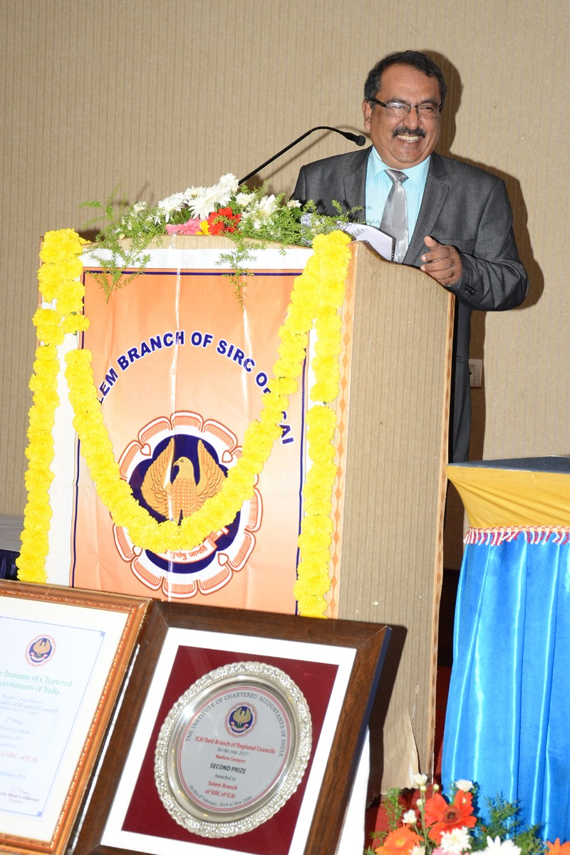
all the best members
Call me – 99941 33388
Mail me – rudiravi@gmail.com
You Tube Channel : Ravindran V
CA.V. Ravindran M.Com., FCA., DISA
Insolvency Professional
Registered Valuer (S&FA)
Independent Director (Qualified)
Social Auditor (Qualified)

