Slide 1
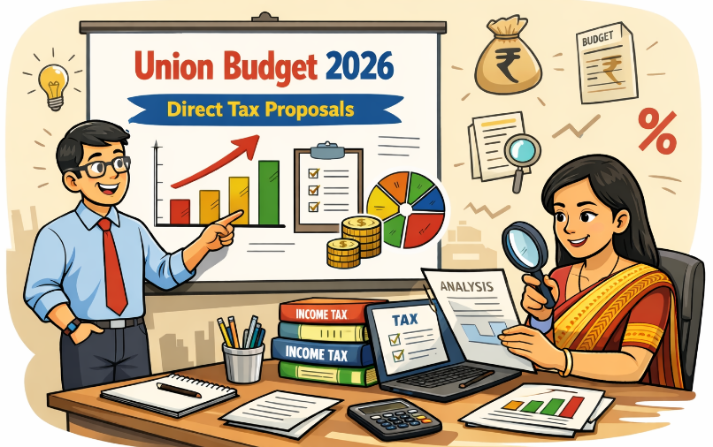
CA. PRASANTH SRINIVAS
S. S. AYYAR & CO.
CHARTERED ACCOUNTANTS, KOTTAYAM
Ph.: 9447125731, E-mail: ssayyarandco@gmail.com

Slide 2
Setting the stage
Economic scenario – tariff war – agreement with EU - rising metal prices.
Yuva Sakthi / Kartavya driven budget
Income Tax Act 2025 becomes effective from 01.04.2026
New user friendly rules and forms to come soon
Appeal – Stay – pre deposit – 10% from 20%
No changes in tax rates or tax rebates
Amendments are proposed in both the Acts
The concept of ‘tax year’ gains significance while learning the amendments.
  Tax year” means the twelve-month period beginning on the 1st day of April and ending on the 31st day of March immediately following that year. Tax year replaces the concept of “previous year” and “assessment year”. Income earned and taxed in the same tax year.
  Most of the amendments are procedural, some affect computation while a few are in the nature of corrigendum.
  CBDT has issued a FAQ on budget related amendments, which is very helpful in understanding the amendments. This is enclosed.

Slide 3
Rationalisation of Due Date for Employee Contribution (PF / ESI)
Subject: Due date for crediting employee contribution
Section Covered: Section 29(1)(e) – Income-tax Act, 2025
Clause No.: Clause 31 of Finance Bill, 2026
FAQ Reference: X, Page 11
Date: Effective from 1 April 2026 (Tax Year 2026–27 onwards)
Existing Provision
  Deduction allowed only if employee contribution is credited within statutory due date
  Due date governed by PF / ESI / Superannuation Fund laws
  Delay beyond such due date results in disallowance
Proposal
  Employee contribution allowed as deduction if credited on or before return filing due date referred to in section 263(1)
Parallel reference
  No amendment proposed to section 36(1)(va) of the Income-tax Act, 1961

Slide 4
Exemption on Interest Income under the Motor Vehicles Act, 1988
Subject: Exemption on interest under the Motor Vehicles Act, 1988
Section Covered: Schedule III r/w section 11 – Income-tax Act, 2025
Clause No.: Clause 108 of Finance Bill, 2026
FAQ Reference: II, Page 2
Date: Effective from 1 April 2026 (Tax Year 2026–27 onwards)
Existing Provision
  Interest awarded by Motor Accidents Claims Tribunal is taxable in the hands of the recipient
Proposal
  Interest income awarded under the Motor Vehicles Act, 1988 shall be exempt
Parallel reference
  No corresponding exemption is proposed in Sections 56 & 57 & 10 of the Income-tax Act, 1961

Slide 5
No TDS on Interest on Compensation Awarded by MACT
Subject: No TDS on interest awarded by MACT to an individual
Section Covered: Section 393(4) – Income-tax Act, 2025
Clause No.: Clause 72 of Finance Bill, 2026
FAQ Reference: III, Page 3
Date: Effective from 1 April 2026 (Tax Year 2026–27 onwards)
Existing Provision
  As per section 393(4), no tax is required to be deducted at source on interest awarded by MACT if the aggregate amount does not exceed ₹50,000 during the tax year
  Interest on compensation awarded by MACT is taxable in the hands of the recipient
Proposal
  No tax shall be deducted at source on any interest awarded by Motor Accidents Claims Tribunal
  Applies where such interest is credited or paid to an individual
  Consequential relief aligned with exemption of such interest income
Parallel reference
  No corresponding exemption is proposed in Sections 56 & 57 & 10 of the Income-tax Act, 1961

Slide 6
Certificate for Deduction of Income-tax at Lower or Nil Rate
Subject: E-filing and issue of certificate for lower / nil deduction of tax
Section Covered: Section 395 – Income-tax Act, 2025
Clause No.: Clause 74 of Finance Bill, 2026
FAQ Reference: IV, Page 5
Date: Effective from 1 April 2026 (Tax Year 2026–27 onwards)
Existing Provision
  Section 395 provides for issuance of certificate for deduction of tax at lower rate or nil rate
  The payee is required to make an application before the Assessing Officer
  The Assessing Officer, after verification and satisfaction, issues the certificate if total income justifies lower or nil deduction
Proposal
  To ease compliance burden of small taxpayers, it is proposed that the application for lower / nil deduction certificate may be made electronically
  Application shall be made to the prescribed income-tax authority
  The authority may issue the certificate electronically, subject to fulfilment of prescribed conditions
  Application may be rejected if prescribed conditions are not fulfilled or the application is incomplete
Parallel reference
  No corresponding amendment is proposed in the Income-tax Act, 1961

Slide 7
TAN where Seller of Immovable Property is a Non-Resident
Subject: TAN by resident individual / HUF for purchase of immovable property from non-resident
Section Covered: 397(1)(c) r/w/s 393(2) Income-tax Act, 2025
Clause No.: Clause 75 of Finance Bill, 2026
FAQ Reference: IX, Page 10
Date: Effective from 1 April 2026 (Tax Year 2026–27 onwards)
Existing Provision
  Where a resident individual or HUF purchases immovable property from a resident seller, TAN is not required
  However, where the seller is a non-resident, the buyer is required to obtain TAN to deduct tax at source.
  This results in compliance burden for a single transaction
Proposal
  Resident individual or Hindu undivided family shall not be required to obtain TAN
  Applicable where tax is required to be deducted on consideration for transfer of immovable property from a non-resident
  Tax shall be deducted and reported using PAN-based challan-cum-statement
Parallel reference
  No corresponding amendment is proposed in the Income-tax Act, 1961

Slide 8
Enabling Filing of Declaration for No Deduction to a Depository
Subject: Filing of declaration for no deduction of tax to a depository
Section Covered: 393(6) Income-tax Act, 2025
Clause No.: Clause 72 of Finance Bill, 2026
FAQ Reference: VI, Page 6 & 7
Date: Effective from 1 April 2027 (Tax Year 2027–28 onwards)
Existing Provision
  Section 393(6) provides that tax shall not be deducted at source in specified cases
  The assessee is required to furnish a written declaration for no deduction of tax to the person responsible for paying income
  Such declaration is required to be submitted separately to each payer in respect of dividend, interest from securities and income from units of mutual funds
Proposal
  To reduce compliance burden, it is proposed to allow filing of declaration for no deduction of tax to the depository
  The depository shall make the declaration available to the person responsible for paying such income
  Time limit for furnishing declarations by the payer to the prescribed income-tax authority is changed from monthly to quarterly
  Applicable only where securities or units are held in a depository and are listed on a recognized stock exchange in India
Parallel reference
  No corresponding amendment is proposed in the Income-tax Act, 1961

Slide 9
TDS on Supply of Manpower
Subject: Applicability of TDS provisions on supply of manpower
Section Covered: 393(1) r/w/s 402(27) Income-tax Act, 2025
Clause No.: Clause 78 of Finance Bill, 2026
FAQ Reference: IV, Page 4
Date: Effective from 1 April 2026 (Tax Year 2026–27 onwards)
Existing Provision
  Section 393(1) [Table: Sl. No. 6(i)] provides for deduction of tax at source on payments to contractors for carrying out any work
  Section 393(1) [Table: Sl. No. 6(iii)] provides for deduction of tax at source on fees for professional or technical services
  Section 393(1) [Table: Sl. No. 6(ii)] provides for TDS on payments made by individual or HUF for work not covered under Sl. No. 6(i)
  There exists ambiguity regarding the applicable rate of TDS on payments for supply of manpower
Proposal
  To provide clarity, it is proposed to include “supply of manpower” within the ambit of “work” in section 402(27)
  Consequently, provisions of section 393(1) [Table: Sl. No. 6(i)] or Sl. No. 6(ii), as the case may be, shall apply (i.e. 1% or 2% and not 10%)
  This removes ambiguity regarding applicability of TDS provisions on supply of manpower
Parallel reference
  No corresponding amendment is proposed in the Income-tax Act, 1961

Slide 10
Compulsory Acquisition of Land under the RFCTLARR Act
Subject: Exemption - compulsory acquisition of land - RFCTLARR Act
Section Covered: Schedule III r/w/s 11 - Income-tax Act, 2025
Clause No.: Clause 108 of Finance Bill, 2026
FAQ Reference: XLIV, Page 62
Date: Effective from 1 April 2026 (Tax Year 2026–27 onwards)
Existing Provision
  Schedule III read with section 11 provides exemption to certain eligible persons on their total income
  The Schedule inter alia provides exemption to an individual or Hindu undivided family on income chargeable under the head “capital gains” arising from transfer of agricultural land, subject to specified conditions
  Section 96 of the RFCTLARR Act, 2013 provides that income-tax shall not be levied on any award or agreement made under the said Act (except those under section 46)
Proposal
  To align the provisions of the Income-tax Act with the RFCTLARR Act, it is proposed to amend Schedule III
  Exemption shall be provided in respect of any income arising from any award or agreement on account of compulsory acquisition of land
  Applicable where such acquisition is carried out under the RFCTLARR Act, other than awards or agreements made under section 46 of the said Act
Parallel reference
  CBDT Circular No. 36/2016 had clarifies that compensation exempt under section 96 of the RFCTLARR Act shall not be taxable under the Income-tax Act, 1961 even in the absence of a specific exemption provision corresponding amendment is proposed in the Income-tax Act, 1961

Slide 11
Disability Pension to Armed Force Personnel
Subject: Exemption - disability pension to ex soldiers
Section Covered: Sch III read with sec 11 – Income-tax Act, 2025
Clause No.: Clause 108 of Finance Bill, 2026
FAQ Reference: XLIII, Pages 61
Date: Effective from 1 April 2026 (Tax Year 2026–27 onwards)
Existing Provision
  Disability pension is granted to members of the Armed Forces who are invalided out of service on account of bodily disability during service
  Disability pension comprises a service element and a disability element
  Exemption for disability pension has continued under the Income-tax Act, 1961 through repeal and savings clause, notifications, administrative instructions and clarificatory circulars
Proposal
  It is proposed to provide statutory exemption for disability pension, including both the service element and the disability element
  Exemption shall be available only where the individual is invalided out of service on account of bodily disability attributable to, or aggravated by, such service
  Exemption shall not apply where the individual has retired on superannuation or otherwise
  The exemption is also proposed to be extended to paramilitary personnel
Parallel reference
  Exemption for disability pension was available under the Income-tax Act, 1961 through administrative instructions and circulars

Slide 12
Rationalising Due Dates for Filing of Return of Income
Subject: Rationalisation of due dates for filing return of income
Section Covered: Section 263(1)(c) – Income-tax Act, 2025
Clause No.: Clauses 5 & 57 of Finance Bill, 2026
FAQ Reference: VIII, Page 9
Date: Effective from 1 April 2026 (Tax Year 2026–27 onwards)
Existing Provision
  Section 263 provides the framework for filing original, belated, revised and updated returns
  Different due dates are prescribed for different classes of assessees based on audit and other conditions
  Non-audit business cases and trusts were required to comply within comparatively shorter timelines – i.e., July 31
Proposal
  Due date for filing return of income for non-audit business or profession cases and partners of such firms is extended from 31st July to 31st August. No mention to trusts not having business income seen – though mentioned in budget speech.
  Due date for assessees whose accounts are required to be audited continues to be 31st October
  Due date for cases involving transfer pricing continues to be 30th November
  Due date for non audit - individuals filing ITR-1 and ITR-2 remains 31st July
Parallel reference
  Corresponding amendments proposed in Explanation-2 to section 139(1) of the Income-tax Act, 1961

Slide 13
Extending the Period for Filing Revised Returns
Subject: Extension of time limit for filing revised return of income
Section Covered: Section 263(5) – Income-tax Act, 2025
Clause No.: Clauses 5, 12, 57 & 83 of Finance Bill, 2026
FAQ Reference: VII, Page8
Date: Effective from 1 April 2026(Tax Year 2026–27 onwards)
Existing Provision
  Section 263(5) permits filing of a revised return to correct any omission or wrong statement in the original or belated return
  Revised return is required to be furnished within nine months from the end of the relevant tax year or before completion of assessment, whichever is earlier
  Revised return and belated return timelines coincide, restricting opportunity to revise returns filed at the end of the period
Proposal
  The prescribed time limit for filing revised return is proposed to be extended from nine months to twelve months from the end of the relevant tax year
  This enables taxpayers who file belated returns at the end of the period to subsequently file a revised return
  Corresponding amendment proposed in section 428(b) to levy fee for revised returns filed beyond nine months – Rs. 5000 if TI > 5L else Rs. 1000
Parallel reference
  Parallel amendments proposed in section 139(5) and section 234I of the Income-tax Act, 1961

Slide 14
Filing of Updated Return in Case of Reduction of Losses
Subject: Scope of filing updated return where loss is reduced
Section Covered: Section 263(6) – Income-tax Act, 2025
Clause No.: Clauses 5 & 57 of Finance Bill, 2026
FAQ Reference: XIX, Pages 27
Date: Effective from 1 April 2026 (Tax Year 2026–27 onwards)
Existing Provision
  Section 263(6) permits filing of an updated return within forty-eight months from the end of the relevant tax year, subject to prescribed conditions
  Updated return cannot be a return of loss, cannot reduce tax liability and cannot increase refund
  Updated return is not permitted where assessment, reassessment, search, survey or prosecution proceedings are pending or completed
  Accordingly, where the original return was a return of loss, filing of an updated return merely to reduce such loss was not permitted
Proposal
  It is proposed to amend section 263(6) to allow filing of an updated return where the taxpayer reduces the amount of loss
  Applicable where loss claimed in the original return filed within the due date under section 263(1) is partially reduced
  This enables correction of excessive loss claims without converting the return into a return of income
  Restriction on filing updated return solely due to reduction of loss is accordingly relaxed
Parallel reference
  Similar amendments are proposed in the Income-tax Act, 1961 to align provisions relating to updated return

Slide 15
Updated Return after Issuance of Notice of Reassessment
Subject: Filing updated return after issue of notice of reassessment
Section Covered: 263(6), 263(6)(c)(v) and 267 – Income-tax Act, 2025
Clause No.: Clauses 5 & 57 of Finance Bill, 2026
FAQ Reference: XIX, Page 28
Date: Effective from 1 April 2026 (Tax Year 2026–27 onwards)
Existing Provision
  Filing of updated return is not permitted where assessment, reassessment, search, survey or prosecution proceedings are pending or completed
  Section 263(6)(c)(v) specifically prohibits filing of updated return where reassessment proceedings have been initiated
Proposal
  It is proposed to allow filing of updated return even after issuance of notice of reassessment under section 280
  Updated return may be furnished within the period specified in such notice
  In such cases, assessee shall be precluded from filing return of income otherwise in response to such notice
  Additional income-tax payable on such updated return shall be increased by a further 10% of aggregate of tax and interest payable
  Where additional income-tax is paid as prescribed, the income so disclosed shall not form the basis for penalty under section 439 (present 270A)
Parallel reference
  Corresponding amendments are proposed in the Income-tax Act, 1961 to allow filing of updated return after issuance of notice under section 148 - come into force from 1 March 2026

Slide 16
Foreign Assets of Small Taxpayers – Disclosure Scheme, 2026 (FAST-DS 2026)
Subject: Disclosure of foreign assets and foreign-sourced income of small taxpayers
Section Covered: Black Money Act, 2015
Clause No.: Clauses 114 to 128 of Finance Bill, 2026
Date: Effective from date to be notified by the Central Government
Existing Provision
  The Black Money Act, 2015 provides for taxation and penal consequences in respect of undisclosed foreign income and assets
  A one-time compliance window was earlier provided from 1 July 2015 to 30 September 2015 for voluntary declaration of undisclosed foreign assets
  Instances of non-compliance continue, particularly among small taxpayers, involving legacy or inadvertent non-disclosures of foreign assets
  Proposal
  It is proposed to introduce a time-bound disclosure scheme for declaration of foreign assets and foreign-sourced income of small taxpayers
  Declaration to be made on payment of tax or fee based on the nature and source of acquisition of such assets or income
  Scheme provides for limited immunity from penalty and prosecution under the Black Money Act in respect of matters covered by the declaration
  Cases involving prosecution or proceeds of crime shall be excluded from the scope of the scheme
Parallel reference
  Similar voluntary disclosure window was earlier provided in 2015 under the Black Money Act

Slide 17
Penalties into Fee
Subject: Conversion of specified penalties into mandatory fee
Section Covered: 446, 447, 454, 427 & 428 – Income-tax Act, 2025
Clause No.: Clauses 83, 88 & 89 of Finance Bill, 2026
FAQ Reference: XV, Pages 21
Date: Effective from 1 April 2026 (Tax Year 2026–27 onwards)
Existing Provision
  Section 446 – penalty - failure to get accounts audited
  Section 447 – penalty - failure to furnish TP report
  Section 454 – penalty - failure to furnish statement of financial transactions or reportable account, including daily penalty for continuing default
  Penalties are discretionary and lead to litigation even in cases of technical or procedural delays
  Proposal
  Penalties for specified procedural defaults are proposed to be converted into mandatory fee
  Penalty under section 446 for failure to get accounts audited is converted into a graded fee under section 428(c), with fee of ₹75,000 (1 day to 1 month) or ₹1,50,000 (beyond 1 month) based on period of delay.
  Penalty under section 447 for failure to furnish report under section 172 is converted into a graded fee under section 428(4), with fee of ₹50,000 (1 day to 1 month) or ₹1,00,000 (beyond 1 month) based on period of delay
  Penalty under section 454(1) for failure to furnish statement of financial transactions or reportable account is converted into a fee under section 427(3)
  An upper limit of ₹1,00,000 is proposed for penalty under section 454(2)
  Parallel reference
  No corresponding proposal in the Income-tax Act, 1961

Slide 18
Penalty for Under-reporting or Misreporting of Income within Assessment Order
Subject: Imposition of penalty for under-reporting or misreporting of income within the assessment order
Section Covered: Sections 274, 220 & 245MA – Income-tax Act, 1961
Clause No.: Clauses 11, 13 & 14 of Finance Bill, 2026
FAQ Reference: XIII, Pages 17–18
Amendment effective from: Applicable to assessment orders passed on or after: 1 April 2027
Existing Provision
  Assessment order is passed first and penalty proceedings are initiated separately
  Separate show-cause notice is issued and independent penalty order is passed
  Interest under section 220(2) is charged from expiry of demand notice
  Dispute Resolution Committee (DRC) may reduce or waive penalty
  Proposal
  Penalty for under-reporting or misreporting of income under section 270A to be imposed within the assessment order itself
  Separate penalty proceedings to be eliminated
  Interest under section 220(2) to be charged only after passing of appellate order by CIT(A) / ITAT, as applicable
  Consequential amendment proposed in section 245MA
  Parallel reference
  Changes proposed in 2025 Act to give effect this

Slide 19
Tax Rate under Section 195 and Penalty under Section 443
Subject: Rationalization of tax rate and penalty in respect of income referred to in sections 102 to 106
Section Covered: Sections 195 and 443 – Income-tax Act, 2025
Clause No.: Clauses 46, 84 & 86 of Finance Bill, 2026
FAQ Reference: XVII, Page 25
Effective from 1 April 2026(Applicable for Tax Year 2026–27 onwards)
Existing Provision
  Section 195 provides for tax on income referred to in sections 102 to 106, including unexplained credits, unexplained investment, unexplained money, unexplained expenditure and certain borrowings
  Where total income includes such income, tax is levied at a flat rate of 60% under section 195(1)
  Section 443 provides for penalty at 10% of tax payable on such income determined by the Assessing Officer
  Proposal
  To rationalize taxation, it is proposed to reduce the tax rate from 60% to 30% under section 195
  Penalty provision under section 443 is proposed to be omitted
  Such income shall instead be covered under misreporting of income and penalty shall be levied under section 439(11), as applicable.
  Parallel reference
  No corresponding proposal in the Income-tax Act, 1961 Sections - 68, 69, 69A-69D, 115BBE & 271AAC

Slide 20
Immunity from Penalty or Prosecution - Section 440
Subject: Expansion of scope of immunity from penalty or prosecution
Section Covered: Section 440 – Income-tax Act, 2025
Clause No.: Clause 85 of Finance Bill, 2026
FAQ Reference: XIV, Page 19
Date: From 1 April 2026(Applicable for Tax Year 2026–27 onwards)
Existing Provision
  Section 440 provides for grant of immunity from penalty or prosecution by the Assessing Officer
  Immunity may be granted where:
    tax and interest payable as per assessment order are paid within the specified time, and
    no appeal is filed against such assessment order
  Immunity is presently available only in cases of under-reporting of income
  Immunity is not available where under-reporting arises in consequence of misreporting of income
  Proposal
  It is proposed to extend the scope of immunity to cases where under-reporting of income arises in consequence of misreporting
  Applicable where penalty is initiated for under-reporting due to misreporting
  Taxpayer shall be required to pay additional income-tax equal to 100% of tax payable on such income in lieu of penalty
  Immunity shall cover both penalty and prosecution proceedings in respect of such income
  Parallel reference
  Sections in Income-tax Act, 1961 separately dealt with

Slide 21
Immunity from Penalty or Prosecution - Section 270AA
Subject: Expansion of scope of immunity from penalty or prosecution
Section Covered: Section 270AA – Income-tax Act, 1961
Clause No.: Clause 15 of Finance Bill, 2026
FAQ Reference: No direct FAQ
Date: Amendment effective from: 1 March 2026
Applicable for: AY 2026–27 and earlier Assessment Years
Existing Provision
  Section 270AA provides for grant of immunity from penalty and prosecution by the AO where:
    tax and interest payable as per assessment order are paid within the time specified in notice of demand, and
    no appeal is filed against such assessment order
  Application for immunity is required to be filed within one month from the end of the month in which assessment order is received
  Immunity can presently be granted only in cases of under-reporting of income
  Immunity is not available where under-reporting arises in consequence of misreporting of income
  Proposal
  It is proposed to extend the scope of immunity to cases where under-reporting of income arises in consequence of misreporting
  Applicable where penalty is initiated for under-reporting of income due to misreporting
  Taxpayer shall be required to pay additional income-tax equal to 100% of tax payable on such income in lieu of penalty
  On fulfilment of conditions, immunity shall be granted from penalty under section 270A and prosecution under sections 276C / 276CC
  Parallel reference
  Sections in Income-tax Act, 2025 separately dealt with

Slide 22
Minimum Alternate Tax (MAT) Provisions
Subject: Rationalization of Minimum Alternate Tax provisions
Section Covered: Section 206 – Income-tax Act, 2025
Clause No.: Clause 50 of Finance Bill, 2026
FAQ Reference: XXXIV, Page 46
Effective from 1 April 2026(Applicable for Tax Year 2026–27 onwards)
Existing Provision
  Section 206 provides for levy of Minimum Alternate Tax (MAT) on companies
  MAT is levied on book profit at 15% (other than units in IFSC)
  Where MAT exceeds normal tax liability, MAT is payable
  Excess MAT paid is allowed as MAT credit, which can be carried forward for 15 years and set off against future normal tax liability
  Proposal
  MAT paid under the old tax regime shall be treated as final tax and no further MAT credit shall be allowed
  MAT rate is proposed to be reduced from 15% to 14% of book profit
  Set-off of MAT credit shall be allowed only in the new tax regime for domestic companies, limited to 25% of tax liability
  In case of foreign companies, set-off shall be allowed to the extent of difference between normal tax and MAT for the relevant tax year. i.e. MAT credit NA henceforth
  Parallel reference
  Sections in Income-tax Act, 1961 not touched.

Slide 23
Rationalisation of TCS Rates
Subject: Rationalization of rates of Tax Collection at Source (TCS)
Section Covered: Section 394(1) – Income-tax Act, 2025
Clause No.: Clause 73 of Finance Bill, 2026
FAQ Reference: XXXVI, Page 51
Date: Effective from 1 April 2026
Existing Provision
  Section 394(1) provides for multiple rates of TCS on specified receipts
  Different rates apply to sale of alcoholic liquor, tendu leaves, scrap, minerals and certain remittances
  Higher and non-uniform rates result in compliance burden and business distortion, particularly in overseas tour packages and LRS remittances
  Proposal
  TCS rates are proposed to be rationalised and largely aligned to 2%, as under:
    Sale of alcoholic liquor for human consumption: 1% → 2%
    Sale of tendu leaves: 5% → 2%
    Sale of scrap: 1% → 2%
    Sale of minerals (coal, lignite or iron ore): 1% → 2%
    Remittances under LRS for education or medical treatment exceeding ₹10 lakh: 5% → 2%
    Sale of overseas tour programme package: 5% / 20% → 2%, without threshold
  Parallel reference
  Sections in Income-tax Act, 1961 not touched.

Slide 24
Jurisdiction to Issue Notice under Section 148 and Conduct Pre-assessment Procedure under Section 148A
Subject: Clarification on jurisdiction for issuance of notice under section 148 and pre-assessment procedure under section 148A
Section Covered: 148, 148A & 144B – Income-tax Act, 1961
Clause No.: Clauses 8 & 62 of Finance Bill, 2026
Date: Income-tax Act, 1961: retrospectively from 1 April 2021
Income-tax Act, 2025: Effective from 1 April 2026
Existing Provision
  Reassessment under section 147 follows a two-step procedure
  Pre-assessment enquiry is conducted under section 148A by the Assessing Officer
  If satisfied, notice under section 148 is issued along with a reasoned order under section 148A(d)
  After issue of notice under section 148, assessment is carried out in a faceless manner by NaFAC under section 144B
  Divergent judicial views exist on whether pre-assessment enquiry should be conducted by NaFAC or the Assessing Officer
  Proposal
  It is clarified that pre-assessment enquiry under section 148A and issuance of notice under section 148 shall always be undertaken by the Assessing Officer
  Jurisdiction of NaFAC or its Assessment Units shall apply only after issuance of notice under section 148
  Clarification is proposed notwithstanding any judgment, decree or order of any court
  Similar clarification is incorporated in the Income-tax Act, 2025 to ensure consistency and avoid litigation
  Parallel reference
  Consequential clarification in Income-tax Act, 2025.

Slide 25
Mistake in Quoting Computer-Generated DIN
Subject: Validity of assessment despite mistake, defect or omission in quoting computer-generated DIN
Section Covered: Section 292B – Income-tax Act, 1961
Clause No.: Clauses 26 & 106 of Finance Bill, 2026
Date: Income-tax Act, 1961: retrospectively from 1 October 2019 Income-tax Act, 2025: Effective from 1 April 2026
Existing Provision
  Section 292B provides that no return of income, assessment, notice, summons or other proceeding shall be invalid merely due to any mistake, defect or omission
  CBDT Circular No. 19 of 2019 mandated quoting of computer-generated DIN on communications issued by the Income-tax Department
  Judicial precedents have held assessments invalid in cases where DIN was not quoted or quoted incorrectly
  Divergent views emerged on whether section 292B could save such assessments
  Proposal
  It is proposed to clarify section 292B that assessment shall not be invalid merely on account of any mistake, defect or omission in quoting computer-generated DIN
  Such assessment shall be valid where it is otherwise in substance and effect in conformity with the intent and purpose of the Act
  Similar clarification is proposed in the Income-tax Act, 2025 to ensure uniform interpretation and reduce litigation
  Parallel reference
  Consequential clarification in Income-tax Act, 2025.

Slide 26
Merger of Non-Profit Organisations (NPOs)
Subject: Taxability of accreted income on merger of registered non-profit organisations
Section Covered: Sections 352(4) & 354A – Income-tax Act, 2025
Clause No.: Clauses 69 & 70 of Finance Bill, 2026
Date: From 1 April 2026(Applicable for Tax Year 2026–27 onwards)
Existing Provision
  Section 352(4) provides for levy of tax on accreted income where a specified person merges with any entity other than a registered non-profit organisation having the same or similar objects
  Existing provisions do not cover cases where a registered non-profit organization merges with another registered non-profit organization having the same or similar objects
  Section 12AC of the Income-tax Act, 1961 provides relief in such cases, but no corresponding provision exists in the Income-tax Act, 2025
  Proposal
  It is proposed to insert section 354A to provide that provisions of section 352 shall not apply where a registered non-profit organization merges with another registered non-profit organization, if:
    the other registered non-profit organisation has same or similar objects, and
    the merger fulfils such prescribed conditions
  Section 352(4) is proposed to be amended to clarify that tax on accreted income shall apply where merger is with:
    an entity other than a registered non-profit organization; or
    a registered non-profit organization having dissimilar objects; or
    a registered non-profit organization where prescribed conditions are not fulfilled
  Parallel reference
  Provision aligned with sec 12AC of the Income-tax Act, 1961.

Slide 27
Violations by a Registered NPO
Subject: Rationalization of specified violations applicable to registered non-profit organizations
Section Covered: Sections 351 & 353 – Income-tax Act, 2025
Clause No.: Clause 68 of Finance Bill, 2026
Date: From 1 April 2026 (Applicable for Tax Year 2026–27 onwards)
Existing Provision
  Section 351 specifies activities constituting “specified violation” by a registered non-profit organization
  Such violations include carrying on commercial activities by an NPO engaged in advancement of any other object of general public utility
  Such violation is also covered under “other violation” in section 353
  Inclusion of such violation under section 351 may result in cancellation of registration of the NPO
  Proposal
  It is proposed to remove reference to such violation from section 351
  This aligns the provisions of the Income-tax Act, 2025 with the Income-tax Act, 1961, where such violation does not result in cancellation of registration
  Such violation shall continue to be covered under section 353 as “other violation”
  Parallel reference
  Aligned with treatment of similar violations under the Income-tax Act, 1961

Slide 28
Remove Certain Funds from Requirement of Registration
Subject: Removal of specified funds from requirement of registration as registered NPO
Section Covered: Section 332(1)(f) – Income-tax Act, 2025
Clause No.: Clause 66 of Finance Bill, 2026
Date: From 1 April 2026(Applicable for Tax Year 2026–27 onwards)
Existing Provision
  Section 332 specifies persons eligible to apply for registration as a registered non-profit organization
  Section 332(1)(f) includes persons referred to in Schedule VII (Table Sl. No. 10) and Table Sl. No. 16
  Such persons were not required to obtain registration under the Income-tax Act, 1961 to claim exemption under section 10 (E.g. 10(23C((iiiac), (iiiad) etc.)
  Inclusion of such persons in section 332(1)(f) creates ambiguity regarding registration requirement under the new Act
  Proposal
  It is proposed to remove the reference to such persons from section 332(1)(f)
  Consequently, such persons shall not be required to obtain registration under section 332 of the Income-tax Act, 2025
  Parallel reference
  The amendment aligns the provision with the Income-tax Act, 1961 and provides clarity

Slide 29
Filing of Belated Return by NPO
Subject: Enabling filing of belated return by registered NPO
Section Covered: Section 349 – Income-tax Act, 2025
Clause No.: Clause 67 of Finance Bill, 2026
Date: From 1 April 2026(Applicable for Tax Year 2026–27 onwards)
Existing Provision
  Section 349 provides for furnishing of return by a registered non-profit organization
  Return is required to be furnished within the time limit specified under section 263(1)(c)
  There is no express provision enabling filing of a belated return by a registered NPO
  Proposal
  It is proposed to amend section 349 to include reference to section 263(4)This enables registered non-profit organizations to furnish a belated return
  Parallel reference
  The amendment aligns the provisions of the Income-tax Act, 2025 with the Income-tax Act, 1961

Slide 30
Non-allowability of interest as deduction against Dividend Income
Subject: Disallowance of interest deduction against dividend income and income from units of mutual funds
Section Covered: Section 93(2) – Income-tax Act, 2025
Clause No.: Clause 36 of Finance Bill, 2026
FAQ Reference: XL, Page 58
Date: From 1 April 2026(Applicable for Tax Year 2026–27 onwards)
Existing Provision
  Dividend income and income from units of mutual funds are taxable under the head “Income from other sources”
  Section 93 allows deduction of interest expenditure incurred for earning such income
  Such deduction is restricted to 20% of the gross dividend income or income from units of mutual funds
  Proposal
  It is proposed to amend section 93(2) to provide that no deduction shall be allowed in respect of any interest expenditure incurred for earning dividend income or income from units of mutual funds
  The existing allowance of interest deduction, even with a ceiling (20%), is proposed to be completely withdrawn
  Parallel reference
  No reference is drawn to Income-tax Act, 1961

Slide 31
Exemption for Sovereign Gold Bond
Subject: Capital gains exemption on redemption of SGB
Section Covered: Section 70(1)(x) – Income-tax Act, 2025
Clause No.: Clause 35 of Finance Bill, 2026
FAQ Reference: XXXVIII, Page 54
Date: From 1 April 2026 (Applicable for Tax Year 2026–27 onwards)
Existing Provision
  Section 70(1)(x) provides exemption from capital gains tax on income arising from redemption of Sovereign Gold Bonds
  Sovereign Gold Bonds are issued by the Reserve Bank of India under the Sovereign Gold Bond Scheme, 2015
  Bonds are issued in multiple series, each series constituting a separate issuance
  Proposal
  It is proposed to amend section 70(1)(x) to ensure uniform application of exemption across all issuances
  Exemption shall be available only where the Sovereign Gold Bond is subscribed at the time of original issue
  Such bond must be held continuously by the subscriber until redemption on maturity
  Parallel reference
  No reference is drawn to Income-tax Act, 1961

Slide 32
Taxation of Buy-back of Shares
Subject: taxation of consideration received on buy-back of shares
Section Covered: Sections 2(40)(f) & 69 – Income-tax Act, 2025
Clause No.: Clauses 27 & 34 of Finance Bill, 2026
FAQ Reference: XXXV, Page 49
Date: from 1 April 2026(Applicable for Tax Year 2026–27 onwards)
Existing Provision
  Consideration received by a shareholder on buy-back of shares is treated as dividend income under section 2(40)(f)
  Such dividend income is taxed in the hands of the shareholder
  Cost of acquisition of shares extinguished on buy-back is recognized separately as a capital loss under section 69
  Proposal
  It is proposed to rationalise taxation of share buy-backs by treating consideration received on buy-back as capital gains, instead of dividend income
  In case of promoters, effective tax on gains arising from buy-back shall be 30%, comprising tax at applicable rates along with additional tax
  In case of promoter companies, the effective tax liability shall be 22%
  Parallel reference
  No reference is drawn to Income-tax Act, 1961

Slide 33
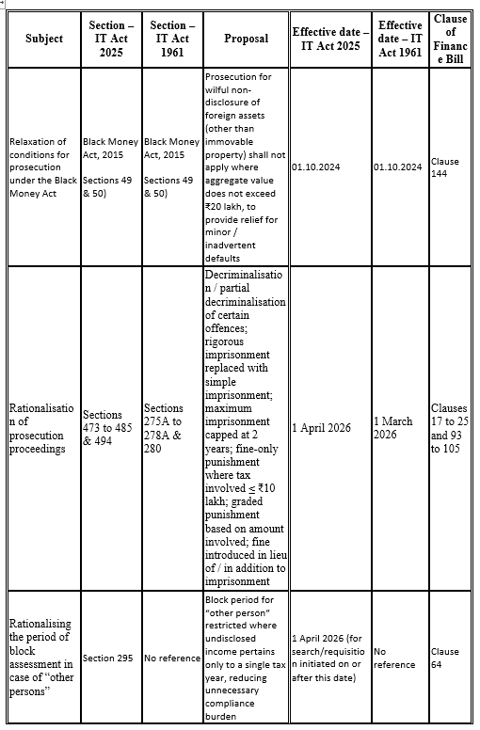
OTHER AMENDMENTS

Slide 34
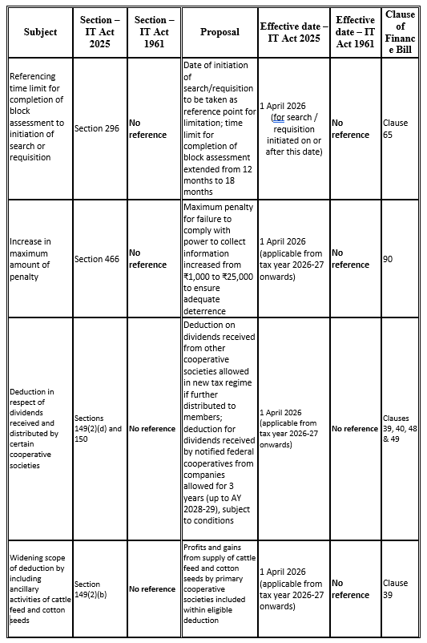
OTHER AMENDMENTS

Slide 35
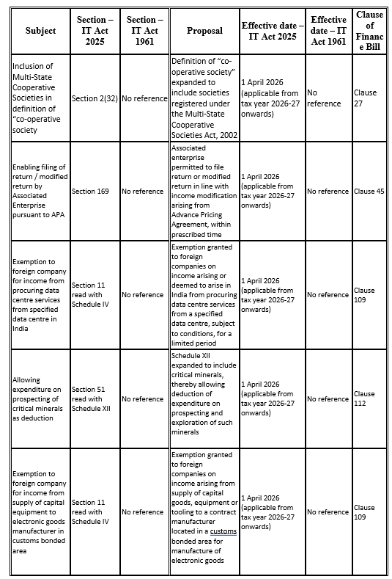
OTHER AMENDMENTS

Slide 36
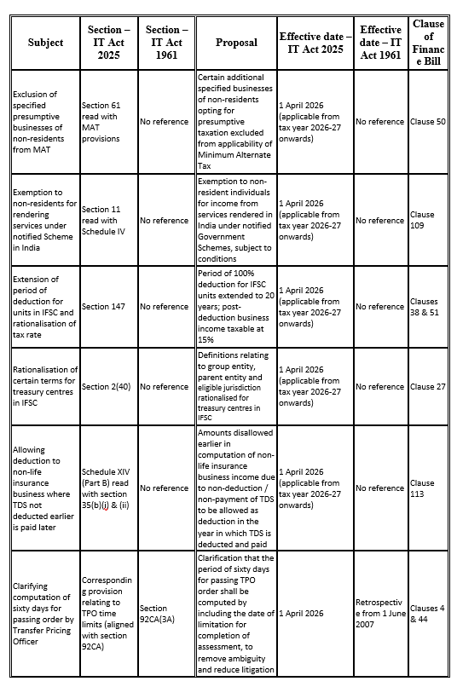
OTHER AMENDMENTS

Slide 37
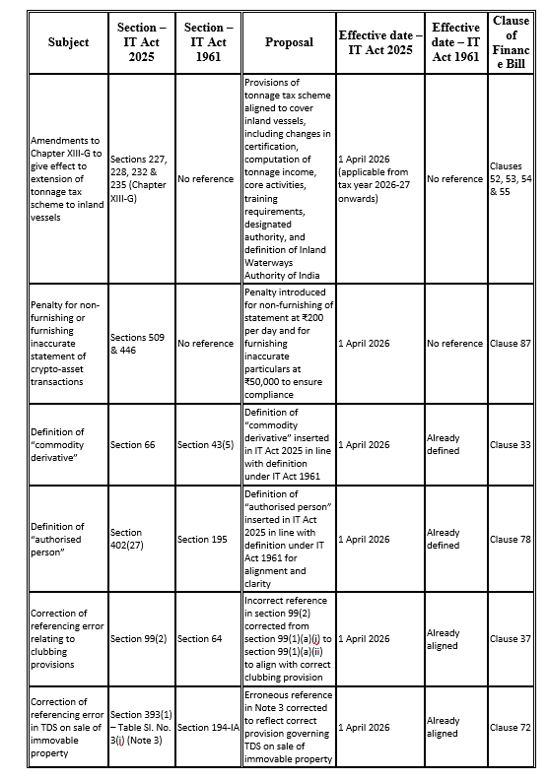
OTHER AMENDMENTS

Slide 38
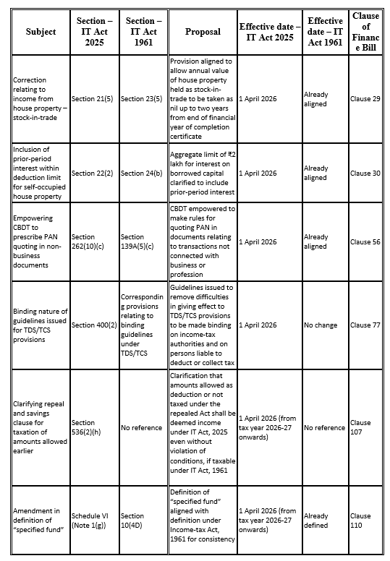
OTHER AMENDMENTS

Slide 39
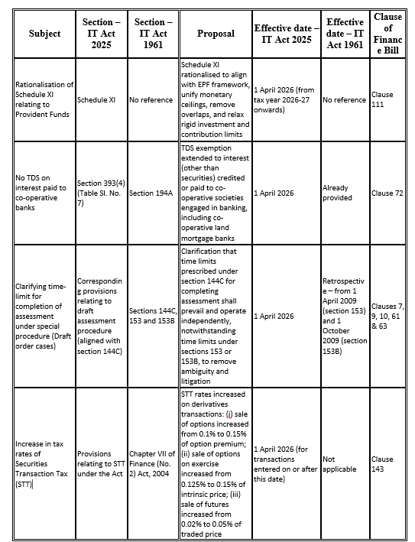
OTHER AMENDMENTS

Slide 40
Post Budget Musings
The relief proposed in respect of employees’ contribution of PF should have been extended under the 1961 Act also. The matter, however, is sub-judice.
The fine prescribed for tax audit default is too harsh. It should have been a staggered fees starting from Rs. 5,000 (1 month), Rs. 10,000 (2 months), Rs. 15,000 (3 months), Rs. 25,000 (3 months to 6 months). Rs. 50,000 (6 months to 9 months) Rs. 1,00,000 (9 months to 1 year), Rs. 1,50,000 (beyond 1 year). Moreover, there should be a reasonable clause window for charging this fine.
Tax audit due date should have been re-aligned with the ITR due date. (remove 1 month before concept)
Post covid the stamp duty value in many places are high compared to actual consideration. Suitable amendment in this regard was expected.
Though said in budget speech – ITR due date in non audit trust cases remains at July 31.
The reduction in tax rate vis a vis unexplained sources in the new Act should have been brought in the 1961 Act also.
1961 Act provides for deemed application of income by filing Form No. 9A when income is not received. Parallel provision could have been inserted in 2025 Act.

Slide 41
thank you…
Income-tax Act, 2025 is the present.
Income-tax Act, 1961 has limbs placed in past, present and future
So we should know both
“The law has changed.
The responsibility has doubled.”

