Slide 1

Workshop on GST at Thrissur Branch of SIRC of ICAI
Topic: Place of Supply – IGST Act 2017
Date: 25-11-2025
By CA Rishabh A Parikh
FCA, MCom(F&T), DISA(ICAI), PGD(GST), BCom, Social Auditor
The Institute of Chartered Accountants of India

Slide 2
Place of Supply –
Section 7- 13 IGST Act 2017

Slide 3
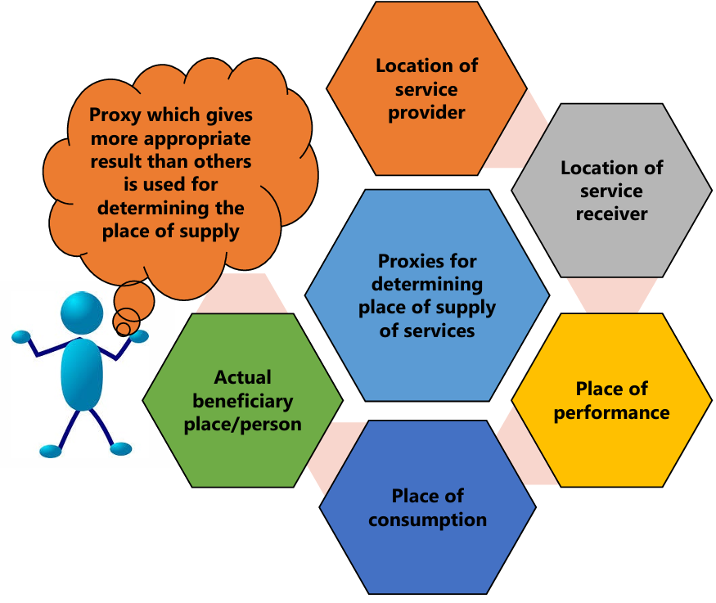
Introduction
GST is a DESTINATION-BASED CONSUMPTION TAX, i.e. the tax is levied on the consumption of supply at the destination thereof or at the point of consumption of such supply.
The ‘place of supply’ denotes the place where the supply is consumed.
Thus, place of supply determines the jurisdiction where the tax revenue should reach.

Slide 4
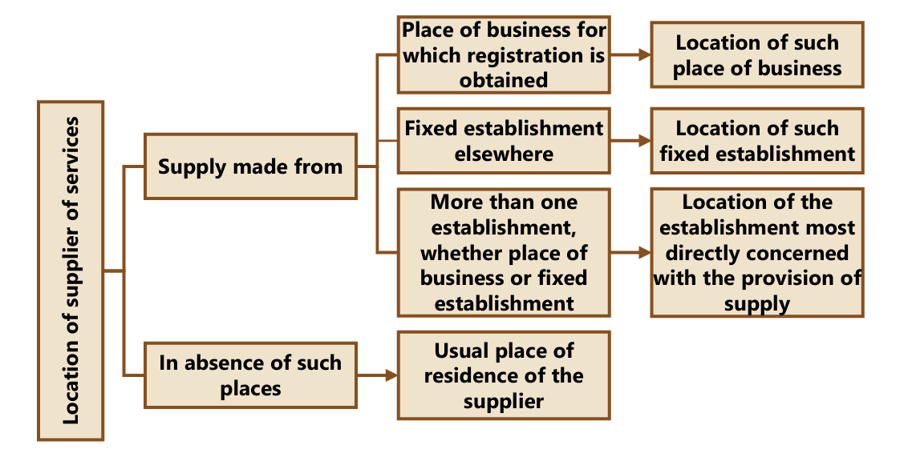
Location of Supplier of Service

Slide 5
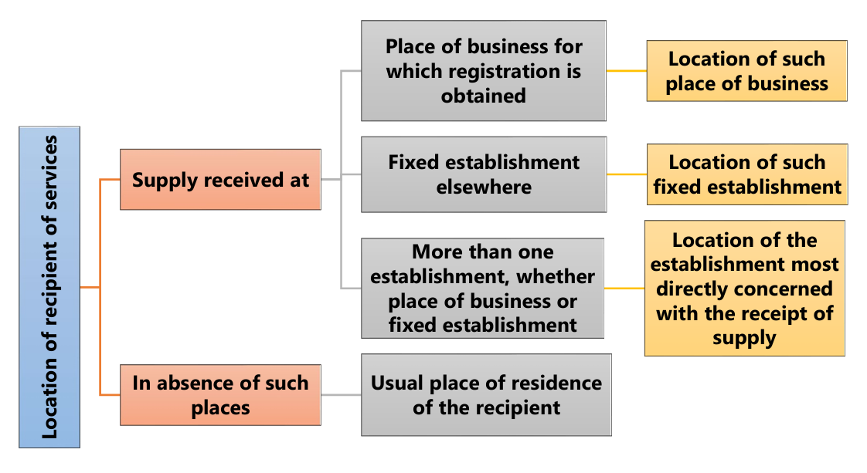
Location of Recipient of Service

Slide 6
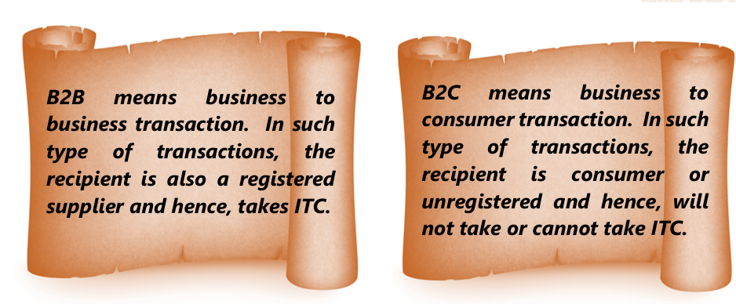
B2B vs B2C

Slide 7
Which tax would be charged in the below case by the Supplier ?
 | Location of Supplier | Location of Recipient | Place of Supply
Q1 | Delhi | Mumbai (GST Registered) | Delhi | Which Tax and can the recipient be able to take ITC?
Q2 | Delhi | Mumbai | Rajasthan | Which Tax and can the recipient be able to take ITC?

Slide 8
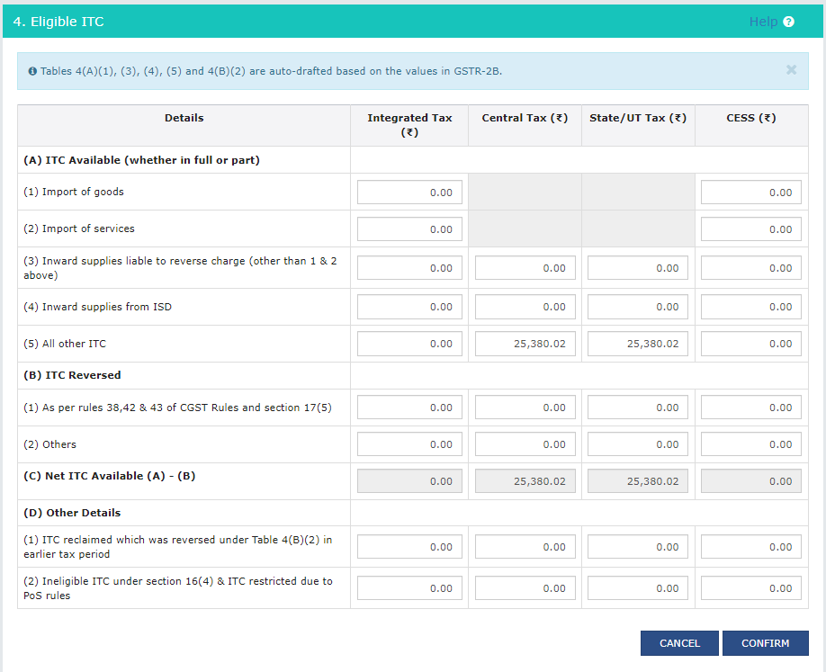
ITC Reporting in 3B

Slide 9
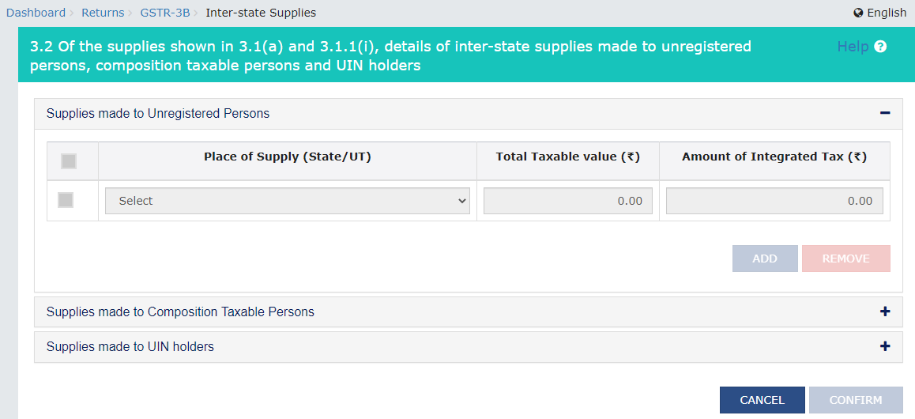
PoS reporting in 3B

Slide 10

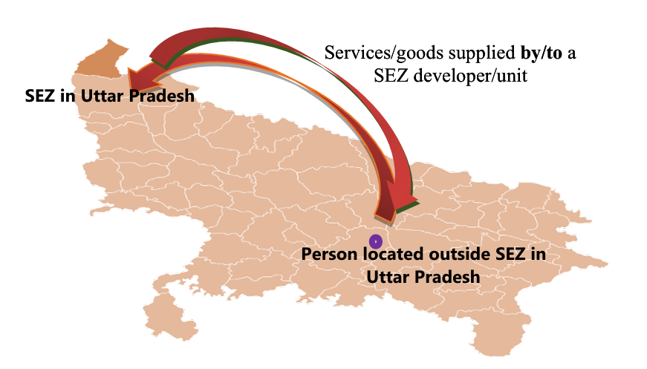
Section 7 – IGST Act
INTER STATE SUPPLIES

Slide 11
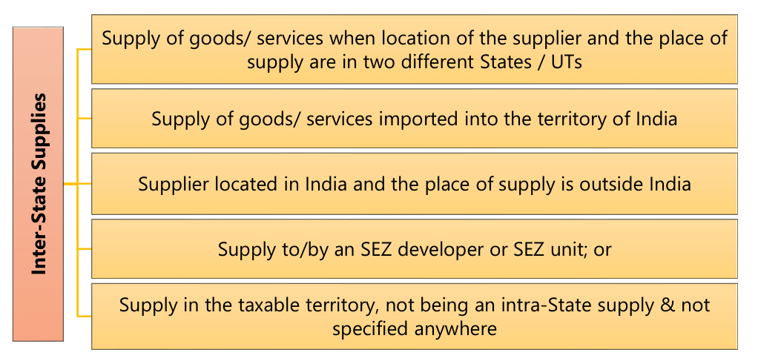
INTER STATE SUPPLY

Slide 12
Supplies TO/ BY SEZ
Supply TO SEZ (developer or unit) is treated as inter-State supply.
Supply BY SEZ (developer or unit) will also be treated as inter-State supply.
Further, the implication of this provision is also that supply by SEZ’s inter se – one SEZ unit (or developer) to another SEZ unit (or developer) – will also be treated as a supply in the course of inter-State trade or commerce.
Examples:
Taxable person (non-SEZ) located in Jaipur supplying goods to a SEZ unit located in Jodhpur is a supply in the course of inter-State trade or commerce.
SEZ unit in Kolkata supplying services to another SEZ unit in Kolkata is a supply in the course of inter-State trade or commerce.
Lease of premises by SEZ developer in Chennai to SEZ unit in that same zone in Chennai will be a supply in the course of inter-State trade or commerce.

Slide 13
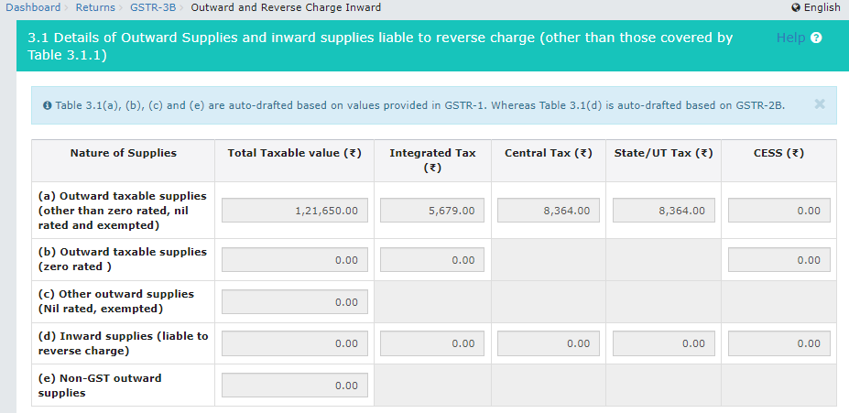
GSTR 3B

Slide 14
Supplies TO/ BY SEZ
Supplies made TO SEZ developer/ unit would be regarded as zero-rated supplies.
As per section 16 of the IGST Act, the following taxable supplies of goods and/ or services are considered as ‘zero rated supplies’:
Export of goods or services or both
Supply of goods or services or both for authorized operations to a SEZ developer or SEZ unit.
Section 2(c) of SEZ Act 2005 - “authorized operations” means operations which may be authorized under sub-section (2) of section 4 and sub-section (9) of section 15
Input tax credit can be availed for making zero-rated supplies, even though such zero-rated supplies may be an exempt supply

Slide 15
Supplies TO/ BY SEZ
Goods imported by SEZ from outside India do not attract liability to IGST as the goods are ‘not yet’ liable to be assessed to customs duty. Section 53 of the SEZ Act states that a SEZ shall be deemed to be a territory outside the customs territory of India for the purposes of undertaking the authorized operations.
Notification No. 18/2017-Integrated Tax (Rate) dated 05.07.2017: IGST exemption to SEZs on import of Services by a unit/ developer in a SEZ for authorized operations.
DTA sales (goods) by SEZ will not be liable to GST under forward charge as IGST will be paid when DTA-buyer files bill of entry in terms of rule 48(1) of SEZ Rules.

Slide 16
Summary SEZ Transactions
Supply | Taxability
Supply of Goods/ Services from DTA TO SEZ unit/Developer (for authorized operation)
Supply of Goods/ Services from DTA TO SEZ unit/Developer (NOT authorized operation)
Supply of GOODS by SEZ to DTA
Supply of SERVICES by SEZ to DTA

Slide 17
Summary SEZ Transactions
Supply | Taxability
Supply of Goods/ Services from DTA TO SEZ unit/Developer (for authorized operation) | ZERO rated supply
Supply of Goods/ Services from DTA TO SEZ unit/Developer (NOT authorized operation) | Inter state taxable supply UNDER FCM
Supply of GOODS by SEZ to DTA | Import of goods – Bill of Entry to be filed Tax to be paid by recipient & ITC to be claimed (SEZ will report in 9C only & not in GSTR 1,3B,9)
Supply of SERVICES by SEZ to DTA | FCM (SEZ will report in GSTR 1,3B,9)

Slide 18

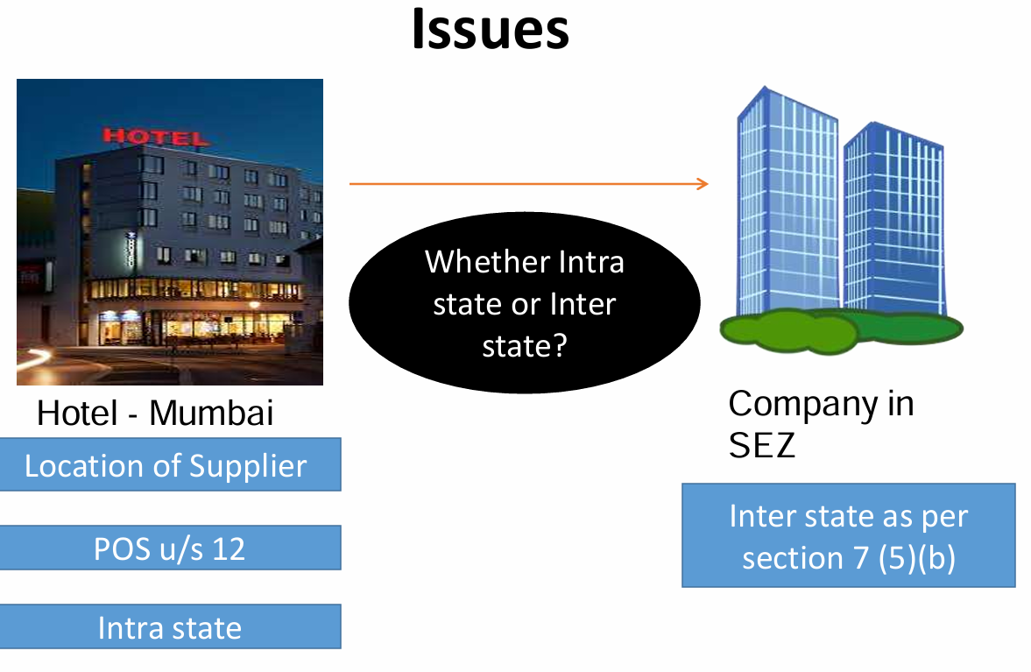
Quick Question
Services by ADVOCATE / FIRM OF ADVOCATES TO SEZ Unit
Taxable Under FCM ? RCM ? Exempt ? Zero Rated ?

Slide 19
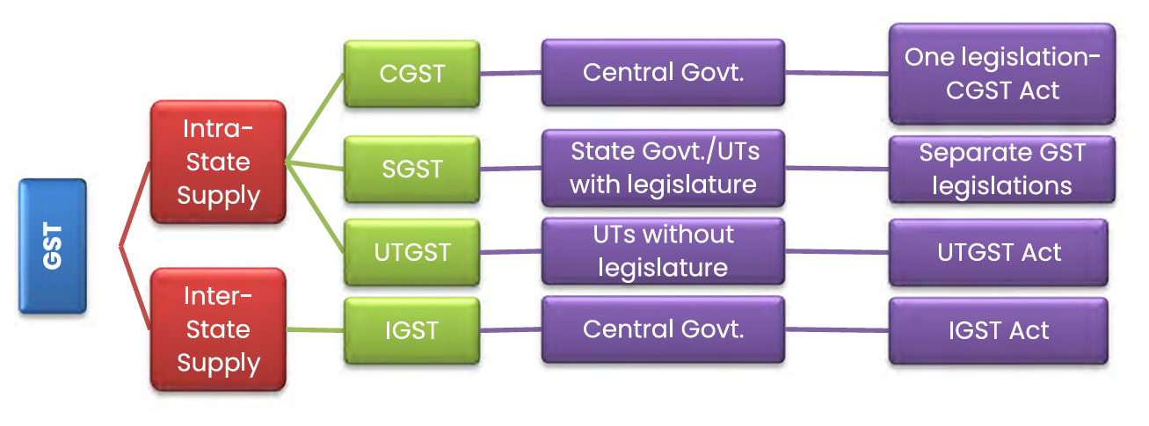
Section 8 – IGST Act
INTRA STATE SUPPLIES

Slide 20
INTRA STATE SUPPLY
Subject to the provisions of section 10, supply of goods where the location of the supplier and the place of supply of goods are in the same State or same UT shall be treated as intra-State supply
Subject to the provisions of section 12, supply of services where the location of the supplier and the place of supply of services are in the same State or same UT shall be treated as intra-State supply.
Provided that the following supply of goods shall not be treated as intra-State supply, namely:-
(i) supply of goods/services to or by a SEZ developer or a SEZ unit;
(ii) goods imported into the territory of India till they cross the customs frontiers of India; or
(iii) supplies made to a tourist referred to in section 15.

Slide 21
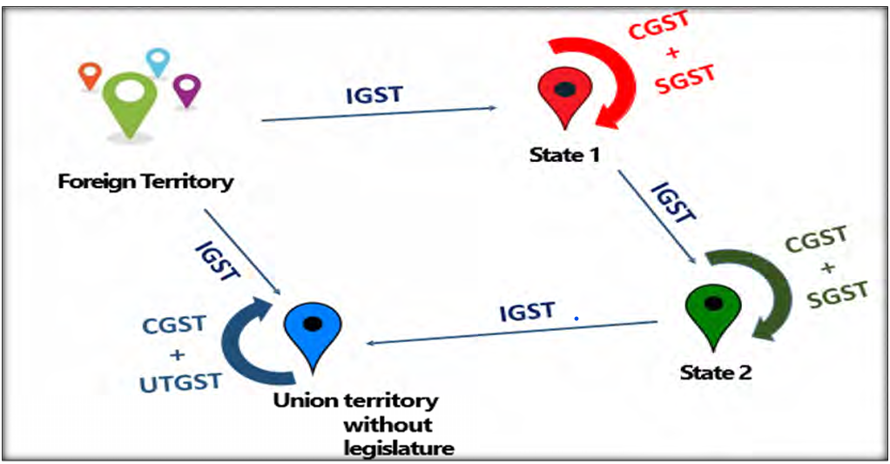
Summary

Slide 22
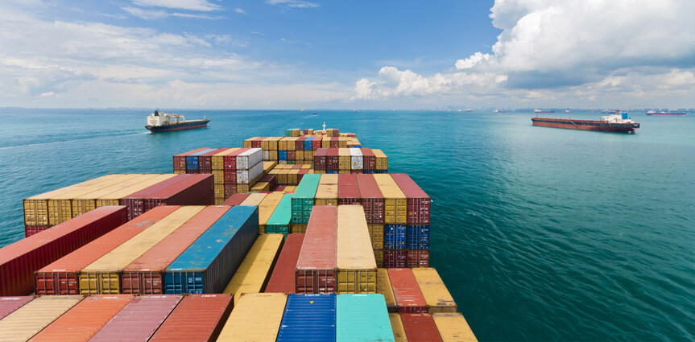
Section 9- IGST Act
SUPPLIES IN TERRITORIAL WATERS

Slide 23
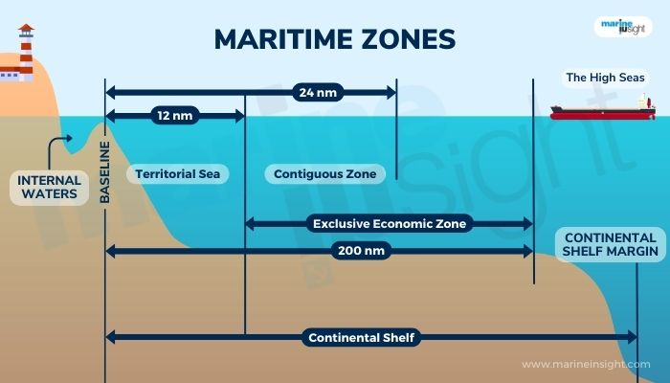
Supplies in Territorial Waters
‘Territorial waters’ has not been defined in the GST law.
As per UN Convention on the Law of the Sea, the term ‘territorial sea’ is a belt of coastal waters extending atmost 12 nautical miles from the baseline of a coastal state.
Section 9 states that Notwithstanding anything contained in this Act –
where the location of the supplier is in the territorial waters, the location of such supplier; or
where the place of supply is in the territorial waters, the place of supply,
shall, for the purposes of this Act, be deemed to be in the coastal State or Union territory where the NEAREST point of the appropriate baseline is located.

Slide 24
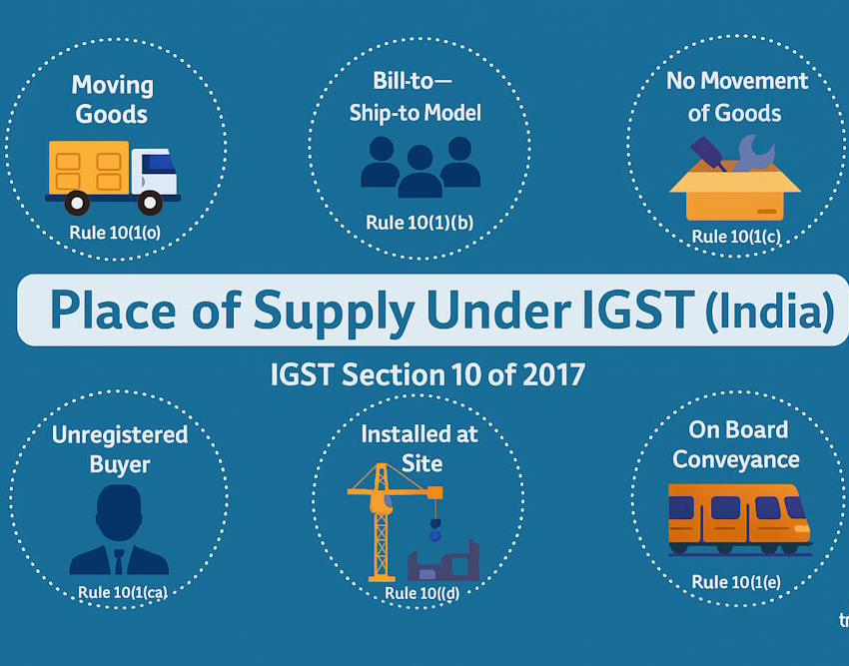
Section 10 - IGST Act
POS OF GOODS –
(OTHER THAN GOODS IMPORTED / EXPORTED)

Slide 25
Section 10 IGST Act
Section 10(1)(a)
Supply involves movement of Goods whether by S/R/others
Section 10(1)(b)
Goods supplied on direction of the third person
Section 10(1)(c) Supply does not involves movement of goods
Location of goods at the time at which movement terminates for delivery to recipient
Principal Place of Business of the third person
Location of goods at the time of delivery to the recipient

Slide 26
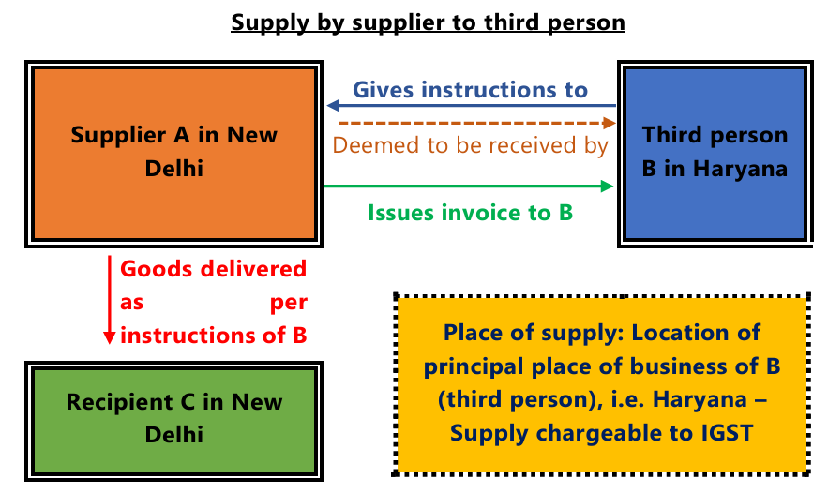
Bill To Ship Model

Slide 27
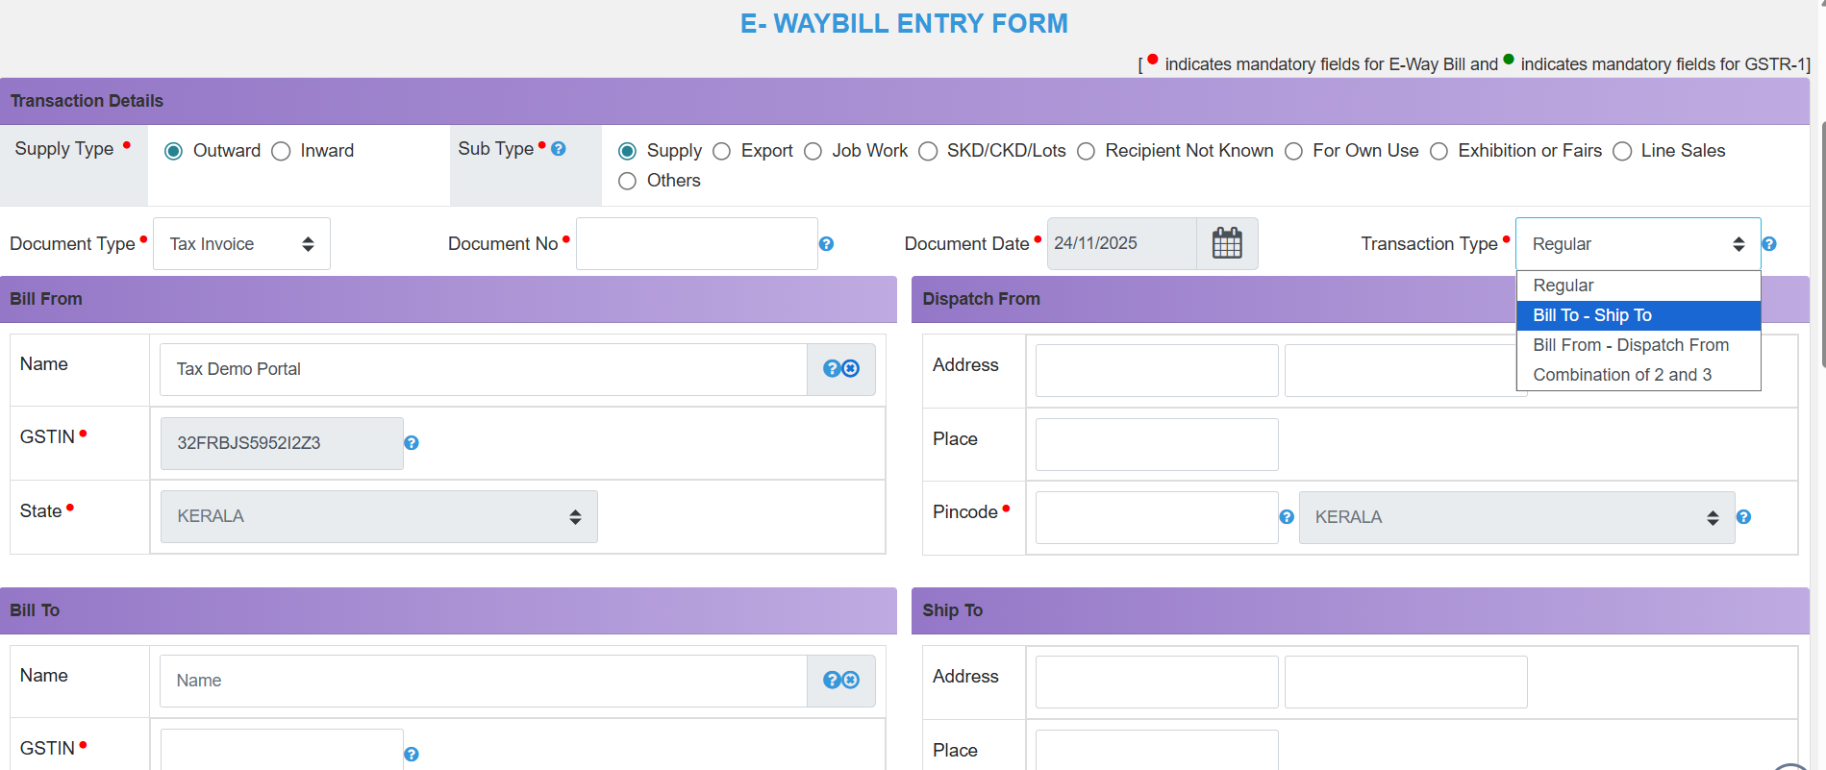
E Way Bill

Slide 28
Section 10 IGST Act
Section 10(1)(ca)
Supply made to unregistered persons
Section 10(1)(d)
Goods are assembled or installed at site
Section 10(1)(e) Goods supplied on board a conveyance
Location as per address of unregistered person recorded in the invoice &
if N/A - LoS
Location at which such goods are taken on board
Place of installation or assembly

Slide 29
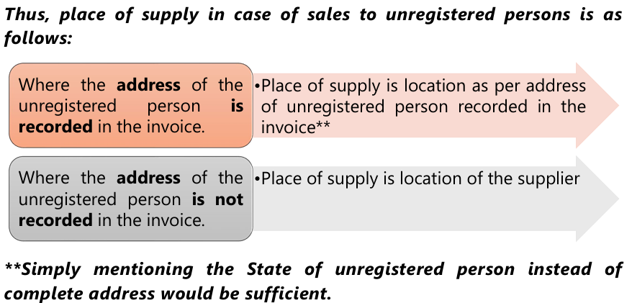
Circular on Section 10(1)(ca)
Mr. A (unregistered person) located in Kerala State places an order on an e-commerce platform for supply of a mobile phone, which is to be delivered at an address located in Karnataka State. Mr. A, while placing the order on the e-commerce platform, provides the billing address located in Kerala State.
In such a scenario, what would be the place of supply of the said supply of mobile phone, whether the State pertaining to the billing address i.e. State Kerala or the State pertaining to the delivery address i.e. Karnataka State?

Slide 30
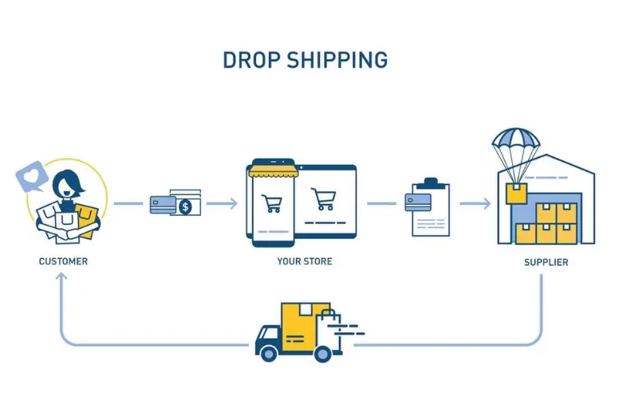
Circular 209/3/2024 GST dated 26.06.2024
As per the provisions of section 10(1)(ca), the place of supply of goods shall be the address of delivery of goods recorded on the invoice i.e. Karnataka State in the present case where the delivery address is located.
I.e in cases involving supply of goods to an unregistered person, where the billing address and delivery address are different, the supplier may record the DELIVERY ADDRESS as the address of the recipient on the invoice for the purpose of determination of PoS of the said supply of goods

Slide 31
Section 11 - IGST Act
POS OF GOODS –
IMPORTED / EXPORTED

Slide 32
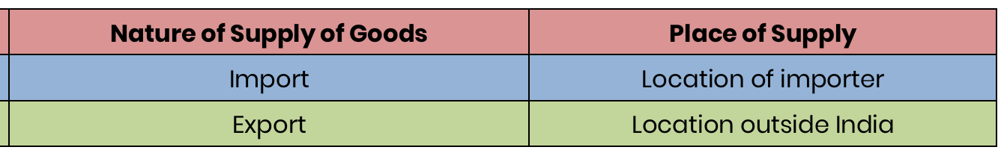
Section 11 IGST Act 2017
“Export of goods” with its grammatical variations and cognate expressions, means taking goods out of India to a place outside India
‘‘Import of goods” with its grammatical variations and cognate expressions, means bringing goods into India from a place outside India

Slide 33
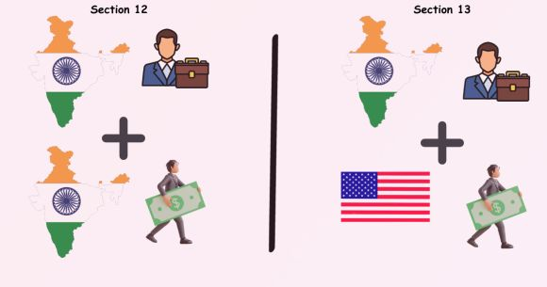
Section 12 IGST Act
POS OF SERVICES
Where Both LoS and LoR are in India

Slide 34
Section 12(3) and 12(4)
Services directly in relation to:
a) Immovable property – grant-of-
Place of supply – Section 12(3): Location of property/ boat/ vessel
If property is outside India – Location of Recipient
rights, construction, use,
accommodation, marriage, letting
out, architects, surveyors, any other
related expert
Boat, Vessel – lodging, club, etc.
Ancillary services to the above
Supply of:
Restaurant and catering
Personal grooming
Fitness
Beauty treatment
Health service including cosmetic
and plastic surgery
Place of supply –
Section 12(4):
Location of ‘actual’
performance

Slide 35
Quick Question

Slide 36
Quick Question
CBIC vide Circular No. 48/22/2018-GST dated 14.06.2018 has clarified that services of short-term accommodation, conferencing, banqueting etc., provided to a SEZ developer or a SEZ unit shall be treated as an inter-State supply.
Accommodation services provided to SEZ units are to be treated as zero rated supplies [Carnation Hotels (P) Ltd. v/s AAR (Karnataka)]

Slide 37
Section 12(5), 12(6) and 12(7)
Sec 12(5): Supply of Services of Training and Performance Appraisal
Sec 12(6): Supply of
Sec 12(7): Supply of:
Services for
admission to:
a) Organising cultural, arts,
sports, educational, scientific,
Cultural and artistic
Sporting
entertainment, conference, fair
exhibition or similar events
b) Services ancillary to above
c) Scientific and
Registered
recipient:
Location of
recipient
educational
Registered recipient:
Location of
recipient
Entertainment event
Amusement Park
Services ancillary to
above
Unregistered recipient:
Venue of event
Unregistered
recipient:
Place of
‘actual’ performance
Venue of
event/ park
Event outside India: Location of recipient

Slide 38
Section 12(8), 12(9) and 12(10)
Sec12(8):
Registered Recipient: Location of Recipient
Unregistered Recipient: Location where goods handed over for transportation
Registered Recipient: Place of
Registered Recipient
Transportation of
goods, including by mail
or courier
Sec12(9):Passenger
Supply of services of:
Transportation Service
Unregistered Recipient: Place where passenger embarks on the conveyance for a continuous journey
Sec 12 (10): Services on board conveyance like
First scheduled point of departure of
that conveyance for that journey
vessel, aircraft, train,
motor vehicle

Slide 39

Section 12(8), 12(9) and 12(10)
Will the PoS be different if it is a EX Factory Contract ?
Sec12(8):
Registered Recipient: Location of Recipient
Unregistered Recipient: Location where goods handed over for transportation
Registered Recipient: Place of
Registered Recipient
Transportation of
goods, including by mail
or courier
Sec12(9):Passenger
Supply of services of:
Transportation Service
Unregistered Recipient: Place where passenger embarks on the conveyance for a continuous journey
(Return journey treated as
separate journey)
Sec 12 (10): Services on board conveyance like
First scheduled point of departure of
that conveyance for that journey
vessel, aircraft, train,
motor vehicle

Slide 40

Place of Supply of Service
Which Section will be used to determine Place of Supply – Sec 12/ Sec 13 of IGST Act. Service is Flight Ticket?
 | LOS | LOR | Boarding Location | Which Section will be used to determine Place of Supply
Q1 - Book the Ticket from Delhi to London from Indigo Delhi | Delhi | Mumbai | Delhi | Sec 12 OR Sec 13
Q2 - Book the Return Ticket from London to Delhi from Indigo Delhi | Delhi | Mumbai | London | Sec 12 OR Sec 13

Slide 41

Continuous Journey - Section 2(3)
Continuous journey means a journey for which a single or more than one ticket or invoice is issued at the same time, either by a single supplier of service or through an agent acting on behalf of more than one supplier of service, and which involves no stopover between any of the legs of the journey for which one or more separate tickets or invoices are issued.
Explanation.––For the purposes of this clause, the term “stopover” means a place where a passenger can disembark either to transfer to another conveyance or break his journey for a certain period in order to resume it at a later point of time.

Slide 42
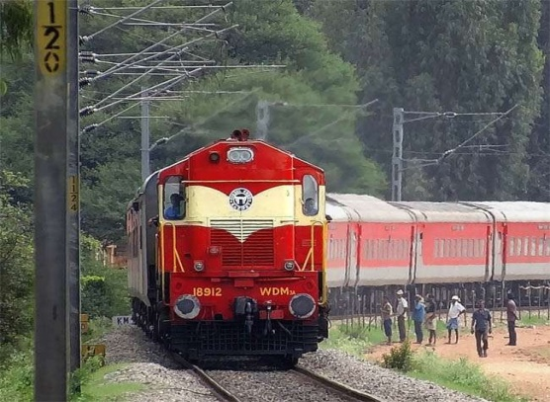

Quick Question
Train is starting from J&K
Mr A from Rajasthan
Goods were loaded in Train at UP
Mr A is going to Kolkata
Mr A has Boarded the train from Delhi
Mr A Purchased Goods and Services at MP
 |  | If Mr A registered at Rajasthan | If Mr A unregistered
1 | Taken Goods at MP consumed at Kolkata – What is POS of Goods
2 | Taken Services during the Journey at MP – What is POS
3 | POS for Train Ticket

Slide 43
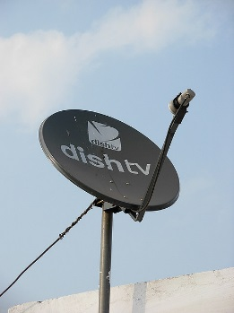
Section 12(11)
Supply of telecommunication services including data transfer, broadcasting, DTH, cable etc.
(a) Services of fixed
telecommunication line, leased
Location
installed
where line /device is
circuits, internet leased circuit,
cable or dish antenna
(b) Post-paid mobile connection
Location of billing address of the
recipient on record
for telecommunication and
internet services*
Through internet: Location of recipient on
record
(c) Pre-paid mobile connection
for telecommunication and
Through selling agents: Location of selling
internet services*
agent on record of supplier
Though others: Location where pre-
payment received / vouchers sold
In cases not covered, address of recipient on records shall be the place of supply;
Where no address of the recipient available in records, location of the supplier shall be the
place of supply

Slide 44
Section 12(12), 12(13) and 12(14)
Supply of:
Sec 12(12) Banking and Other Financial Services including Stock Broking
Sec 12(14)
Advertisement Services to Government.
Sec 12(13)
Insurance Services
Location of recipient in suppliers records
(If not available, location of supplier)
Registered recipient:
Location of such person
Unregistered recipient: Location of recipient in supplier’s records
Place is State of dissemination in proportion

Slide 45
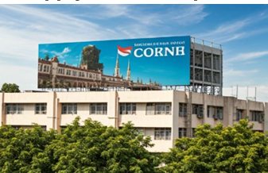
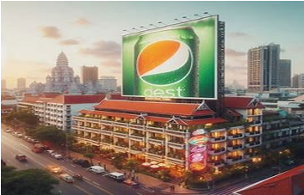
Circular on Advertisements
Circular No. 203/15/2023 GST dated 27.10.2023
VS
ADVERTISMENT VS RIGHT TO USE SPACE

Slide 46
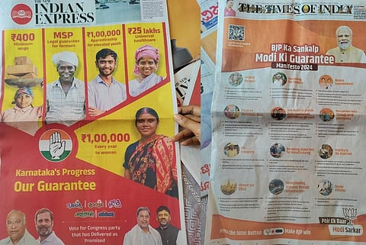

Circular on Advertisements
VS

Slide 47
Notification No. 12/2017-IGST dated 15.11.2017
Type of Transaction | Manner of determination of value
Newspapers & Publications | The value attributable to dissemination of advertisement in a State shall be the amount payable for publishing the advertisement in such state.
Printed material like pamphlets, leaflets, diaries, calendars, T- shirts, etc. | The value attributable to dissemination of advertisement in a state shall be the amount payable for distribution of a specific number of such material in a State or UT.
Hoardings other than those on trains | The value attributable to dissemination of advertisement in a State is to be based on the amount payable for hoardings located in each State or UT.
Advertisement placed on trains | The value attributable to dissemination of advertisement in a State is to be based on the ratio of the length of railway track in each state for that train.
Advertisement on back of Utility Bills of Oil & Gas Companies, etc. | The value attributable to dissemination of advertisement in a State or UT is to be based on bills pertaining to consumers having billing addresses in each State or UT.

Slide 48
Notification No. 12/2017-IGST dated 15.11.2017
Type of Transaction | Manner of determination of value
Advertisement on back of Railway Tickets | The value attributable to dissemination of advertisement in a State is to be based on the basis of ratio of the number of Railway Stations in each State or UT.
Advertisement over Radio Stations | The value attributable to dissemination of advertisement in a State is to be calculated based on the amount payable to such radio stations.
Advertisement on Television Channels | The value attributable to dissemination of advertisement in a State is to be calculated on the basis of the viewership of such channel in the State/UT.
Advertisement at Cinema Halls | The value attributable to dissemination of advertisement in a State is to be based on the amount payable to a cinema hall/screens in a multiplex in such State or UT.
Advertisement Over Internet | The value attributable to dissemination of advertisement in a State is to be based on the basis of the internet subscribers in such state or UT.

Slide 49
Section 12(2) –General Clause
Section 12(2)(a): Registered recipient:
Location of recipient
For Supply of any other Service,
Place of supply is:
(General Rule)
Section 12(2)(b): Unregistered recipient:
  Location of recipient if address in supplier’s records
Location of supplier if address not available

Slide 50
Section 13 IGST Act
POS OF SERVICES
Where either LoS or LoR is Outside India

Slide 51
Sec 13(3) to 13(8) IGST
Services when goods required to be made physically available by recipient or
requiring physical
presence of receiver / person acting on his behalf
Service by way of admission to / organising an event, etc. and ancillary services
Services supplied directly in relation to immovable property
Banking services to account holders, intermediary services, hiring of means of transport (other than aircraft and vessels) up to 1 month
Sec 13(3)(a)
Location where services actually performed
Sec 13(4) Location of such immovable property (or where it is intended to be located)
Sec 13(5)
Place where the event is actually held
Sec 13(8)
Location of
supplier
1 to 3 → When supplied at >1 location (including taxable territory) → Deemed location in India. – Sec 13(6)
When supplied from >1 state / UT → In proportion to the value of services – Sec 13(7)

Slide 52
IGST [Amendment] Act 2018, W.e.f 1-2-2019 amendment to section 13(3)(a)
To determine the place of supply of services supplied in respect of goods which are TEMPORARILY IMPORTED IN TO INDIA for repairs or for any other treatment or processes and ARE EXPORTED AFTER SUCH REPAIRS or treatment or processes without being to put to use in India, other than that which is required for such repairs or treatment or process, the provisions of section 13(3)(a) will not be applicable and place of supply shall be determined as per section 13(2) , the general provision [i.e. Location of recipient of service]
Further, where Services are supplied in respect of goods but from a remote location by way of electronic means, the PoS shall be the Location where the goods are situated at the time of supply of services

Slide 53
Intermediary Services
Section 2(13) of the IGST Act, 2017, an “Intermediary” means a broker, an agent or any other person, by whatever name called, who arranges or facilitates the supply of goods or services or both or securities, between two or more persons, but does not include a person who supplies such goods or services or both or securities on his own account
Section 2(5) of CGST Act “agent” means a person, including a factor, broker, commission agent, arhatia, del credere agent, an auctioneer or any other mercantile agent, by whatever name called, who carries on the business of supply or receipt of goods or services or both on behalf of another;

Slide 54
Circulars and Amendment
Important Circular No. 230/24/2024 dated 10/Sept/24 for intermediary services in relation to advertisement services
Important Circular No. 232/26/2024 dated 10/Sept/24 for clarification on place of supply of data hosting services provided by service providers located in India to cloud computing service providers located outside India
Important Circular No. 242/36/2024 dated 31/Dec/24 for clarification on place of supply of Online Services supplied by the suppliers of services to unregistered recipients
The 56th GST Council Meeting has recommended omission of section 13(8)(b). Accordingly, after the said law amendment, the PoS for “intermediary services” will be determined as per the default provision under section 13(2) of the IGST Act i.e. the location of the recipient of such services. This will help Indian exporters of such services to claim export benefits.

Slide 55
Sec 13(2) and 13(10) to 13(12) IGST
Passenger transportation service
Online information and database access or retrieval services
Service provided on board a conveyance
Residuary Sec 13(2) General Provision
Location of the recipient;
If not available in the ordinary course of business, location of supplier
Sec 13(10)
Place where passenger embarks on the conveyance for a continuous journey
Sec 13(11)
First scheduled point of departure of that conveyance for that journey
Sec 13(12)
Location of recipient*

Slide 56

OIDAR Services
Explanation.––For the purposes of this sub-section, person receiving such services shall be deemed to be located in the taxable territory, if any TWO of the following non contradictory conditions are satisfied-
Location of address presented by the recipient through internet is in the taxable territory;
the credit card or debit card or store value card or charge card or smart card or any other card by which the recipient settles payment has been issued in the taxable territory;
the billing address of the recipient is in the taxable territory;
the IP address of the device used by the recipient is in the taxable territory;
the bank of the recipient in which the account used for payment is maintained is in the taxable territory;
the country code of the SIM card used by the recipient is of taxable territory;
the location of the fixed land line through which the service is received by the recipient is in the taxable territory.

Slide 57
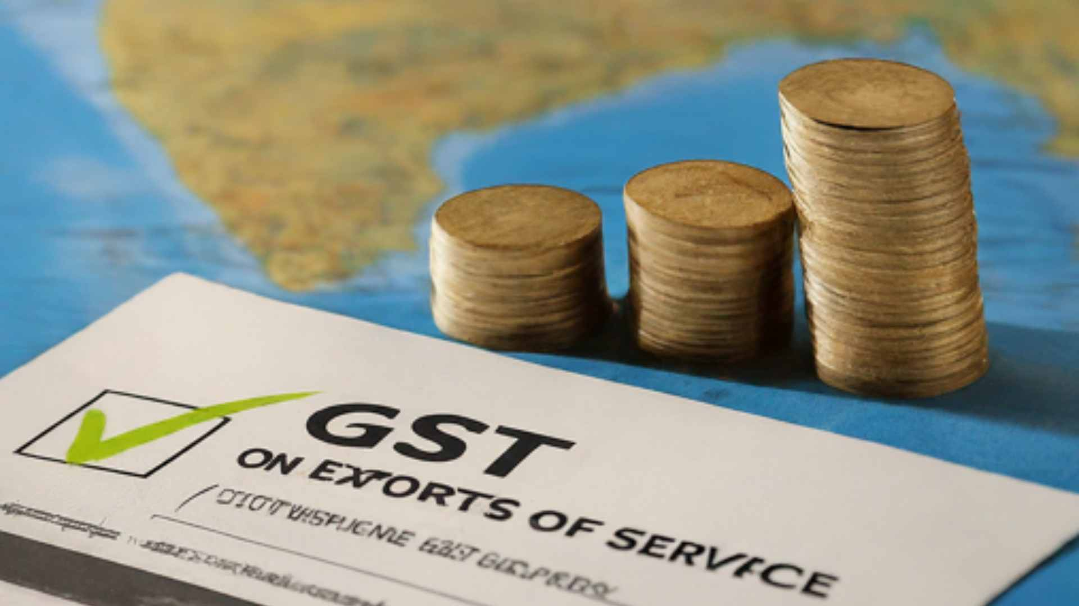
Export of Service - Section 2(6)
Export of services means the supply of any service when
the supplier of service is located in India,
the recipient of service is located outside India,
the place of supply of service is outside India,
the payment for such service has been received by the supplier of service in convertible foreign exchange or in Indian rupees wherever permitted by the RBI; and
the supplier & recipient are not merely establishments of a distinct person in accordance with explanation 1 of section 8

Slide 58
Explanation 1 and 2 to Section 8
As per Explanation 1 to Section 8, the following are treated as establishments of distinct persons:
• an establishment in India and any other establishment outside India;
• an establishment in a State/UT and any other establishment outside that State /UT; or
• an establishment in a State/UT and any other establishment registered within that State/UT
Explanation 2 ––A person carrying on a business through a branch or an agency or a representational office in any territory shall be treated as having an establishment in that territory.

Slide 59
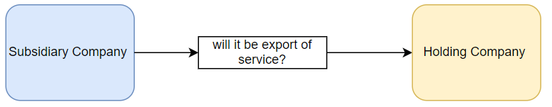
Question
59
A company incorporated in India and a body corporate incorporated by or under the laws of a country outside India, which is also referred to as foreign company under the Companies Act, are separate persons under CGST Act, and thus are separate legal entities.
Accordingly, these two separate persons would not be considered as “merely establishments of a distinct person in accordance with Explanation 1 in section 8”. [Circular No. 161/17/2021-GST]
Supplies between such companies, therefore, would qualify as ‘export of services’, subject to fulfillment of other conditions as provided under sub-section (6) of section 2 of IGST Act.

Slide 60
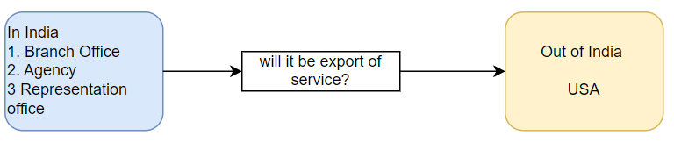
Question
60
Not to be treated as Export of services as they are to be treated as establishments of a distinct person [Circular No. 161/17/2021-GST]
However Entry no. 10F via N/N 15/18 I.T.R provides exemption to the above services –
Services supplied by an establishment of a person in India to any establishment of that person outside India, which are treated as establishments of distinct persons in accordance with Expl. 1 in sec.8 of the IGST Act, 2017.

Slide 61
PoS of services notified u/s 13(13)
In order to prevent double taxation or non-taxation of the supply of a service, or for the uniform application of rules, the Govt shall have the power to notify any description of services or circumstances in which the place of supply shall be the place of effective use and enjoyment of a service.
Specified R&D services related to pharmaceutical sector by a person in taxable territory to a person in the non taxable territory
B2B maintenance, repair or overhaul services of aircrafts, aircraft engines/ parts
B2B MRO services of ships and other vessels, their engines and other components / parts
Location of recipient of services subject to certain conditions
Location of recipient of services
Location of recipient
of services

Slide 62


Slide 63

Thank You
Presented by:
CA Rishabh A Parikh,
FCA, M.Com (F&T), DISA (ICAI), PGD(GST), B.Com, Social Auditor
Email id: carishabhparikh@gmail.com
Mobile: +91-8547165943

