Slide 1

REFUND MECHANISM IN GST
CA PRASANTH SURYA
THRISSUR BRANCH
GST & INDIRECT TAX COMMITTEE OF ICAI

Slide 2
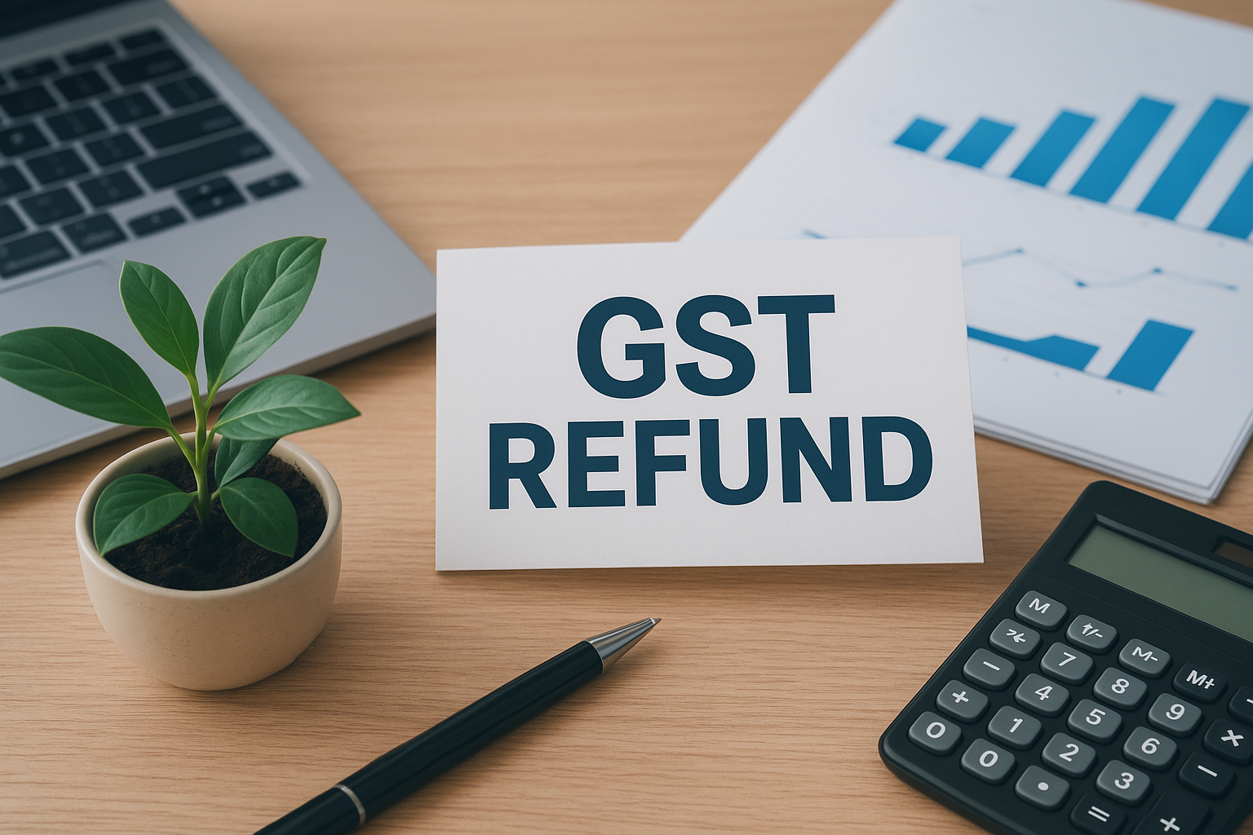
COMMON TYPES OF REFUND
Zero-rated supply (Exports, supply to SEZ)
Inverted duty structure
Excess payment of tax

Slide 3
Zero-rated supply
Exports or supplies to SEZ with payment of tax
(Automatic refund without application)
Exports or supplies to SEZ without payment of tax under LUT
(Refund on application)

Slide 4
ISSUANCE OF CREDIT NOTES
Credit Notes for the FY 2024-25 shall be issued within 30/11/2025

Slide 5
Common issues-GST refund
Aadhar authentication mandatory
Bank account has to be validated
Valid application within 2 years
If the government has reasons to believe that our purchases are forged, high chances of withholding refund on our outward supply

Slide 6
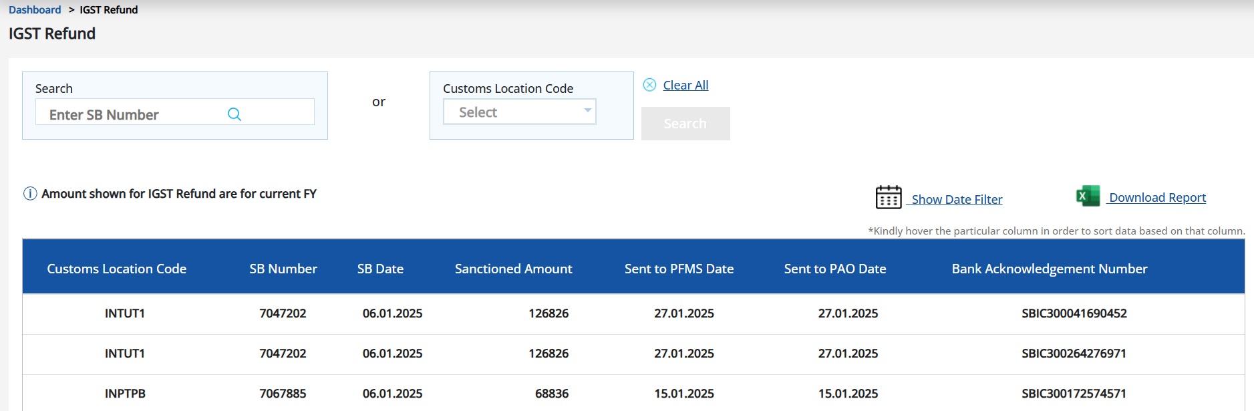
Common issues-GST refund
Check in ICEGATE portal

Slide 7

Common issues-Exports with payment of tax
EGM generation errors
Mismatch of GSTR1 and GSTR3B
Incomplete details in GSTR1 (Port Code,Shipping Bill No, Shipping Bill date, IGST value)
Code | Reason
SB000 | Successfully validated
SB001 | Invalid SB details
SB002 | EGM not filed
SB003 | GSTIN mismatch
SB004 | Record already received and validated
SB005 | Invalid Invoice Number
SB006 | Gateway EGM not available

Slide 8
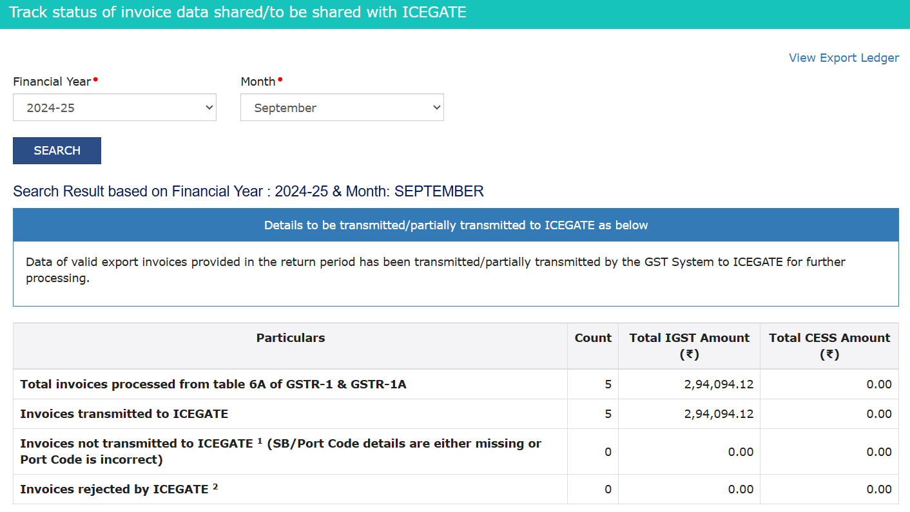
Common issues-Exports with payment of tax
-Check status in Services-> Track status of invoice data to be shared with ICEGATE

Slide 9
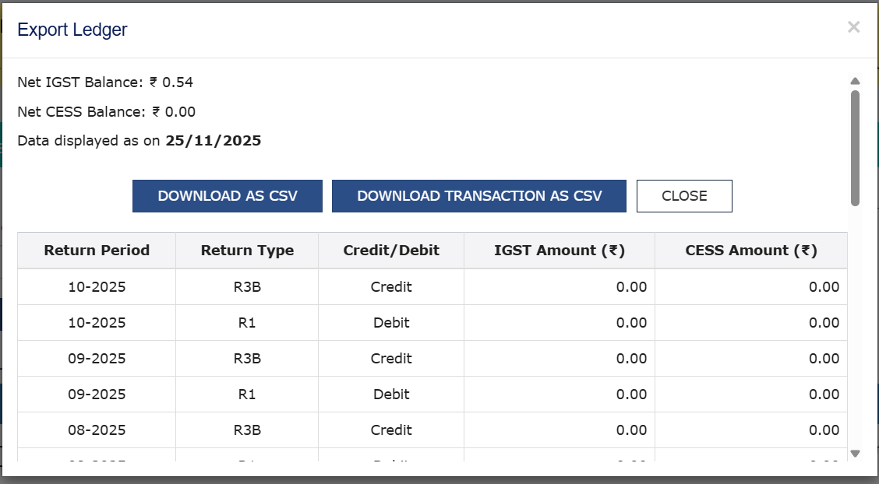
Common issues-Exports with payment of tax
-View export ledger for GSTR1 and GSTR3B payment reconciliation

Slide 10
Common issues-Exports refund
-Repayment of refund with interest within 30 days if export proceeds not realised within prescribed period
-On subsequent realisation of sale proceeds, refund will be returned back to the taxpayer on application within 3 months from the date of receipt
-Simultaneous claim of FTP benefits and IGST refund (No explicit restriction)

Slide 11
Common issues-Exports without payment of tax refund
-Prior to Exports, Bond or LUT shall be filed in the GST Portal
Though it’s a procedural lapse, LUT not filed prior to exports can be a showstopper in claiming refund

Slide 12

Common issues-Supplies to SEZ refunds
The term supply ‘for authorised operations’ had been introduced vide Notification No. 7/2023-CT dated 31/07/2023 w.e.f. 01/10/2023
Endorsement by the specified officer of SEZ is required as attachment as per Circular No.125

Slide 13
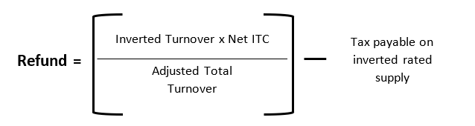
IDS Refund formula
Upto
05/07/22

Slide 14
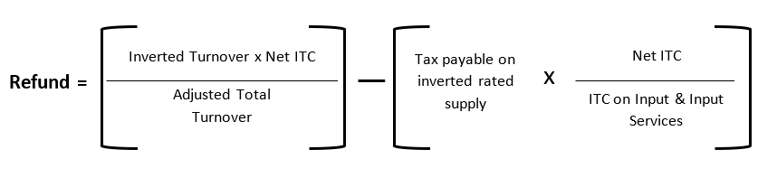
After
05/07/22
IDS Refund formula

Slide 15

Common issues-IDS
-IDS refund can be claimed only on inputs ITC
-IDS refund can also be claimed on outward supply of services
-No IDS refund if the accumulation is due to change in GST rate
-Suppose, if there are multiple inputs for an outward supply and only one of the inputs has a higher GST rate than the GST rate of the outward supply, even in such cases, IDS refund is eligible
-Satisfaction to the proper officer of IDS application to our case

Slide 16
Common issues-IDS
-IDS refund can be claimed only on inputs ITC
-IDS refund can also be claimed on outward supply of services
-No IDS refund if the accumulation is due to change in GST rate
-Suppose, if there are multiple inputs for an outward supply and only one of the inputs has a higher GST rate than the GST rate of the outward supply, even in such cases, IDS refund is eligible
-Satisfaction to the proper officer of IDS application to our case

Slide 17
Common issues-IDS
-Satisfaction to the proper officer of IDS application to our case
-Irregular IDS application deters officers the confidence of the applicability of IDS in our case
-Conditions not abided in the case of merchant exports

Slide 18
IDS after GST 2.0
Footwear industry (upto Rs.2,500 per pair)
Apparel industry (upto Rs.2,500)
Renewable energy devices
Merchant export supply

Slide 19
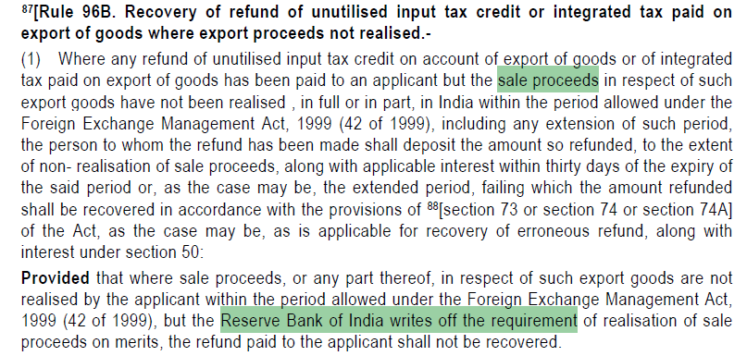
Common issues-Export

Slide 20
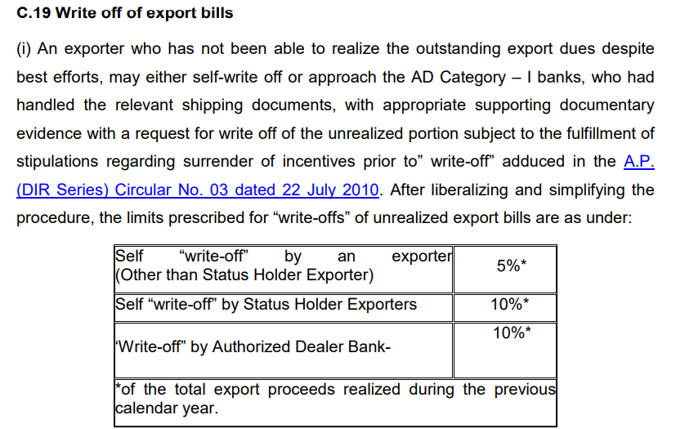
Common issues-Export

Slide 21
Common issues-Export
Non realisation of export sale proceeds-Rule 96B
RBI master direction 16/2015-16
If it is applicable for export made with payment of tax?

Slide 22
Common issues-Export/SEZ/IDS
-With effect from applications filed on or after 01/01/2022, only ITC reflected in GSTR2B can be included in the refund computation
-Para 1.3 of Circular No.197/09/2023 dt 17-07-2023 reads as follows:
“The matter has been examined and it has been decided that since availment of input tax credit has been linked with FORM GSTR-2B w.e.f. 01.01.2022, availability of refund of the accumulated input tax credit under section 54(3) of CGST Act for a tax period shall be restricted to input tax credit as per those invoices, the details of which are reflected in FORM GSTR-2B of the applicant for the said tax period or for any of the previous tax periods and on which the input tax credit is available to the applicant.”

Slide 23
Common issues-Export/SEZ/IDS
-The Adjusted total turnover given in refund applications is always matched with GSTR3B turnover. There is an explicit exclusion of exempt supplies from the Adjusted total turnover.
-There might be Schedule III transactions such as Bonded warehouse sales, High sea sales that would be reported in GSTR3B fearing non-disclosure of sales. In many cases, it is tough to prove to the satisfaction of the proper officer that such turnover shall be excluded while calculating adjusted total turnover

Slide 24
Common issues-Export/SEZ/IDS
-No one-to-one matching of purchase and sales with respect to refund formula prescribed in the rules
Purchases made in April might have been used in the sale of August month, But there is no provision to claim such refund if the prescribed formula doesn’t yield a positive figure

Slide 25
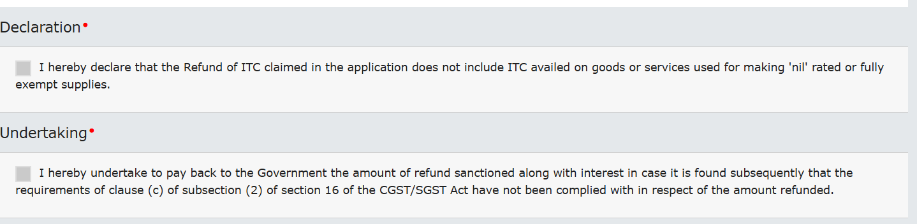
Common issues-Export/SEZ/IDS
-Circular No.125 clarifies the declaration/undertaking that is to be given online (check-box to be ticked while filing refund application). Those declarations are sometimes required to be submitted printing in letterhead and uploading separately as annexure

Slide 26
Issues requiring clarification
-Co-existence of GST refund on zero rated supplies and IDS domestic supplies
-No explicit bar on dual refunds in the same month
-M/s VSM Weavess India Private Limited (Madras High Court)
”it is evident that the refund claimed and received earlier pertained to zero rated supplies and not unutilized ITC. Under Section 54 of the GST Act, refund may be claimed either for unutilized ITC on account of an inverted duty structure or in respect of zero rated exports. Therefore, the refund claim for zero rated exports does not disentitle the petitioner from claiming a refund for unutilized ITC.”

Slide 27
Issues requiring clarification
-Treatment of capital goods turnover in the Adjusted total turnover
For example, in a month, only exports and a local capital goods supply is made, it would be unfair to proportion the refund in export to total turnover ratio (including capital goods supply) as capital goods ITC will not form part of Net ITC calculated as per the rule in the first place

Slide 28

Adventurous interpretations
-Section 54 which envisages refund reads as following:
Any person claiming refund of any tax and interest, if any, paid on such tax or any other amount paid by him, may make an application before the expiry of two years from the relevant date in such form and manner as may be prescribed:
It is interpreted that the refund period given is discretionary as ‘may’ is used instead of ‘shall’

Slide 29
Adventurous interpretations
-Rule 89(4) prescribes refund for zero rated supplies. Inorder to prevent excess refund from artificial hike in export prices to sister concerns, the ‘turnover of zero-rated supply of goods’ has been amended w.e.f. 23/03/2020
“Turnover of zero-rated supply of goods" means the value of zero-rated supply of goods made during the relevant period without payment of tax under bond or letter of undertaking or the value which is 1.5 times the value of like goods domestically supplied by the same or, similarly placed, supplier, as declared by the supplier, whichever is less

Slide 30
Adventurous interpretations
Subsequently, there were concerns in the industry that it would be unfair to limit only the numerator to ‘1.5 times’ but include the actual export turnover(which might be more than 1.5 times) while calculating ‘adjusted total turnover’ in the denominator.
Therefore, Circular No. 147/03/2021-GST dated 12/03/2021 clarified that for exports turnover, the same amount in numerator can be taken in denominator while calculating exports turnover in the Adjusted Total turnover. It can be misinterpreted to mean that the only the Exports turnover under LUT shall be considered and Exports made with payment of tax can be ignored

Slide 31
After effects of refund
Subsequently, in review stages, Annexure-B is being scrutinised. Any ineligible ITC reported in Annexure B leads to the pay-back of refund with interest. The main concern is the proper officer is often of the view that the entire ineligible ITC reported in the annexure has to be returned back irrespective of the fact that only a proportionate amount calculated through the prescribed rule would have been ultimately availed as refund
Any acceptance of excess claim of ITC of a notice would subsequently lead to corresponding effect in refund calculation if refund is claimed for such period

Slide 32
Provisional refund in IDS cases
Earlier, only with respect to zero rated supplies, provisional refund (90%) was available
Now the same has been brought to IDS supplies as well
The Provisional order in FORM GST RFD-04 shall be made within 7 days from the date of acknowledgement

Slide 33
Important recent case laws
If refund is sanctioned subsequent to appellate order, interest on delayed refunds shall be calculated from the date of the receipt of original refund application and not the date of the appellate order
(Lupin Limited v Union of India-W.P.No.610 of 2024)-Bombay HC
Interest on IGST refund claimed on payment of Ocean freight RCM-held payable
(West India Continental Oils Fats Pvt. Ltd. Versus The Union of India)-Bombay HC
Limitation period not applicable to refund of GST wrongly collected on exempt residential rent
(M/s. Nspira Management Services Private Limited Versus Assistant/ Deputy Commissioner of Central Tax, Nellore, Union of India)-AP HC

Slide 34
Important recent case laws
Deficiency memo must be issued within 15 days from the date of refund application
(Gameloft Software)-Delhi HC
Rule 96(10) applies prospectively but covers pending proceedings
(Messrs Addwrap Packaging Pvt. Ltd. & Anr. Versus Union Of India & Ors.)- Gujarat HC
Refund of unutilized ITC on services received from ISD used for zero-rated supplies-eligible
(M/s. Ajanta Pharma Limited Versus Union of India & Ors.)-Gujarat HC

Slide 35
Important recent case laws
Payment made during search and seizure and subsequent inspection was involuntary, coerced and not a voluntary self-ascertainment under the GST law.
(Sri J Ramesh Chand Versus Union Of India, Commissioner South GST, Inspector Of Central Tax and Intelligence Officer DGGI BZU Bengaluru)-Karnataka HC

Slide 36
THANK YOU
CA PRASANTH SURYA
96599-77302
prasanthsurya.ca@gmail.com

