Slide 1

STANDARDS
ON
AUDITING
AN UPDATE
JOMON K GEORGE

Slide 2
AUDIT PROCESS
01
02
OPENING BALANCE CHECKING
IC EVALUATION & COMMUNICATING FINDINGS TO TCWG
04
05
LEDGER ANALYSIS
VERIFICATION
03
VOUCHING

Slide 3
AUDIT PROCESS
06
07
AS COMPLIANCE
COMPARING FS WITH BOOKS – SIGNED TB
09
10
ANALYTICAL REVIEW
CARO POINTS –INFORMED REPORTING
08
SCHEDULE III COMPLIANCE - INFO FOR NOTES

Slide 4

AUDITING STANDARDS
HISTORY
&
EVOLUTION
APC set up in 1982 - SAPs
Renamed as AASB in 2002 – AASs
New Preface in 2008

Slide 5
NEW CLASSIFICATION
SQCs
Engagement
Standards
STANDARDS ON AUDITING-AN UPDATE
JOMON K GEORGE
SAs
SAs
SREs
SREs
SAEs
SRSs

Slide 6

WHY
COMPLY WITH STANDARDS
to expedite audits effectively in accordance with GAAPs
to utilize resources effectively
to guide, direct and supervise assistants properly
to ensure quality control
to disprove charges of negligence
to face & pass PEER REVIEW
STANDARDS ON AUDITING-AN UPDATE
JOMON K GEORGE

Slide 7
WHY
COMPLY WITH STANDARDS
The Companies Act 2013
Section 143(9)
Every Auditor shall comply with AUDITING STANDARDS
STANDARDS ON AUDITING-AN UPDATE
JOMON K GEORGE

Slide 8
A SHAMEFUL REMARK
We do not expect the auditors to find a needle
in a haystack but they must see the elephant
in the room.
Former MCA Secretary

Slide 9

Overall Objectives of the Independent Auditor and the conduct of an audit in accordance with SAs.
SA 200
Professional Skepticism - An attitude that includes a questioning mind, being alert to conditions which may indicate possible misstatement due to error or fraud, and a critical assessment of audit evidence.
SOME PRACTICE BASED STANDARDS
Auditor – Can’t just be a watchdog anymore

Slide 10

Professional skepticism includes being alert to :
SA 200
Audit evidence that contradicts other audit evidence obtained.
Information that brings into question the reliability of documents and responses to inquiries to be used as audit evidence.
Conditions that may indicate possible fraud.
Circumstances that suggest the need for audit procedures in addition to those required by the SAs.
SOME PRACTICE BASED STANDARDS

Slide 11
Agreeing on Terms of Audit Engagement
SA 210
Obtain an Audit Engagement Letter covering :
the objective and scope of the audit of FS.
the responsibilities of the auditor
the responsibilities of management
identification of the applicable financial reporting framework .
reference to the expected form and content of any reports to be issued by the auditor
SOME PRACTICE BASED STANDARDS

Slide 12

Quality Control for Audit Work
SA 220
This SA deals with the specific responsibilities of the auditor regarding quality control procedures for an audit of financial statements.
This SA is to be read in conjunction with relevant ethical requirements.
SOME PRACTICE BASED STANDARDS

Slide 13

Under SQC 1, the firm has an obligation to establish and maintain a system of quality control to provide it with reasonable assurance that :
the firm and its personnel comply with professional standards and regulatory and legal requirements
and
the reports issued by the firm are appropriate in the given circumstance.
SA 220
SOME PRACTICE BASED STANDARDS

Slide 14

Audit Documentation
SA 230
The auditor shall prepare audit documentation that is sufficient to enable an experienced auditor to understand :
The nature, timing, and extent of the audit procedures performed to comply with the SAs and applicable legal and regulatory requirements
The results of the audit procedures performed, and the audit evidence obtained;
Significant matters arising during the audit, the conclusions reached thereon, and significant professional judgments made in reaching those conclusions.
SOME PRACTICE BASED STANDARDS

Slide 15
The Auditor’s Responsibilities relating to Fraud in an Audit of Financial Statements
SA 240
SA 250
SA 260
The auditor’s responsibilities relating to Laws and Regulations in an Audit of Financial Statements
SOME PRACTICE BASED STANDARDS
Communication with those charged with governance

Slide 16

Planning an Audit of FS
SA 300
This SA deals with the auditor’s responsibility to plan an audit of financial statements in recurring audits and initial audit engagements.
Overall Audit Strategy
Detailed Audit Plan
SOME PRACTICE BASED STANDARDS

Slide 17
Identifying and Assessing the Risks of Material Misstatement Through Understanding the Entity and its Environment
SA 315
Deals with the auditor’s responsibility to identify and assess the risks of material misstatement in the financial statements, through understanding the entity and its
environment, including internal controls
SOME PRACTICE BASED STANDARDS

Slide 18

Audit Evidence
SA 500
Deals with the auditor’s responsibility to design and perform audit procedures to obtain sufficient appropriate audit evidence to draw reasonable conclusions on which to base his opinion.
SOME PRACTICE BASED STANDARDS

Slide 19
Audit Evidence – Specific Considerations for Selected Items
SA 501
This SA deals with specific considerations by the auditor in obtaining sufficient appropriate audit evidence with respect to :
Certain aspects of inventory
Litigation and claims involving the entity
Segment Information.
SOME PRACTICE BASED STANDARDS

Slide 20

External Confirmations
SA 505
SA 500 indicates that the reliability of audit evidence is influenced by its source and by its nature and states :
Audit evidence obtained from independent sources outside the entity, directly by the auditor is much more reliable than audit evidence obtained indirectly or by inference.
Audit evidence is more reliable when it exists in documentary form, whether paper/electronic.
SOME PRACTICE BASED STANDARDS

Slide 21
When using external confirmation procedures, the auditor shall maintain control over external confirmation requests, including :
Selecting the appropriate confirming party and determining the information to be confirmed or requested;
Designing the confirmation requests, including determining that requests are properly addressed and contain return information for responses to be sent directly to the auditor
SA 505
SOME PRACTICE BASED STANDARDS

Slide 22
Initial Audit Engagements – Opening Balances
SA 510
In an initial audit engagement, the auditor should make sure that :
Opening Balances do not contain misstatements that materially affect the current period’s financial statements
Appropriate Accounting Policies reflected in the opening balances have been consistently applied in the current period’s financial statements or changes if any thereto are properly accounted for and adequately presented and disclosed.
SOME PRACTICE BASED STANDARDS

Slide 23
Analytical Procedures
SA 520
Analytical Procedures means evaluations of financial information through analysis of plausible relationships among both financial and non-financial data.
Analytical procedures also encompass such investigation as is necessary of identified fluctuations or relationships that are inconsistent with other relevant information or that differ from expected values by a significant amounts
SOME PRACTICE BASED STANDARDS

Slide 24
Audit Sampling
SA 530
Audit Sampling is the application of audit procedures to less than 100% of items within a population of audit relevance such that all sampling units have a chance of selection in order to provide the auditor with a reasonable basis on which to draw conclusions about the entire population.
SOME PRACTICE BASED STANDARDS

Slide 25

When designing an audit sample, the auditor shall determine a sample size sufficient to reduce sampling risk to an acceptably low level.
The auditor shall select items for the sample in such a way that each sampling unit in the population has a chance of selection.
SA 530
SOME PRACTICE BASED STANDARDS

Slide 26
Going Concern
SA 570
The auditor should obtain sufficient appropriate audit evidence regarding the appropriateness of management’s use of Going Concern basis of accounting in the preparation of the financial
Statements.
Also assess, whether a material uncertainty exists related to conditions that may cast significant doubt on the entity’s ability to continue as a Going Concern.
SOME PRACTICE BASED STANDARDS

Slide 27
Written Representations
SA 580
The auditor should obtain Written Representations from the management that they believe that they have fulfilled their
responsibility for the preparation of the financial statements and that information provided is complete.
SOME PRACTICE BASED STANDARDS

Slide 28
SA 580
WR is to support other audit evidence relevant to the financial statements or specific assertions in the financial statements by means of written representations, if determined necessary by
the auditor or required by other SAs.
SOME PRACTICE BASED STANDARDS

Slide 29
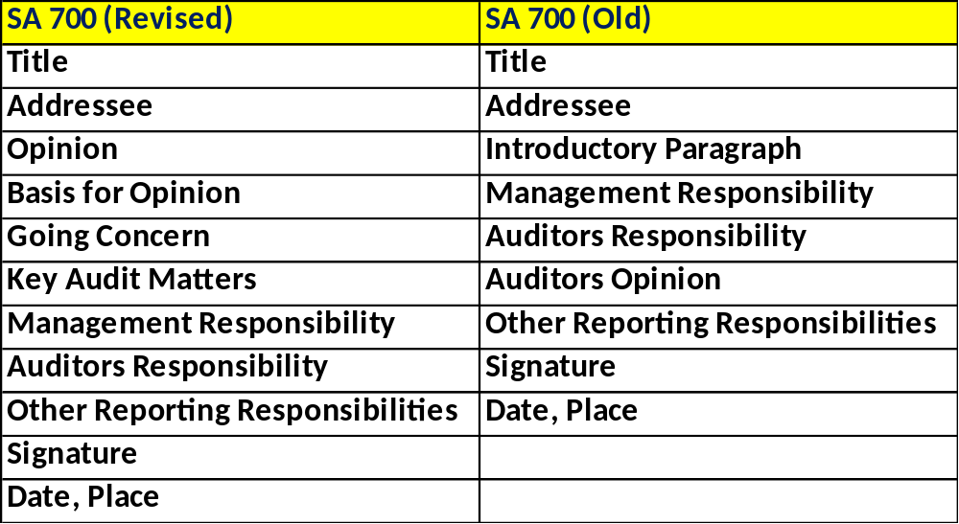

Forming an opinion and reporting on Financial Statements
SA 700
SOME PRACTICE BASED STANDARDS

Slide 30
Communicating Key Audit Matters in AR
SA 701
Key Audit Matters - Those matters that, in the auditor’s professional judgment, were of most significance in the audit of the financial statements of the current period.
Key Audit Matters are selected from matters communicated with those charged with governance.
SOME PRACTICE BASED STANDARDS

Slide 31
Modifications to the Opinion in the Independent AR
SA 705
Clean Report
Qualified Opinion
Disclaimer
Adverse
SOME PRACTICE BASED STANDARDS

Slide 32
Emphasis of Matter Paragraphs and Other Matter Paragraphs in the Independent Auditor’s Report.
SA 706
EoM Paragraph – A paragraph included in the auditor’s report that refers to a matter appropriately presented or disclosed in the financial statements that, in the auditor’s judgment, is of such importance that it is fundamental to users’ understanding of the financial statements.
SOME PRACTICE BASED STANDARDS

Slide 33

JOMON K GEORGE
Thank You…

