Slide 1

ACCOUTING STANDARDS
AN UPDATE
JOMON K GEORGE

Slide 2



ASB and its
Evolution
Total of
29-2 Standards
Legal Position
The CA 2013

Slide 3
SECTION 133 (CHAPTER IX)
The Central Government may prescribe the standards of accounting, or any addendum thereto, as recommended by the ICAI in consultation with and after examination of the recommendations made by the NFRA.
ACCOUTING STANDARDS-AN UPDATE
JOMON K GEORGE

Slide 4
Section 143 (Chapter X)
The auditor shall report whether, in his opinion, the financial statements comply with the accounting standards
ACCOUTING STANDARDS-AN UPDATE
JOMON K GEORGE
For all unlisted companies with net worth of less than 250 Crs, ASs are applicable.

Slide 5
Small & Medium Company
An SMC is a company which meets all the
following conditions :
Its equity/debt securities are not listed/ proposed
to be listed in India/
abroad.
It is not a Bank, FI or
Insurance Company.
Its turnover does not exceed Rs.250 crores in the PY
JOMON K GEORGE
Its borrowings does not
exceed Rs.50 crores
during the PY.
It is not a holding/subsidiary of a non-SMC.
As at the end of the financial year

Slide 6
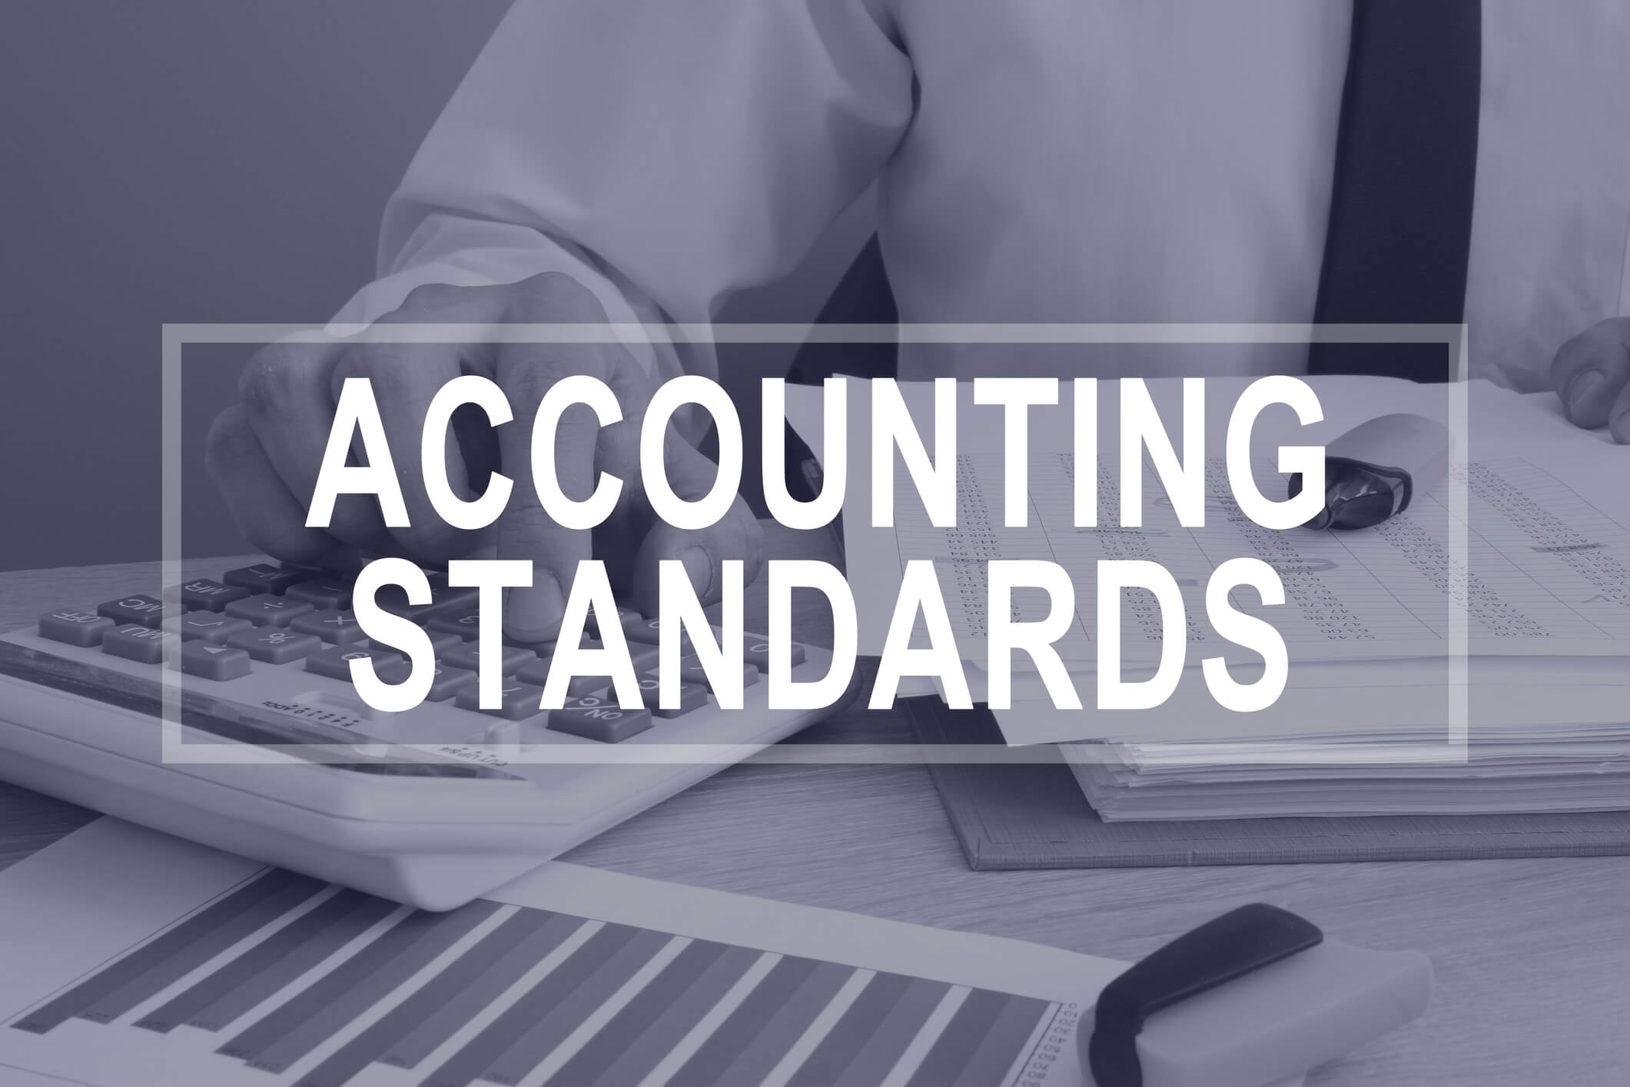
-APPLICABILITY OF ACCOUNTING STANDARDS-
ACCOUTING STANDARDS-AN UPDATE
-APPLICABILITY OF ACCOUTING STANDARDS-
APPLICABILITY

Slide 7
The New Regime
By Notification GSR (432) dated 23rd June 2021, Companies (Accounting Standards) Rules 2021 has been issued.
This supercedes Companies (Accounting Standards) Rules 2006
ACCOUTING STANDARDS-AN UPDATE
JOMON K GEORGE

Slide 8
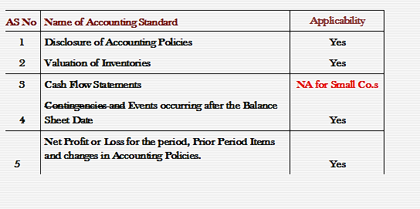
APPLICABILITY OF ACCOUNTING STANDARDS
ACCOUTING STANDARDS-AN UPDATE
JOMON K GEORGE

Slide 9
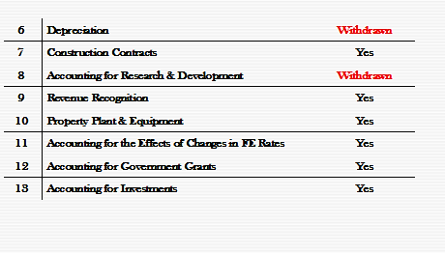
APPLICABILITY OF ACCOUNTING STANDARDS
ACCOUTING STANDARDS-AN UPDATE
JOMON K GEORGE

Slide 10
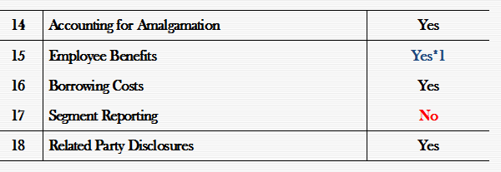
APPLICABILITY OF ACCOUNTING STANDARDS
ACCOUTING STANDARDS-AN UPDATE
JOMON K GEORGE
*1 Termination benefits falling due after 12 months need not be accounted on discounted basis.

Slide 11
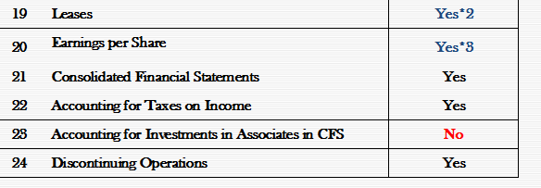
APPLICABILITY OF ACCOUNTING STANDARDS
ACCOUTING STANDARDS-AN UPDATE
JOMON K GEORGE
*2 AS 19 – Paragraph 22(c), (e) & (f), 25(a), (b) & (e), 37(a) & (f) and 46 (b) & (d) dealing with additional disclosures about operating and financing leases are not applicable.
*3. AS 20 – Need not calculate/disclose Diluted earnings per share.

Slide 12
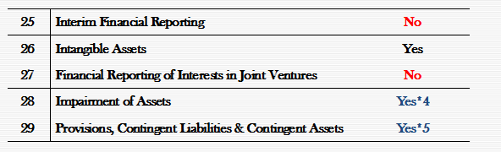
APPLICABILITY OF ACCOUNTING STANDARDS
ACCOUTING STANDARDS-AN UPDATE
JOMON K GEORGE
*4.AS 28 – Have an option to measure (value in use) on a reasonable estimate basis (without discounting).
*5.AS 29 – Paragraphs 66 & 67 dealing with disclosures of opening balance, additions/deletions and closing balance of provisions are not applicable.

Slide 13
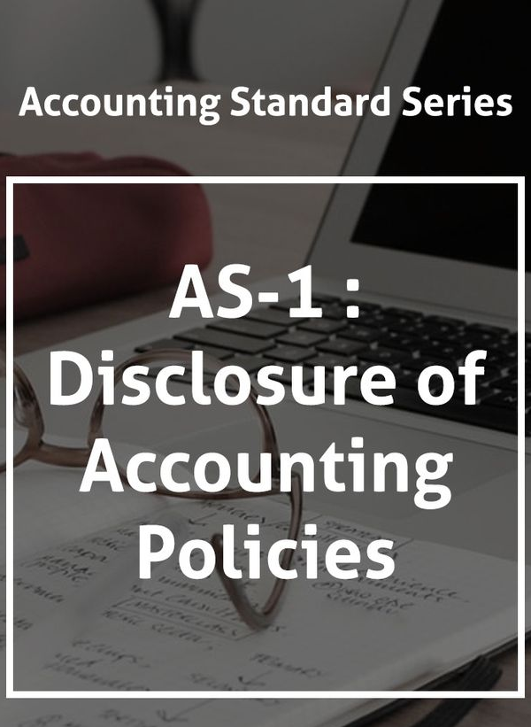
All significant policies to be disclosed
Any change in the policy should also be closed.
Accounting Assumptions need not be mentioned.
DISCLOSURE OF ACCOUNTING POLICIES
-DISCLOSURE OF ACCPOUNTING POLICIES
JOMON K GEORGE

Slide 14
Poor disclosures . Very generic
SMC aspect missing
Sketchy One Pager
DISCLOSURE OF ACCOUNTING POLICIES
-DISCLOSURE OF ACCPOUNTING POLICIES
JOMON K GEORGE

Slide 15
No mention about :
  Employee Benefits
  Borrowing Costs
  Earnings per Share
  Deferred Taxation
  Impairment
  Provisions & Contingent Liabilities
DISCLOSURE OF ACCOUNTING POLICIES
-DISCLOSURE OF ACCPOUNTING POLICIES
JOMON K GEORGE

Slide 16
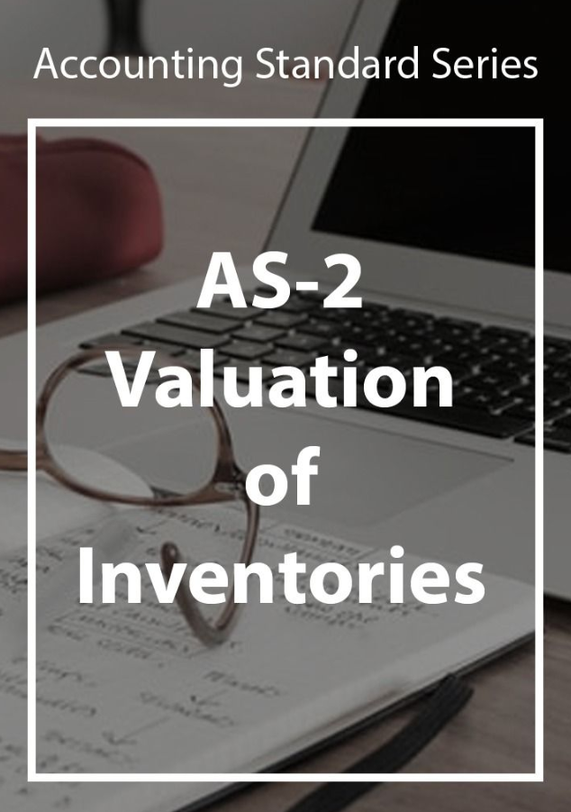
Financial Charges are not normally included in cost.
Inventories should be valued and stated at lower of Cost or NRV.
-VALUATION OF INVENTORIES-
-VALUATION OF INVENTORIES-
JOMON K GEORGE

Slide 17
Recognises Absorption Costing only
Cost Formula - Only FIFO, WAC allowed
Allows exclusive method of GST only
-VALUATION OF INVENTORIES-
-VALUATION OF INVENTORIES-
JOMON K GEORGE

Slide 18
Changes in Classification :
  Raw materials and components
  Work-in-progress
  Finished goods
  Stock-in-trade (in respect of goods acquired for trading)
  Stores and spares
  Loose tools
  Others (specify nature).
-VALUATION OF INVENTORIES-
-VALUATION OF INVENTORIES-
JOMON K GEORGE

Slide 19
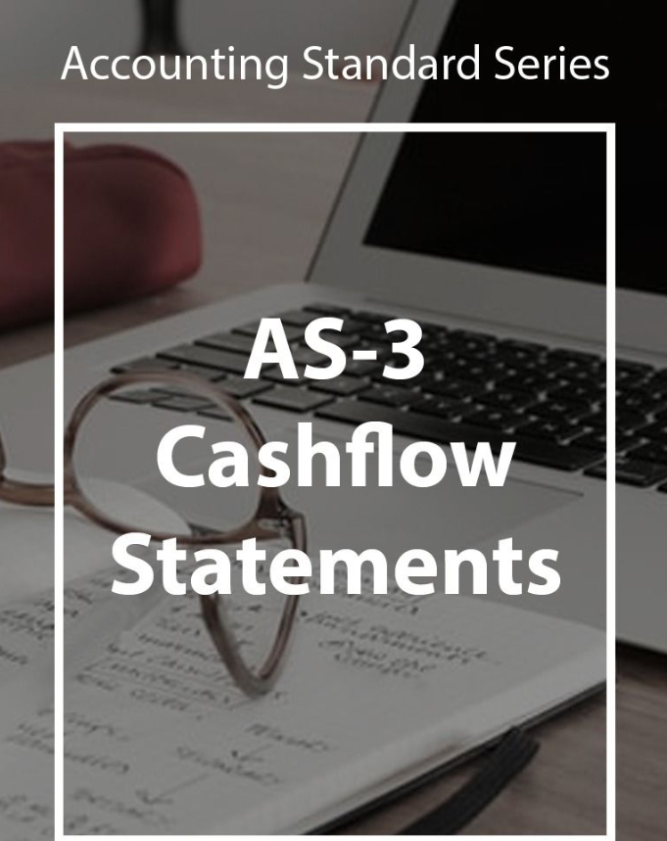
All companies except Small, Dormant & OPCs have to prepare Cash Flow Statements - Section 2(40)
Not prepared in many applicable cases
Wrong classifications
CASH FLOW STATEMENTS
-CASH FLOW STATEMENTS
JOMON K GEORGE

Slide 20
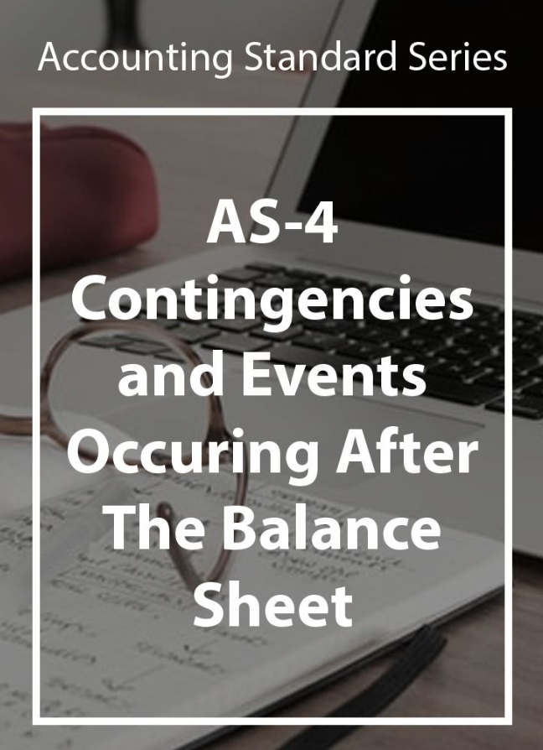
All Contingencies to be disclosed
Adjusting Events Occurring after the BS date to be recognized
JOMON K GEORGE
-CONTINGENCIES AND EVENTS OCCURING AFTER BALANCE SHEET-
-CONTINGENCIES AND EVENTS OCCURING AFTER BALANCE SHEET-

Slide 21
Change in treatment of dividend declared after balance sheet date but before the date financial statements are approved
  Not to be treated as a liability.
  However, disclosure in the notes is to be made.
JOMON K GEORGE
-CONTINGENCIES AND EVENTS OCCURING AFTER BALANCE SHEET-
-CONTINGENCIES AND EVENTS OCCURING AFTER BALANCE SHEET-

Slide 22
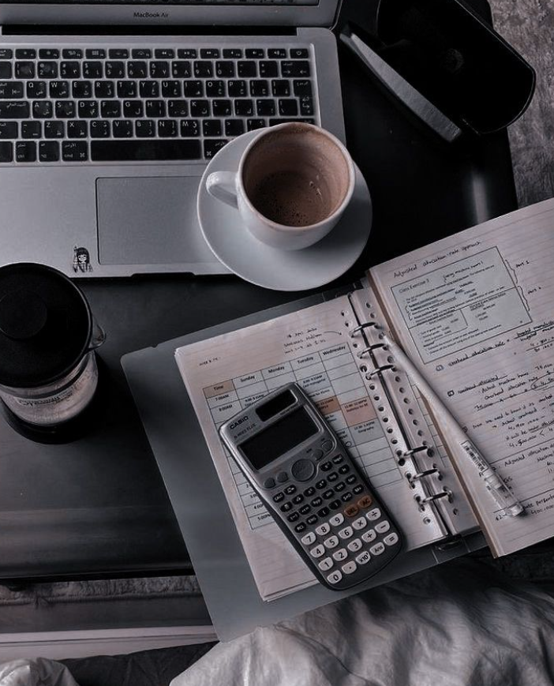
AS-5
Net Profit or Loss for the Period, Prior Period Items and Changes in Accounting Policies
Extraordinary Items
Prior Period Items
Changes in Accounting Estimates
Changes in Accounting Policies
Net Profit or Loss for the Period, Prior Period Items and Changes in Accounting Policies
-Net Profit or Loss for the Period, Prior Period Items and Changes in Accounting Policies
JOMON K GEORGE

Slide 23
Withdrawn Fully.
AS-6
Depreciation
AS-8
Accounting for Research and Development
-AS 6 & AS 8-
-AS 6 & AS 8-
JOMON K GEORGE

Slide 24
AS-7
Construction Contracts
Recognises “Percentage of Completion” method only.
CONSTRUCTION CONTRACTS
CONSTRUCTION CONTRACTS
JOMON K GEORGE

Slide 25
Revenue From:
Sales
Services
Interest
Royalty
Dividend
AS-9
Revenue Recognition
-REVENUE RECOGNITION
REVENUE RECOGNITION-
JOMON K GEORGE
AS 7 & AS 9 are mutually exclusive

Slide 26
AS-10
Property, Plant and Equipment
Name of Accounting Standard changed from Fixed Assets to Property, Plant and Equipment
Accounting Standard 6 : Depreciation Accounting merged with Accounting Standard 10 : Property, Plant and Equipment.
PROPERTY, PLANT AND EQUIPMENT
PROPERTY, PLANT AND EQUIPMENT
JOMON K GEORGE

Slide 27
AS-10
Property, Plant and Equipment
Para 32 and 34 : Model for Subsequent Revaluation
Revaluations should be made with sufficient regularity
Entire class to be revalued and revaluation not on ad hoc basis (earlier permitted by AS 10)
PROPERTY, PLANT AND EQUIPMENT
PROPERTY, PLANT AND EQUIPMENT
JOMON K GEORGE

Slide 28
Only cost model to be applied for Investment Property
(land and building other than related to operations)
(Para 20)
AS-13
Accounting for Investments
ACCOUNTING FOR INVESTMENTS
ACCOUNTING FOR INVESTMENTS-
JOMON K GEORGE

Slide 29
Para 9: Change in the scope of the consolidated financial statements to make consolidation mandatory in the absence of subsidiary company
Amendment in accordance with Companies Act, 2013 which require the consolidation of Associate/ JV even if subsidiary is not there.
Consolidation to be done in accordance with AS 23 : Accounting for Associates in Consolidated Financial Statements & Accounting Standard (AS) 27:Financial Reporting of Interests in Joint Ventures.
AS-21
Consolidated Financial Statements
CONSOLIDATED FINANCIAL STATEMENTS
CONSOLIDATED FINANCIAL STATEMENTS
JOMON K GEORGE

Slide 30
Discounting of Provisions permitted in case of decommissioning, restoration etc.
Earlier discounting of provisioning was not permitted.
The discount rate (or rates) should be a pre-tax rate (or rates) that reflect(s) current market assessments of the time value of money and the risks specific to the liability. The discount rate(s) should not reflect risks for which future cash flow estimates have been adjusted.
AS-29
Provisions, Contingent Liabilities/ Assets
PROVISIONS, CONTINGENT LIABILITIES/ ASSETS
-
PROVISIONS, CONTINGENT LIABILITIES/ ASSETS
JOMON K GEORGE

Slide 31

JOMON K GEORGE
Thank You…

